Slide 1
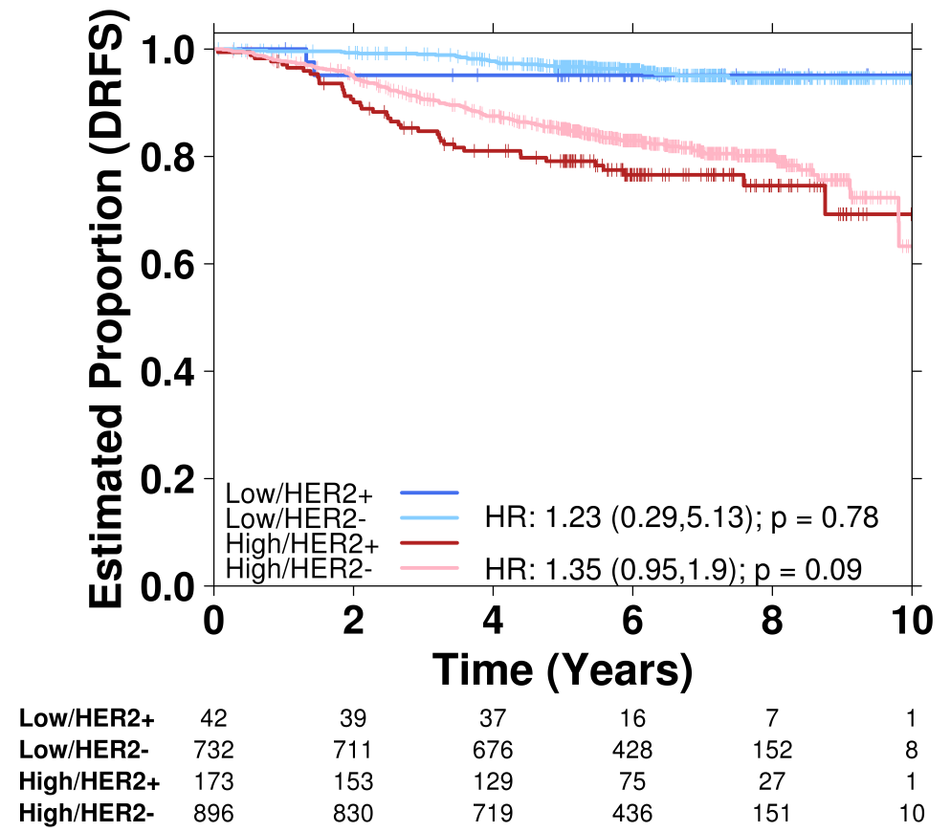
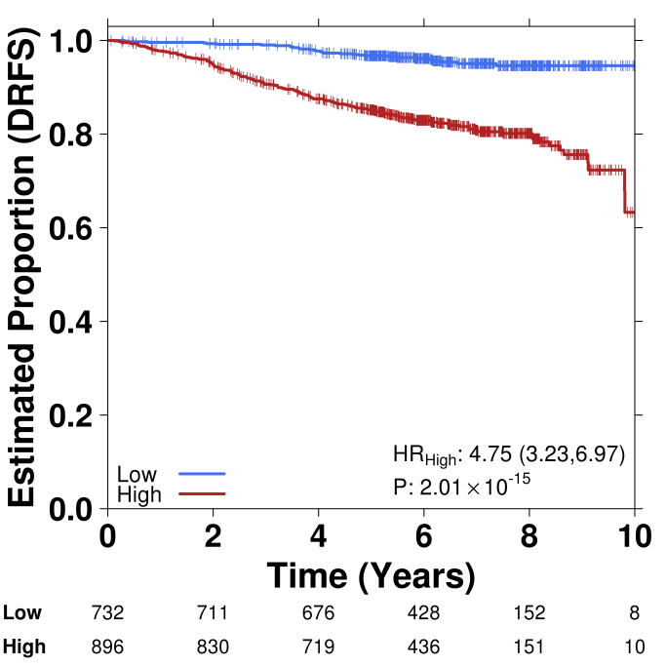
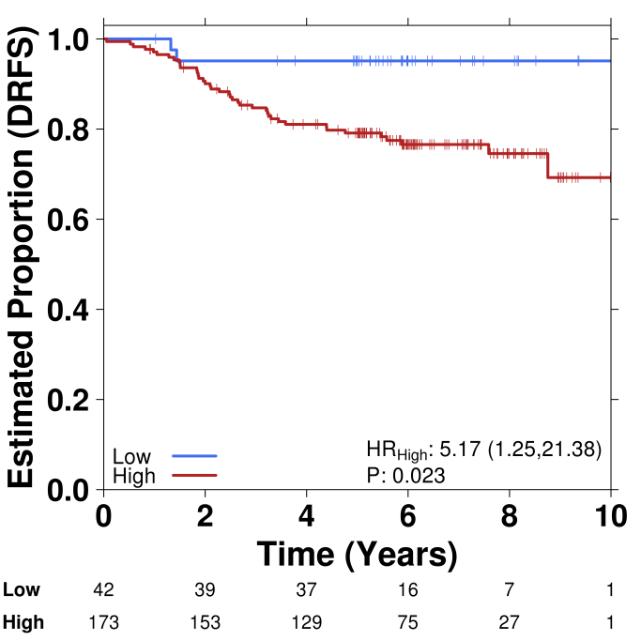
A
Validation Cohort
B
HER2-Negative Validation Cohort
C
HER2-Positive Validation Cohort
Notes:
Supplementary Figure 5

