Slide 1
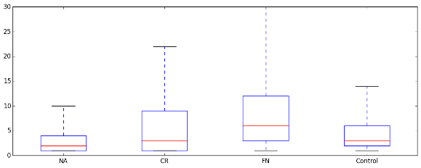
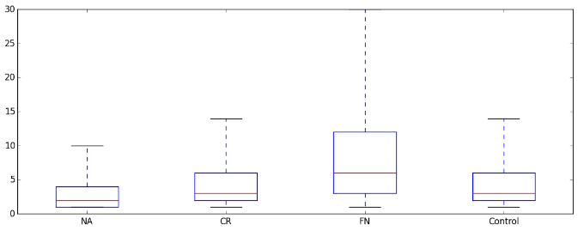
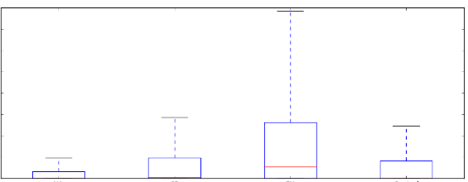
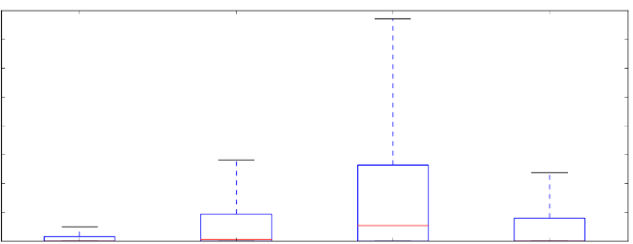
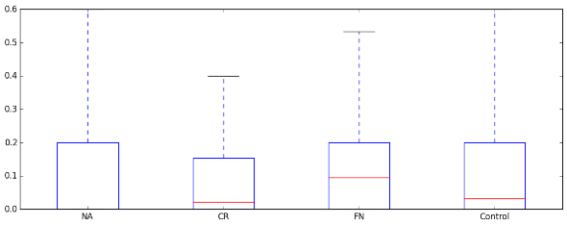
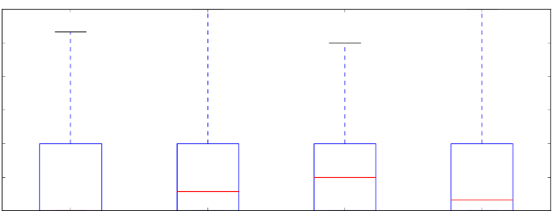
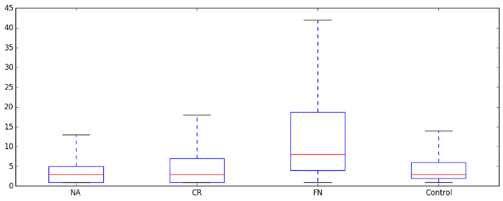
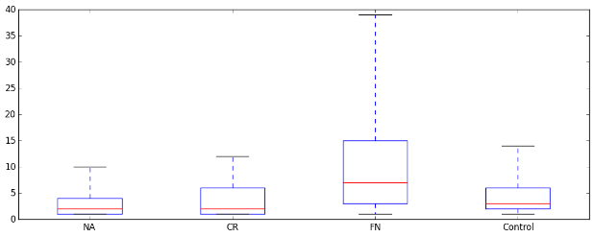
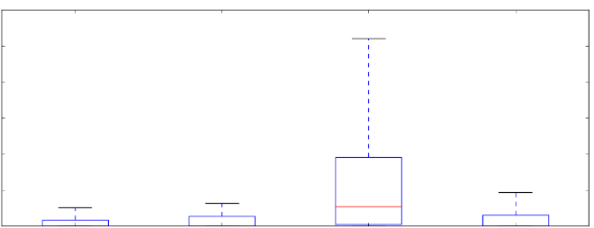
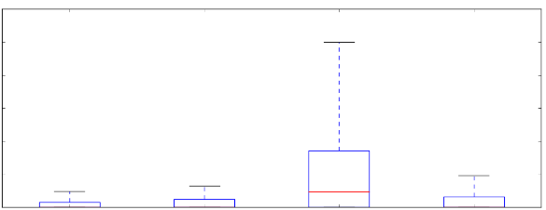
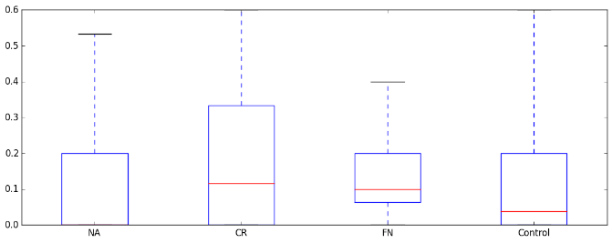
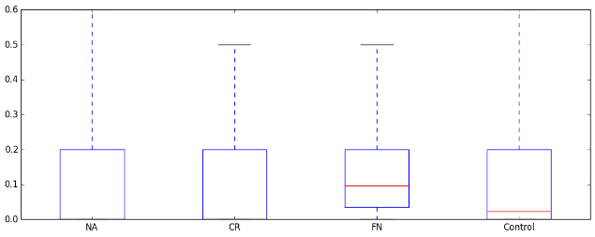
Supplementary Figure 2a. Importance of first neighbours in each cancer type in the signalling network from Cui et al. (2007). UA: unaffected, CR: cancer-related, FN: first neighbours, HCC: hepatocellular carcinoma, NSCLC: non-small cell lung cancer. * - p<0.05; ** - p<0.01; *** - p<0.001. Wilcoxon rank sum test results to the whole cancer specific network are indicated in red, to cancer-related proteins in orange, and to unaffected proteins in grey.
Colon
Breast
30
***
30
20
***
***
20
***
***
*
Degree
***
Degree
*
***
10
10
***
0
UA
N=749
CR
N=81
FN
N=376
Whole network
N=1206
0
UA
N=696
CR
N=125
FN
N=380
Whole network
N=1201
16000
16000
12000
12000
***
Betweenness
***
***
8000
**
8000
***
***
***
Betweenness
***
4000
***
4000
***
0
UA
N=749
CR
N=81
FN
N=376
Whole network
N=1206
0
UA
N=696
CR
N=125
FN
N=380
Whole network
N=1201
0.6
**
0.6
***
Clustering coefficient
***
**
***
***
0.4
***
0.4
*
**
Clustering coefficient
***
0.2
0.2
0
UA
N=749
CR
N=81
FN
N=376
Whole network
N=1206
0
UA
N=696
CR
N=125
FN
N=380
Whole network
N=1201
HCC
NSCLC
40
***
40
30
***
30
***
Degree
20
***
Degree
20
***
10
10
***
***
0
**
FN
N=146
Whole network
N=1170
0
30000
UA
N=984
CR
N=40
UA
N=880
CR
N=70
FN
N=265
Whole network
N=1215
25000
30000
***
25000
***
20000
***
20000
***
Betweenness
***
Betweenness
15000
15000
***
10000
10000
5000
***
5000
***
0
UA
N=984
CR
N=40
FN
N=146
Whole network
N=1170
0
UA
N=880
CR
N=70
FN
N=265
Whole network
N=1215
0.6
*
0.6
***
0.4
***
0.4
***
Clustering coefficient
*
Clustering coefficient
0.2
*
***
0.2
0
UA
N=984
CR
N=40
FN
N=146
Whole network
N=1170
0
UA
N=880
CR
N=70
FN
N=265
Whole network
N=1215

Slide 2
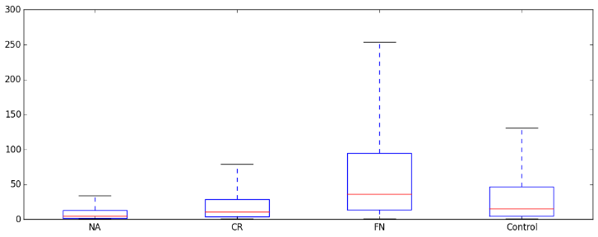
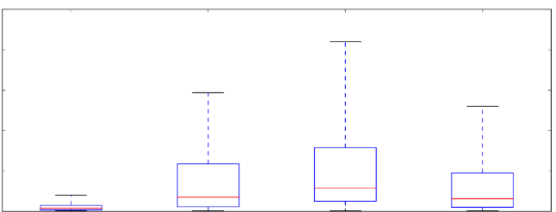
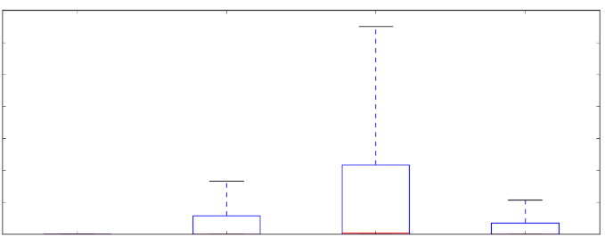
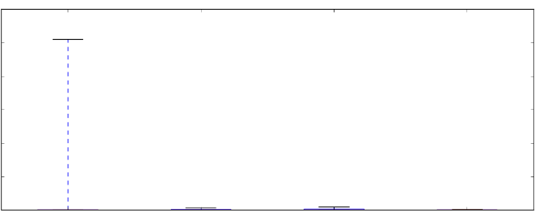
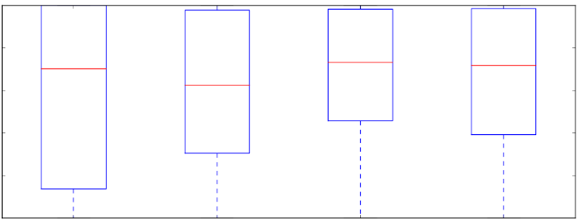
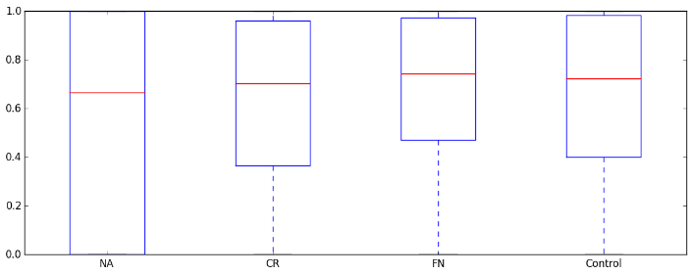
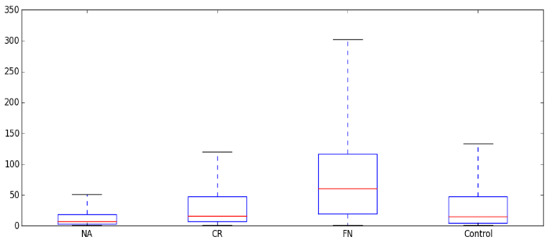
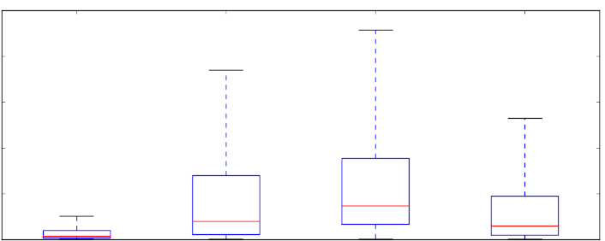
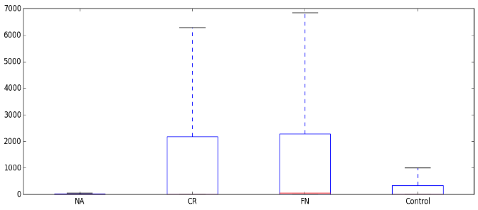
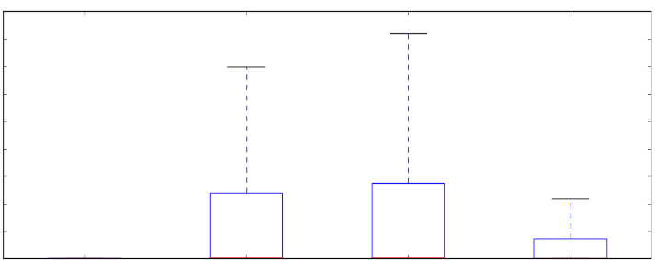
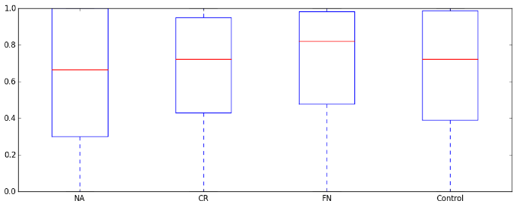
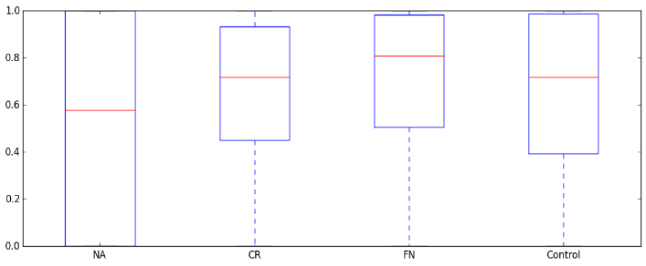
Supplementary Figure 2b: Importance of first neighbours in each cancer type in the signalling network from the Reactome. UA: unaffected, CR: cancer-related, FN: first neighbours, HCC: hepatocellular carcinoma, NSCLC: non-small cell lung cancer. * - p<0.05; ** - p<0.01; *** - p<0.001. Wilcoxon rank sum test results to the whole cancer specific network are indicated in red, to cancer-related proteins in orange, and to unaffected proteins in grey. Note: Reactome contains lot of protein complexes, which explains the high clustering coefficient values.
Colon
250
Breast
300
250
***
200
***
Degree
200
***
150
***
***
150
**
***
Degree
100
***
100
***
50
50
***
***
0
UA
N=1582
CR
N=237
FN
N=2078
Whole network
N=3897
0
UA
N=1109
CR
N=422
FN
N=2267
Whole network
N=3798
6000
300000
***
200000
4000
***
Betweenness
Betweenness
***
100000
***
2000
***
***
*
**
0
***
0
UA
N=1109
***
***
Whole network
N=3798
UA
N=1582
CR
N=237
FN
N=2078
Whole network
N=3897
CR
N=422
FN
N=2267
1
**
1
0.8
0.8
0.6
0.6
Clustering coefficient
Clustering coefficient
0.4
0.4
***
*
0.2
0.2
***
**
*
0
UA
N=1582
***
FN
N=2078
Whole network
N=3897
0
UA
N=1109
CR
N=422
FN
N=2267
Whole network
N=3798
CR
N=237
HCC
NSCLC
300
250
*
***
200
***
***
200
***
Degree
150
***
Degree
***
***
100
***
100
***
50
***
0
UA
N=2223
CR
N=122
FN
N=1473
Whole network
N=3818
0
UA
N=1545
CR
N=247
FN
N=2100
Whole network
N=3892
6000
***
***
4000
4000
*
3000
Betweenness
***
Betweenness
***
***
2000
2000
***
***
***
1000
***
0
UA
N=2223
CR
N=122
FN
N=1473
Whole network
N=3818
0
UA
N=1545
CR
N=247
FN
N=2100
Whole network
N=3892
1
1
0.8
0.8
Clustering coefficient
0.6
0.6
0.4
Clustering coefficient
***
**
0.4
***
0.2
*
***
0.2
*
0
UA
N=2223
CR
N=122
FN
N=1473
Whole network
N=3818
0
***
*
***
UA
N=1545
CR
N=247
FN
N=2100
Whole network
N=3892

Slide 3
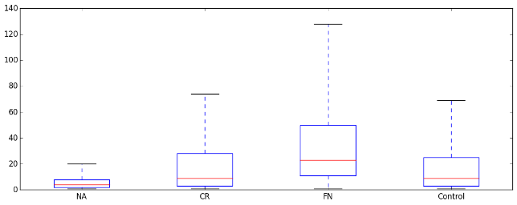
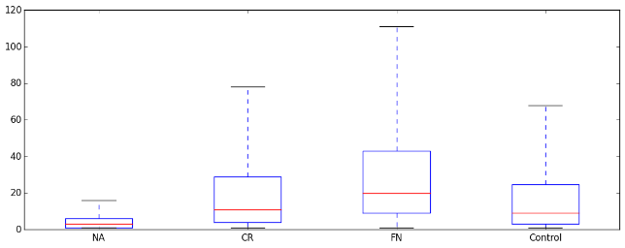
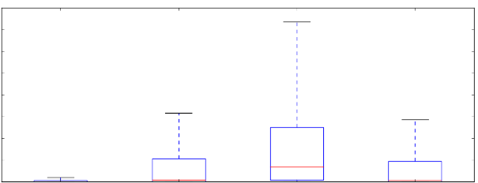
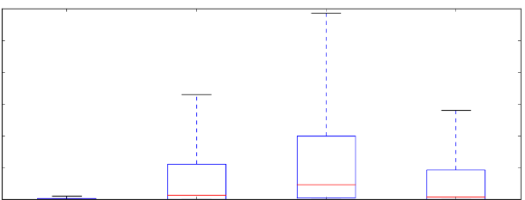
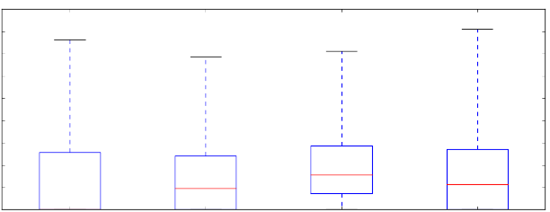
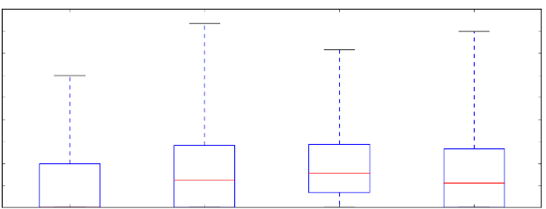
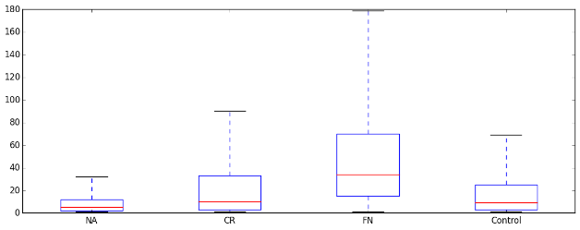
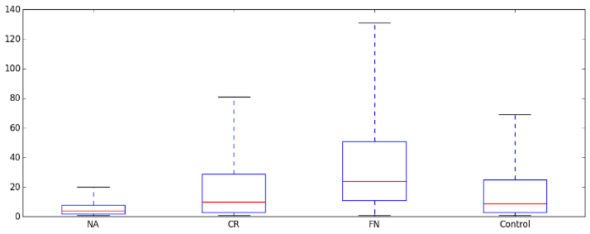
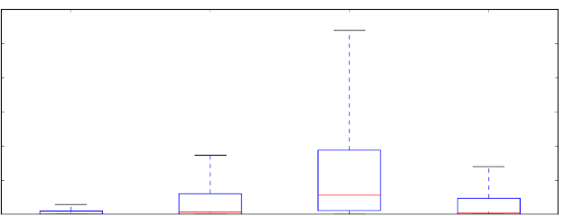
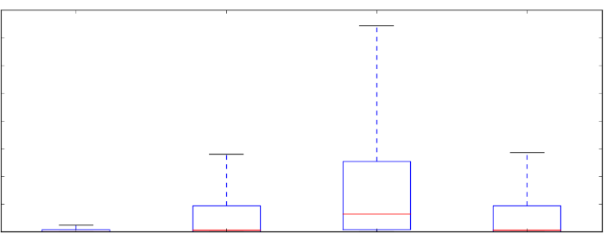
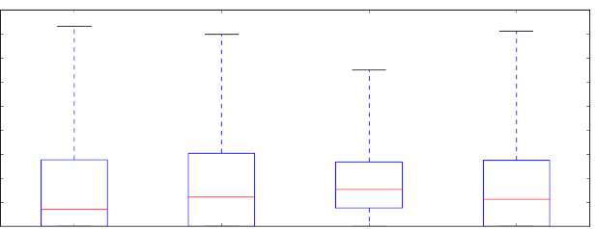
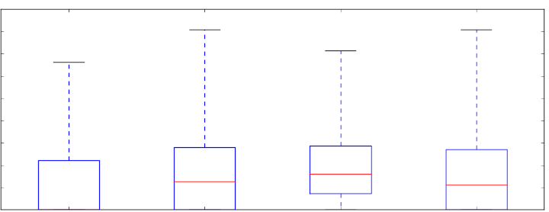
Supplementary Figure 2c. Importance of first neighbours in each cancer type in the combined protein-protein interaction network of Biogrid, DIP and Intact. UA: unaffected, CR: cancer-related, FN: first neighbours, HCC: hepatocellular carcinoma, NSCLC: non-small cell lung cancer. * - p<0.05; ** - p<0.01; *** - p<0.001. Wilcoxon rank sum test results to the whole cancer specific network are indicated in red, to cancer-related proteins in orange, and to unaffected proteins in grey.
Colon
Breast
120
120
***
***
Degree
80
***
***
80
***
***
***
Degree
***
40
40
***
0
***
0
***
UA
N=4850
CR
N=628
FN
N=4724
Whole network
N=9752
UA
N=3782
CR
N=1057
FN
N=5159
Whole network
N=9998
80000
60000
60000
***
40000
***
***
Betweenness
***
Betweenness
***
***
40000
***
***
20000
***
20000
***
***
0
UA
N=4850
CR
N=628
FN
N=4724
Whole network
N=9752
0
UA
N=3782
CR
N=1057
FN
N=5159
Whole network
N=9998
0.4
0.4
***
0.3
***
0.3
***
***
***
***
Clustering coefficient
***
Clustering coefficient
***
***
***
0.2
***
0.2
0.1
0.1
0
UA
N=4850
CR
N=628
FN
N=4724
Whole network
N=9752
0
UA
N=3782
CR
N=1057
FN
N=5159
Whole network
N=9998
HCC
NSCLC
160
***
120
120
*
***
***
Degree
80
***
***
80
***
***
Degree
40
***
40
***
***
0
UA
N=6698
CR
N=307
FN
N=3002
Whole network
N=10007
0
UA
N=4963
CR
N=624
FN
N=4634
Whole network
N=10221
120000
80000
100000
60000
80000
***
***
Betweenness
***
60000
***
Betweenness
***
40000
***
40000
***
***
20000
***
20000
***
0
UA
N=6698
CR
N=307
FN
N=3002
Whole network
N=10007
0
UA
N=4963
CR
N=624
FN
N=4634
Whole network
N=10221
0.4
***
0.4
***
***
***
***
0.3
***
***
0.3
***
***
Clustering coefficient
Clustering coefficient
0.2
***
0.2
0.1
0.1
0
UA
N=6698
CR
N=307
FN
N=3002
Whole network
N=10007
0
UA
N=4963
CR
N=624
FN
N=4634
Whole network
N=10221

Slide 4
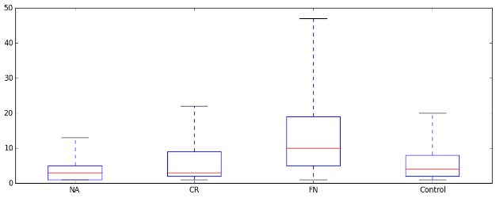
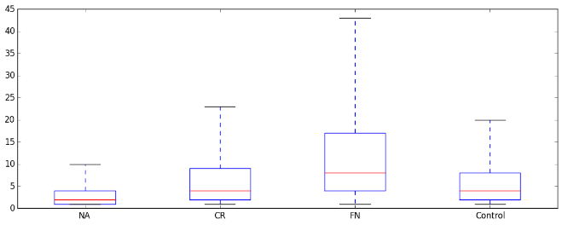
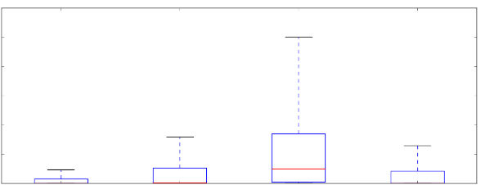
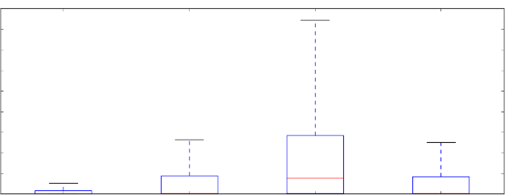
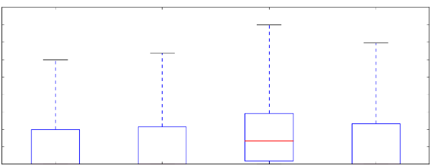
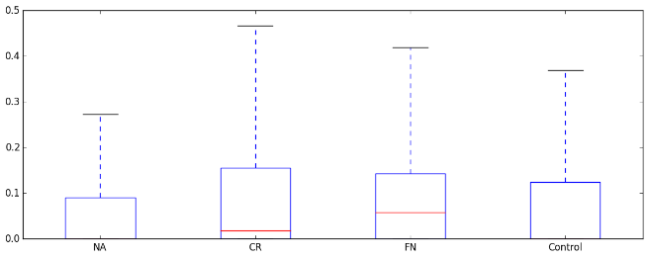
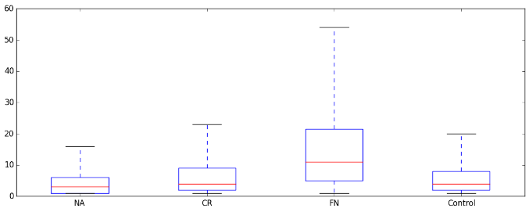
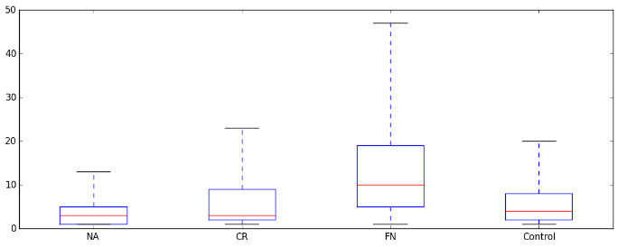
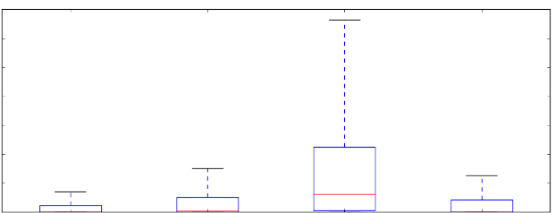
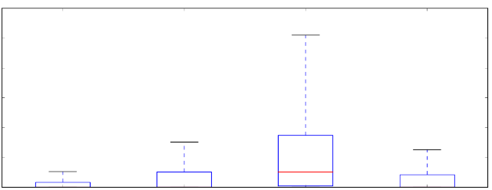
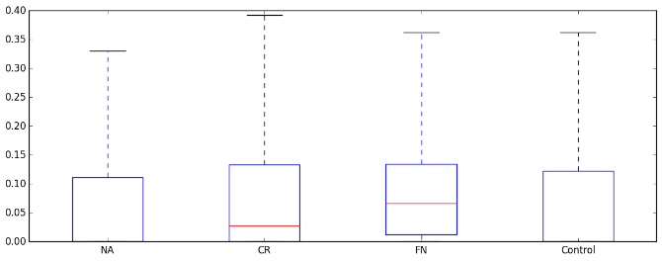
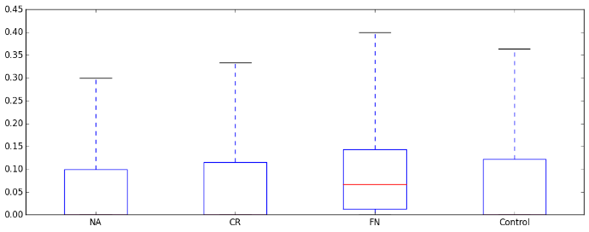
Supplementary Figure 2d. Importance of first neighbours in each cancer type in the manually curated protein-protein interaction network of HPRD. UA: unaffected, CR: cancer-related, FN: first neighbours, HCC: hepatocellular carcinoma, NSCLC: non-small cell lung cancer. * - p<0.05; ** - p<0.01; *** - p<0.001. Wilcoxon rank sum test results to the whole cancer specific network are indicated in red, to cancer-related proteins in orange, and to unaffected proteins in grey.
Colon
Breast
40
***
40
***
***
***
***
***
20
***
***
Degree
20
***
Degree
***
0
UA
N=4540
CR
N=405
FN
N=1836
Whole network
N=6781
0
UA
N=3763
CR
N=669
FN
N=2221
Whole network
N=6653
120000
90000
80000
***
60000
***
***
***
Betweenness
***
Betweenness
***
***
40000
***
30000
0
***
0
***
FN
N=2221
UA
N=4540
CR
N=405
FN
N=1836
Whole network
N=6781
0.5
UA
N=3763
CR
N=669
Whole network
N=6653
0.4
***
*
***
0.4
***
0.3
***
0.3
*
***
Clustering coefficient
***
Clustering coefficient
***
***
***
0.2
0.2
0.1
0.1
0
UA
N=4540
CR
N=405
FN
N=1836
Whole network
N=6781
0
UA
N=3763
CR
N=669
FN
N=2221
Whole network
N=6653
HCC
NSCLC
60
***
40
40
***
***
Degree
***
***
20
***
Degree
20
***
***
***
***
0
UA
N=5186
CR
N=213
FN
N=1231
Whole network
N=6630
0
UA
N=4657
CR
N=404
FN
N=1740
Whole network
N=6801
120000
120000
***
80000
***
80000
***
***
Betweenness
***
Betweenness
***
40000
***
***
40000
***
0
UA
N=5186
CR
N=213
FN
N=1231
Whole network
N=6630
0
***
0.4
UA
N=4657
CR
N=404
FN
N=1740
Whole network
N=6801
0.3
***
0.4
***
***
***
Clustering coefficent
*
***
0.3
***
0.2
***
***
Clustering coefficent
***
0.1
0.2
0
0.1
UA
N=5186
CR
N=213
FN
N=1231
Whole network
N=6630
0
UA
N=4657
CR
N=404
FN
N=1740
Whole network
N=6801

