Slide 1
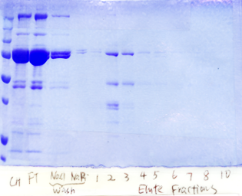
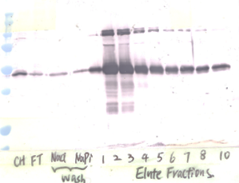
Fig. 1
A
P FT W1 W2 E1 E2 E3 E4 E5 E6 E7 E8
B
P FT W1 W2 E1 E2 E3 E4 E5 E6 E7 E8
kDa
kDa
150
150
100
100
75
75
50
50
37
37
25
25
HP1 Ab
Fig. 2
A
150
B
◄
100
◄
150
◄
◄
75
100
◄
75
50
50
37
37
25
25
20
HP1 1 3 4 5 6 9 13
20
HP1 1 3 5 6 HP1 4 HP1 9 13
Ab:
serpin
Ab:
serpin
serpin
serpin
C
1A NEEGAEAAAANAFFIT-RQAR---LDIRYFVANKPFIFL
1J NEEGAEAAAANAFILTDRCC-SDYDDNIEFDVNRPFYFN
1Y NEEGAEAAAANDVSIGLRS---GFISSAVMVIDRPFVFK
3 NELGSVAFSATQIGIQNKFGEDS-DINYEVVANKPFMFF
4 TEEGTVASGVTIAEFSNRIG------IIRYEVNRPFSYI
5 TEAGTVASAATTASFADRIS------TPSFHANRPFLYF
6 DEEGTVAAAATALFGF-RSSR--PAEPTRFIANFPFVYL
9 SEEGTVAAAATEAMFEPRMM------PEQFVANKPFLFM
13 NEYGTEAVAATSGILA-RSAE-------QFYADSPFYMF
15B NEEGAEAAAATGMVMMLRCA---PMPSPHFRADHPFLYL

Slide 2
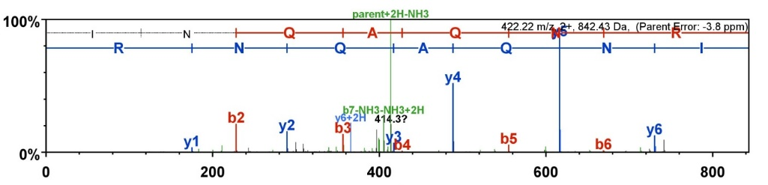
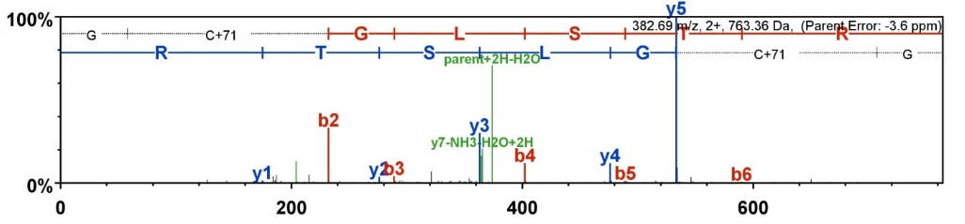
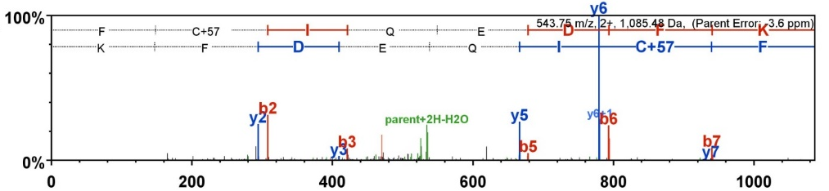
Fig. 3
A
INQAQNR
m/z=422.22
GCGLSTR
m/z = 382.69
FCIQEDFK
Intensity (x10⁶)
m/z = 543.75
B
Retention time (min)
INQAQNR
relative intensity
GCGLSTR
FCIQEDFK
m/z

Slide 3
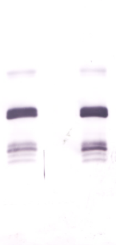
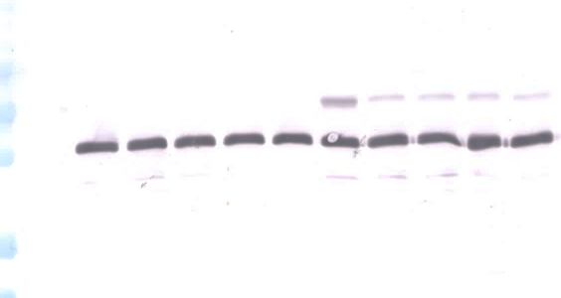
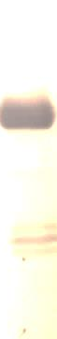
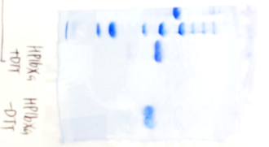
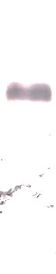
Fig. 4
A
B
75
kDa
50
75
37
50
37
25
25
20
+ |  | +
+ |  | +
 | + | +
20
 | + | + | + | + | + | + | + | + | + | +
+ |  |  |  |  |  | + | + | + | + | +
 |  | a | b | c | d |  | a | b | c | d
proHP6
proHP1
moricin-1
proHP6
proHP1a
plasma
Fig. 5
A
clip domain
S S
catalytic domain
PQGR to IEGR
proHP1b_{Xa}
putative activation site
B
kDa
proHP1b_{Xa}
proHP1a_{Xa}
100
50
37
25
20
CBB
immunoblot
Ab: HP1
Fig. 6
A
B
C
150
+DTT
150
+DTT
-DTT
150
+DTT
100
100
100
75
75
75
50
50
50
37
37
37
25
25
25
20
20
20
15
15
proHP6
+ + + +
+ + +
+ + +
proHP6
+ + + + + +
proHP1b_{Xa}
+ + + + +
+ + + + +
Factor Xa
Factor Xa (ng)
50 100 200 300 400
Factor Xa (ng)
50 100 200 400
50 100 200 400
proHP1b_{Xa}

