Slide 1
HTA
(Affymetrix Human Transcriptome
Array 2.0) CEL files
RNA-seq
(Illumina 2000) read libraries
TopHat alignment
Partek® GS
- normalization
- summarization
HTSeq
gene expression estimation
featureCounts
(Rsubread)
exon expression estimation
HTA gene level
HTA exon/junction level
Counts gene level
Counts exon/junction level
Exploratory analysis
- PCA
- analysis of variation
- Spearman correlation
Differential expression analysis
- limma (incl. voom)
- edgeR
Detection limits and dynamic range
Prediction analysis
- AUC calculation
Functional enrichment
- enriched of gene ontology terms with significant genes
Splicing analysis
DEXSeq and diffSplice
based on exon and junction expression
Figure S1. Data processing pipeline. The lines show the flow of information between the different parts of the study. The colour of the lines corresponds to the colour of the analysis box targeted.

Slide 2
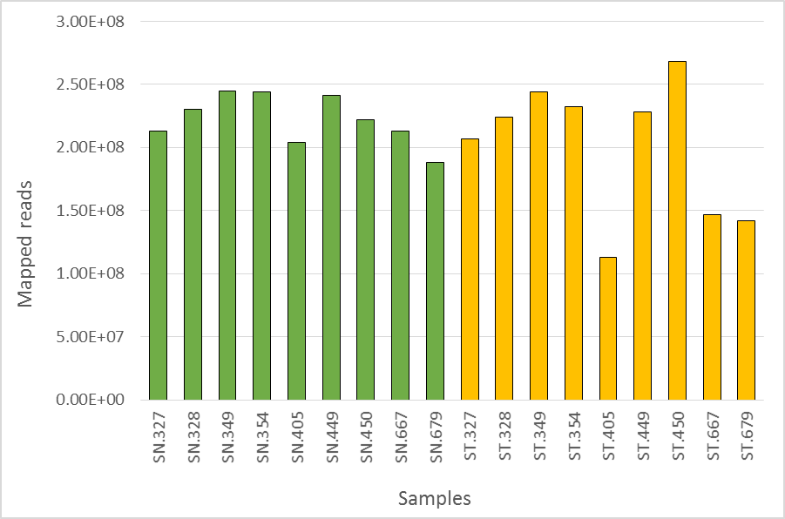
Figure S2. Number of mapped reads after RNA-seq analysis of the samples, including TopHat alignment. In general, normal tissues (green) show more reproducible mapping results than tumours (yellow).

Slide 3
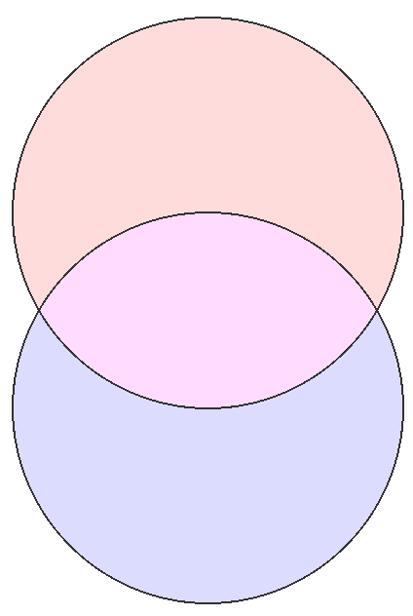
a
protein coding mRNA
b
lncRNA
RNA-seq
13
462
genes
20 033
5 855
HTA
0
0
c
protein coding mRNA
d
lncRNA
RNA-seq
47 358
2 875
exons
511 866
25 640
HTA
0
0
Figure S3. Genes (a, b) and exons (c, d) for protein coding and long non-coding RNAs (lncRNAs) presented by the platforms after remapping of HTA probes to the Ensembl GRCh37 genome.

Slide 4
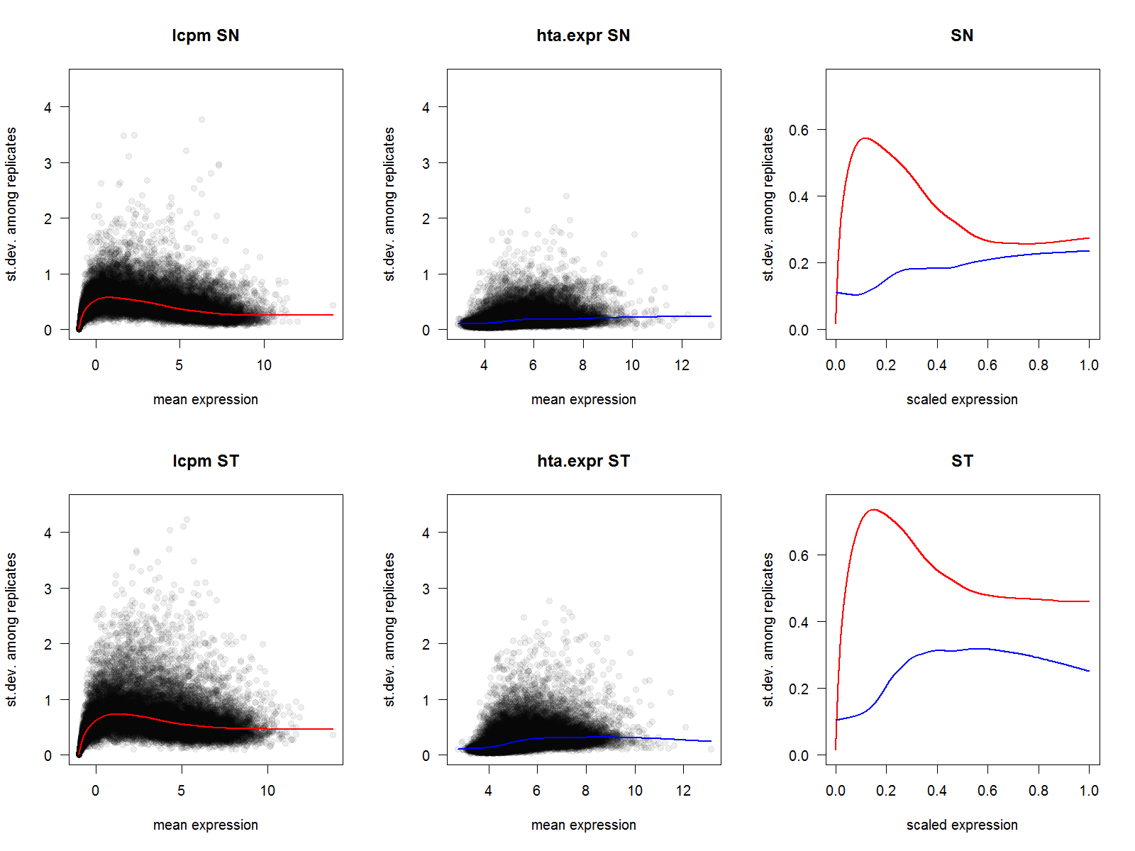
a
RNA-seq
b
HTA
c
Comparison
Normal tissue
d
RNA-seq
e
HTA
f
Comparison
Tumour tissue
Figure S4. Dependency of the standard deviation of gene expression between biological replicates on the mean signal level for normal (top row: a-c) and tumour (bottom row: d-f) groups. Lines show Lowess smoothing. In the right most plots (c, f) comparison of the Lowess regression lines is given for scaled gene expression. Variability between biological replicates is higher for RNA-seq data for both normal and tumour samples, especially for low abundant transcripts.

Slide 5
a
b
dynamic range
c
d
dynamic
range
Figure S5. Dynamic range for RNA-seq (a,b) and HTA (c,d) platforms based on significantly differentially expressed genes (FDR<0.01). (a) and (c) show the distribution of expressions (averaged over all samples) for all genes and significant genes only, with the same cut-off used to determine the dynamic range. The distributions of log₂FC are presented in (b) and (d).

Slide 6
a
b
c
d
e
f
g
h
Figure S6. MA-plots representing populations of all (grey) and significant (coloured) coding mRNAs (top panel: c, d) and lncRNAs (bottom panel: f, g) assessed by RNA-seq (left panel, red and orange in c, f) and HTA platforms (right panel, blue and cyan in d, g). Shaded areas in the figures of the top-most panel (a, b) correspond to the detection limits.

Slide 7
a
Biological processes
RNA-seq only
tissue development
developmental process
extracellular matrix organization
extracellular structure organization
single-organism cellular process
single-organism process
collagen catabolic process
intraciliary transport
cell proliferation
multicellular organismal process
negative regulation of cell-substrate adhesion
positive regulation of mitotic cell cycle
cell-substrate junction assembly
regulation of cell proliferation
reproduction
response to alcohol
ADP phosphorylation
locomotion
glucose catabolic process
cell junction organization
pyruvate metabolic process
sensory organ morphogenesis
smoothened signaling pathway
negative regulation of biological process
Common
microtubule-based process
mitotic cell cycle process
microtubule cytoskeleton organization
cell cycle
cellular component organization or biogenesis
cell division
axonemal dynein complex assembly
DNA-dependent DNA replication
chromosome segregation
DNA strand elongation
anatomical structure formation involved in morphogenesis
anaphase-promoting complex-dependent proteasomal ubiquitin- dependent protein catabolic process
DNA metabolic process
cellular response to DNA damage stimulus
cellular component movement
regulation of chromosome segregation
regulation of cell division
regulation of ubiquitin-protein transferase activity
cilium or flagellum-dependent cell motility
nucleoside diphosphate phosphorylation
anatomical structure homeostasis
nucleotide phosphorylation
NADH regeneration
glycolytic process through fructose-6-phosphate
canonical glycolysis
nucleoside diphosphate metabolic process
HTA only
protein-DNA complex assembly
nuclear cell cycle DNA replication
small GTPase mediated signal transduction
negative regulation of ubiquitin-protein transferase activity
mitotic recombination
chromosome localization
epithelial cilium movement involved in determination of left/right asymmetry
DNA duplex unwinding
proteasomal protein catabolic process
negative regulation of chromosome segregation
protein localization to chromosome
postreplication repair
positive regulation of canonical Wnt signaling pathway
guanosine-containing compound biosynthetic process
translesion synthesis
antigen processing and presentation of peptide antigen
single-organism metabolic process
RNA-seq
114
114
HTA
127
b
Molecular functions
RNA-seq
5
RNA-seq only
extracellular matrix structural constituent
structural molecule activity
protein binding involved in cell adhesion
protein complex binding
Common
microtubule motor activity
tubulin binding
protein binding
motor activity
ATP binding
carbohydrate derivative binding
HTA only
purine ribonucleotide binding
nucleoside phosphate binding
small molecule binding
binding
heterocyclic compound binding
organic cyclic compound binding
DNA-dependent ATPase activity
poly(A) RNA binding
structure-specific DNA binding
histone binding
RNA binding
damaged DNA binding
14
HTA
23
c
Cellular components
RNA-seq only
extracellular region
proteinaceous extracellular matrix
extracellular matrix
intraciliary transport particle
primary cilium
cell-cell junction
collagen trimer
chaperonin-containing T-complex
intraciliary transport particle B
mitotic spindle midzone
cell junction
membrane region
U4 snRNP
plasma membrane region
Common
microtubule cytoskeleton
cilium
non-membrane-bounded organelle
organelle
protein complex
cytoplasm
cell projection
macromolecular complex
extracellular region part
midbody
banded collagen fibril
vesicle
complex of collagen trimers
cytoplasmic part
cytosol
MCM complex
proteasome accessory complex
desmosome
HTA only
nuclear part
membrane-enclosed lumen
intracellular part
intracellular
DNA packaging complex
protein-DNA complex
proteasome complex
cell part
cell
envelope
DNA polymerase complex
cytosolic proteasome complex
microtubule organizing center part
RNA-seq
20
64
HTA
41
-log₁₀(FDR)> 18
-log₁₀(FDR)> 10
-log₁₀(FDR)> 2
Figure S7. Enriched gene ontology biological processes (a), molecular functions (b) and cellular components (c) by significant (FDR<10⁻⁴) protein coding genes from unpaired RNA-seq (edgeR) and HTA (limma) analyses. Only ontology terms with FDR < 0.01 were considered and compressed into short lists by REVIGO semantic analysis. The order and font size represent the FDR-based score – the most significant/represented are at the top of the list and with larger font.

Slide 8
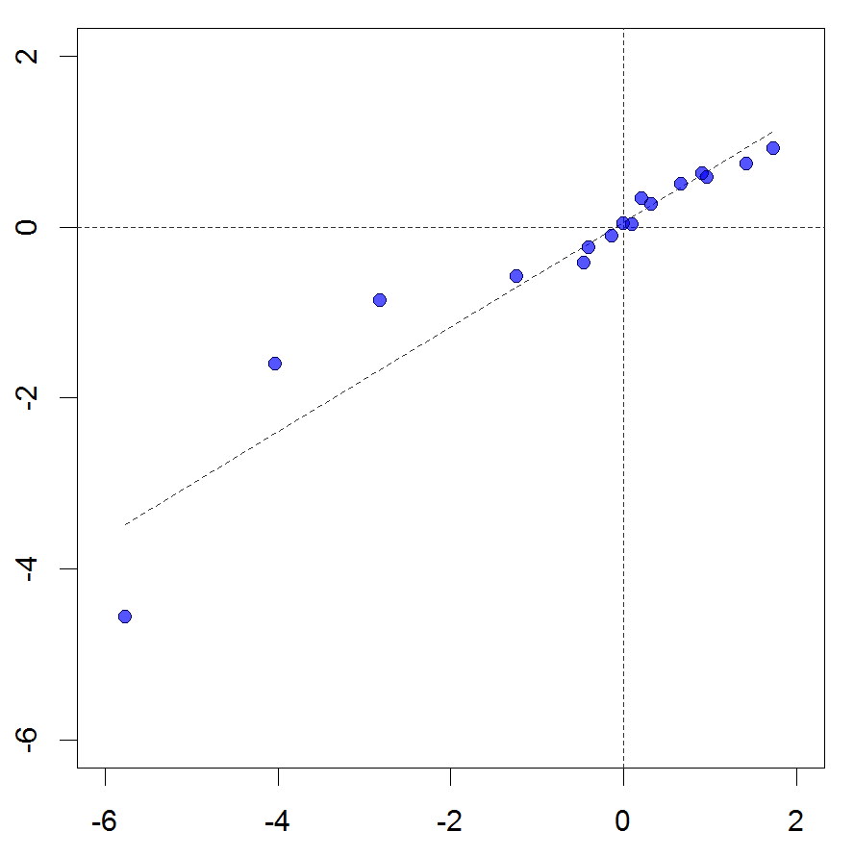
CDKN2A
NFE2L2
SOX2
TP53
PDGFRA
KEAP1
GRM8
FGFR1
WHSC1L1
BAI3
RUNX1T1
FBXW7
STK11
HTA, log₂FC
ERBB4
DDR2
MUC16
RNA-seq, log₂FC
Figure S8. Expression of oncogenes important for lung squamous cell carcinoma is concordant for the two platforms. Results are presented as average logFC between tumour and normal samples. Some oncogenes show only a small absolute logFC as they are mainly affected by mutations at DNA level.

Slide 9
Figure S9. Variability in exon expression measured by RNA-seq and HTA platforms. Exon expression measured for one of the samples (a). Colours represent the gene length: blue – short, green – intermediate, red – long. Dependency between standard deviation and scaled mean expression for normal (b) and tumour (c) samples (obtained using the same approach as in Fig. S4 c-f).

Slide 10
a
b
Number of spliced exons
Number of spliced exons
Average gene expression
Quantiles of gene expression
c
d
RNA-seq
HTA
Jaccard index
Jaccard index
exons: log₁₀(FDR)
exons: log₁₀(FDR)
Figure S10. Sensitivity of differential exon usage analysis to gene expression (a, b) and overlaps between differentially expressed and differentially spliced genes in RNA-seq (c) and HTA (d). The difference in dynamic range between platforms (visible in a) was normalized by considering quantiles in (b). The fold-change threshold of differentially used exons was set constant.

Slide 11
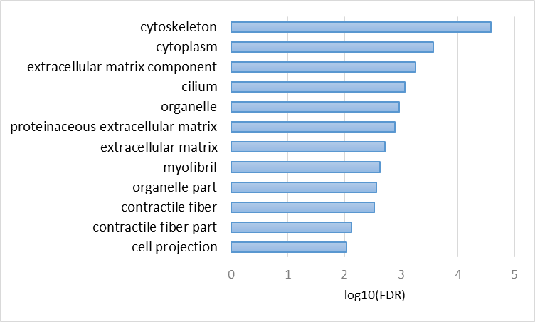
a
GO categories enriched
by spliced genes
GO biological processes enriched
by 207 consistently spliced genes
b
BP: 5
MF: 8
CC: 32
RNA-seq
BP: 16
MF: 22
CC: 46
HTA
BP: 89
MF: 12
CC: 44
Figure S11. GO enrichment (FDR<0.01) based on all genes identified as spliced by analysis of both exons and junctions within RNA-seq and HTA platforms (a). In (b), the results of functional annotation of the core 207 genes consistently identified as spliced by both platforms and both measures are presented.

