Slide 1
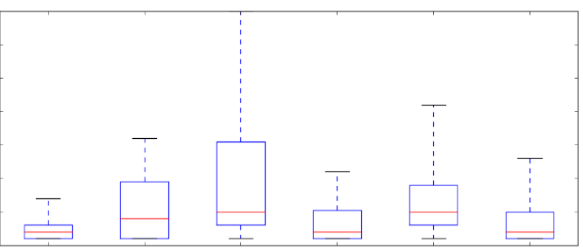
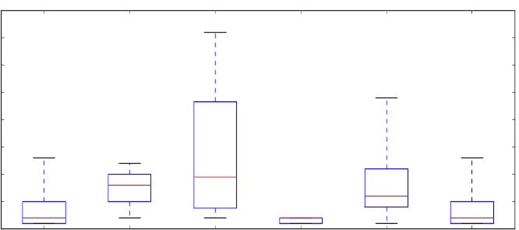
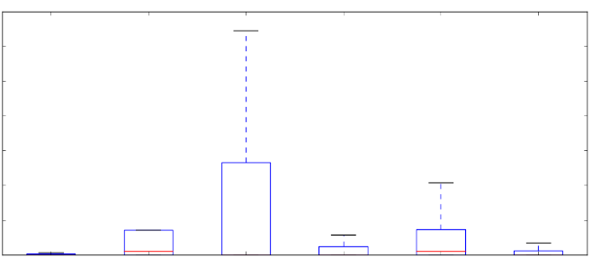
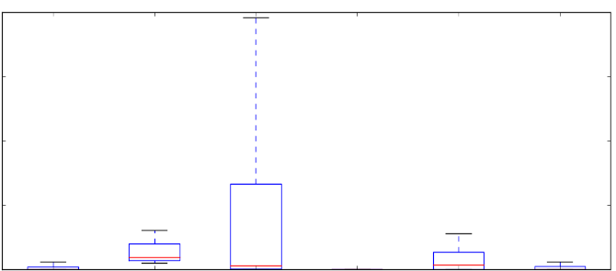
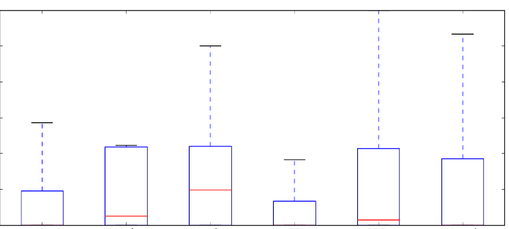
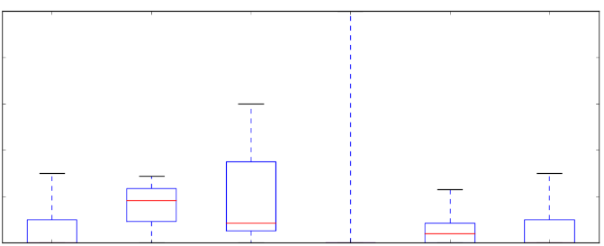
Supplementary Figure 4. Differences between first neighbours of mutated and differentially expressed proteins in breast, hepatocellular carcinoma and non-small cell lung cancer in the SignaLink network. For data on colon cancer, see Figure 3. in the main text. UA: unaffected, DE: differently expressed, FN: first neighbour, HCC: hepatocellular carcinoma, NSCLC: non-small cell lung cancer. * - p<0.05; ** - p<0.01; *** - p<0.001. Wilcoxon rank sum test results to the whole cancer specific network are indicated in red, and to unaffected proteins in grey.
Breast
HCC
30
***
40
***
***
***
30
***
***
20
***
Degree
***
20
***
10
*
10
0
UA
N=343
Mutation
N=8
Mutation
FN N=42
DE
N=44
DE FN
N=154
Whole
network
N=572
0
UA
N=463
Mutation
N=3
Mutation
FN N=20
DE
N=18
DE FN
N=49
Whole
network
N=545
1200
*
20000
***
15000
8000
***
Betweenness
10000
***
***
***
***
4000
***
5000
*
***
0
UA
N=343
Mutation
N=8
Mutation
FN N=42
DE
N=44
DE FN
N=154
Whole
network
N=572
*
***
0
UA
N=463
Mutation
N=3
Mutation
FN N=20
DE
N=18
DE FN
N=49
Whole
network
N=545
0.30
***
***
0.80
0.20
***
***
Clustering coefficient
***
***
*
***
0.10
*
0.40
0
UA
N=343
Mutation
N=8
Mutation
FN N=42
DE
N=44
DE FN
N=154
Whole
network
N=572
0
UA
N=463
Mutation
N=3
Mutation
FN N=20
DE
N=18
DE FN
N=49
Whole
network
N=545

Slide 2
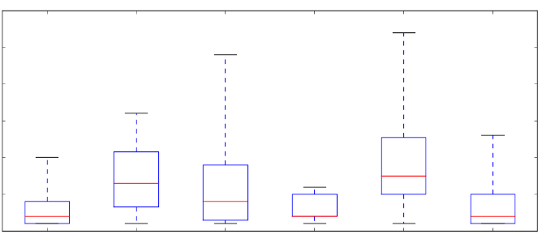
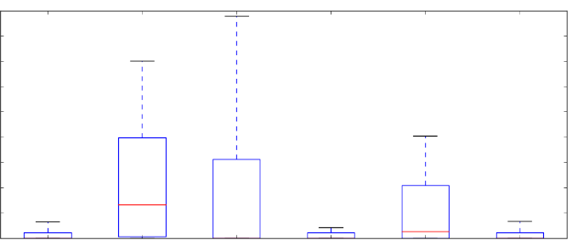
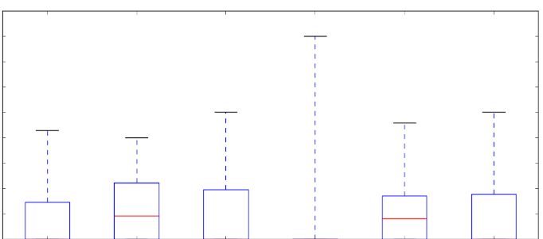
NSCLC
30
***
***
***
Degree
***
***
20
**
*
10
0
UA
N=343
Mutation
N=14
Mutation
FN N=67
DE
N=17
DE FN
N=54
Whole
network
N=581
8000
**
*
6000
**
Betweenness
***
*
4000
***
2000
0
UA
N=343
Mutation
N=14
Mutation
FN N=67
DE
N=17
DE FN
N=54
Whole
network
N=5581
0.45
0.30
**
Clustering coefficient
*
0.15
*
0
UA
N=343
Mutation
N=14
Mutation
FN N=67
DE
N=17
DE FN
N=54
Whole
network
N=5581

