Slide 1
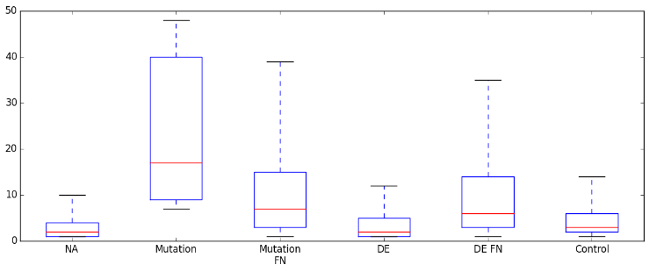
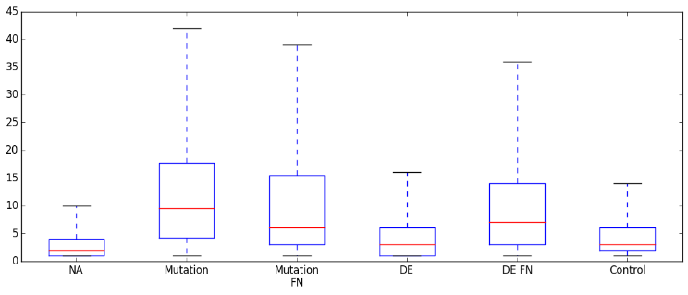
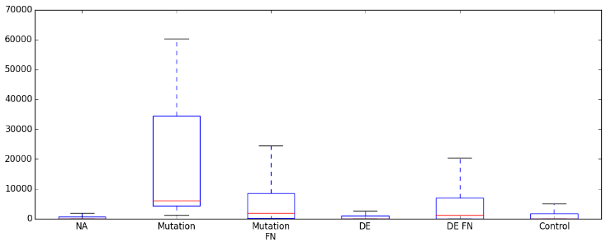
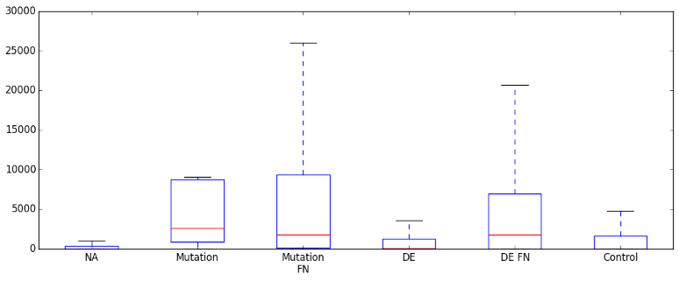
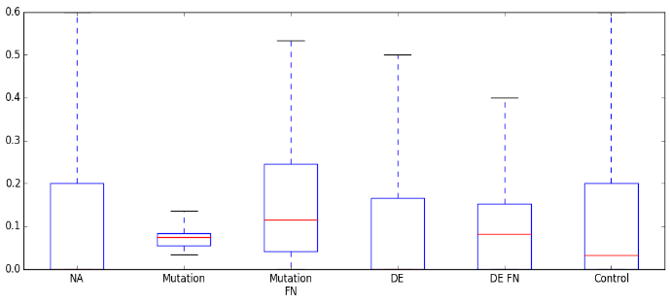
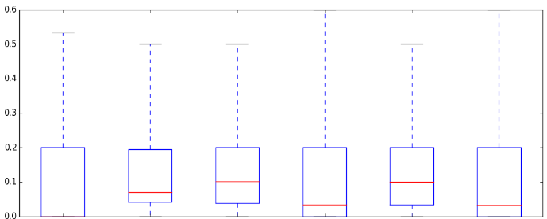
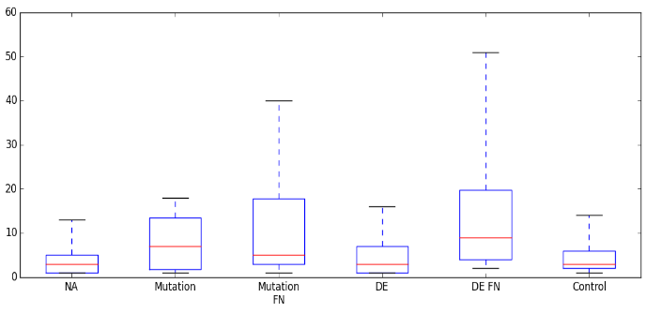
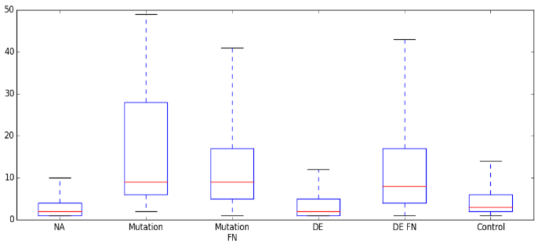
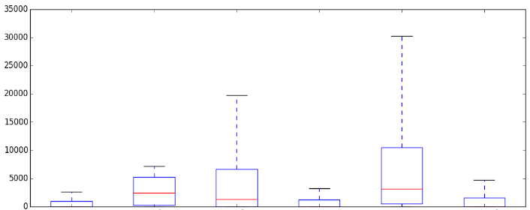
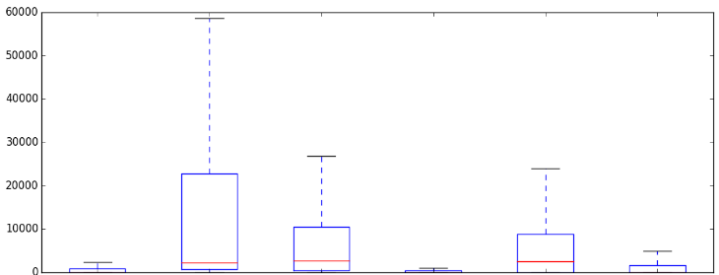
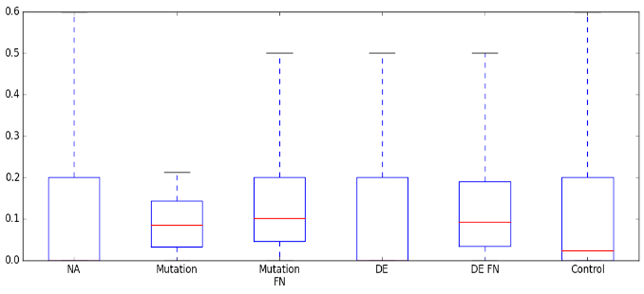
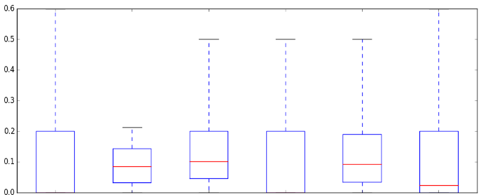
Supplementary Figure 5a. Differences between first neighbours of mutated and differentially expressed proteins in each cancer type, in the signalling network from Cui et al. (2007). UA: unaffected, DE: differently expressed, FN: first neighbour, HCC: hepatocellular carcinoma, NSCLC: non-small cell lung cancer. * - p<0.05; ** - p<0.01; *** - p<0.001. Wilcoxon rank sum test results to the whole cancer specific network are indicated in red, and to unaffected proteins in grey.
Colon
Breast
**
***
***
***
***
***
***
***
***
***
***
***
Degree
***
**
Degree
***
***
***
***
DE FN
N=200
Whole
network
N=1201
UA
N=794
Mutated
N=13
Mutated
FN N=200
DE
N=13
UA
N=696
Mutated
N=14
Mutated
FN N=155
DE
N=112
DE FN
N=312
Whole
network
N=1201
***
***
***
***
***
Betweenness
*
**
***
***
***
Betweenness
***
***
***
***
***
***
**
UA
N=794
Mutated
N=13
Mutated
FN N=200
DE
N=13
DE FN
N=200
Whole
network
N=1201
UA
N=696
Mutated
N=14
Mutated
FN N=155
DE
N=112
DE FN
N=312
Whole
network
N=1201
***
**
***
***
*
***
***
***
***
**
Clustering coefficient
**
***
Clustering coefficient
UA
N=696
Mutated
N=14
Mutated
FN N=155
DE
N=112
DE FN
N=312
Whole
network
N=1201
UA
N=696
Mutated
N=14
Mutated
FN N=155
DE
N=112
DE FN
N=312
Whole
network
N=1201
HCC
NSCLC
***
***
***
***
***
***
***
Degree
**
Degree
***
***
***
***
***
*
UA
N=984
Mutated
N=4
Mutated
FN N=30
DE
N=36
DE FN
N=122
Whole
network
N=1170
UA
N=880
Mutated
N=13
Mutated
FN N=144
DE
N=57
DE FN
N=162
Whole
network
N=1215
***
***
***
**
***
Betweenness
**
Betweenness
***
***
***
***
***
***
***
UA
N=984
Mutated
N=4
Mutated
FN N=30
DE
N=36
DE FN
N=122
Whole
network
N=1170
UA
N=880
Mutated
N=13
Mutated
FN N=144
DE
N=57
DE FN
N=162
Whole
network
N=1215
*
*
***
***
***
***
***
***
Clustering coefficient
Clustering coefficient
*
UA
N=984
Mutated
N=4
Mutated
FN N=30
DE
N=36
DE FN
N=122
Whole
network
N=1170
UA
N=880
Mutated
N=13
Mutated
FN N=144
DE
N=57
DE FN
N=162
Whole
network
N=1215

Slide 2
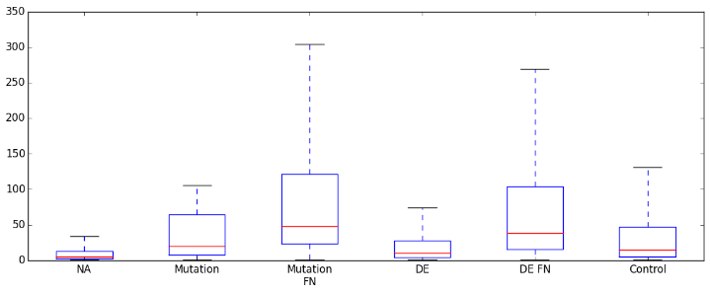
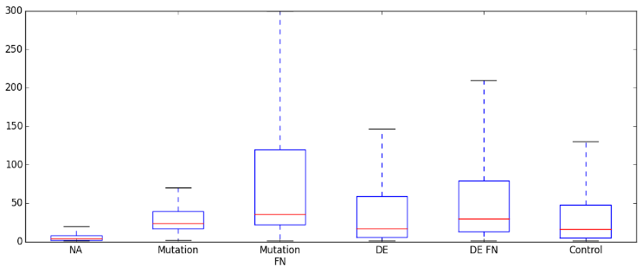
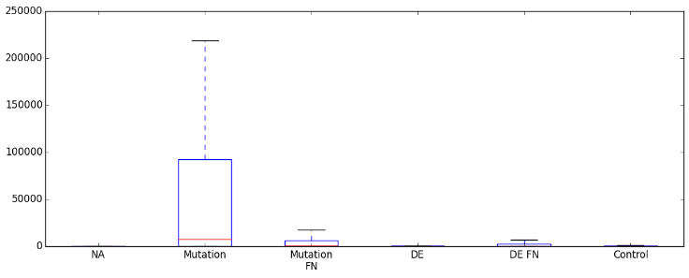
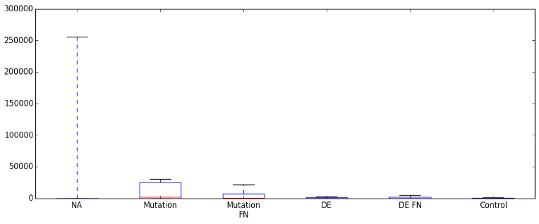
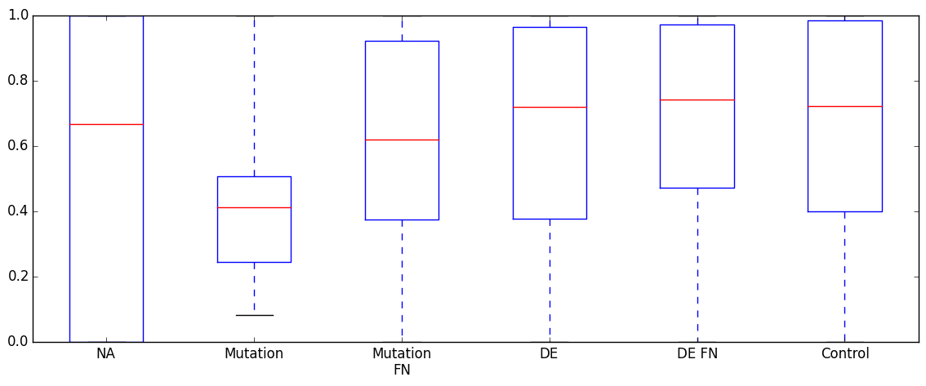
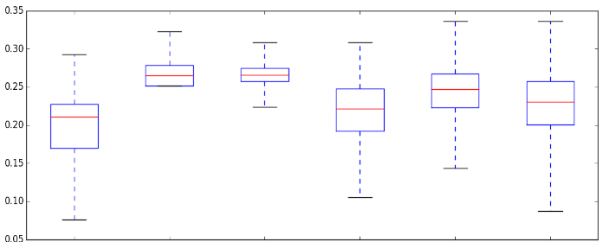
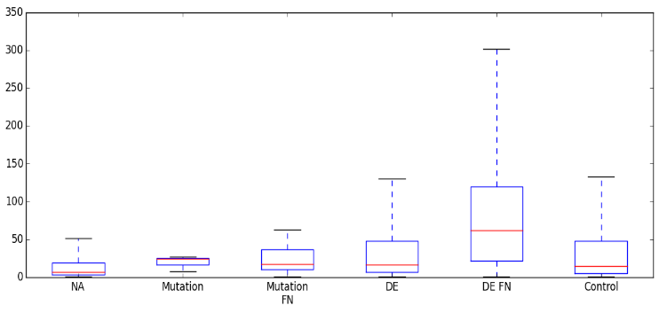
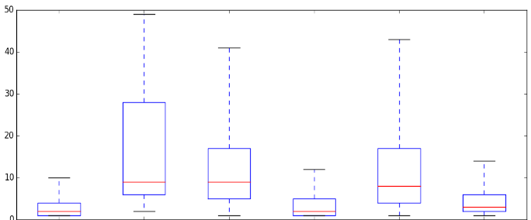
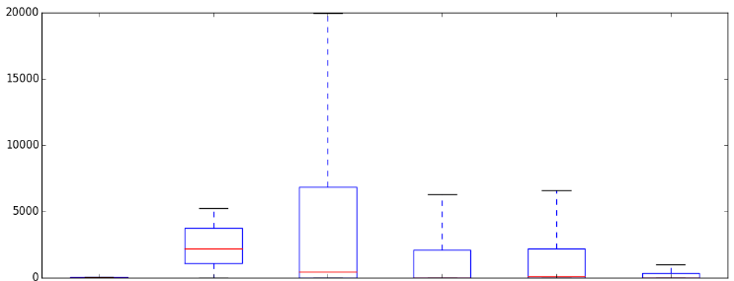
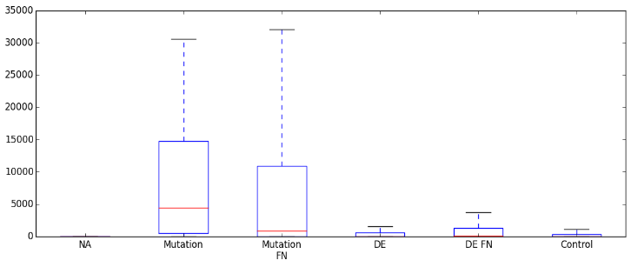
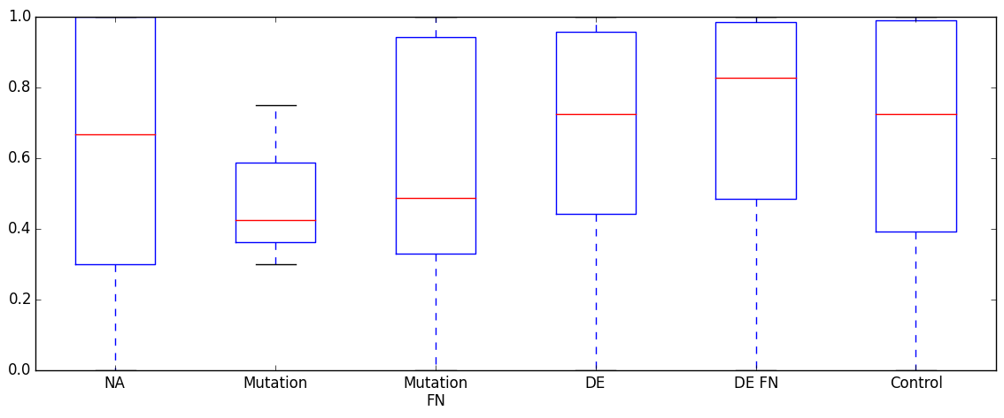
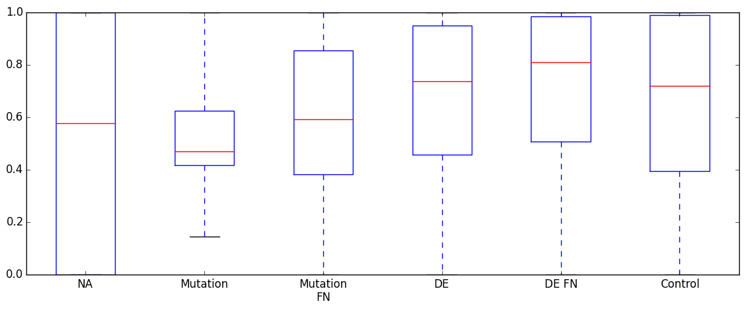
Supplementary Figure 5b. Differences between first neighbours of mutated and differentially expressed proteins in each cancer type, in the signalling network from Reactome. UA: unaffected, DE: differently expressed, FN: first neighbour, HCC: hepatocellular carcinoma, NSCLC: non-small cell lung cancer. * - p<0.05; ** - p<0.01; *** - p<0.001. Wilcoxon rank sum test results to the whole cancer specific network are indicated in red, and to unaffected proteins in grey.
Colon
Breast
***
***
***
***
***
***
***
***
*
Degree
***
***
Degree
***
**
***
***
***
***
***
***
UA
N=1582
Mutated
N=24
Mutated
FN N=279
DE
N=215
DE FN
N=1924
Whole
network
N=3897
UA
N=1109
Mutated
N=14
Mutated
FN N=505
DE
N=410
DE FN
N=2221
Whole
network
N=3798
***
**
***
Betweenness
**
Betweenness
***
***
***
***
***
***
***
***
***
***
*
***
***
***
UA
N=1582
Mutated
N=24
Mutated
FN N=279
DE
N=215
DE FN
N=1924
Whole
network
N=3897
***
UA
N=1109
Mutated
N=14
Mutated
FN N=505
DE
N=410
DE FN
N=2221
Whole
network
N=3798
*
***
Clustering coefficient
Clustering coefficient
*
***
**
*
*
UA
N=1582
Mutated
N=24
Mutated
FN N=279
DE
N=215
DE FN
N=1924
Whole
network
N=3897
Mutated
N=14
***
DE FN
N=2221
UA
N=1109
Mutated
FN N=505
DE
N=410
Whole
network
N=3798
HCC
NSCLC
***
***
***
***
***
***
***
***
**
Degree
***
Degree
***
***
***
***
UA
N=2223
Mutated
N=3
Mutated
FN N=58
DE
N=119
DE FN
N=1428
Whole
network
N=3818
UA
N=1545
Mutated
N=20
Mutated
FN N=512
DE
N=227
DE FN
N=1955
Whole
network
N=3892
***
***
***
***
Betweenness
***
**
Betweenness
***
***
***
***
***
***
***
***
UA
N=2223
Mutated
N=3
Mutated
FN N=58
DE
N=119
DE FN
N=1428
Whole
network
N=3818
Mutated
N=20
Mutated
FN N=512
***
***
Whole
network
N=3892
UA
N=1545
DE
N=227
DE FN
N=1955
*
***
Clustering coefficient
Clustering coefficient
***
***
*
***
**
*
***
Mutated
N=20
Mutated
FN N=512
***
Whole
network
N=3892
UA
N=2223
Mutated
N=3
Mutated
FN N=58
DE
N=119
DE FN
N=1428
Whole
network
N=3818
UA
N=1545
DE
N=227
DE FN
N=1955

Slide 3
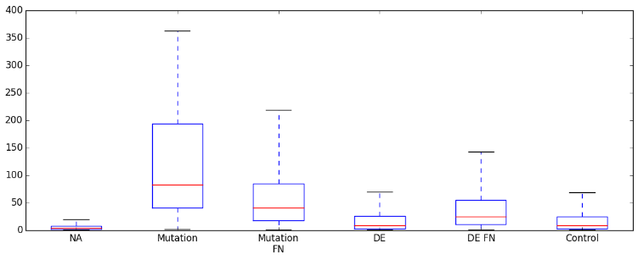
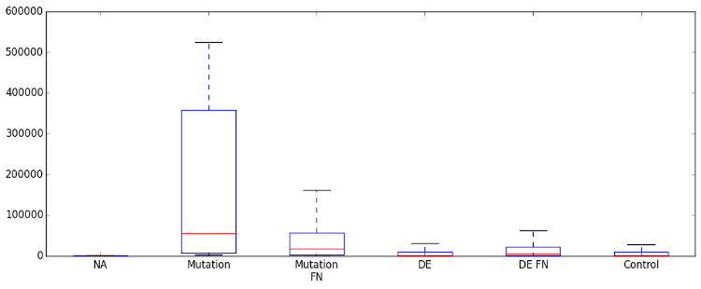
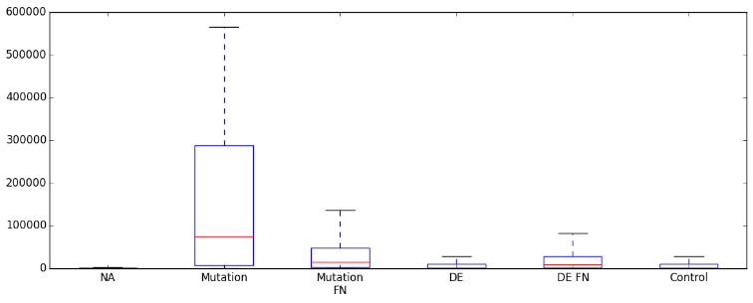

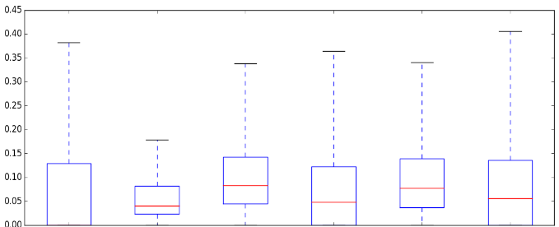
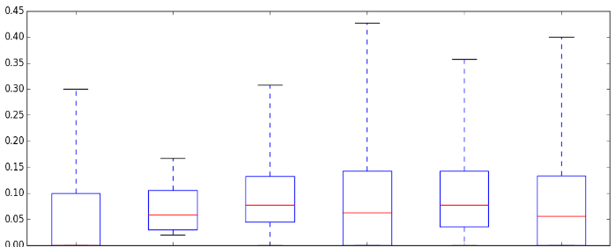
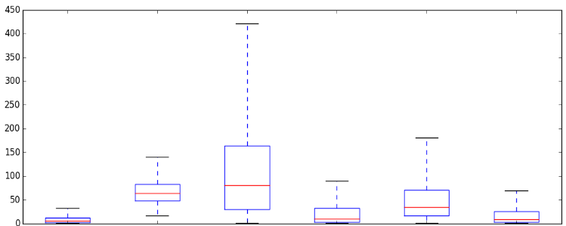
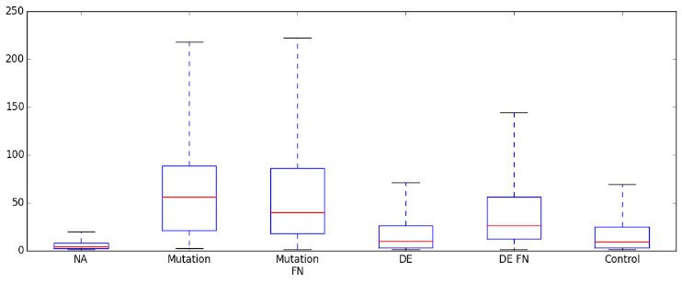
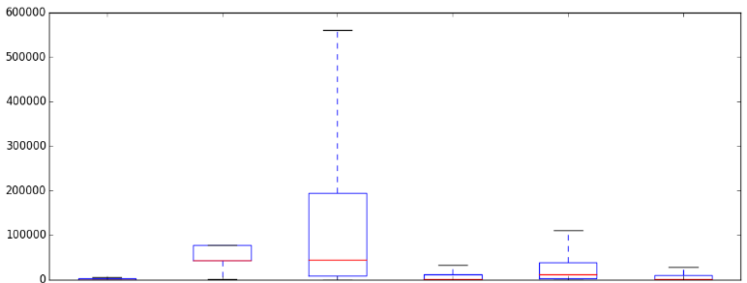
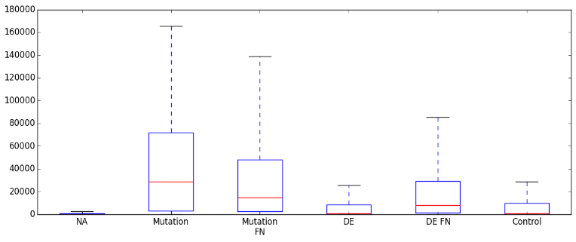
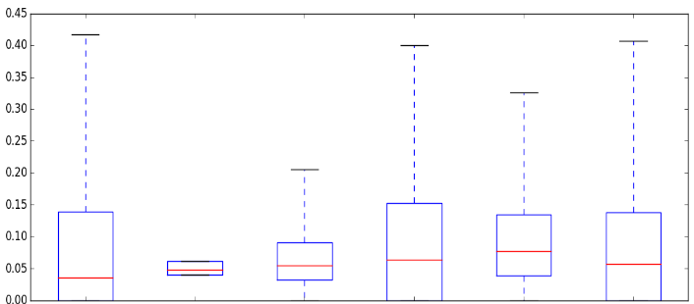
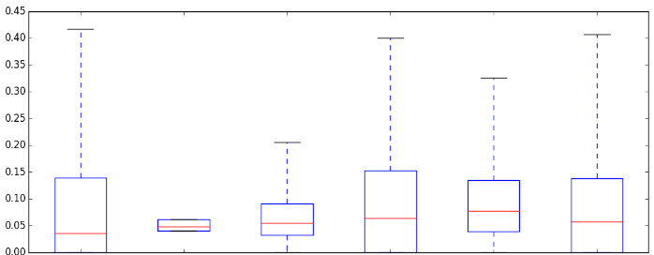
Supplementary Figure 5c. Differences between first neighbours of mutated and differentially expressed proteins in each cancer type, in the combined protein-protein interaction network of Biogrid, DIP and Intact. UA: unaffected, DE: differently expressed, FN: first neighbour, HCC: hepatocellular carcinoma, NSCLC: non-small cell lung cancer. * - p<0.05; ** - p<0.01; *** - p<0.001. Wilcoxon rank sum test results to the whole cancer specific network are indicated in red, and to unaffected proteins in grey.
***
Colon
***
*
Breast
***
**
***
***
***
***
Degree
***
***
Degree
***
***
***
***
***
***
***
***
***
UA
N=4854
Mutated
N=27
Mutated
FN N=2112
DE
N=603
DE FN
N=4301
Whole
control
N=9752
***
***
UA
N=3782
Mutated
N=20
Mutated
FN N=1676
DE
N=1039
DE FN
N=4940
Whole
network
N=9998
***
***
*
***
***
***
Betweenness
**
***
***
***
***
Betweenness
***
***
***
***
***
***
***
***
***
UA
N=4854
Mutated
N=27
Mutated
FN N=2112
DE
N=603
DE FN
N=4301
Whole
control
N=9752
---
Mutated
N=20
Mutated
FN N=1676
***
***
Whole
network
N=9998
UA
N=3782
DE
N=1039
DE FN
N=4940
***
***
***
***
***
***
***
***
***
***
***
Clustering coefficient
**
***
Clustering coefficient
*
***
***
***
***
***
***
UA
N=3782
Mutated
N=20
Mutated
FN N=1676
DE
N=1039
DE FN
N=4940
Whole
network
N=9998
UA
N=3782
Mutated
N=20
Mutated
FN N=1676
DE
N=1039
DE FN
N=4940
Whole
network
N=9998
HCC
NSCLC
***
***
***
**
***
***
***
Degree
***
***
***
***
***
***
Degree
***
***
***
***
**
***
***
UA
N=6698
Mutated
N=5
Mutated
FN N=236
DE
N=302
DE FN
N=2953
Whole
network
N=10007
UA
N=4657
Mutated
N=26
Mutated
FN N=437
DE
N=378
DE FN
N=1534
Whole
network
N=6801
***
***
***
***
*
***
***
Betweenness
Betweenness
***
***
***
***
***
***
***
***
***
***
***
***
***
UA
N=6698
Mutated
N=5
Mutated
FN N=236
DE
N=302
DE FN
N=2953
Whole
network
N=10007
UA
N=4657
Mutated
N=26
Mutated
FN N=437
DE
N=378
DE FN
N=1534
Whole
network
N=6801
***
***
***
***
***
***
***
*
***
***
Clustering coefficient
***
Clustering coefficient
***
***
**
**
UA
N=4657
Mutated
N=26
Mutated
FN N=437
DE
N=378
DE FN
N=1534
Whole
network
N=6801
UA
N=4657
Mutated
N=26
Mutated
FN N=437
DE
N=378
DE FN
N=1534
Whole
network
N=6801

Slide 4
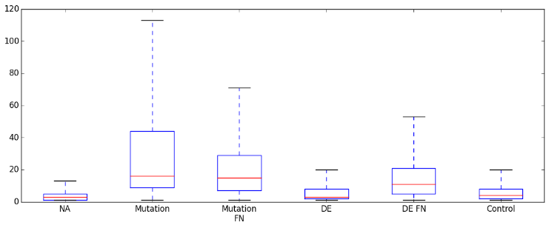
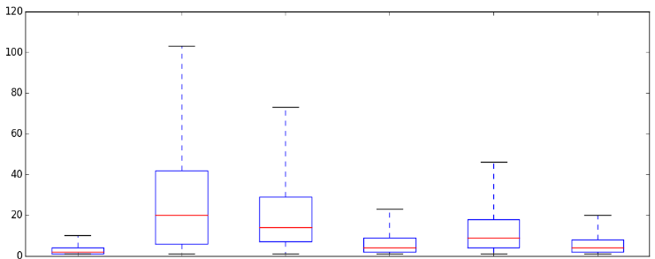
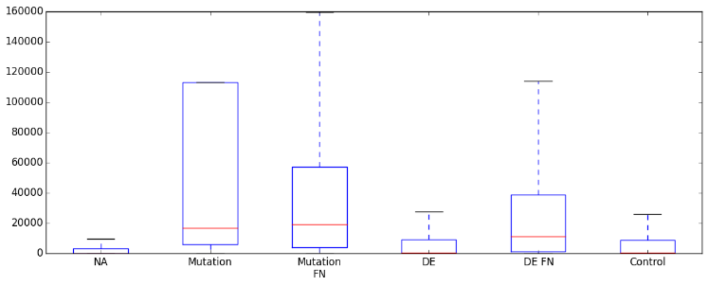
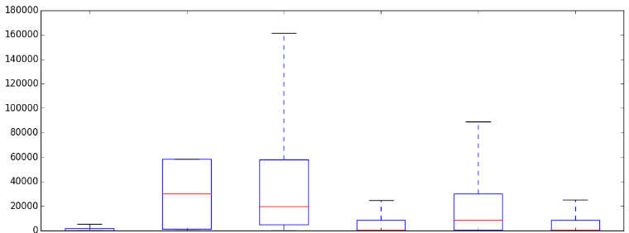
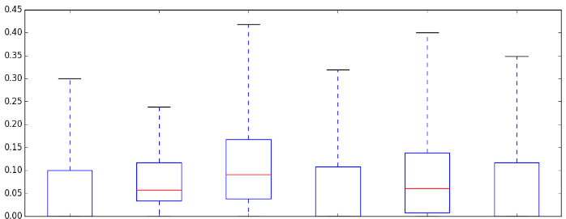
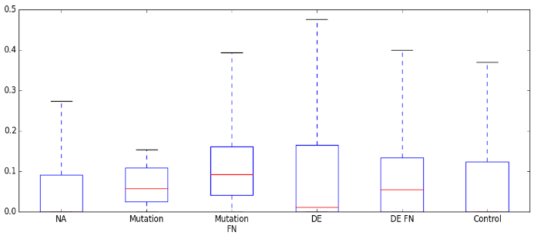
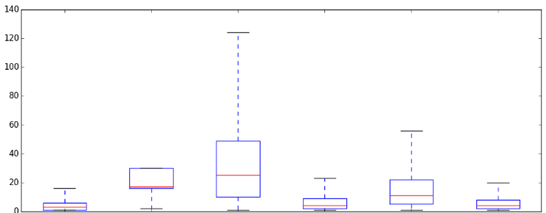
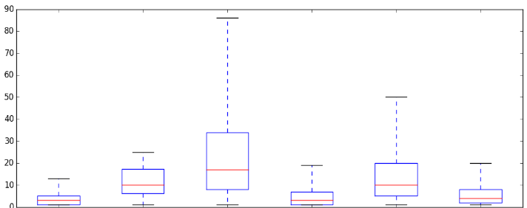
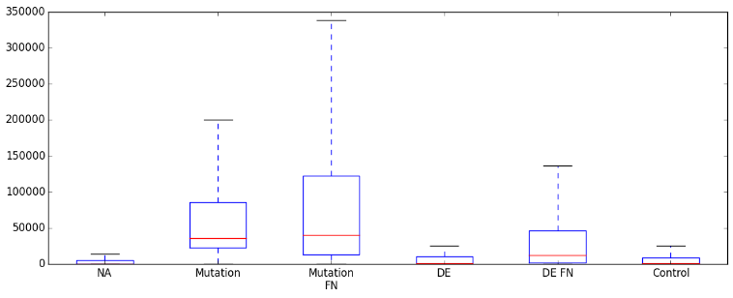
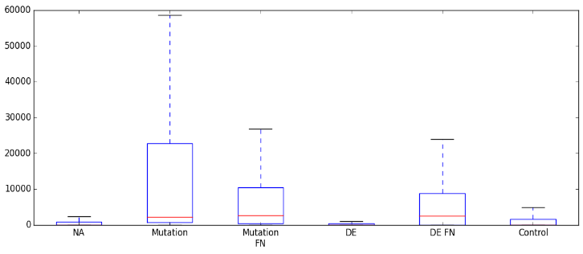
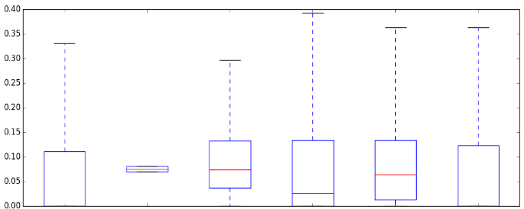
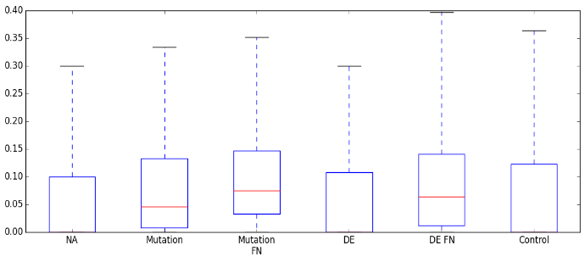
DE
N=654
Supplementary Figure 5d. Differences between first neighbours of mutated and differentially expressed proteins in each cancer type, in the manually curated protein-protein interaction network of HPRD. UA: unaffected, DE: differently expressed, FN: first neighbour, HCC: hepatocellular carcinoma, NSCLC: non-small cell lung cancer. * - p<0.05; ** - p<0.01; *** - p<0.001. Wilcoxon rank sum test results to the whole cancer specific network are indicated in red, and to unaffected proteins in grey.
Colon
***
Breast
***
***
***
***
***
***
***
***
***
***
***
Degree
***
***
Degree
***
***
***
***
***
Whole
network
N=6781
Mutated
N=17
Mutated
FN N=524
DE
N=654
DE FN
N=2052
Whole
network
N=6653
UA
N=4540
Mutated
N=21
Mutated
FN N=667
DE
N=386
DE FN
N=1578
UA
N=3763
***
***
***
***
***
***
***
***
***
***
***
***
***
Betweenness
***
Betweenness
***
***
***
***
***
***
UA
N=4540
Mutated
N=21
Mutated
FN N=667
DE
N=386
DE FN
N=1578
Whole
network
N=6781
UA
N=3763
Mutated
N=17
Mutated
FN N=524
DE
N=654
DE FN
N=2052
Whole
network
N=6653
*
***
***
***
***
***
***
*
***
***
***
***
***
Clustering coefficient
***
***
Clustering coefficient
***
*
UA
N=4540
Mutated
N=21
Mutated
FN N=667
DE
N=386
DE FN
N=1578
Whole
network
N=6781
UA
N=3763
Mutated
N=17
Mutated
FN N=524
DE
N=654
DE FN
N=2052
Whole
network
N=6653
HCC
NSCLC
***
***
***
***
***
***
***
Degree
*
***
Degree
***
***
***
**
***
***
*
***
***
***
UA
N=5186
Mutated
N=5
Mutated
FN N=121
DE
N=208
DE FN
N=1180
Whole
network
N=6630
UA
N=4657
Mutated
N=26
Mutated
FN N=524
DE
N=378
DE FN
N=1534
Whole
network
N=6801
***
***
***
***
Betweenness
*
***
***
*
***
Betweenness
***
***
*
***
***
***
***
***
***
UA
N=5186
Mutated
N=5
Mutated
FN N=121
DE
N=208
DE FN
N=1180
Whole
network
N=6630
Mutated
N=26
Mutated
FN N=524
***
DE FN
N=1534
Whole
network
N=6801
UA
N=4657
DE
N=378
***
***
***
*
***
*
***
***
***
***
***
*
Clustering coefficient
***
Clustering coefficient
***
UA
N=5186
Mutated
N=5
Mutated
FN N=121
DE
N=208
DE FN
N=1180
Whole
network
N=6630
UA
N=4657
Mutated
N=26
Mutated
FN N=524
DE
N=378
DE FN
N=1534
Whole
network
N=6801

