Slide 1
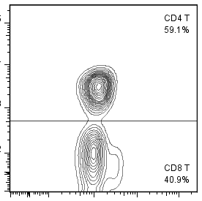
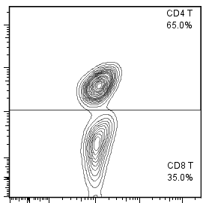
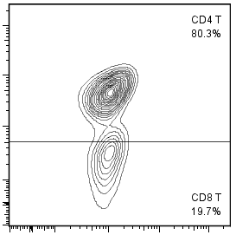
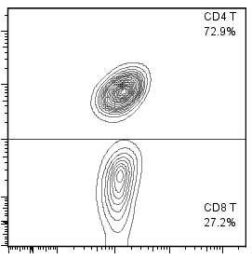
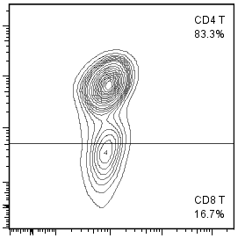
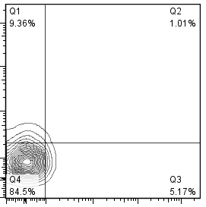
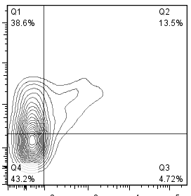
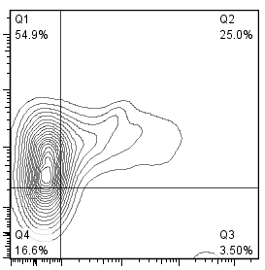
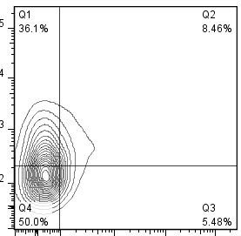
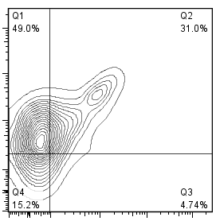
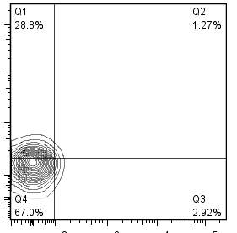
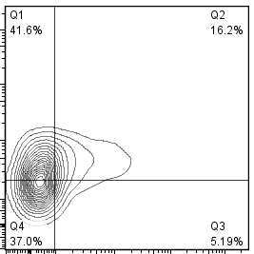
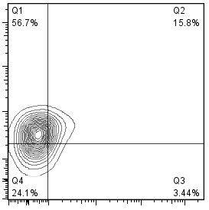
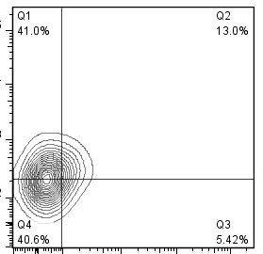
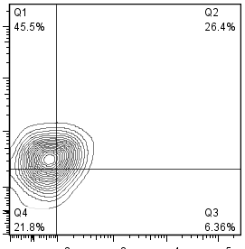
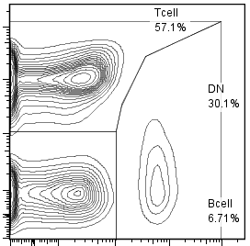
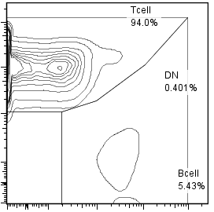
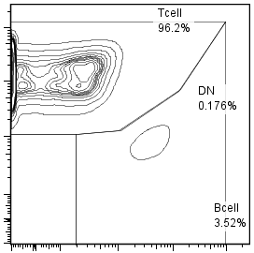
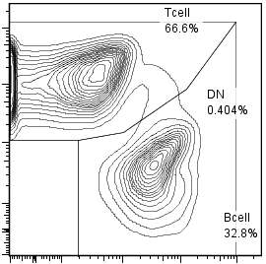
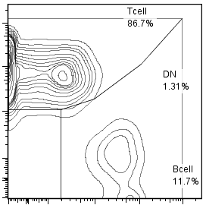
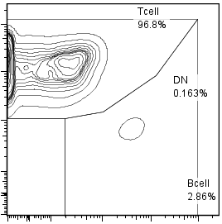
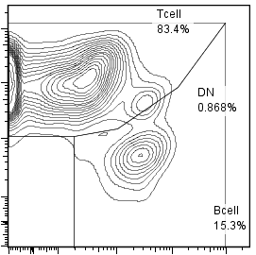
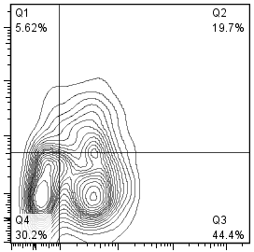
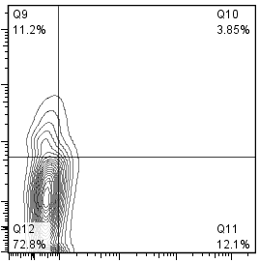
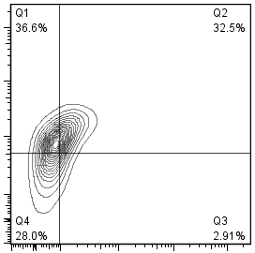
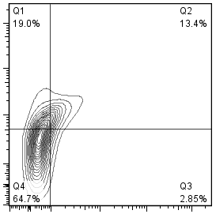
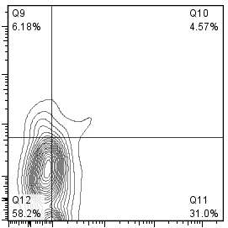
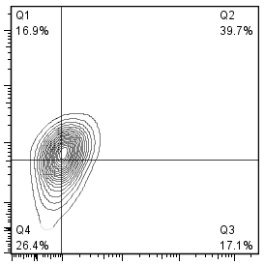
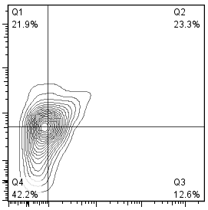
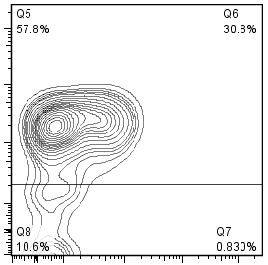
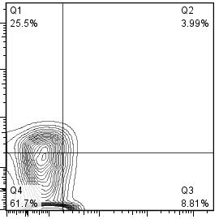
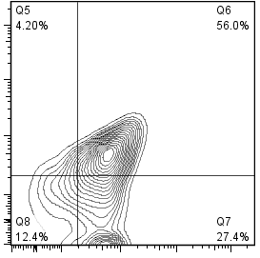
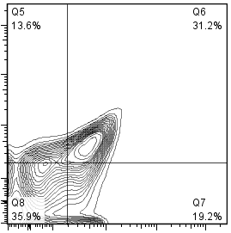

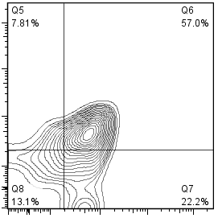
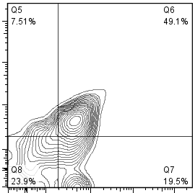
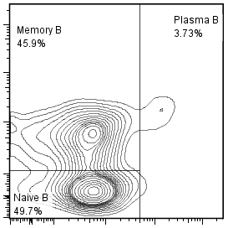
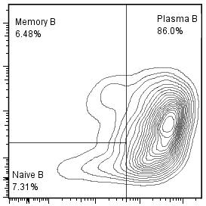
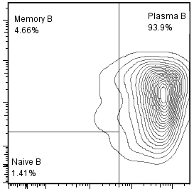
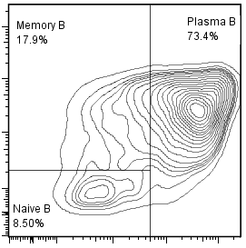
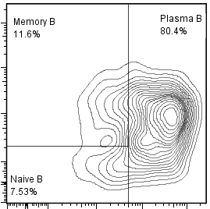
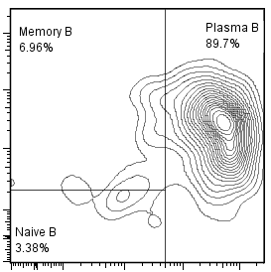
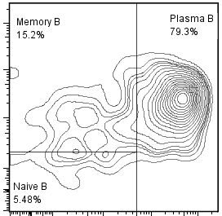
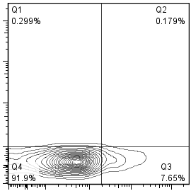
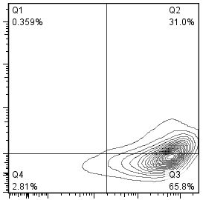
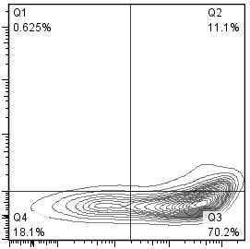
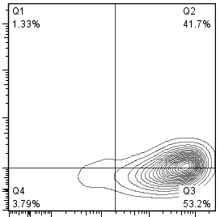
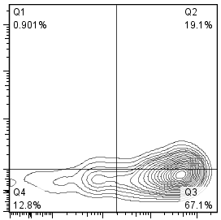
Fig. S 3
Spleen
NOG-hIL-4-Tｇ
BM
A
HD
Non-
Immunized
Immunized
(CH401MAP)
Non-
Immunized
Immunized
(CH401MAP)
CD3+ gate
59.1
65.0
80.3
72.9
83.3
CD4
CD3
40.9
35.0
19.7
27.2
16.7
T cell
CD4+ gate
9.36
1.01
38.6
13.5
54.9
25.0
36.1
8.46
49.0
31.0
PD-1
CD25
84.5
5.17
43.2
4.72
16.6
3.50
50.0
5.48
15.2
4.75
CD4- gate
28.8
1.27
41.6
16.2
56.7
15.8
41.0
13.0
45.5
26.4
PD-1
67.0
2.92
37.0
5.19
24.1
3.44
40.6
5.42
21.8
6.37
CD25
B
NOG
Spleen
BM
Non-
Immunized
NOG-hIL-4-Tｇ
NOG
NOG-hIL-4-Tｇ
CD45+
gate
HD
Non-
Immunized
Immunized
(CH401MAP)
Non-
Immunized
Non-
Immunized
Immunized
(CH401MAP)
57.1
94.0
96.2
66.6
86.7
96.8
83.4
CD5
30.1
6.71
0.40
5.43
0.18
3.52
0.40
32.8
1.31
11.7
0.16
2.86
0.87
CD19
15.3
CD19+
gate
5.62
19.7
11.2
3.85
36.6
32.5
19.0
13.4
6.18
4.57
16.9
39.7
21.9
23.3
CD5
30.2
44.4
72.8
12.1
29.0
2.91
64.7
2.85
58.2
31.0
26.4
17.1
42.2
12.6
IgD
57.8
30.8
25.5
3.99
56.0
13.6
31.2
24.3
6.18
7.81
B cell
4.20
57.0
7.51
49.1
CD21
10.6
0.83
61.7
8.81
12.4
27.4
35.9
19.2
57.8
11.7
13.1
22.2
23.9
19.5
CD24
45.9
3.73
6.48
86.0
4.66
93.9
17.9
73.4
11.6
80.4
6.96
89.7
15.2
79.3
CD27
CD38
49.7
7.31
1.41
8.50
7.53
3.38
5.48
0.30
0.18
0.36
31.0
0.63
11.1
1.33
41.7
0.90
ND
ND
19.1
CD138
91.9
7.65
2.81
65.8
18.1
70.2
3.79
53.2
12.8
67.1
CD38

