Slide 1
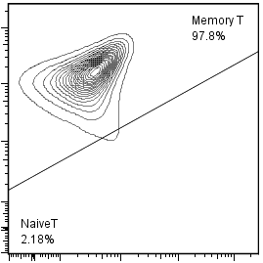
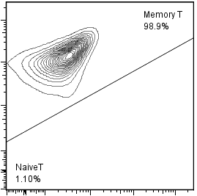
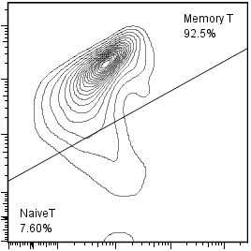
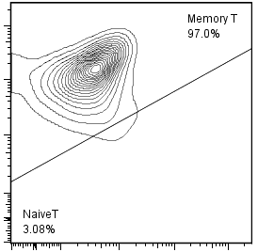
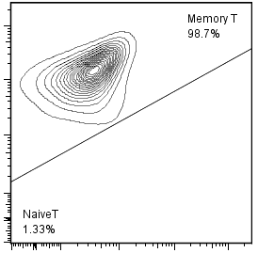
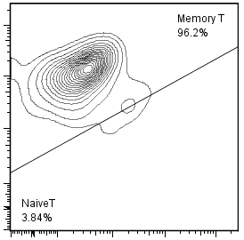
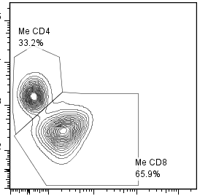
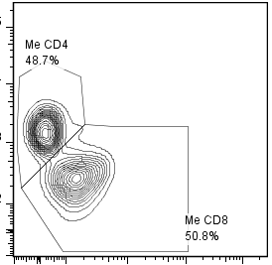
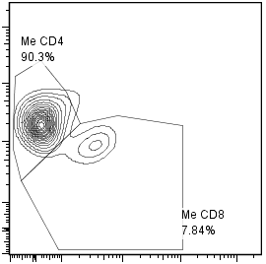
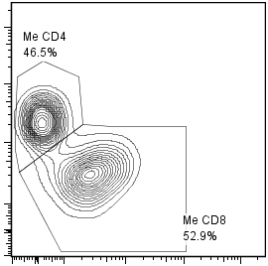

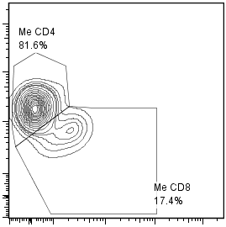
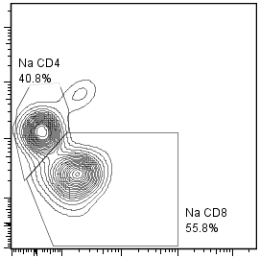
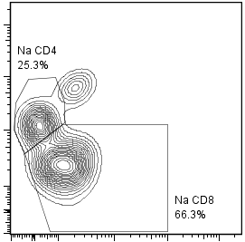
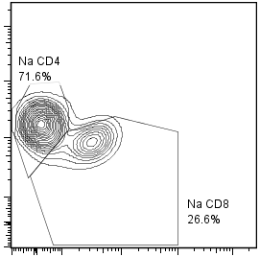
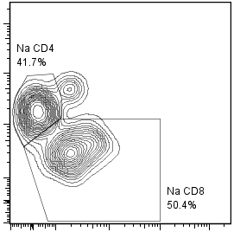
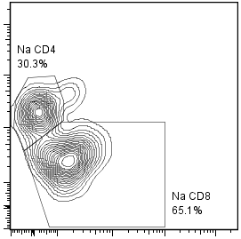
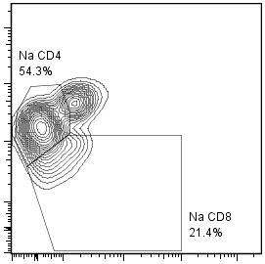
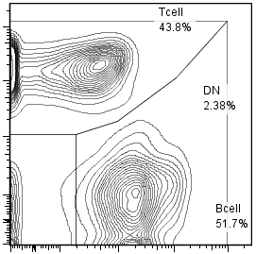
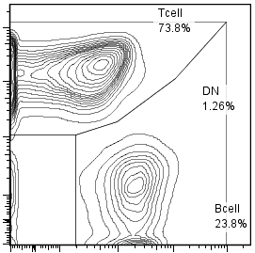
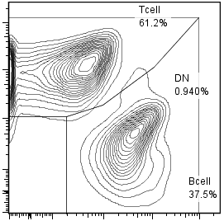
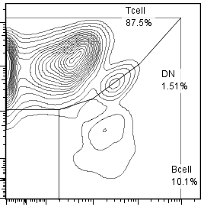
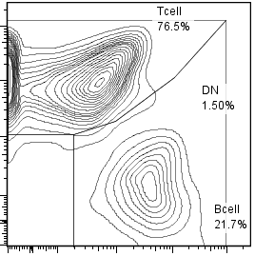
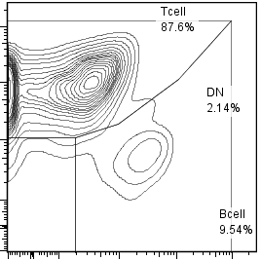
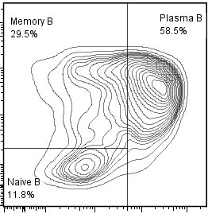
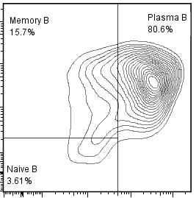
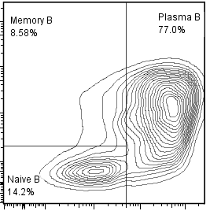
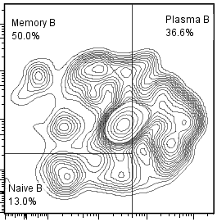
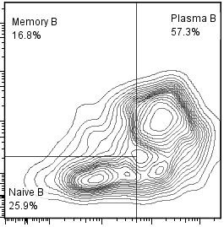
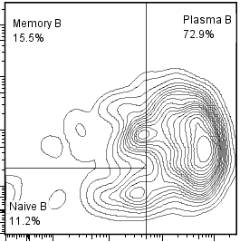
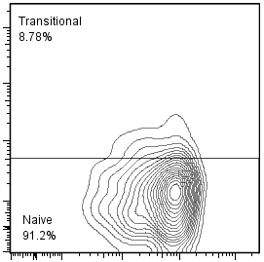
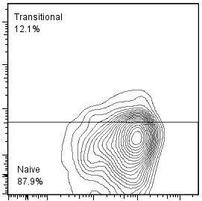
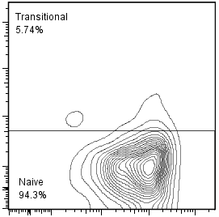
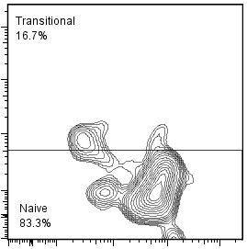
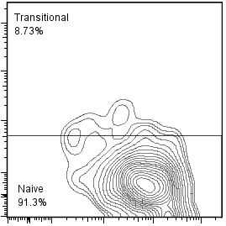
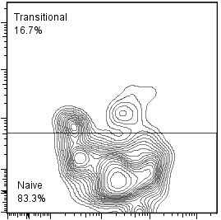
Fig. S 4
Spleen
NOG-hIL-4-Tｇ
BM
PBS
CH401
MAP
KLH
PBS
CH401
MAP
KLH
CD3+ gate
97.8
98.7
92.5
97.0
98.7
96.2
Memory
CD45RO
2.18
1.31
3.08
1.33
3.84
Naive
CD45RA
7.60
CD45RO+
gate
33.2
48.7
90.3
46.5
44.1
81.6
CD4+
Memory
T cell
CD8+
Memory
CD4
65.9
50.9
7.84
52.9
54.6
17.4
CD8
CD45RA+
gate
40.8
25.3
71.6
41.7
30.3
54.3
CD4+
Naive
CD8+
Naïve
CD4
55.8
66.3
26.6
50.4
65.1
21.4
CD8
CD45+ gate
B cell
CD5
51.7
23.8
37.5
10.1
21.7
9.54
B cell
CD19
CD19+ gate
29.5
58.5
15.7
80.6
8.59
77.0
50.0
36.6
16.8
57.3
15.5
72.9
Memory
B cell
CD27
11.8
3.61
14.2
13.0
25.9
11.2
Plasmablast
CD38
CD27-
CD38- gate
8.78
12.1
5.74
16.7
8.73
16.7
Transitional
CD5
91.2
87.9
94.3
83.3
91.3
83.3
Naïve
CD19

