Slide 1


Demonstration
Feel the ViBe (Violence Beaten)
www.feel-the-vibe.nl
Feel the ViBe is made by the Radboud University Medical Center, department of Primary & Community care, Gender & Women’s health.
The project is funded by Fonds Slachtofferhulp (Victim Support Fund, the Netherlands). The sponsor had no influence on any part of the study.
www.fondsslachtofferhulp.nl
www.radboudumc.nl

Slide 2
Target Group
Adolescents and Young Adults exposed to family violence
ViBe stands for ViolenceBeaten → Beat the Violence!
Age 12-25
Anonymous, Free
100% online: www.feel-the-vibe.nl
Dutch language

Slide 3
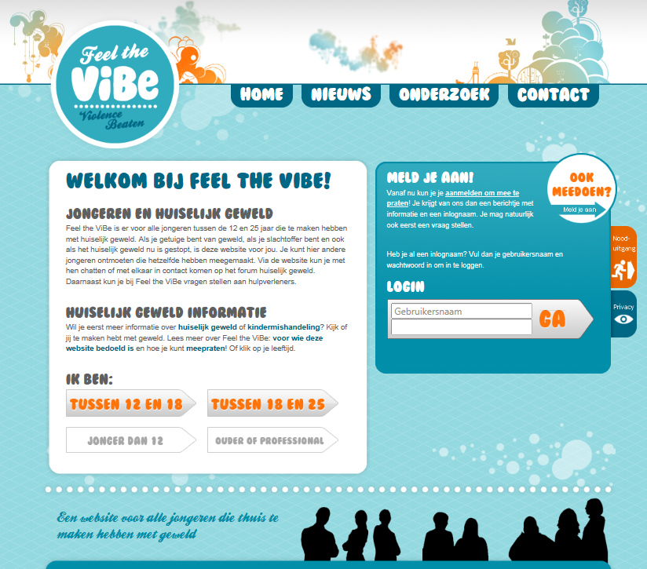
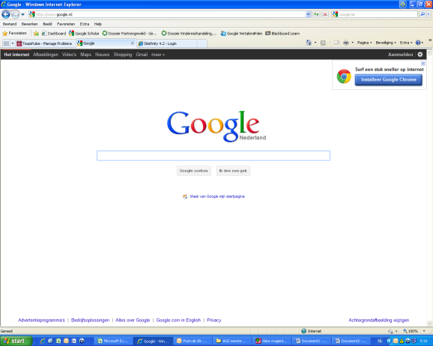
Homepage feel-the-vibe.nl

Slide 4
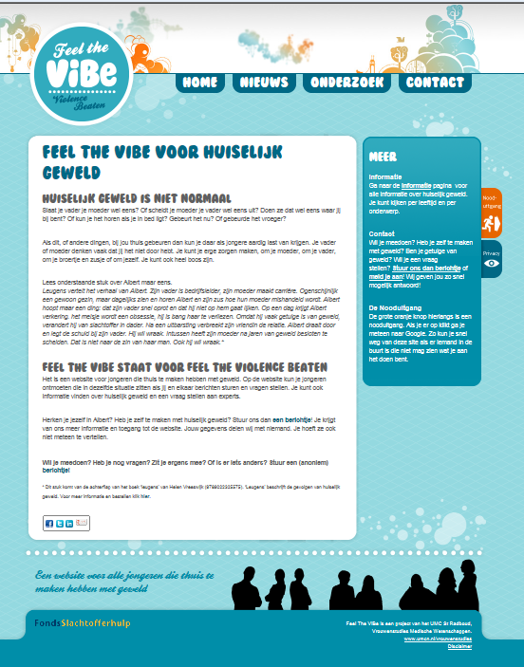
General Public information on Family Violence and Feel the ViBe

Slide 5
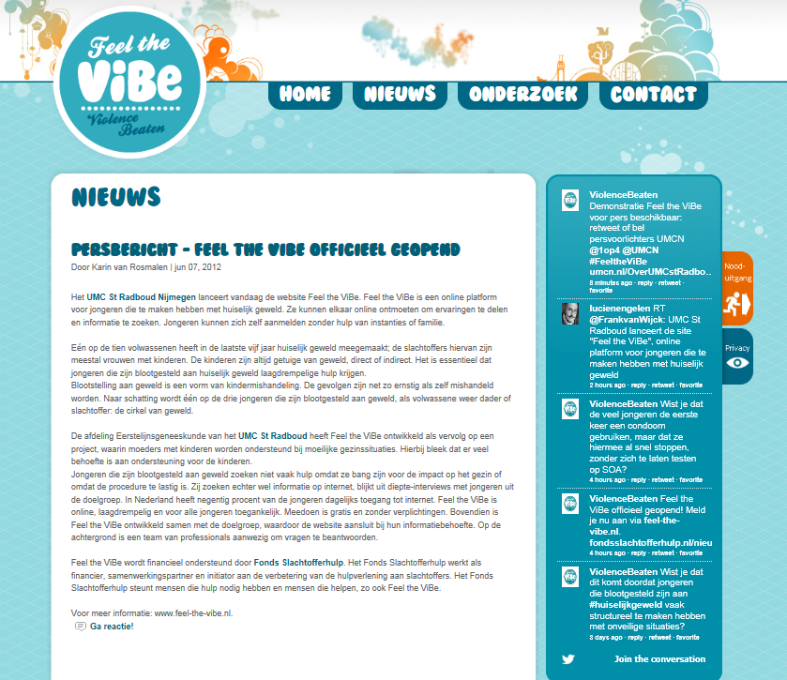
News page
Twitter: @ViolenceBeaten
Twitter showed a fact on family violence every day during the intervention. Participants also receive these facts by text message or email by choice

Slide 6
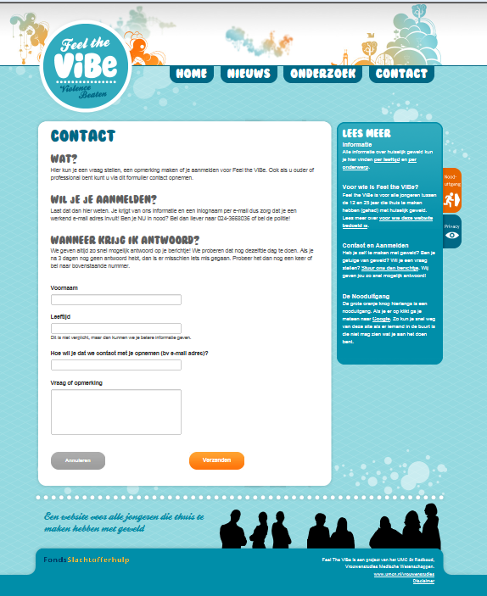
Participants apply for Feel the ViBe using the online contact form.

Slide 7
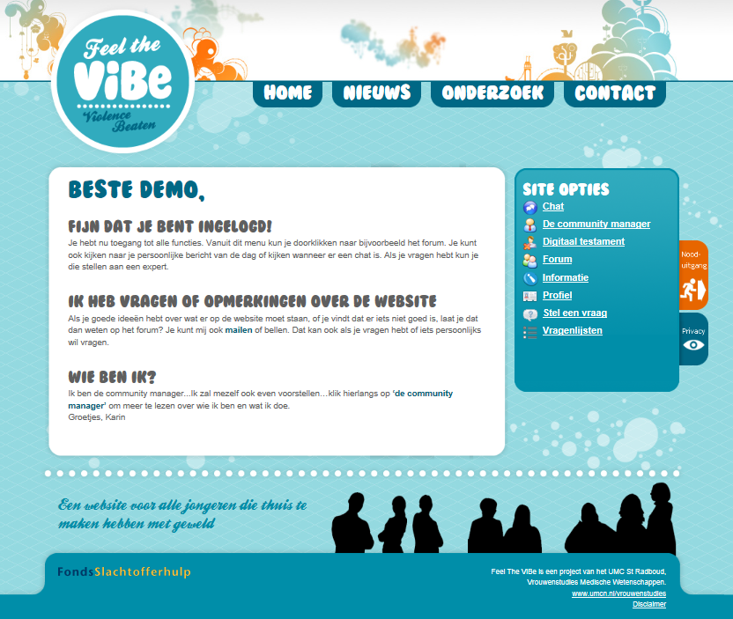
Using your login you enter your personal menu, showing all intervention parts

Slide 8
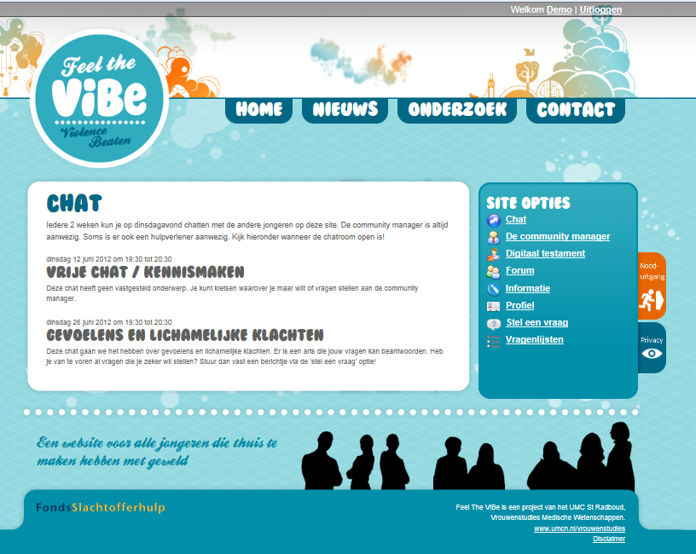
Chat: always available, but guided chat with a healthcare provider every two weeks.

Slide 9
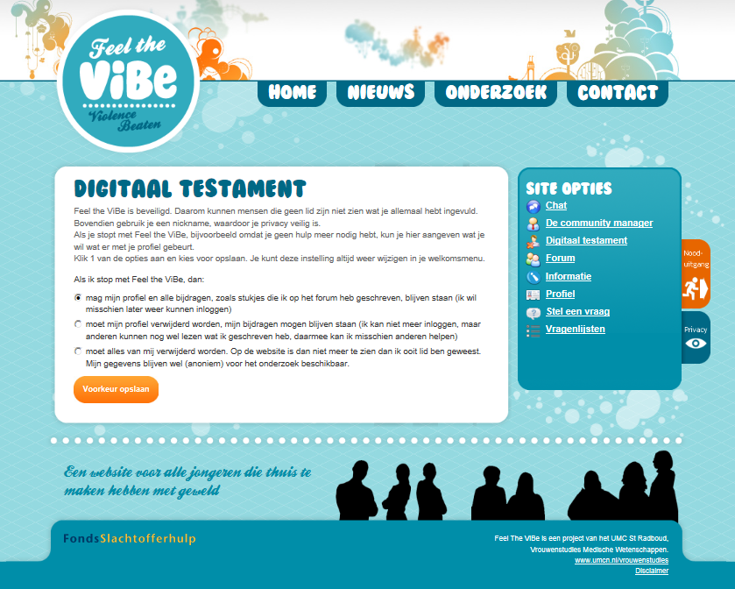
Digital Testament: participants are in charge of their digital legacy choosing how to use their data after they stop participation.

Slide 10
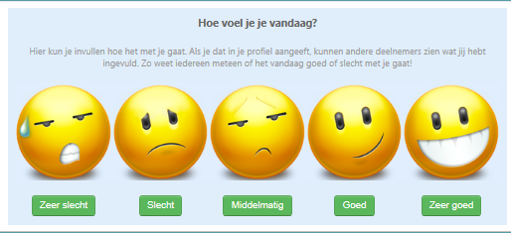
Avatar: At login you show the other participants how you feel at that moment. At logout, you do the same.
If you don’t want this you choose your own avatar.

Slide 11
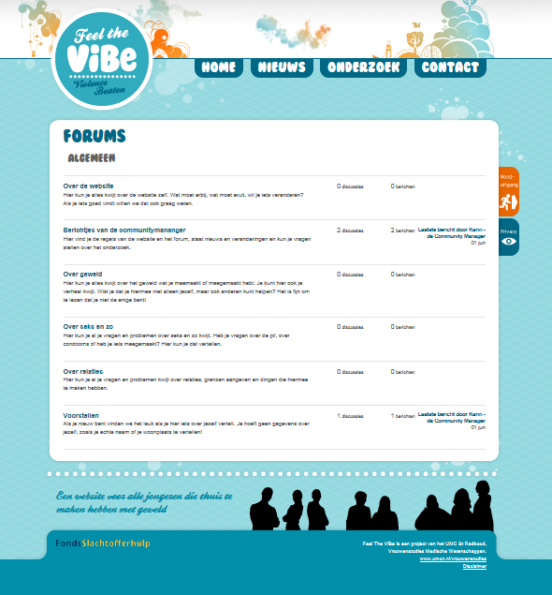
Forum:
Participants can meet and discuss freely
Blocked in this demo due to private information

Slide 12
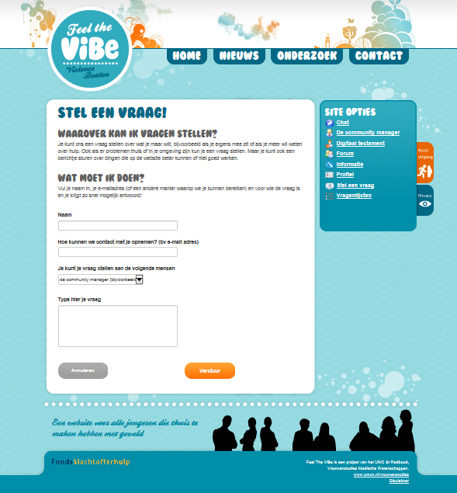
Ask the expert!
Participants could ask questions to the Community Manager and other professionals.

Slide 13

Information for participations on several topics, eg family violence, depression, finding help, relations and sexual and reproductive health

Slide 14
In need of more information?
Go to www.feel-the-vibe.nl and use the contact form
Contact the researcher: karin.vanrosmalen-nooijens@radboudumc.nl

