Slide 1
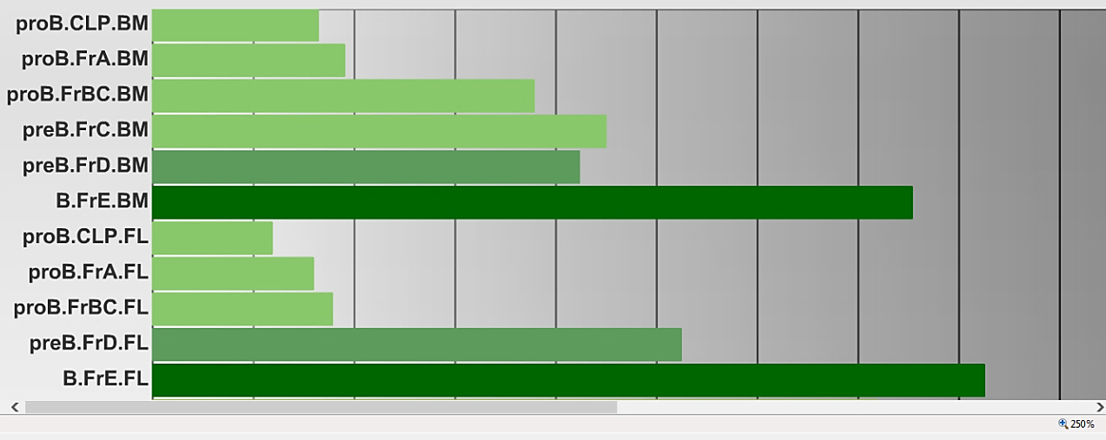
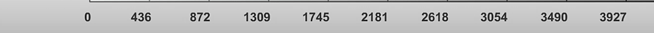
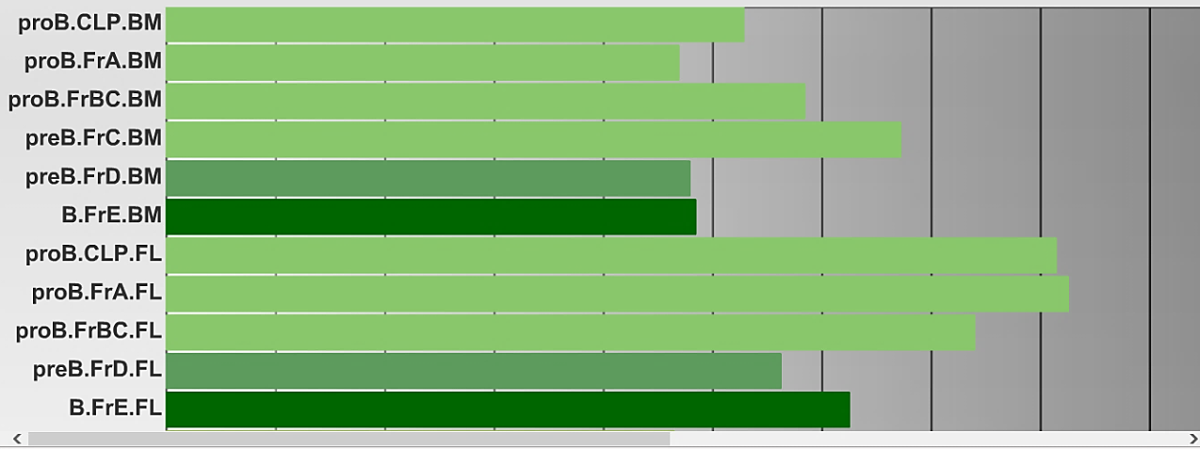
ATP2A3 (SERCA3)
ATP2A2 (SERCA2)
Figure S1. Expression profile of SERCA3 (upper part) and SERCA2 (lower part) mRNA in key early normal B cell populations in the mouse, adapted from the Immunological Genome Project (ImmGen) transcriptomic database at http://www.immgen.org/databrowser/
CLP: common lymphoid progenitor; proB.FrA: pre-pro-B cell; proB.FrBC: pro-B cell; preB: cycling pre-B cell; B.FrE: newly formed B cell; these cell populations represent consecutive stages of early B cell differentiation. Arrow ( ) indicates the direction of differentiation taking place in two hematopoietic niches (bone marrow; BM and fetal liver; FL).

