Slide 1
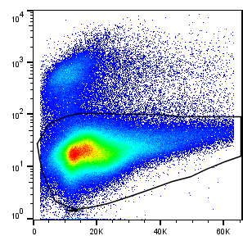
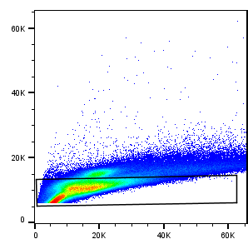
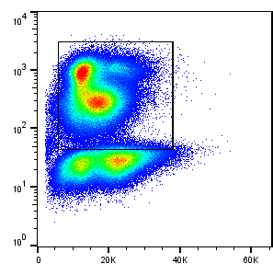
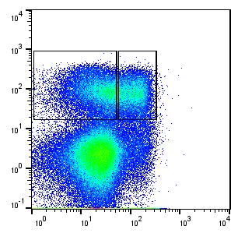
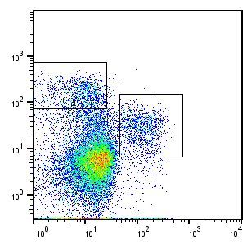
Supplemental figure 3
A
Gating strategy for lamina propria MDSCs
Live
Live/dead
Width
Singlets
CD45
CD11b
FSC
FSC-A
FSC
CD11c
M-MDSC
Ly6C
PMN-MDSC
Ly6G

