Slide 1
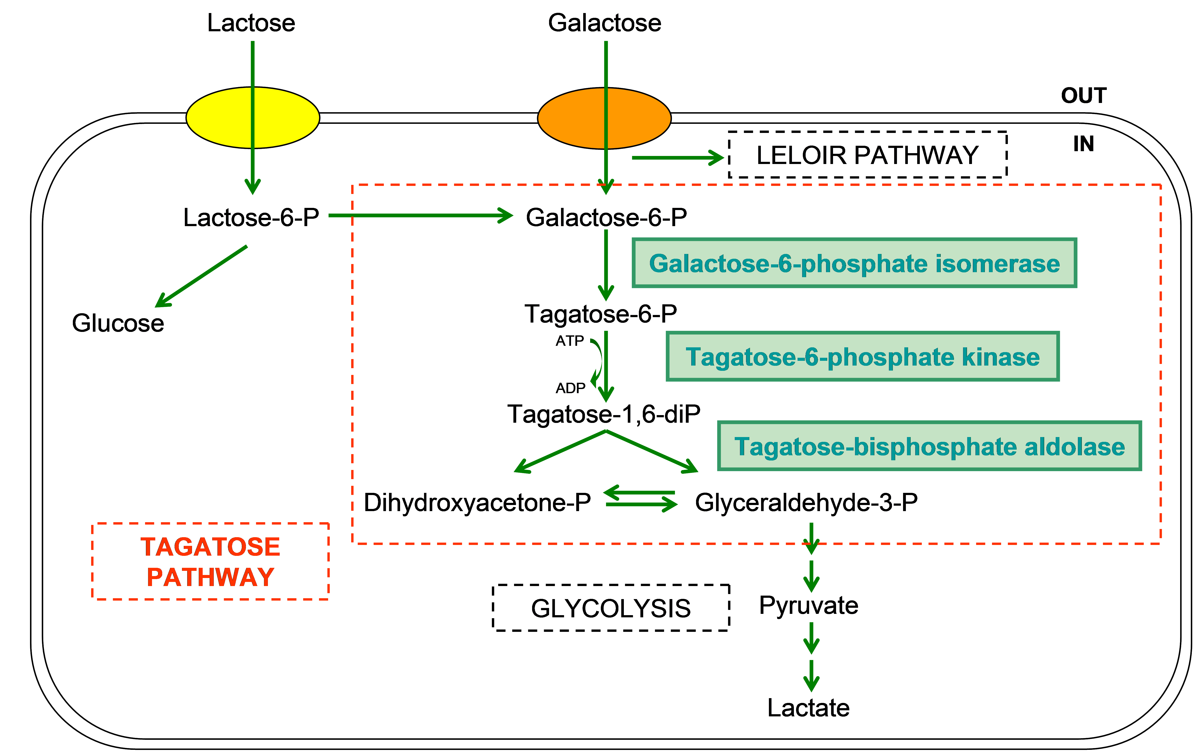
Fig. S1. Schematic representation of galactose metabolism through the tagatose pathway. Enzymes exclusively expressed by L. delb. 23 are highlighted.

