Slide 1
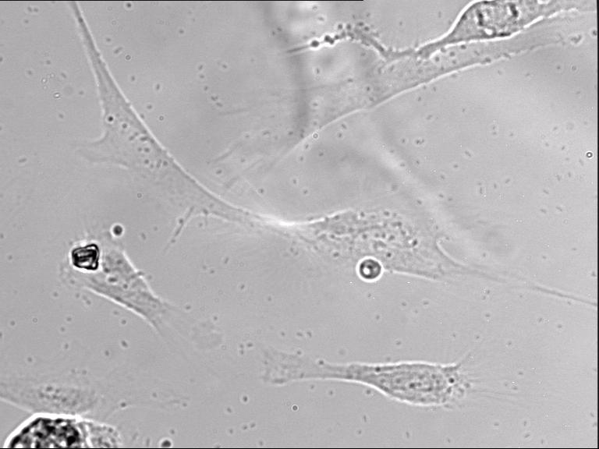
Additional file 10.
Time-lapse video of washing (Na+/Hepes buffer) wildtype A7r5 vascular smooth muscle cells being after vasopressin stimulation, followed by partial relaxation of the cells. Images were captured every 15 seconds and relaxation was monitored for a total of 18 minutes.

