Slide 1
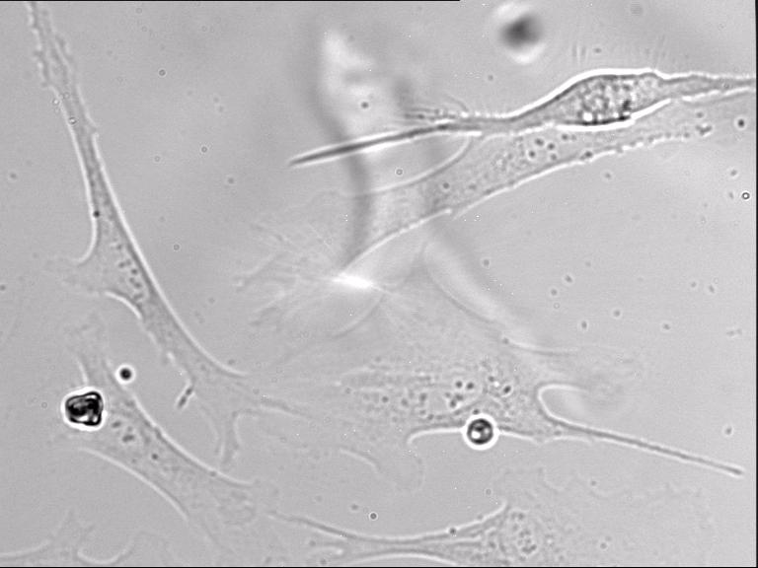
Additional file 9.
Time-lapse video of wildtype A7r5 vascular smooth muscle cell contraction induced with 100 nM vasopressin perfusion. Images were captured every 15 seconds and contraction was monitored for a total of 35 minutes.

