Slide 1
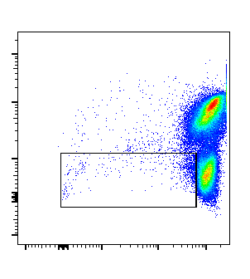
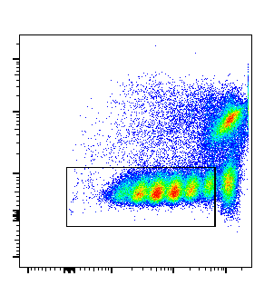
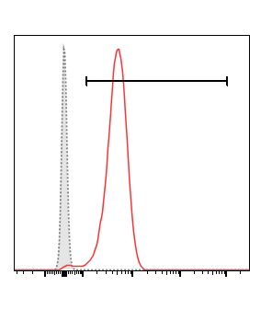
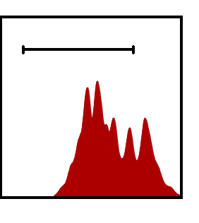
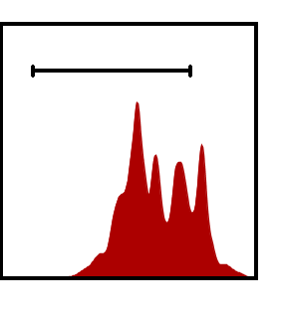
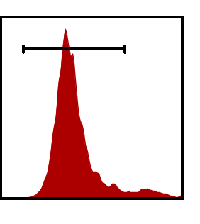
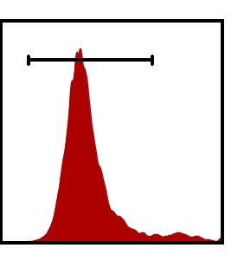
A
Dynabeads
anti-CD3/CD28
Unsti
DCM+CD19+CD14
98.0
1.17
57.2
CFSE
CD3
B
Anti-CD3/CD28
IgM with azide
IgG with azide
IgG azide-free
Anti-CD3/CD28
74.4
78.4
93.7
94.2
Count
CFSE
sFigure 1. A) Dynabeads anti-CD3/CD28 provided specific activating signal to T cells in PBMCs culture system. Total PBMCs pre-stained with CFSE were cultured with Dynabeads anti-CD3/CD28 for five days. Gated on CFSE^{low}DCM⁻CD19⁻CD14⁻ proliferating cells. B) Pre-stained PBMCs were stimulated with anti-CD3/CD28 in presence of different isotypes.

Slide 2
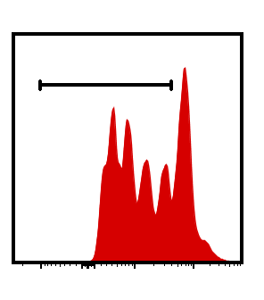
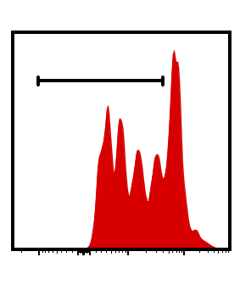
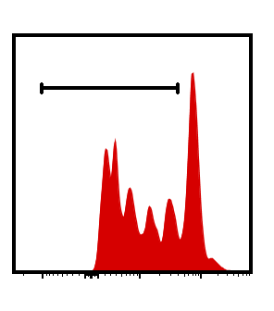
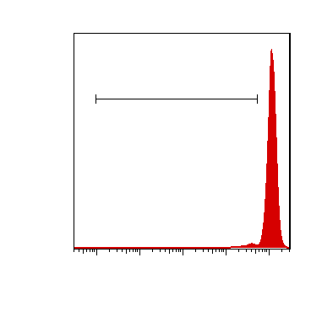

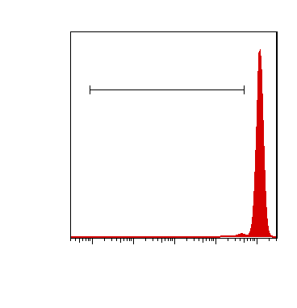
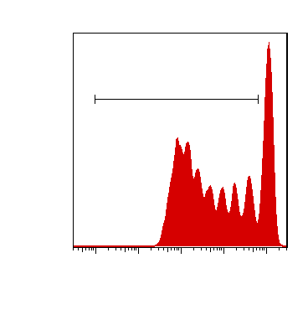
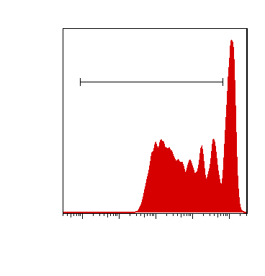
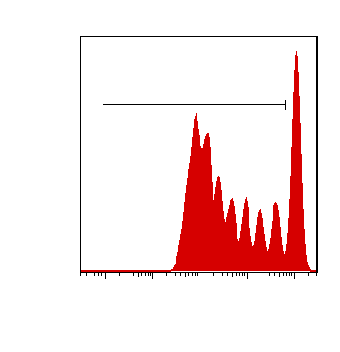
A
Dynabeads anti-CD3/CD28
Bead-bound
anti-CD100
Bead-bound
anti-CD72
Control beads
67.0
63.9
65.3
Cells (Max%)
CFSE
B
CD3
CD4
CD8
4.12
3.49
3.46
Dynabeads
anti-CD3/CD28
+sAnti-CD100
72.9
70.3
76.5
Dynabeads anti-
CD3/CD28/CD100
CFSE
sFigure 2. A) Total PBMCs were stained with CFSE and cultured with Dynabeads anti-CD3/CD28 plus control beads or beads-bound anti-CD100 or anti-CD72. 20µg anti-CD100 or anti-CD72 were used for 100 Million Dynabeads coating according to the optimal protocol from Thermofisher. B) Inhibition ratios of soluble anti-CD100 and bead-bound anti-CD100 were calculated (n=4, ***P<0.001).

Slide 3
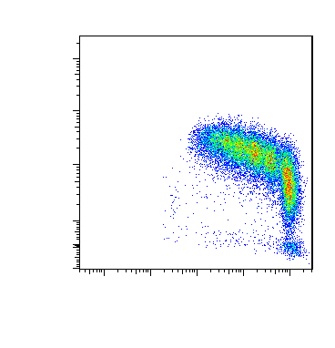
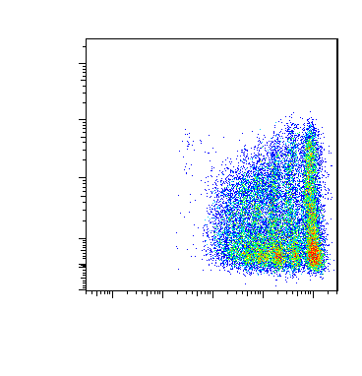
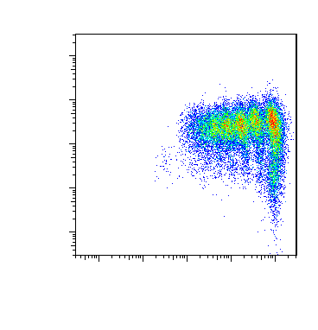
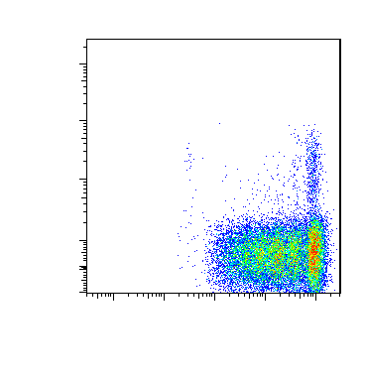
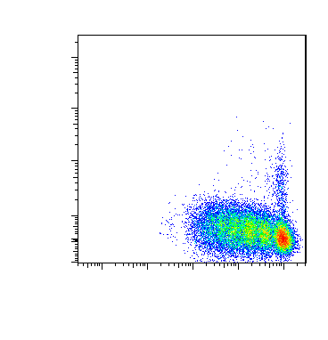
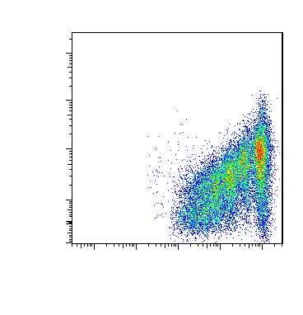
CD100
CD45RA
CCR7
CD57
CD56
CD69
CFSE
sFigure 3. Proliferating T cells exhibited a CD100^{hi}CD45RA^{low}CCR7^{hi}CD57⁻CD56⁻CD69^{low} phenotype. Total PBMCs were pre-stained with CFSE and cultured with Dynabeads anti-CD3/CD28 for five days. Gated on CD3⁺CD45⁺DCM⁻CD19⁻CD14⁻ cells. CFSE^{Low} population indicates the proliferating T cells.
Notes:
CD69

Slide 4
sFigure 4. The transcriptional expression level of PLXNB1, PLXNB2 and CD72 in CD100⁺ activating T cells. CD3⁺CD4⁺CD100⁺ or CD3⁺CD8⁺CD100⁺ T cells were purified by FACS sorting. BaseMean: Average value of reads per kilobases per millionreads from all samples (n=12).

Slide 5
A
B
sFigure 5. A) Intracellular IL-2 and interferon gamma (IFNg) were detected 24 hours after indicated treatments (n=4). B) CFSE ⁺ PBMCs were pre-activated by anti-CD3/CD28 coated beads for 24 hours, and beads were removed afterwards. Soluble anti-CD100 133-1C6 was added and CFSE on PBMCs was detected 4 days later. Inhibition ratios were calculated (n=4, ****P<0.0001).

