Slide 1
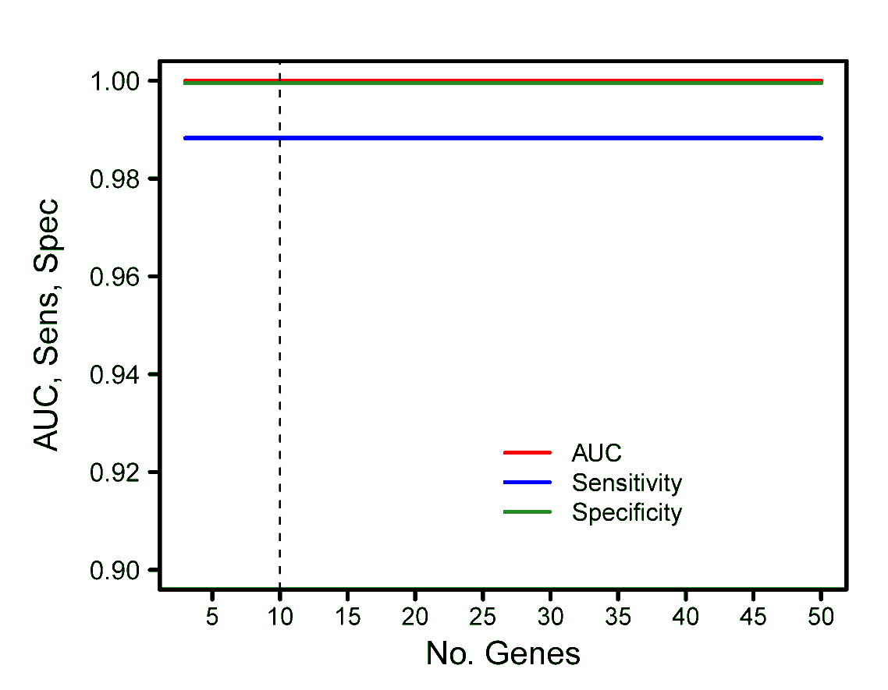
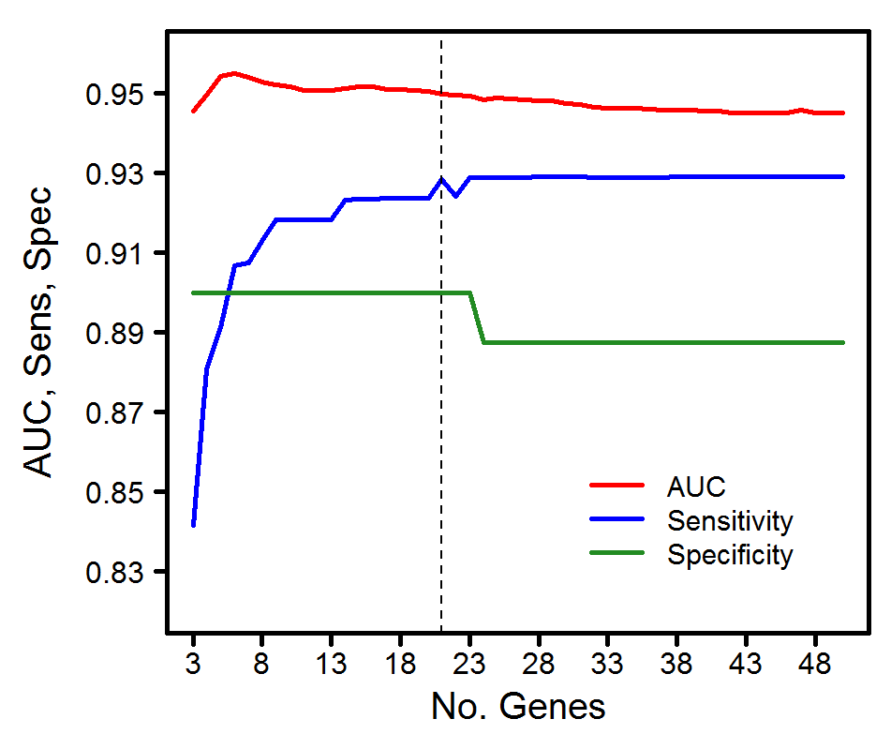
A
B
Supplementary Figure 1. Optimization of (A) ADC-SCC and (B) Tumor-Nonmalignant signature gene sizes. Five-fold stratified cross-validation with 100 iterations were performed on gene sizes ranging from n= 3, 4, … , 50 (where n is the number of genes selected for each class in a Volcano plot as described in Methods). For each n and each iteration we compute the mean AUC, sensitivity, and specificity related to the scoring values, and then compute the median across all 100 iterations. The optimal n is shown as a vertical dash line. In (B), no optimal number were found and n=10 was selected for convenience and sufficient redundancy.

Slide 2
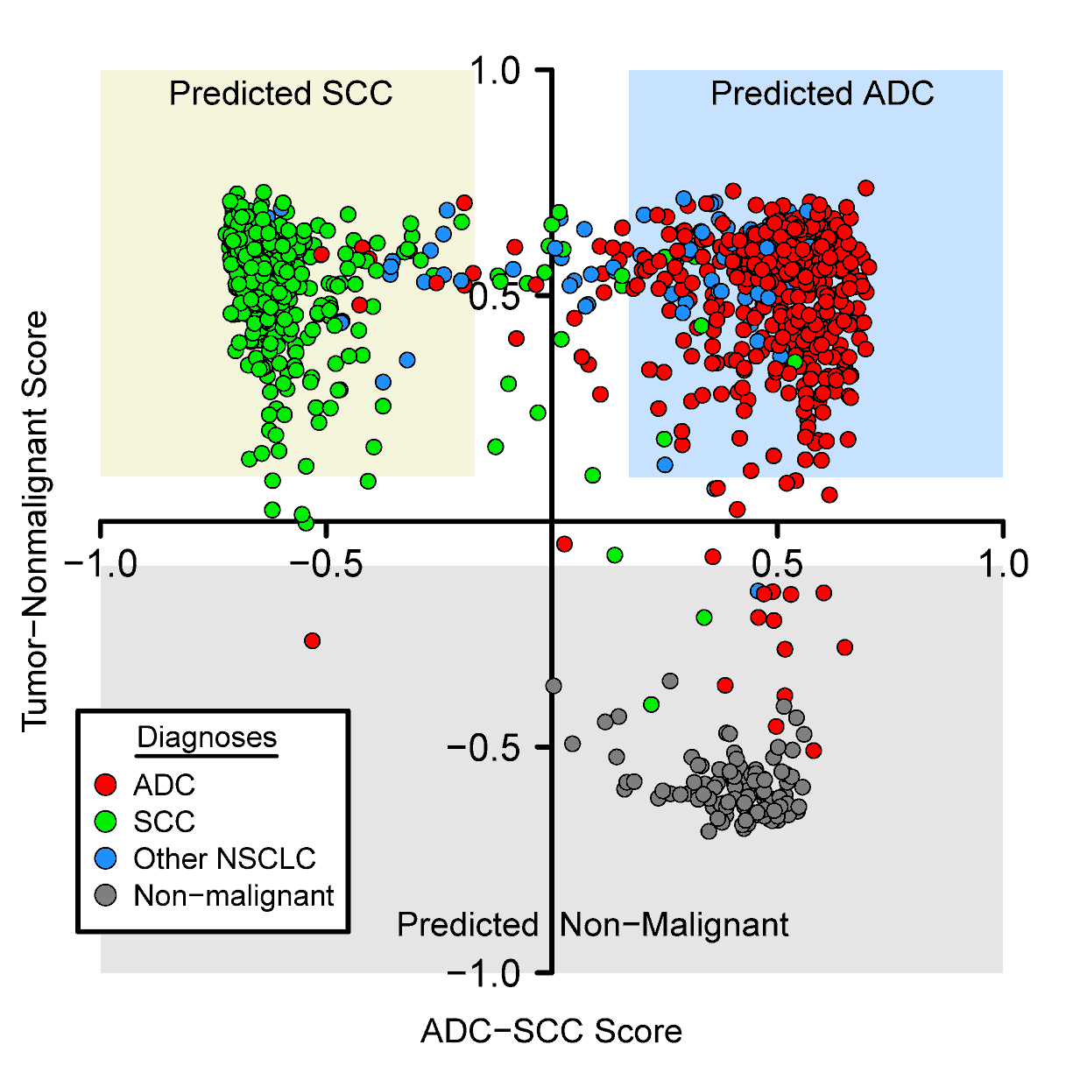
Supplementary Figure 2. Both signatures are combined into a double scoring system for ADC, SCC, and non-malignant lung. These clearly separate all three groups in the TCGA test set. Light yellow predicts for SCC, light blue predicts for ADC, light grey predicts for non-malignant (or high stromal infiltration). White areas are the regions with scores below their respective cutoffs (+/- 0.17 for ADC-SCC, +/- 0.10 for Tumor-Nonmalignant).

Slide 3
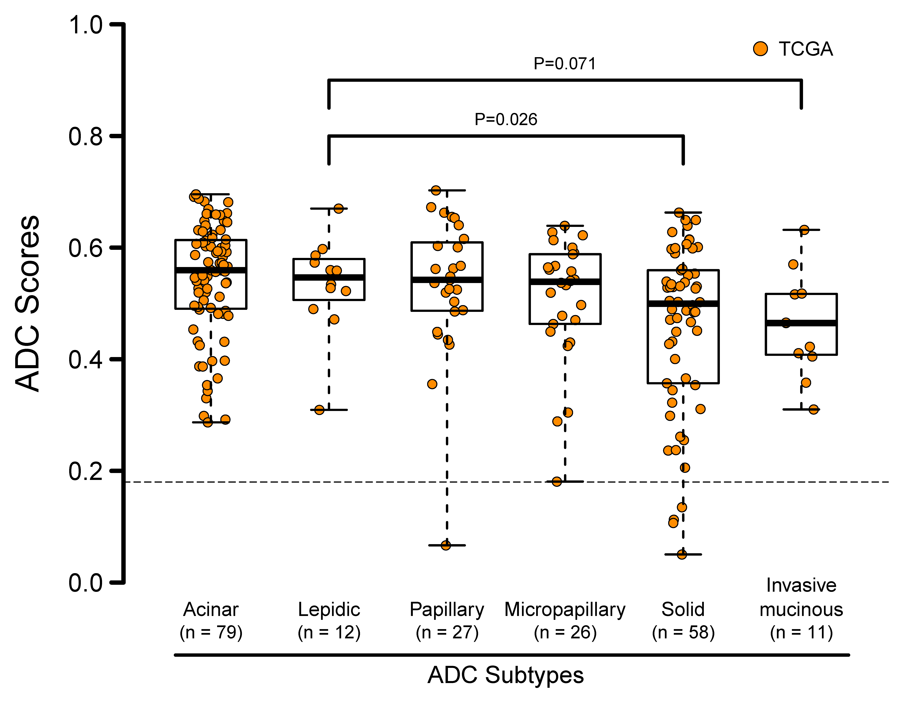
A
Supplementary Figure 3. Box plots of ADC (A, B) and SCC (C) scores for different tumor categories. (A) Some ADC subtypes in the TCGA set have significantly different scores that may correlate with their degree of differentiation. (B) and (C) Tumors with mutations or amplifications specific for ADC (B) or SCC (C) tend to have higher scores than tumors wild-type for these changes. Other genes analyzed but showing no significant score differences were PIK3CA, ROS1, and RET for ADC and PTEN, FGFR1, and PDGFRA for SCC. Misclassified tumors are excluded from these plots. Significant T test P values are shown. ADC and SCC scores are defined here by their absolute score values.

Slide 4
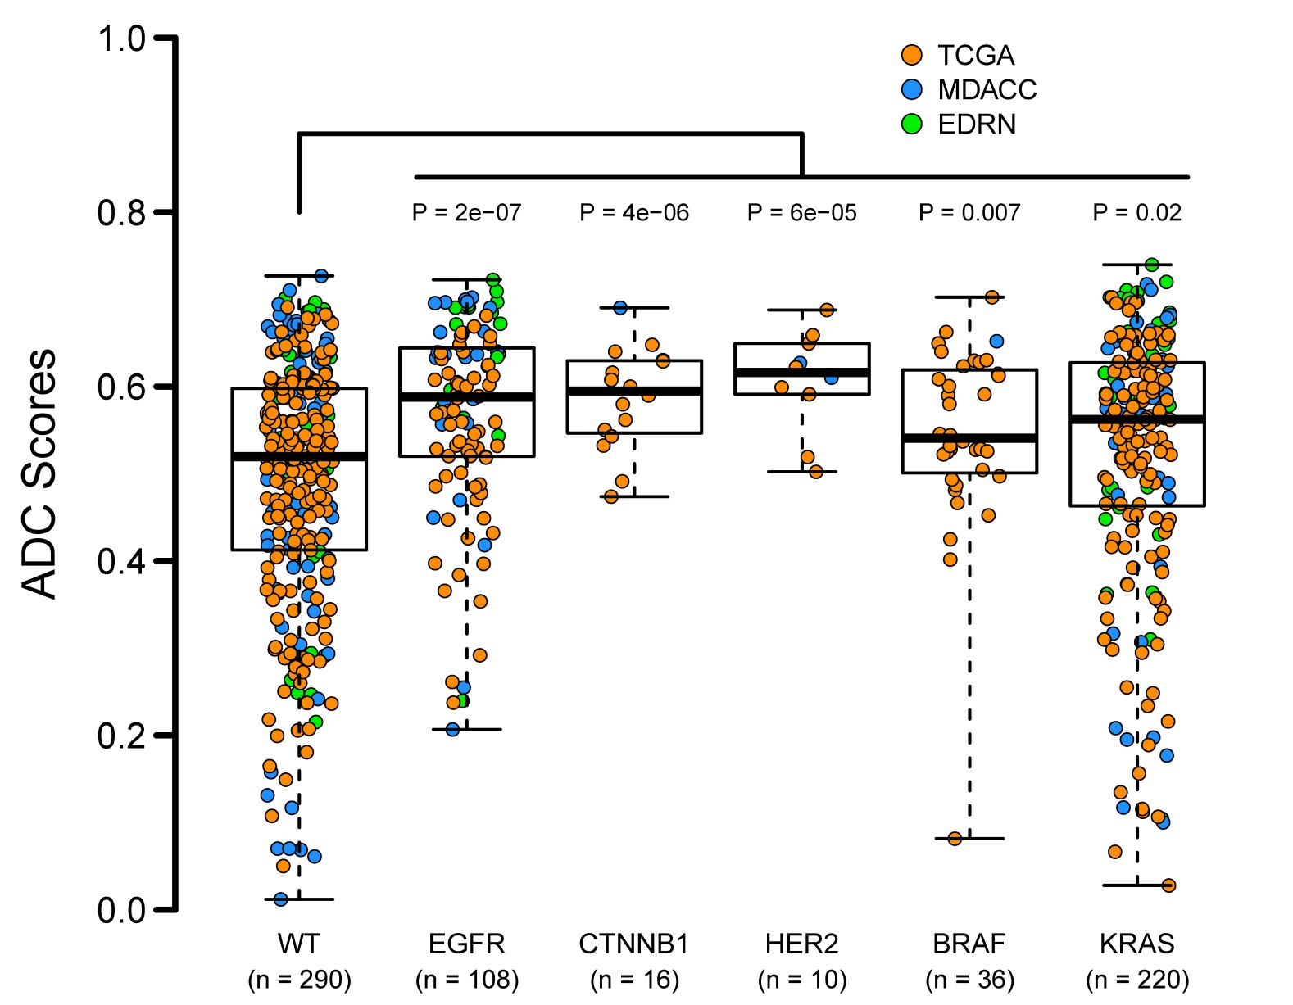
B
Supplementary Figure 3. Box plots of ADC (A, B) and SCC (C) scores for different tumor categories. (A) Some ADC subtypes in the TCGA set have significantly different scores that may correlate with their degree of differentiation. (B) and (C) Tumors with mutations or amplifications specific for ADC (B) or SCC (C) tend to have higher scores than tumors wild-type for these changes. Other genes analyzed but showing no significant score differences were PIK3CA, ROS1, and RET for ADC and PTEN, FGFR1, and PDGFRA for SCC. Misclassified tumors are excluded from these plots. Significant T test P values are shown. ADC and SCC scores are defined here by their absolute score values.

Slide 5
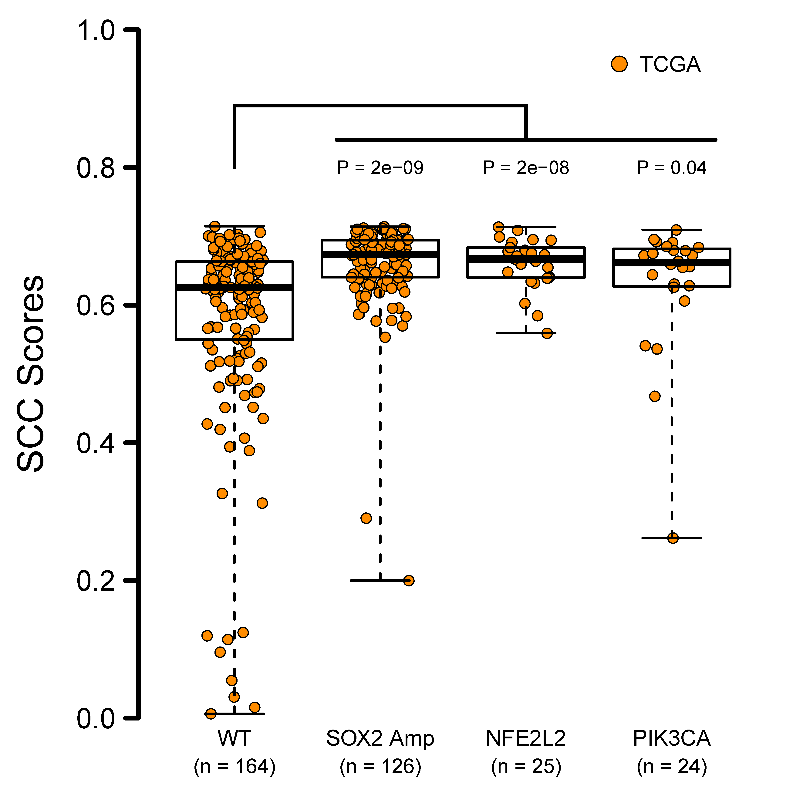
C
Supplementary Figure 3. Box plots of ADC (A, B) and SCC (C) scores for different tumor categories. (A) Some ADC subtypes in the TCGA set have significantly different scores that may correlate with their degree of differentiation. (B) and (C) Tumors with mutations or amplifications specific for ADC (B) or SCC (C) tend to have higher scores than tumors wild-type for these changes. Other genes analyzed but showing no significant score differences were PIK3CA, ROS1, and RET for ADC and PTEN, FGFR1, and PDGFRA for SCC. Misclassified tumors are excluded from these plots. Significant T test P values are shown. ADC and SCC scores are defined here by their absolute score values.

Slide 6
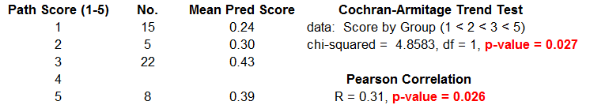
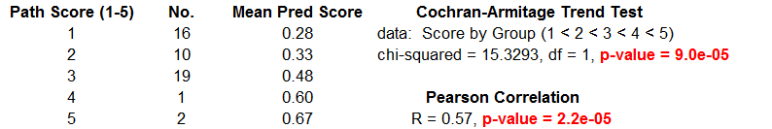
Comparison
A
ADC
B
SCC
Supplementary Figure 4. Significant association between ADC (A) and SCC (B) scores and the degree of differentiation. One hundred pathology slides (50 each for ADC and SCC) were reviewed and graded, and converted into “Path Scores” from 1 (poorly differentiated) to 5 (well differentiated). The number of slides for each path score is indicated as well as the mean ADC or SCC prediction scores. Both the trend test and Pearson correlation test indicate strong association between ADC-SCC score and tumor diffentiation.

Slide 7
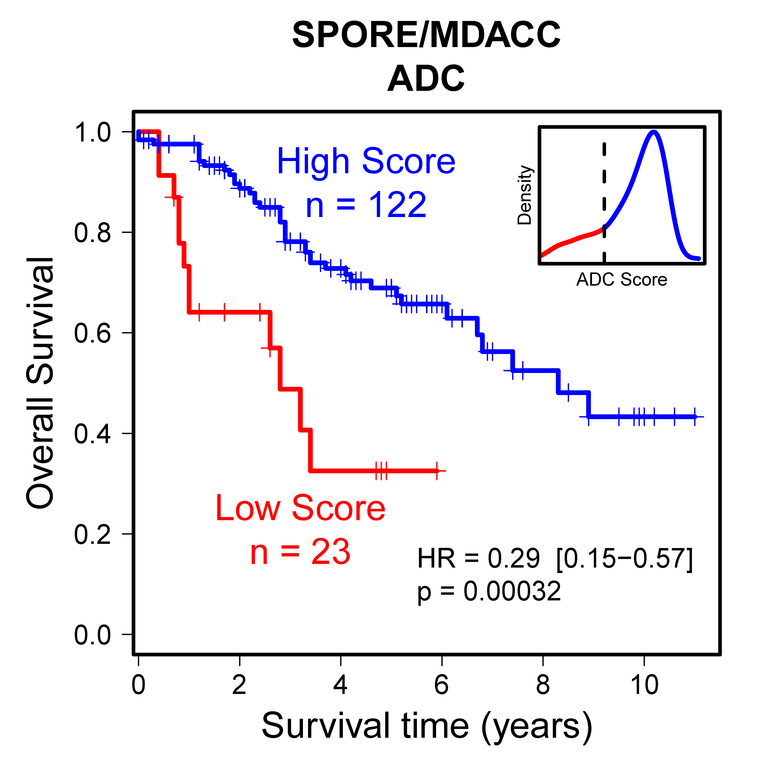
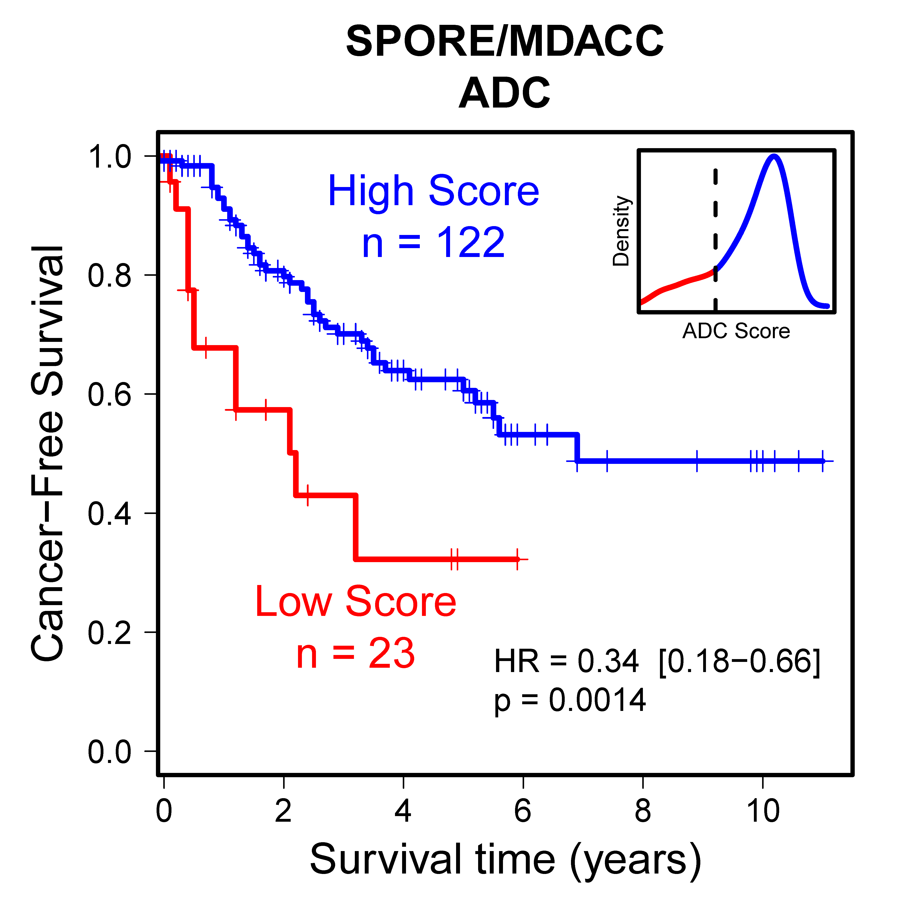
A
Supplementary Figure 5. Significant association of ADC-SCC scores with patient survival were observed in several cohorts (A, C, D), with the exception of the SCC subgroup of the MDACC set (B). These analyses were done separately for ADC and SCC. The score cutoffs between high and low values were determined with distribution plots, shown as insets. Both overall (left panels) and cancer-free survival (right panels) were analyzed, when this information was available.

Slide 8
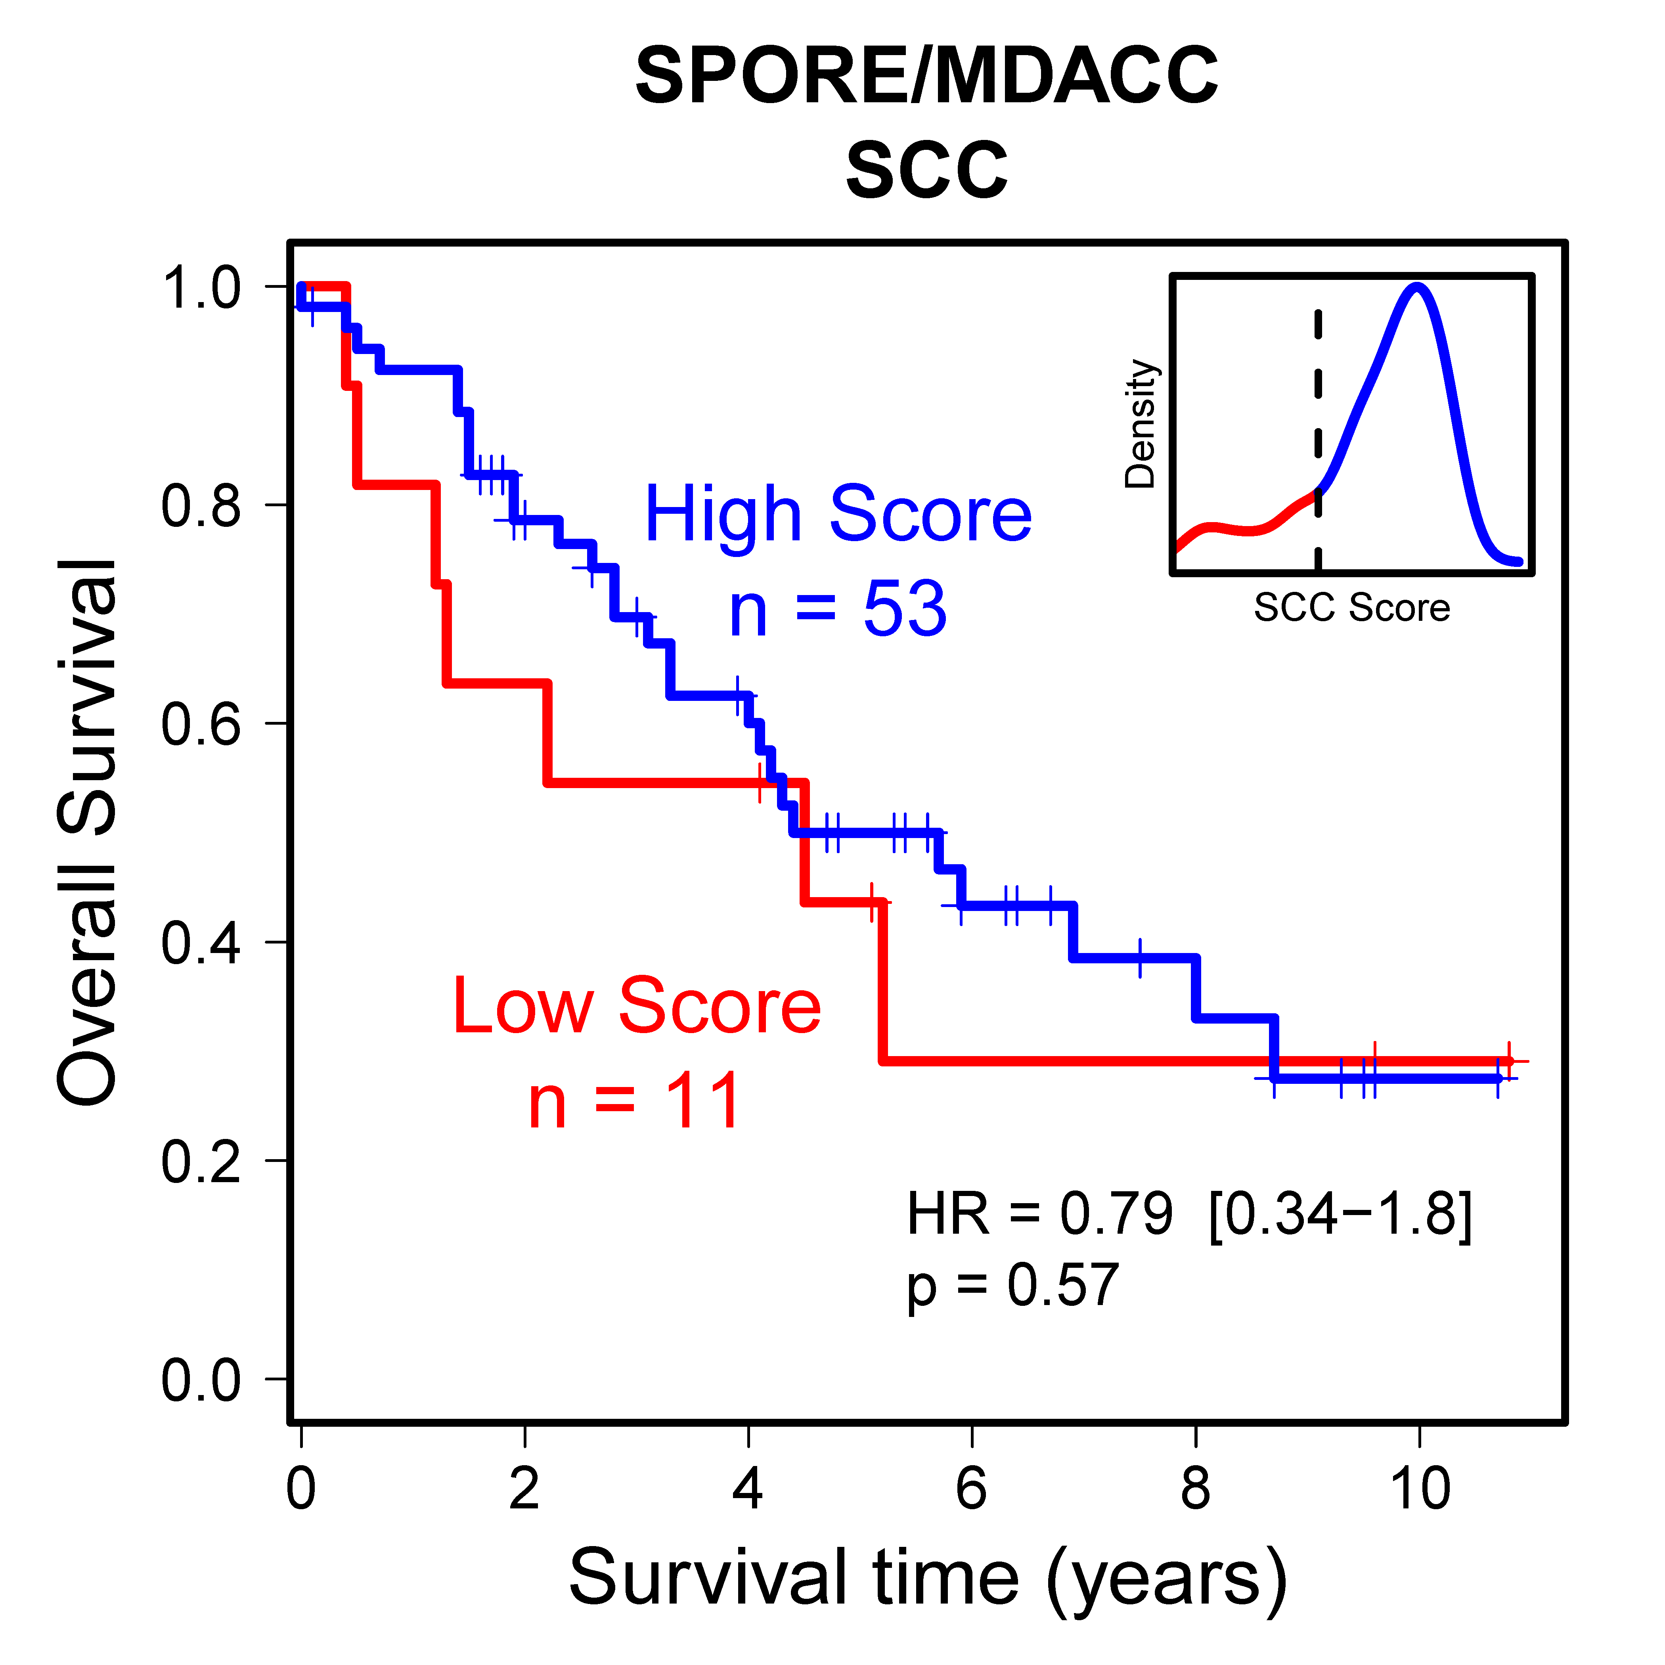
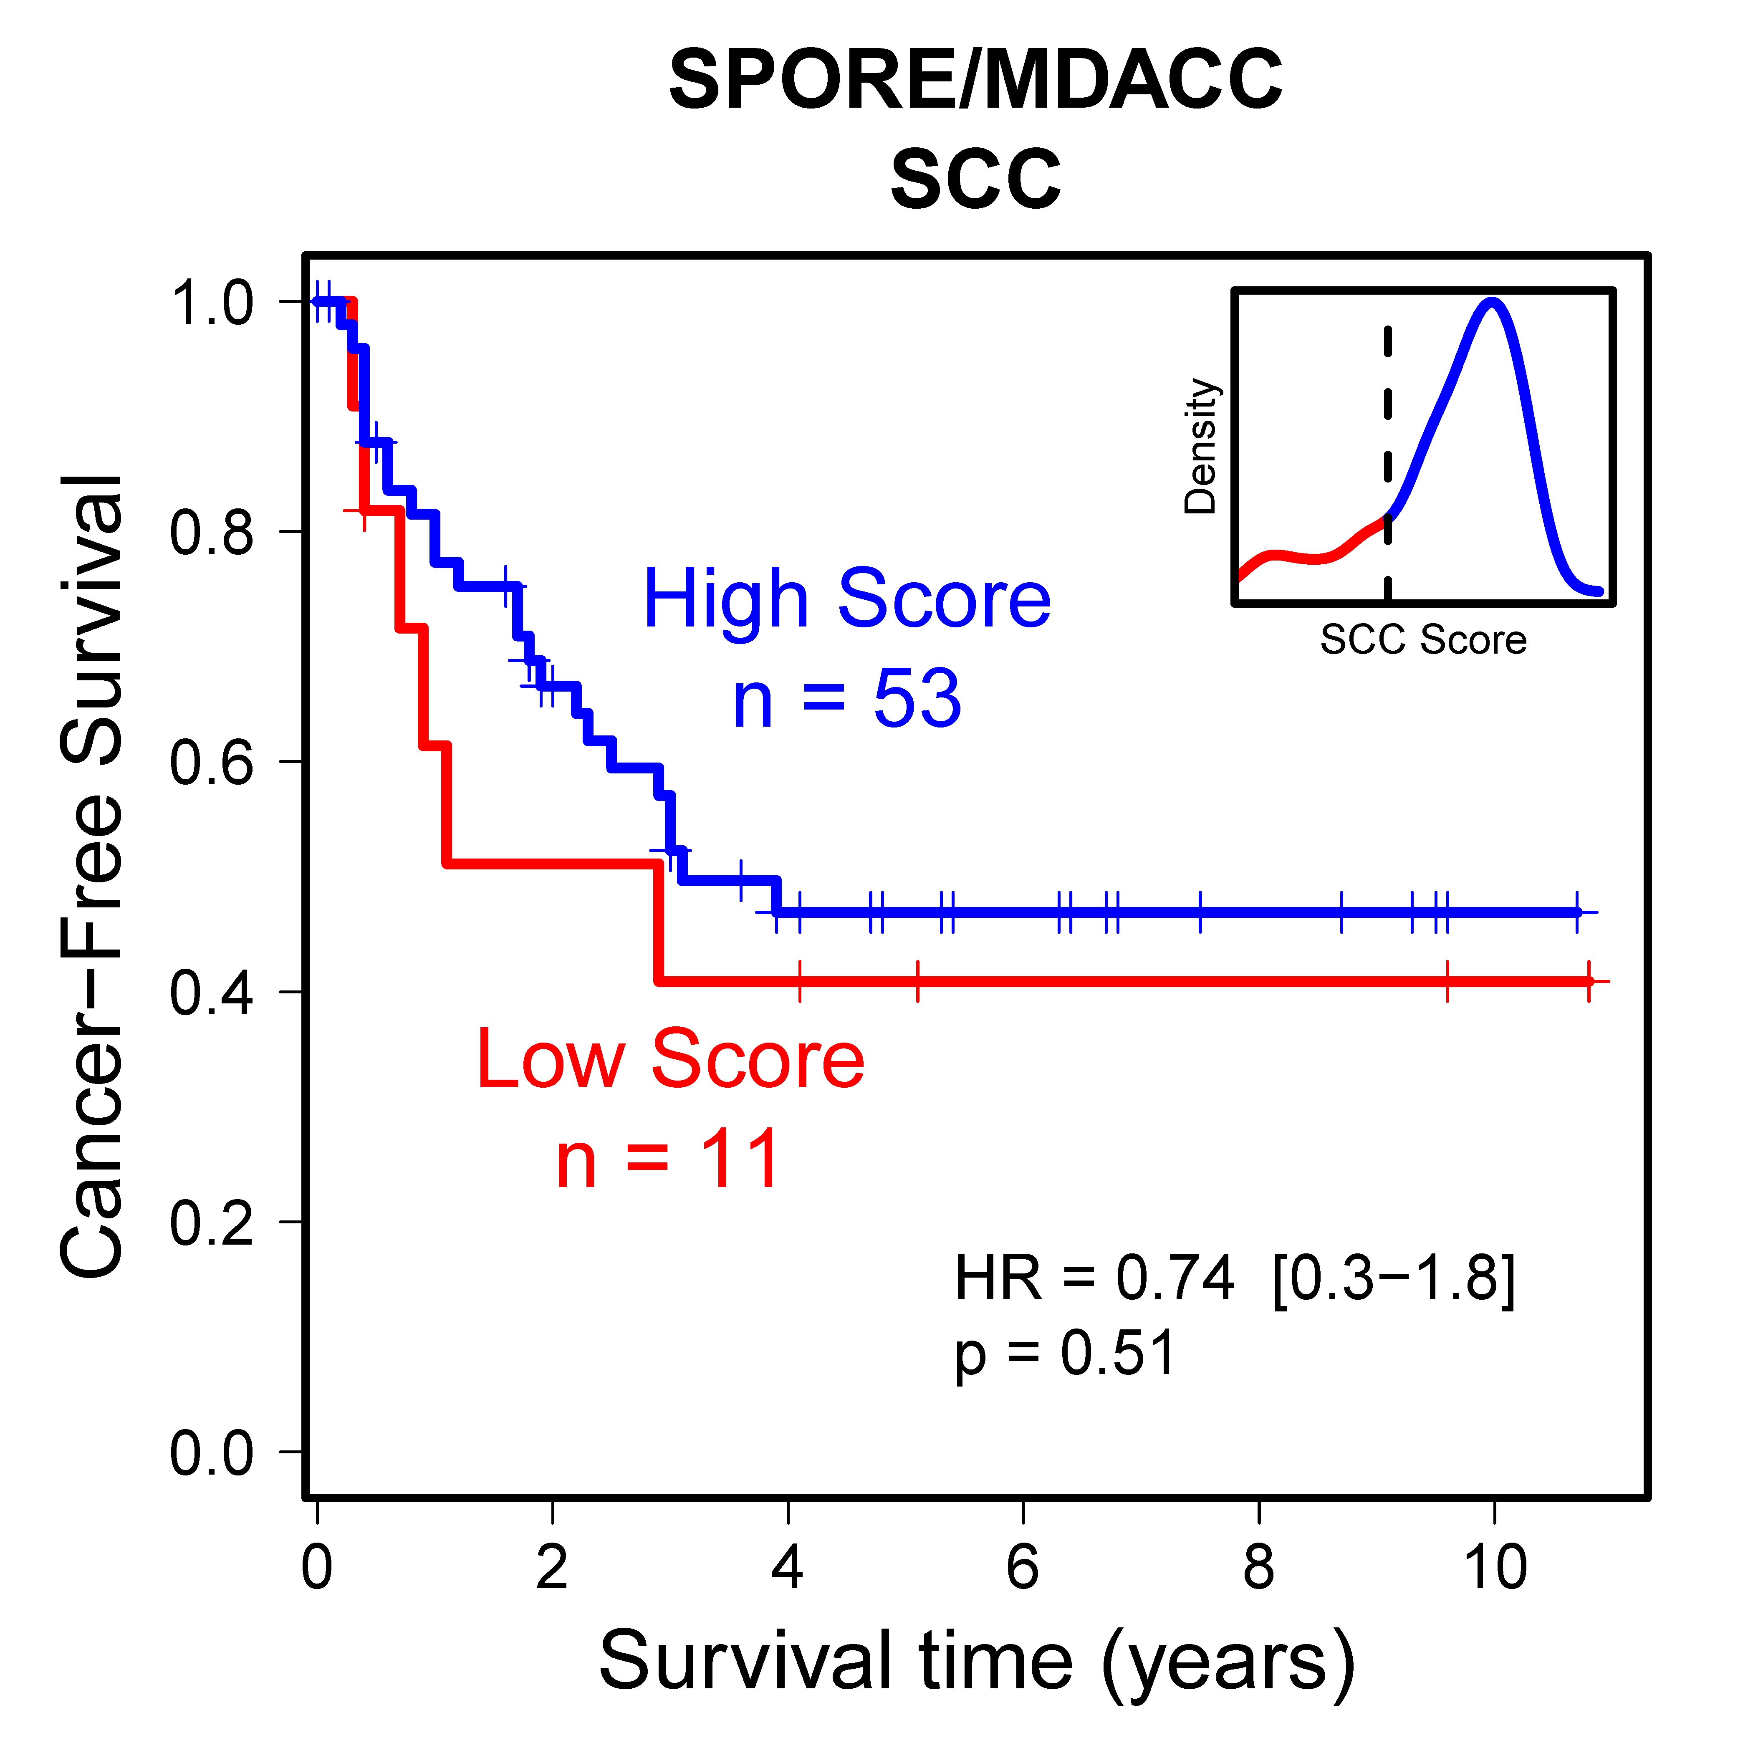
B
Supplementary Figure 5. Significant association of ADC-SCC scores with patient survival were observed in several cohorts (A, C, D), with the exception of the SCC subgroup of the MDACC set (B). These analyses were done separately for ADC and SCC. The score cutoffs between high and low values were determined with distribution plots, shown as insets. Both overall (left panels) and cancer-free survival (right panels) were analyzed, when this information was available.

Slide 9
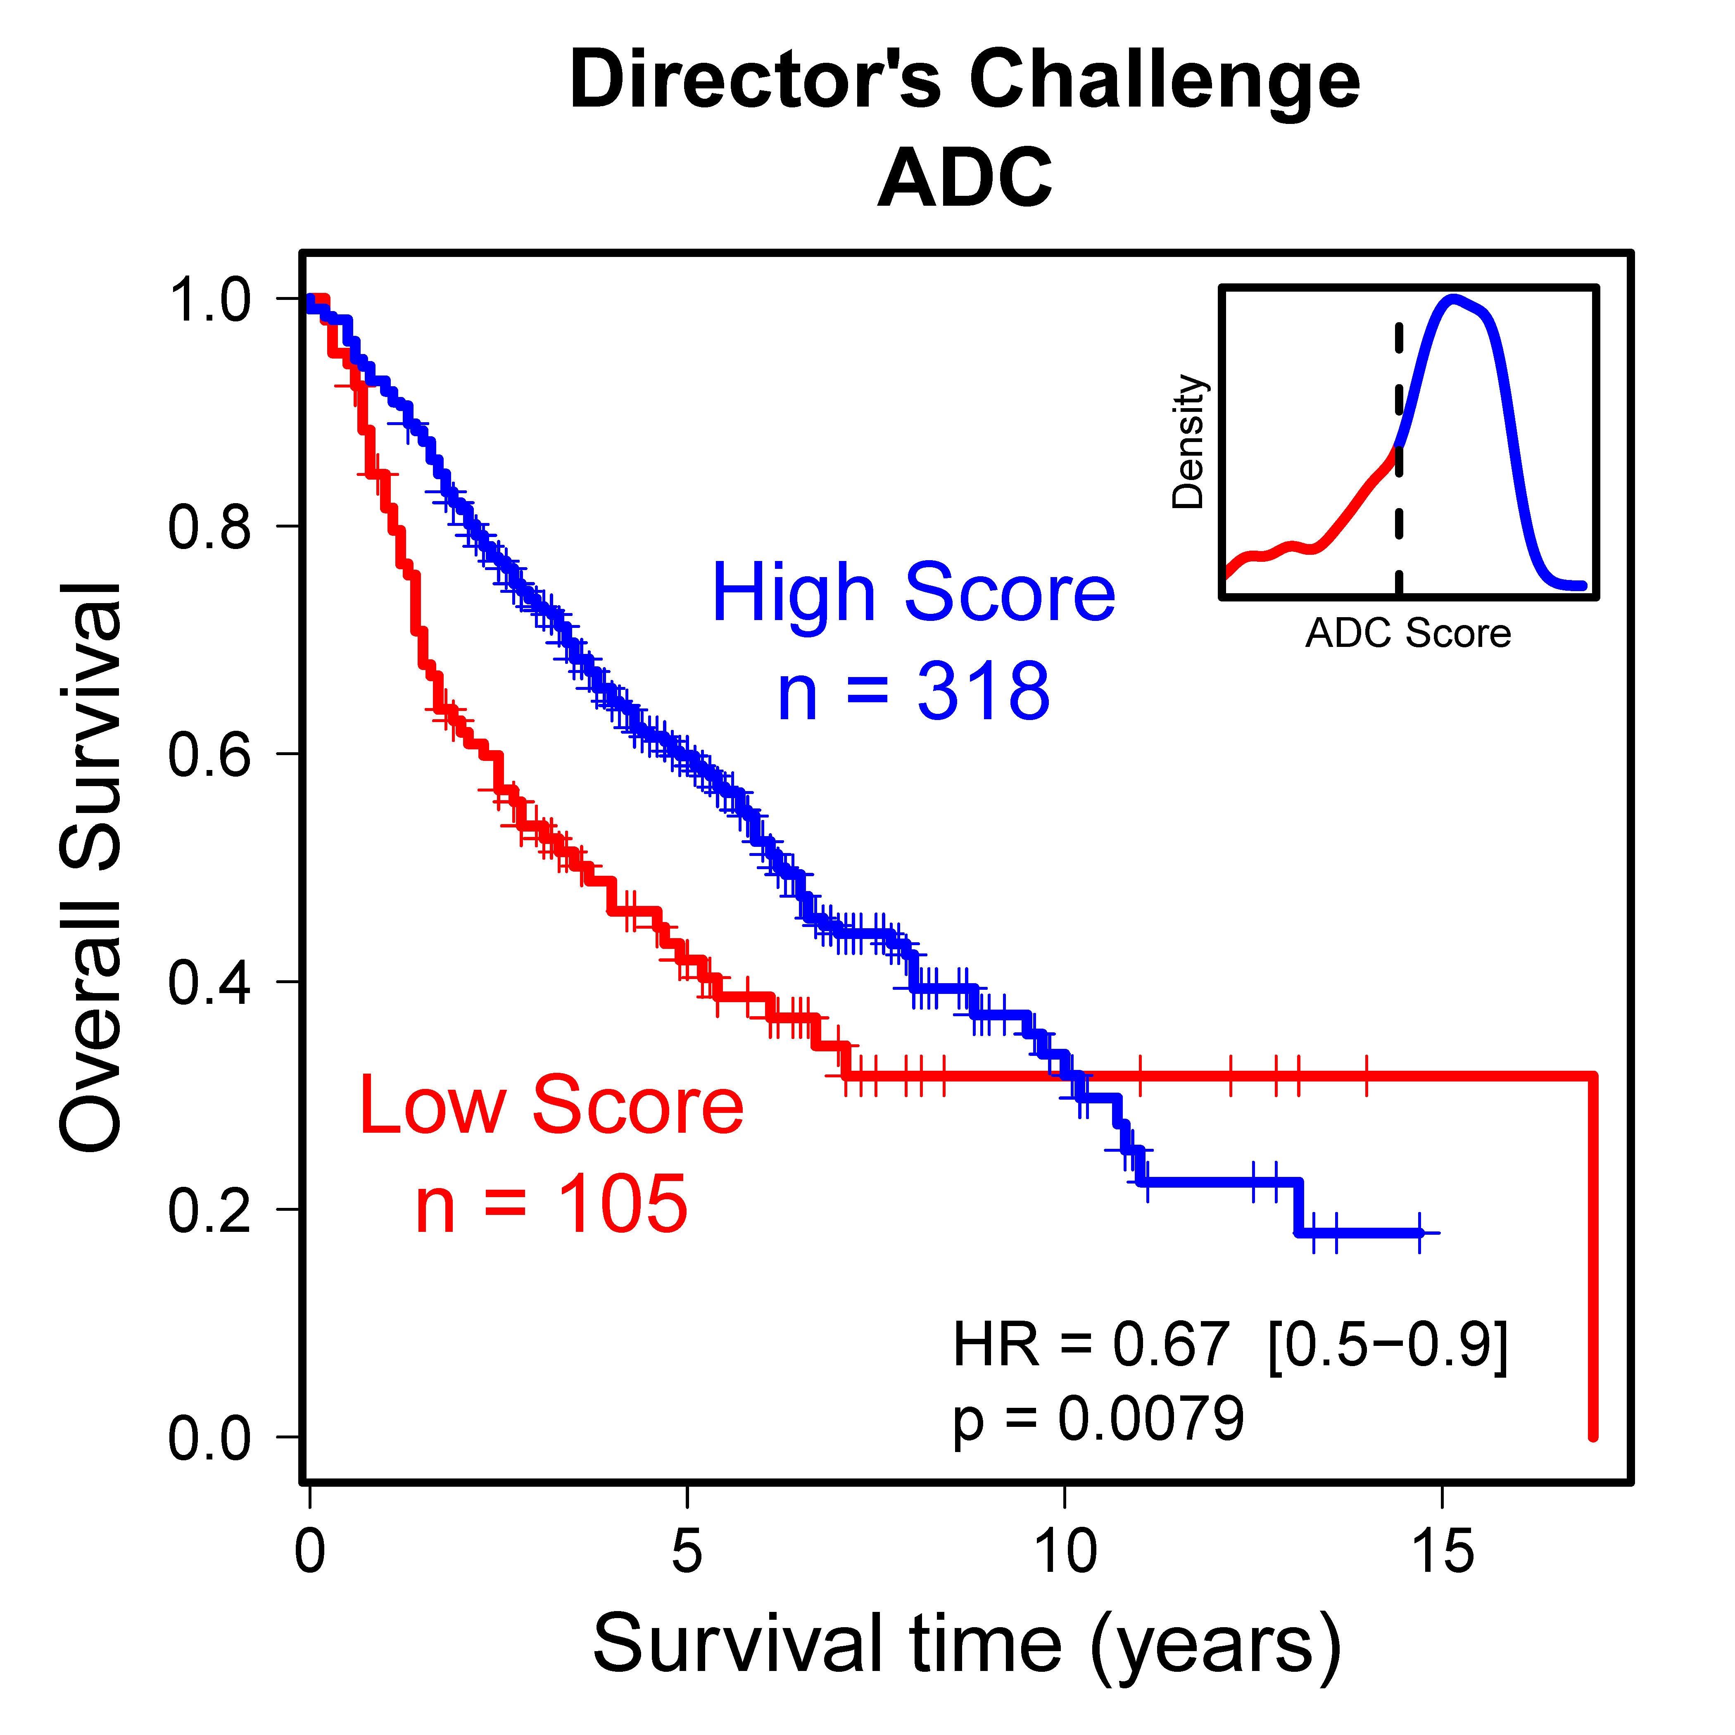
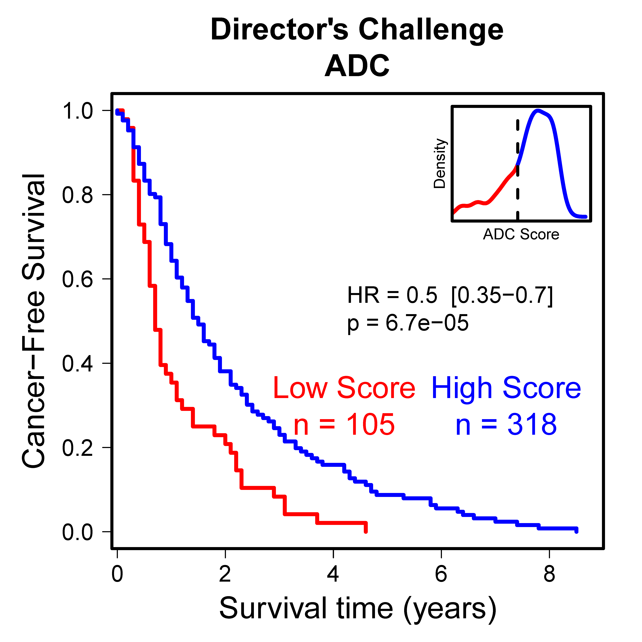
C
Supplementary Figure 5. Significant association of ADC-SCC scores with patient survival were observed in several cohorts (A, C, D), with the exception of the SCC subgroup of the MDACC set (B). These analyses were done separately for ADC and SCC. The score cutoffs between high and low values were determined with distribution plots, shown as insets. Both overall (left panels) and cancer-free survival (right panels) were analyzed, when this information was available.

Slide 10
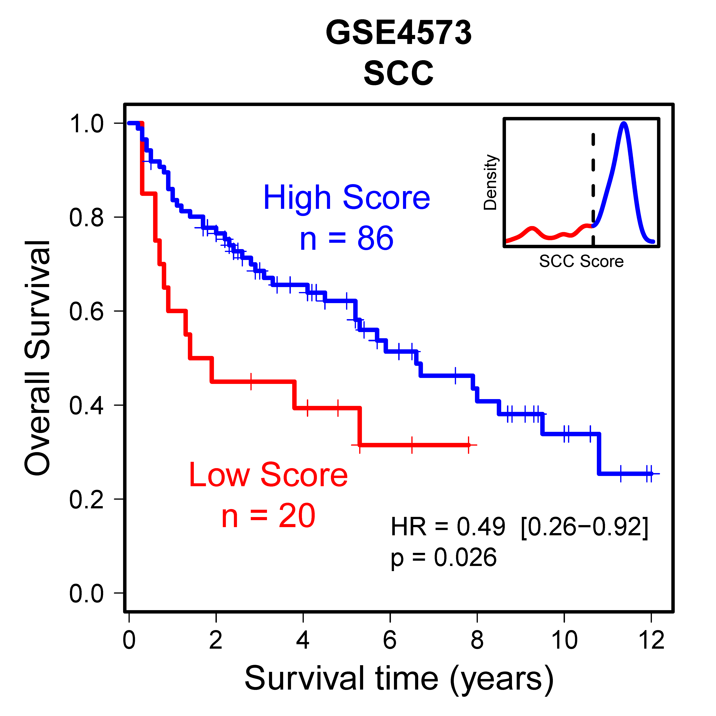
D
Supplementary Figure 5. Significant association of ADC-SCC scores with patient survival were observed in several cohorts (A, C, D), with the exception of the SCC subgroup of the MDACC set (B). These analyses were done separately for ADC and SCC. The score cutoffs between high and low values were determined with distribution plots, shown as insets. Both overall (left panels) and cancer-free survival (right panels) were analyzed, when this information was available.

Slide 11
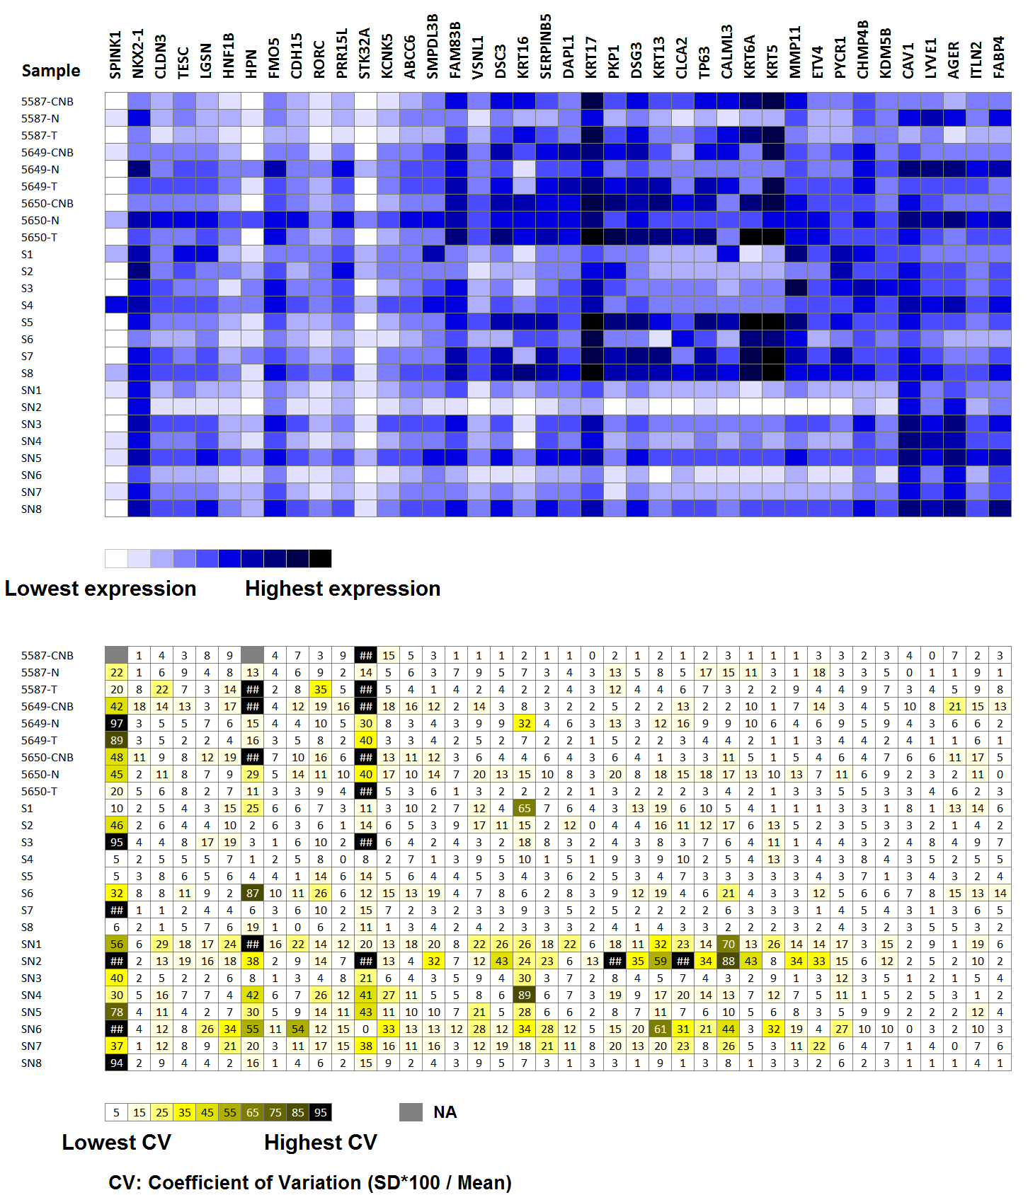
A
B
Supplementary Figure 6. HTG EdgeSeq assay on 25 samples run in triplicate. (A) Median expression levels show a high dynamic range for different genes or different samples. (B) Coefficients of variation (standard deviation * 100 divided by the mean) show good reproducibility of the assay, especially for high expression values. The 25 samples shown here are the same as the first 25 samples shown in Supplementary Table 3.

