Slide 1
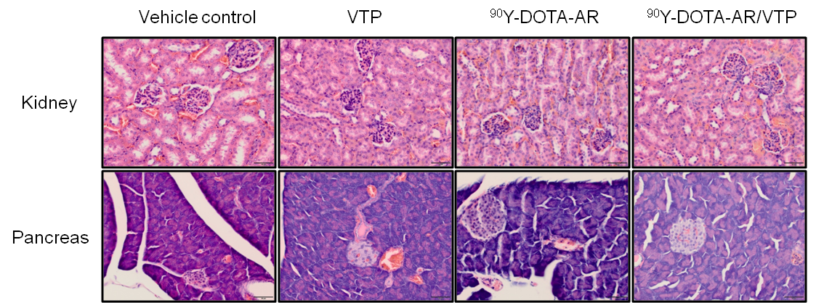
Supplemental Figure S1.

