Slide 1
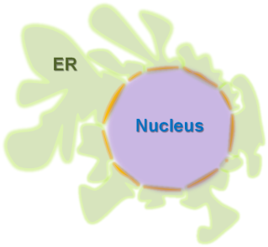
erv14 Induced
Responses
UPR
ERAD
Apoptosis
Nucleophagy
erv14 Inhibited
Processes
Chromatin anchoring
(speculative)
Sphingolipid
Synthesis
Protein folding and transport
Figure S2. ER stress induced and inhibited pathways
Illustration of pathways influenced by erv14 and explanatory text.
Explanatory text in separate Word document

