Slide 1
A.

Slide 2
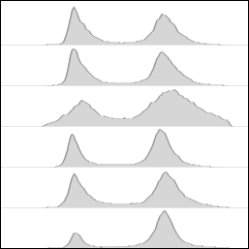
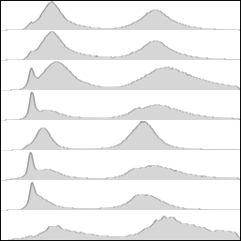
B.
Genotype | % |  |  | Dbl. Time norm. rad9 | Unstab. Chr. Fold suppr. of rad9
 | 1n | s | 2n
rad9 | 44.5 | 8.3 | 47.2 | 1 | 1
rad9 erv14 ERV14X2 | 44.2 | 11.8 | 52.9 | 1.01 | 1.40
rad9 yme1 | 37.5 | 9.6 | 52.9 | 1.17 | 1.66
rad9 isc1 | 31.8 | 9.7 | 58.5 | 1.06 | 1.74
rad9 scj1 | 31.4 | 10.5 | 58.1 | 1.02 | 2.00
rad9 erv14 | 22.0 | 11.2 | 66.7 | 1.40 | 8.10
%cells
1n
s
2n
C.
Nuclear Profiles
Genotype | % single | %small budded | %large budded mono-nucleated | %large budded bi-nucleated
rad9 | 61 | 15 | 10 | 15
rad9 erv14 ERV14X2 | 59 | 13 | 12 | 17
rad9 yme1 | 64 | 13 | 9 | 15
rad9 isc1 | 47 | 12 | 32 | 13
rad9 scj1 | 48 | 13 | 27 | 13
rad9 erv14 | 30 | 10 | 38 | 28
Figure S3. Scatter plots of doubling time vs. genome stabilization.
(A) Scatter plot correlation of doubling time vs. genome stabilization of rad9Δ, ERV14 complementation
of rad9Δ erv14, and rad9Δ-slow-cell-cycle mutations with corresponding data table.
(B) Corresponding DNA content FACS analysis.
(C) Cell morphology/Nuclear Profile analysis.

