Slide 1
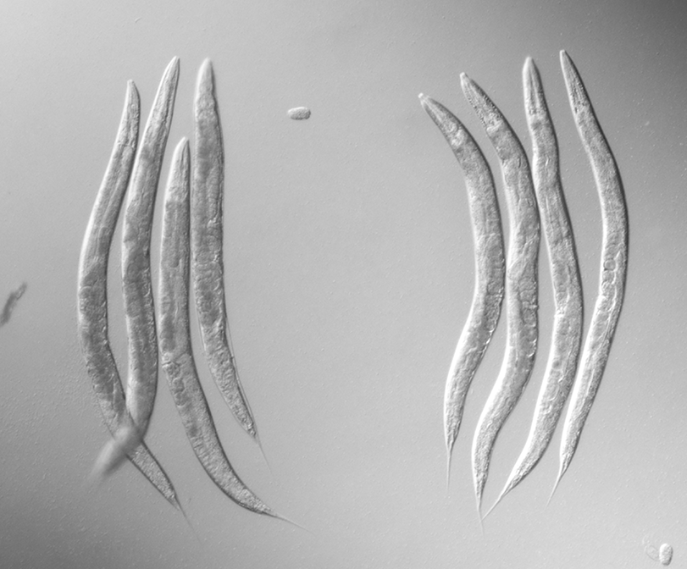
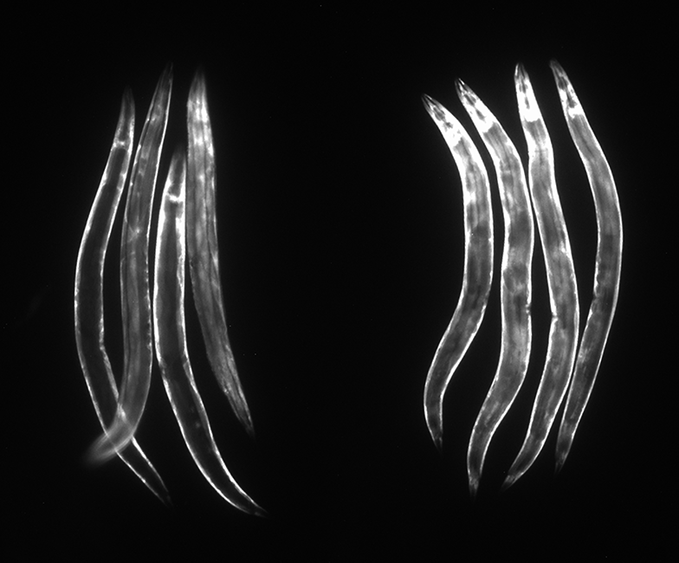
Figure S1
alh-6(k1018); gst-4::gfp
Control
Acrylamide
Control
Acrylamide
Notes:
Figure S1: alh-6 mutants respond normally to external toxins. The alh-6(k1018) mutants result in constitutive gst-4::gfp expression, with strong signals in muscle tissues. The GST-4::GFP signal is increased, especially in pharyngeal (arrows) and intestinal cells, after exposure to acrylamide for ~24 hours.

