Slide 1
Supplementary Materials
Figure S1. Unsupervised clustering, PCA, and volcano analysis of total proteins in AML.
Figure S2. Profile of protein-phosphotyrosine (pY) in AML. A. Unsupervised clustering of protein-phosphotyrosine pY peptides in AML. B. Enriched phosphotyrosine sequences from total pY profiling, was produced by using the sequence logo generator, WebLogo (www.weblogo.berkeley.edu).
Figure S3. Correlation of total pY peptides (pY-ome) with pY of tyrosine kinase A-loop (kinome) and PTP levels (PTP-ome) in AML.
Figure S4. Sequence frequency logos for AML pY proteome analysis. Sequence frequency analysis was shown for the clusters with more than five, but less than 10 phosphor-tyrosine peptides, as described in Fig. 4E.
Figure S5. Discordant correlations between PTPN1 and PTPN2 with the pY-ome.
Figure S6. MS spectra of some phosphotyrosine peptides. All MS information of pY sites was shown in Table S4.

Slide 2
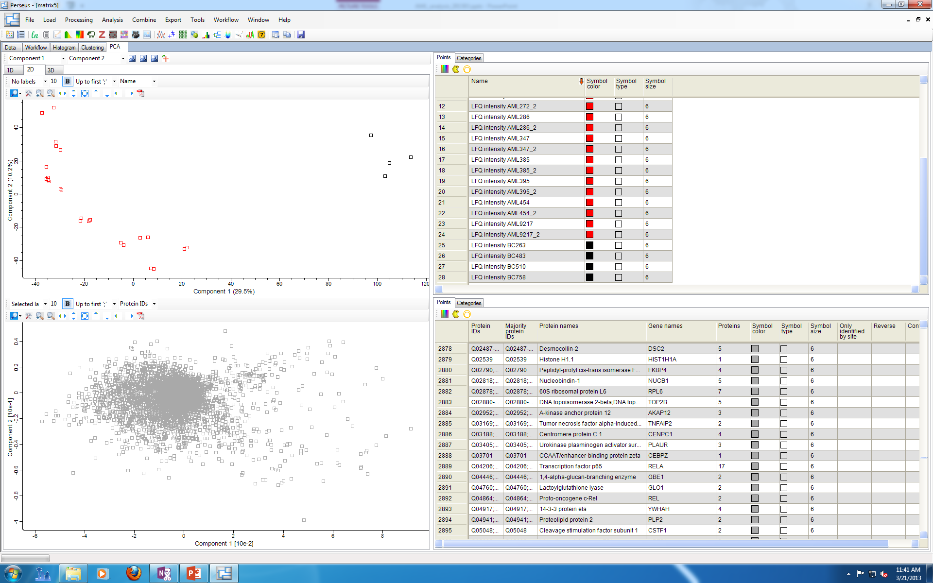
Figure S1
A
Cluster dendrogram with AU value (%)
AU: Approximately Unbiased p value (%);
Red box: AU > 95%
Euclidean distance
Distance: Euclidean
Cluster method: average
B
AML382
AML118
BC263
AML286_2
BC758
BC483
AML286
AML9217
BC510
AML395;
AML347
AML240
AML135
AML272
AML454
AML212
AML215

Slide 3
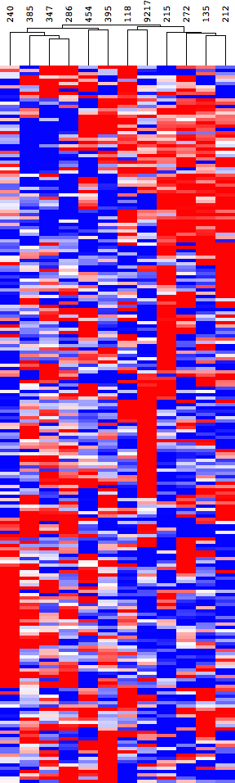

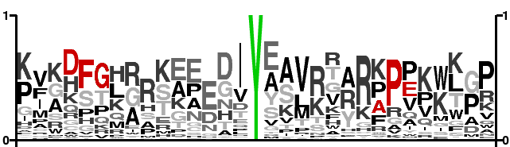
Figure S2
A
Group 1
Group 2
AML pYome 219 pY sites
15
19
23
Intensity (log2)
B

Slide 4
Figure S3
A
C
AML pYome
FES
TEG
BTK
AML
Kinome
LYN
SYK
FGR
ABL
LCK
Correlation coefficient
-0.5 0 0.5
B
AML pYome
C
PTPRJ
PTPRE
PTPN9
PTPRO
PTPN12
PTPRC
AML
PTPome
PTPN6
PTPN7
PTPN18
PTPN2
PTPRG
PTPRB
PTPN13
PTPRA
PTPN11
PTPN1
Correlation coefficient
-0.5 0 0.5

Slide 5





Figure S4
AML pYome cluster pY motifs
Cluster 3
6 input sequences
Cluster 7
5 input sequences
Cluster 10
5 input sequences
Cluster 16
5 input sequences
Cluster 17
9 input sequences

Slide 6
Figure S5

Slide 7
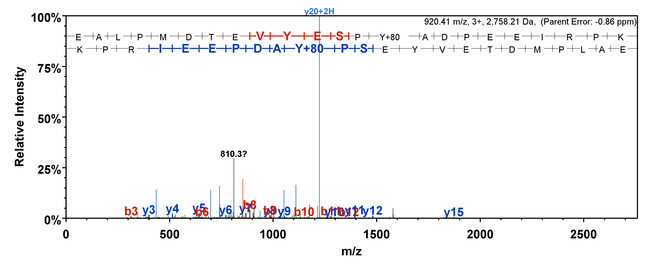
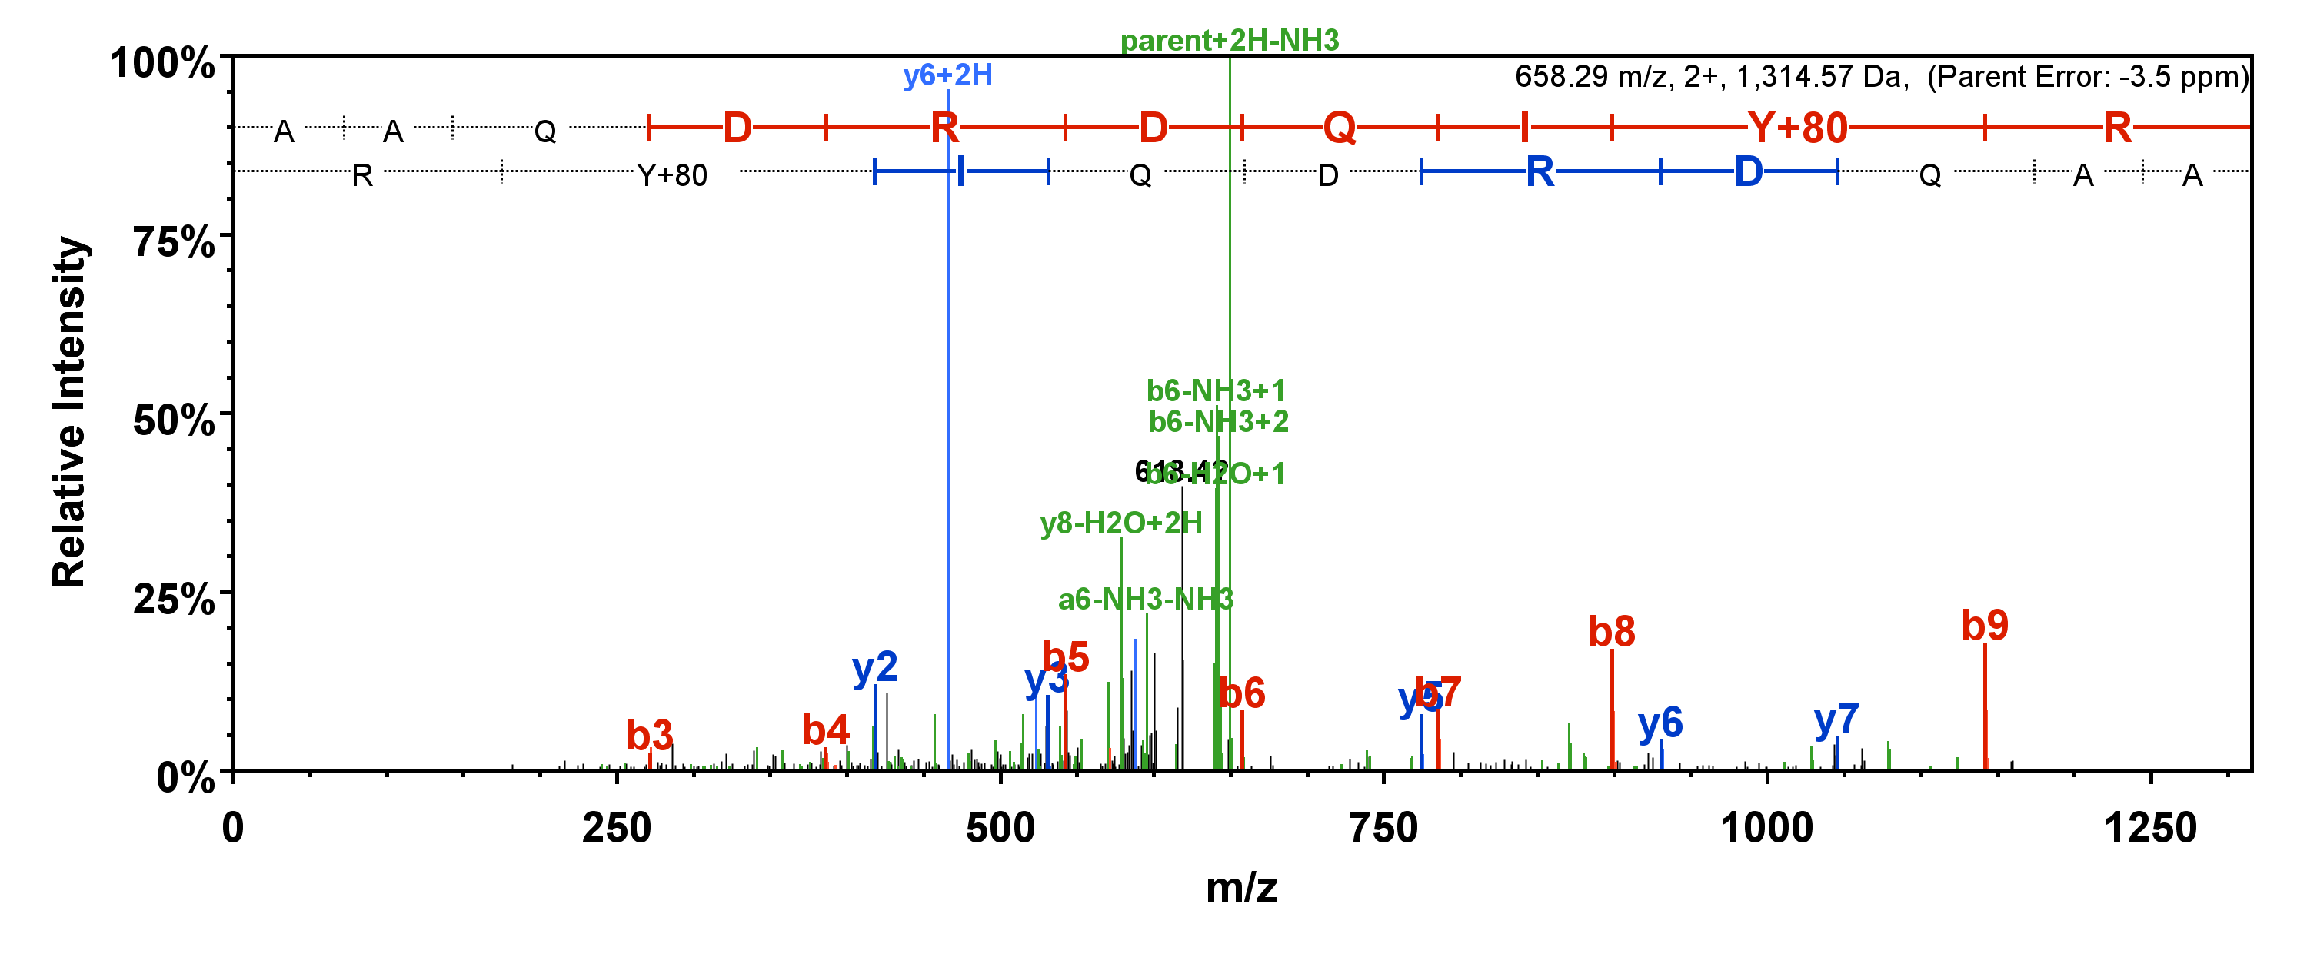
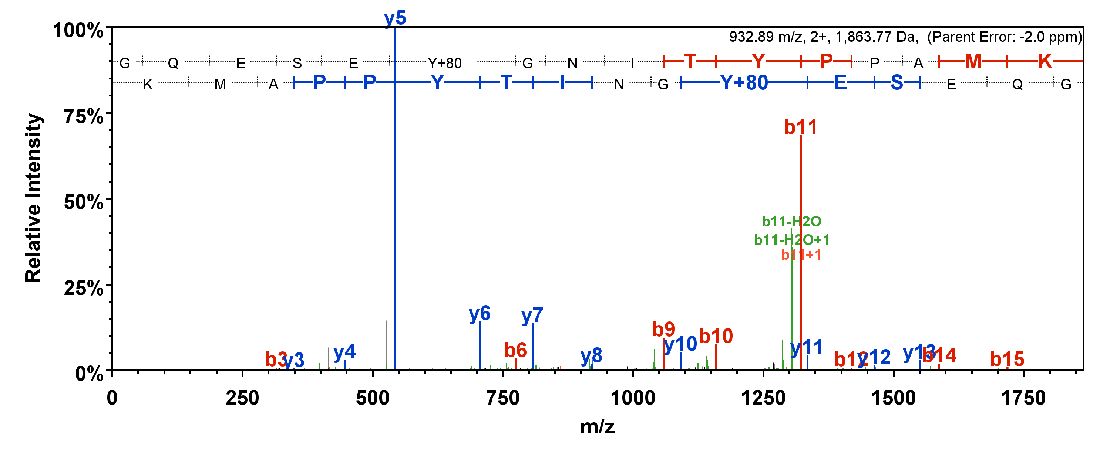
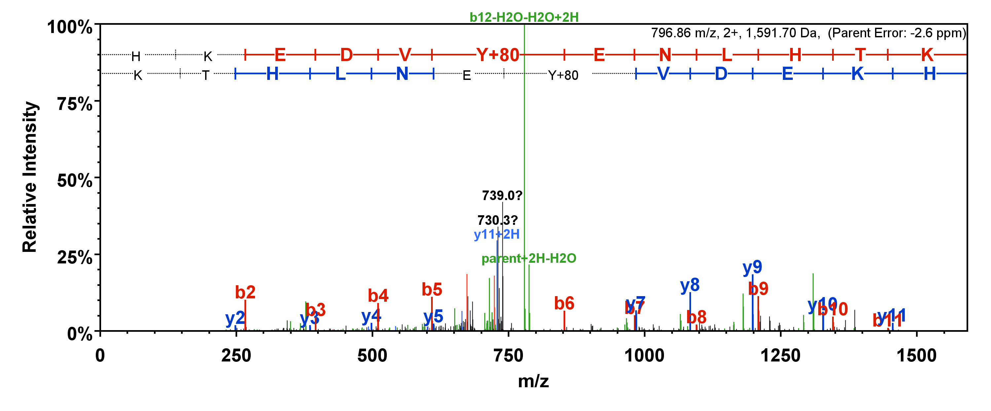
Fig.S6A
Syk pY352
TRA2B pY260
PTPN6 pY536
PTPN6 pY564

Slide 8
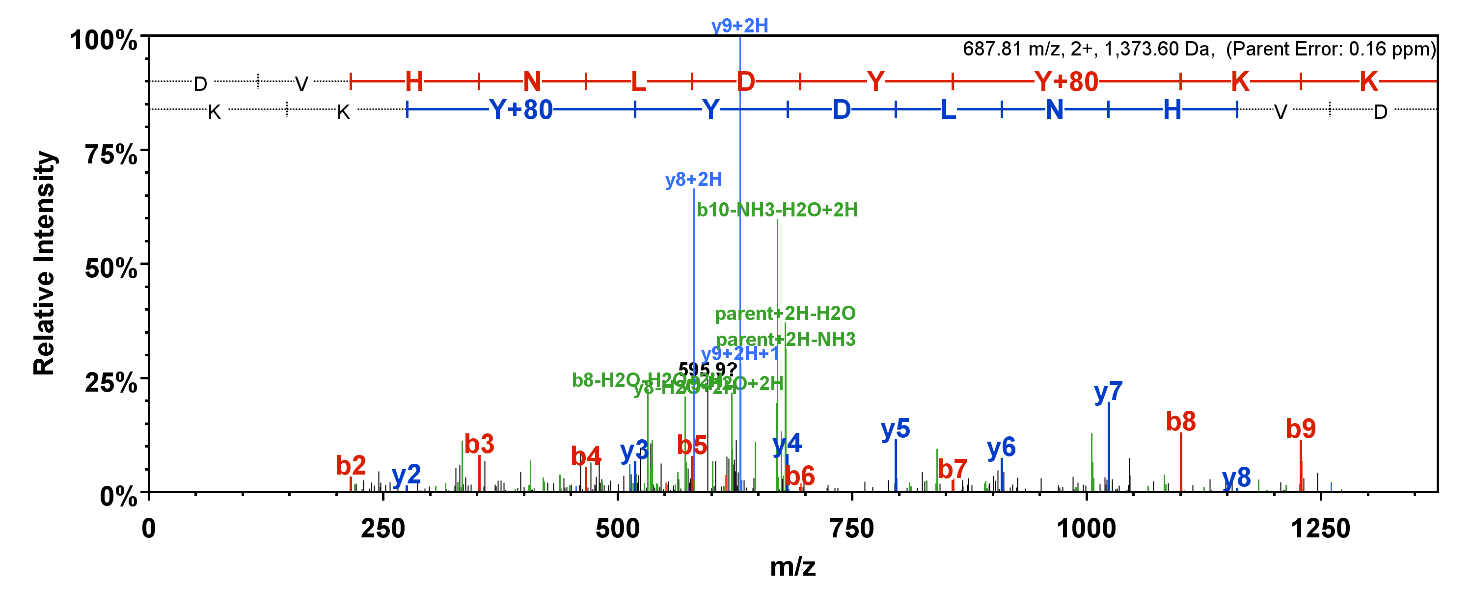
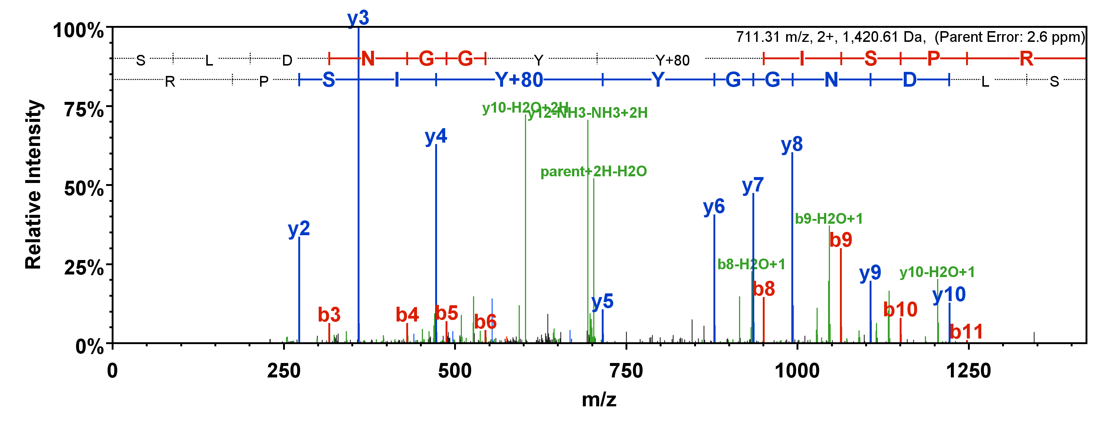
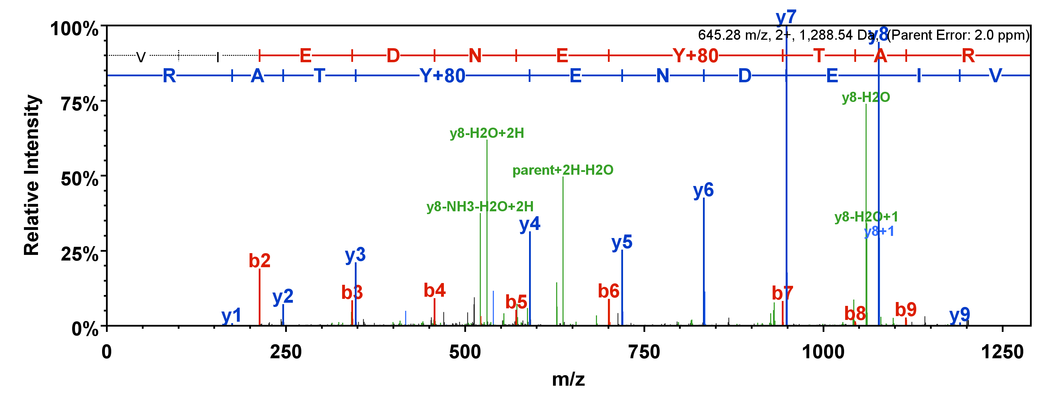
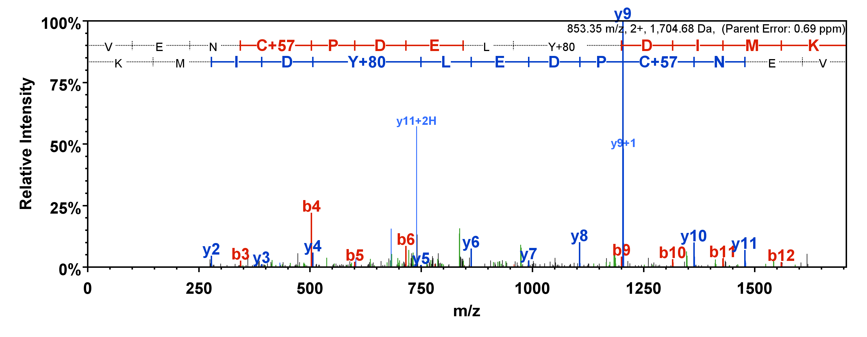
Fig.S6B
FGFR3 pY648
Lyn pY194
Lyn pY411
Lyn pY473

Slide 9
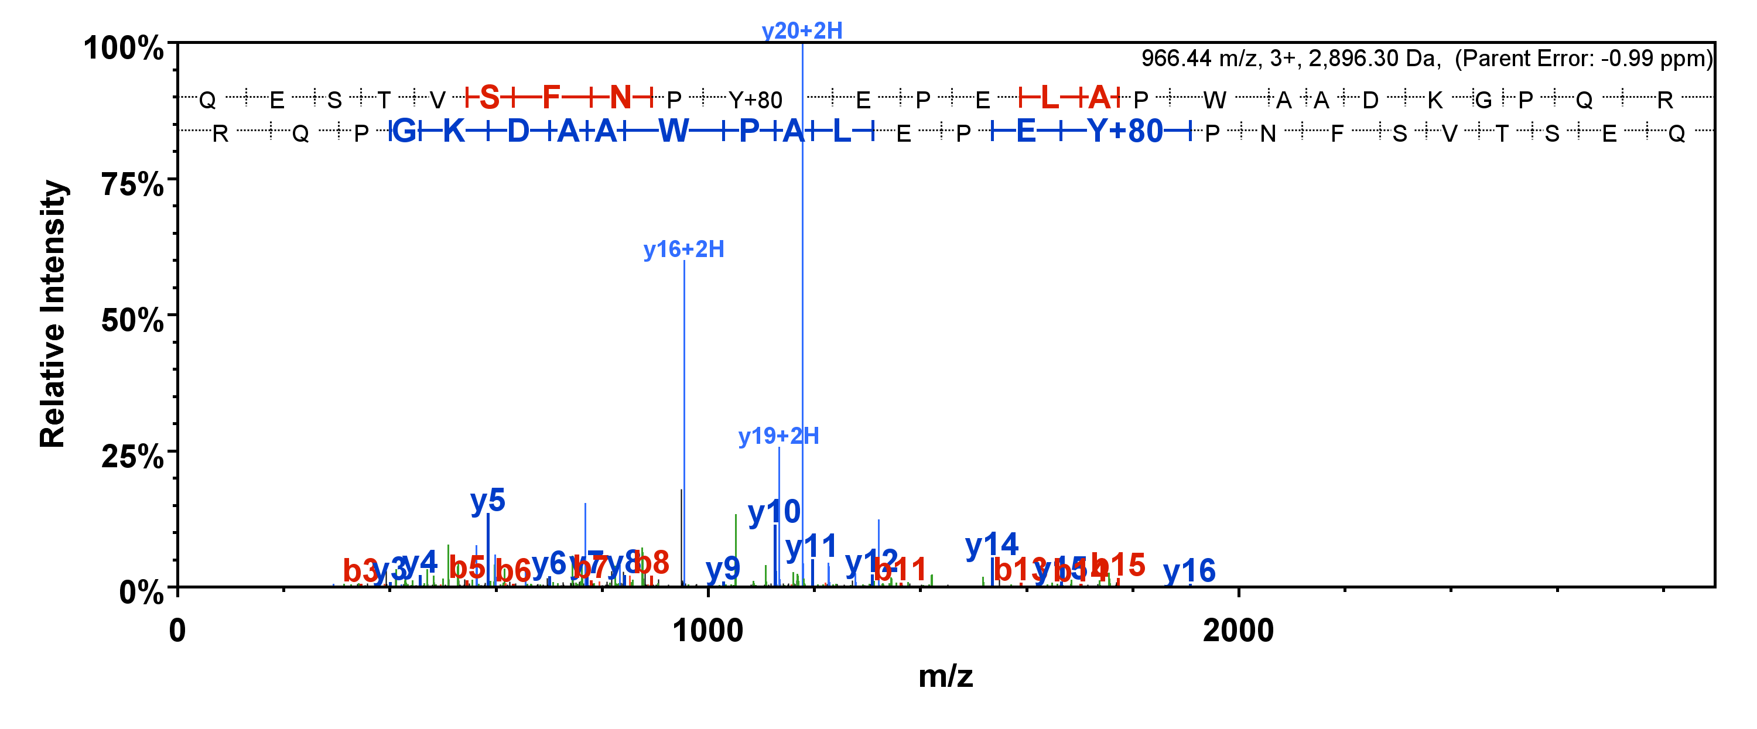
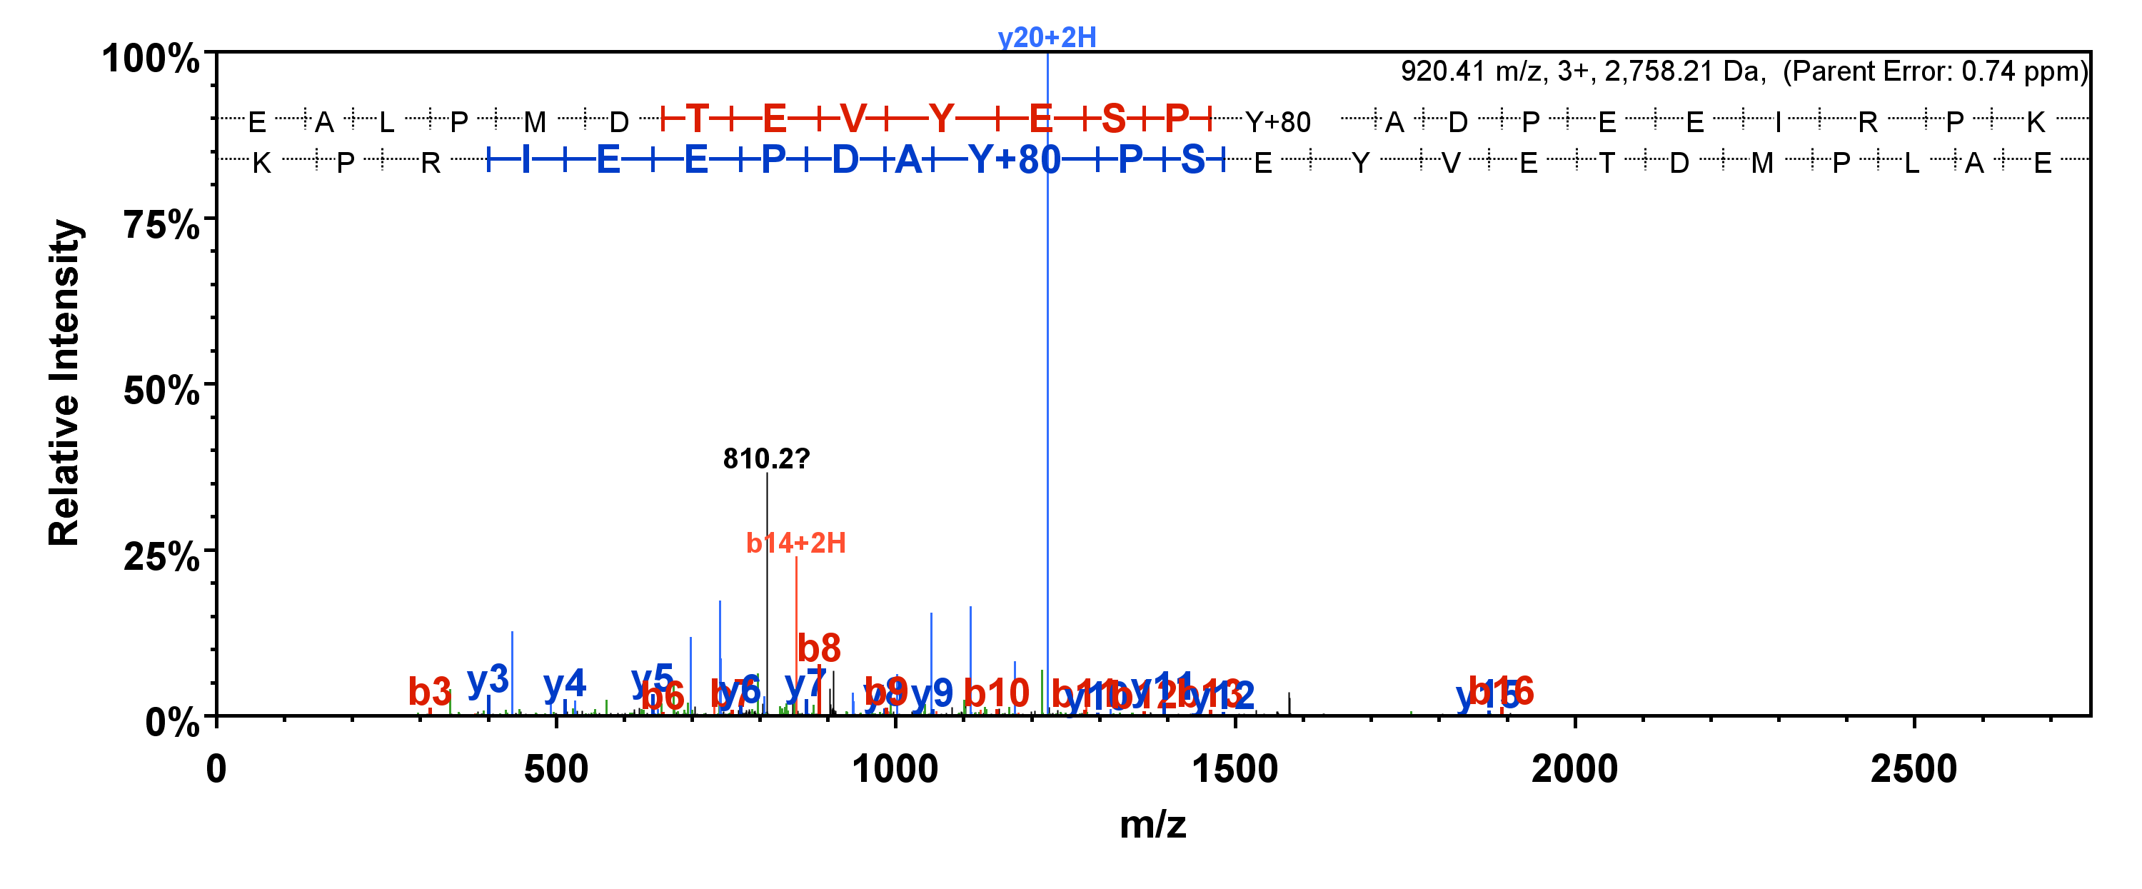
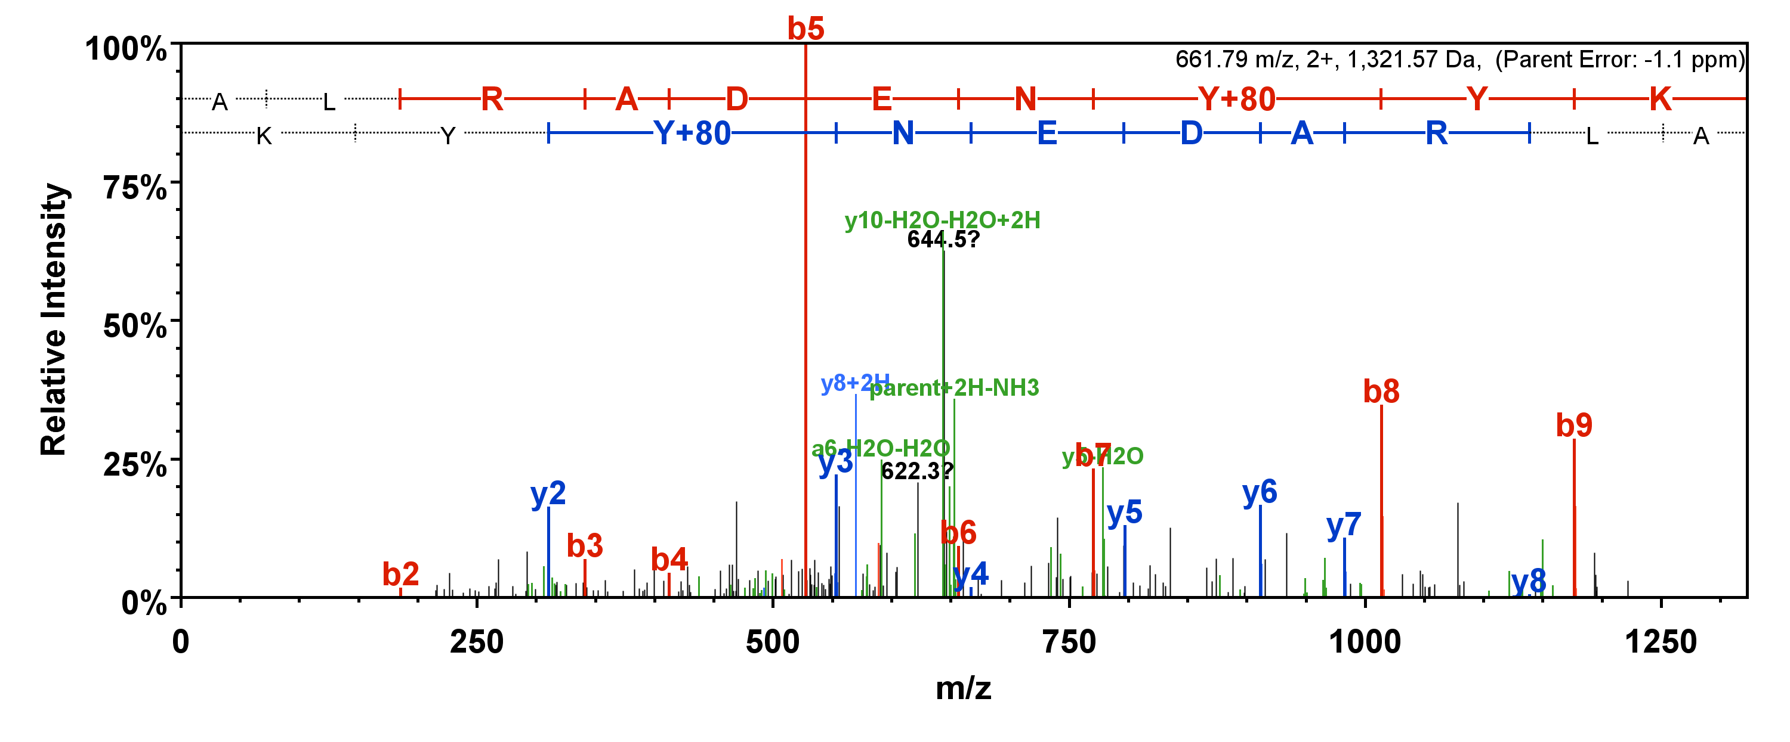
Fig.S6C
Syk pY323
Syk pY352
Syk pY525

