Slide 1
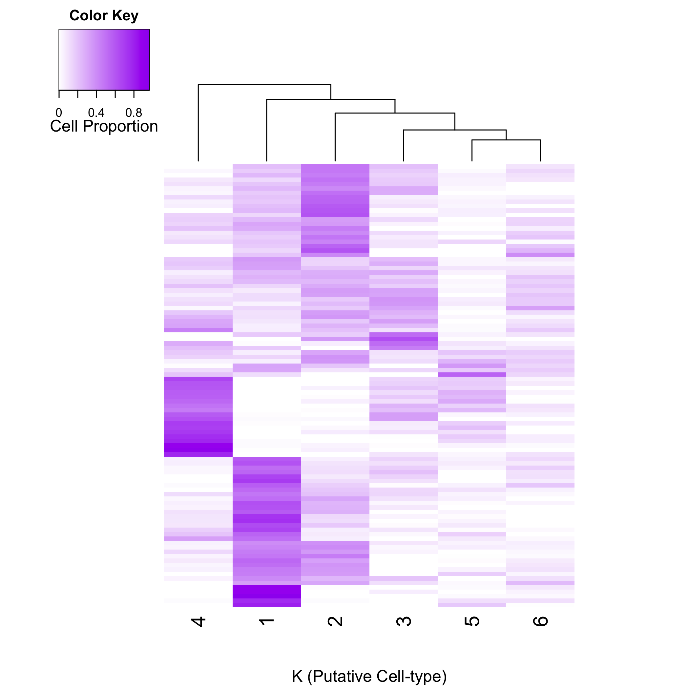
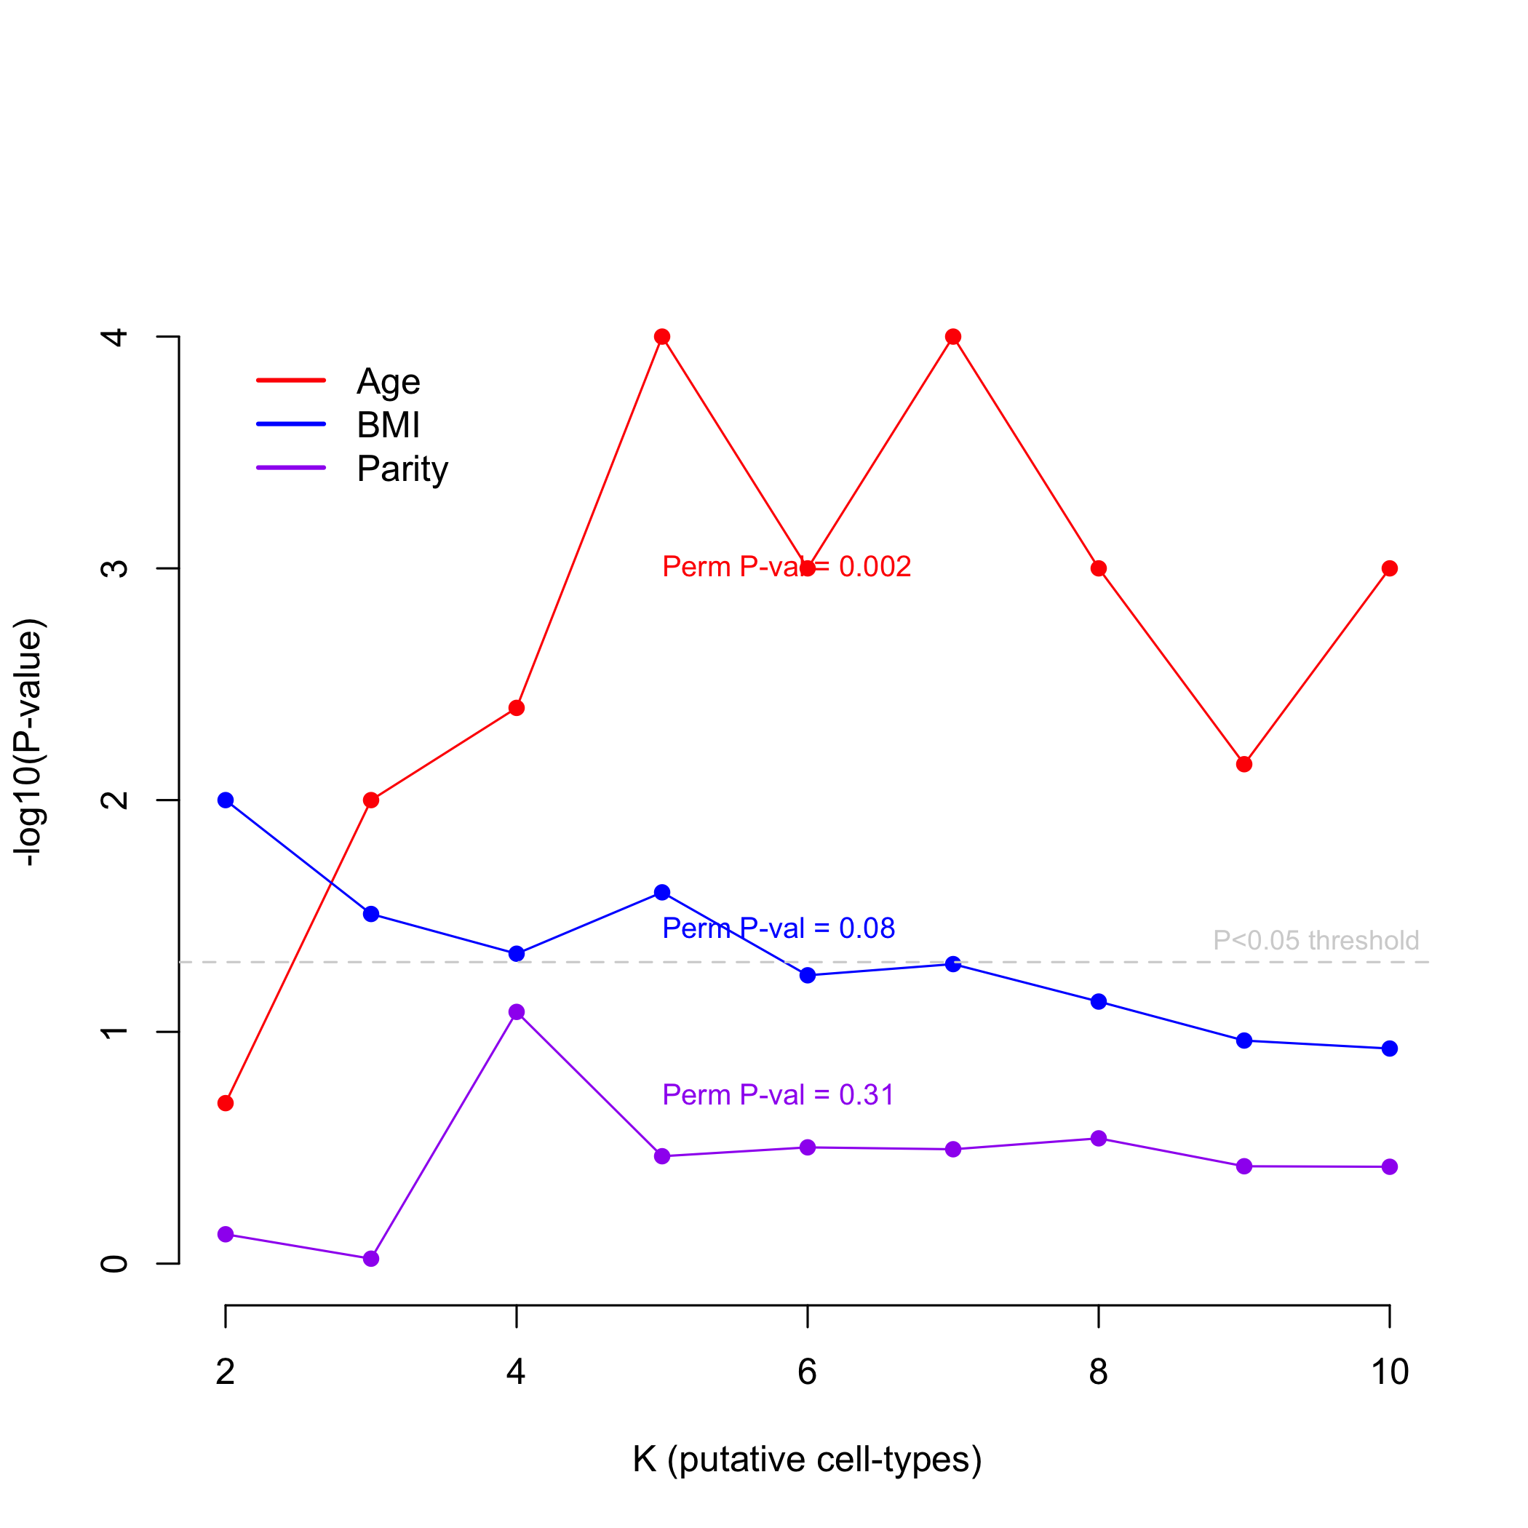
Additional File 2
A
B
Komen
Normal Breast (n = 100)

