Slide 1
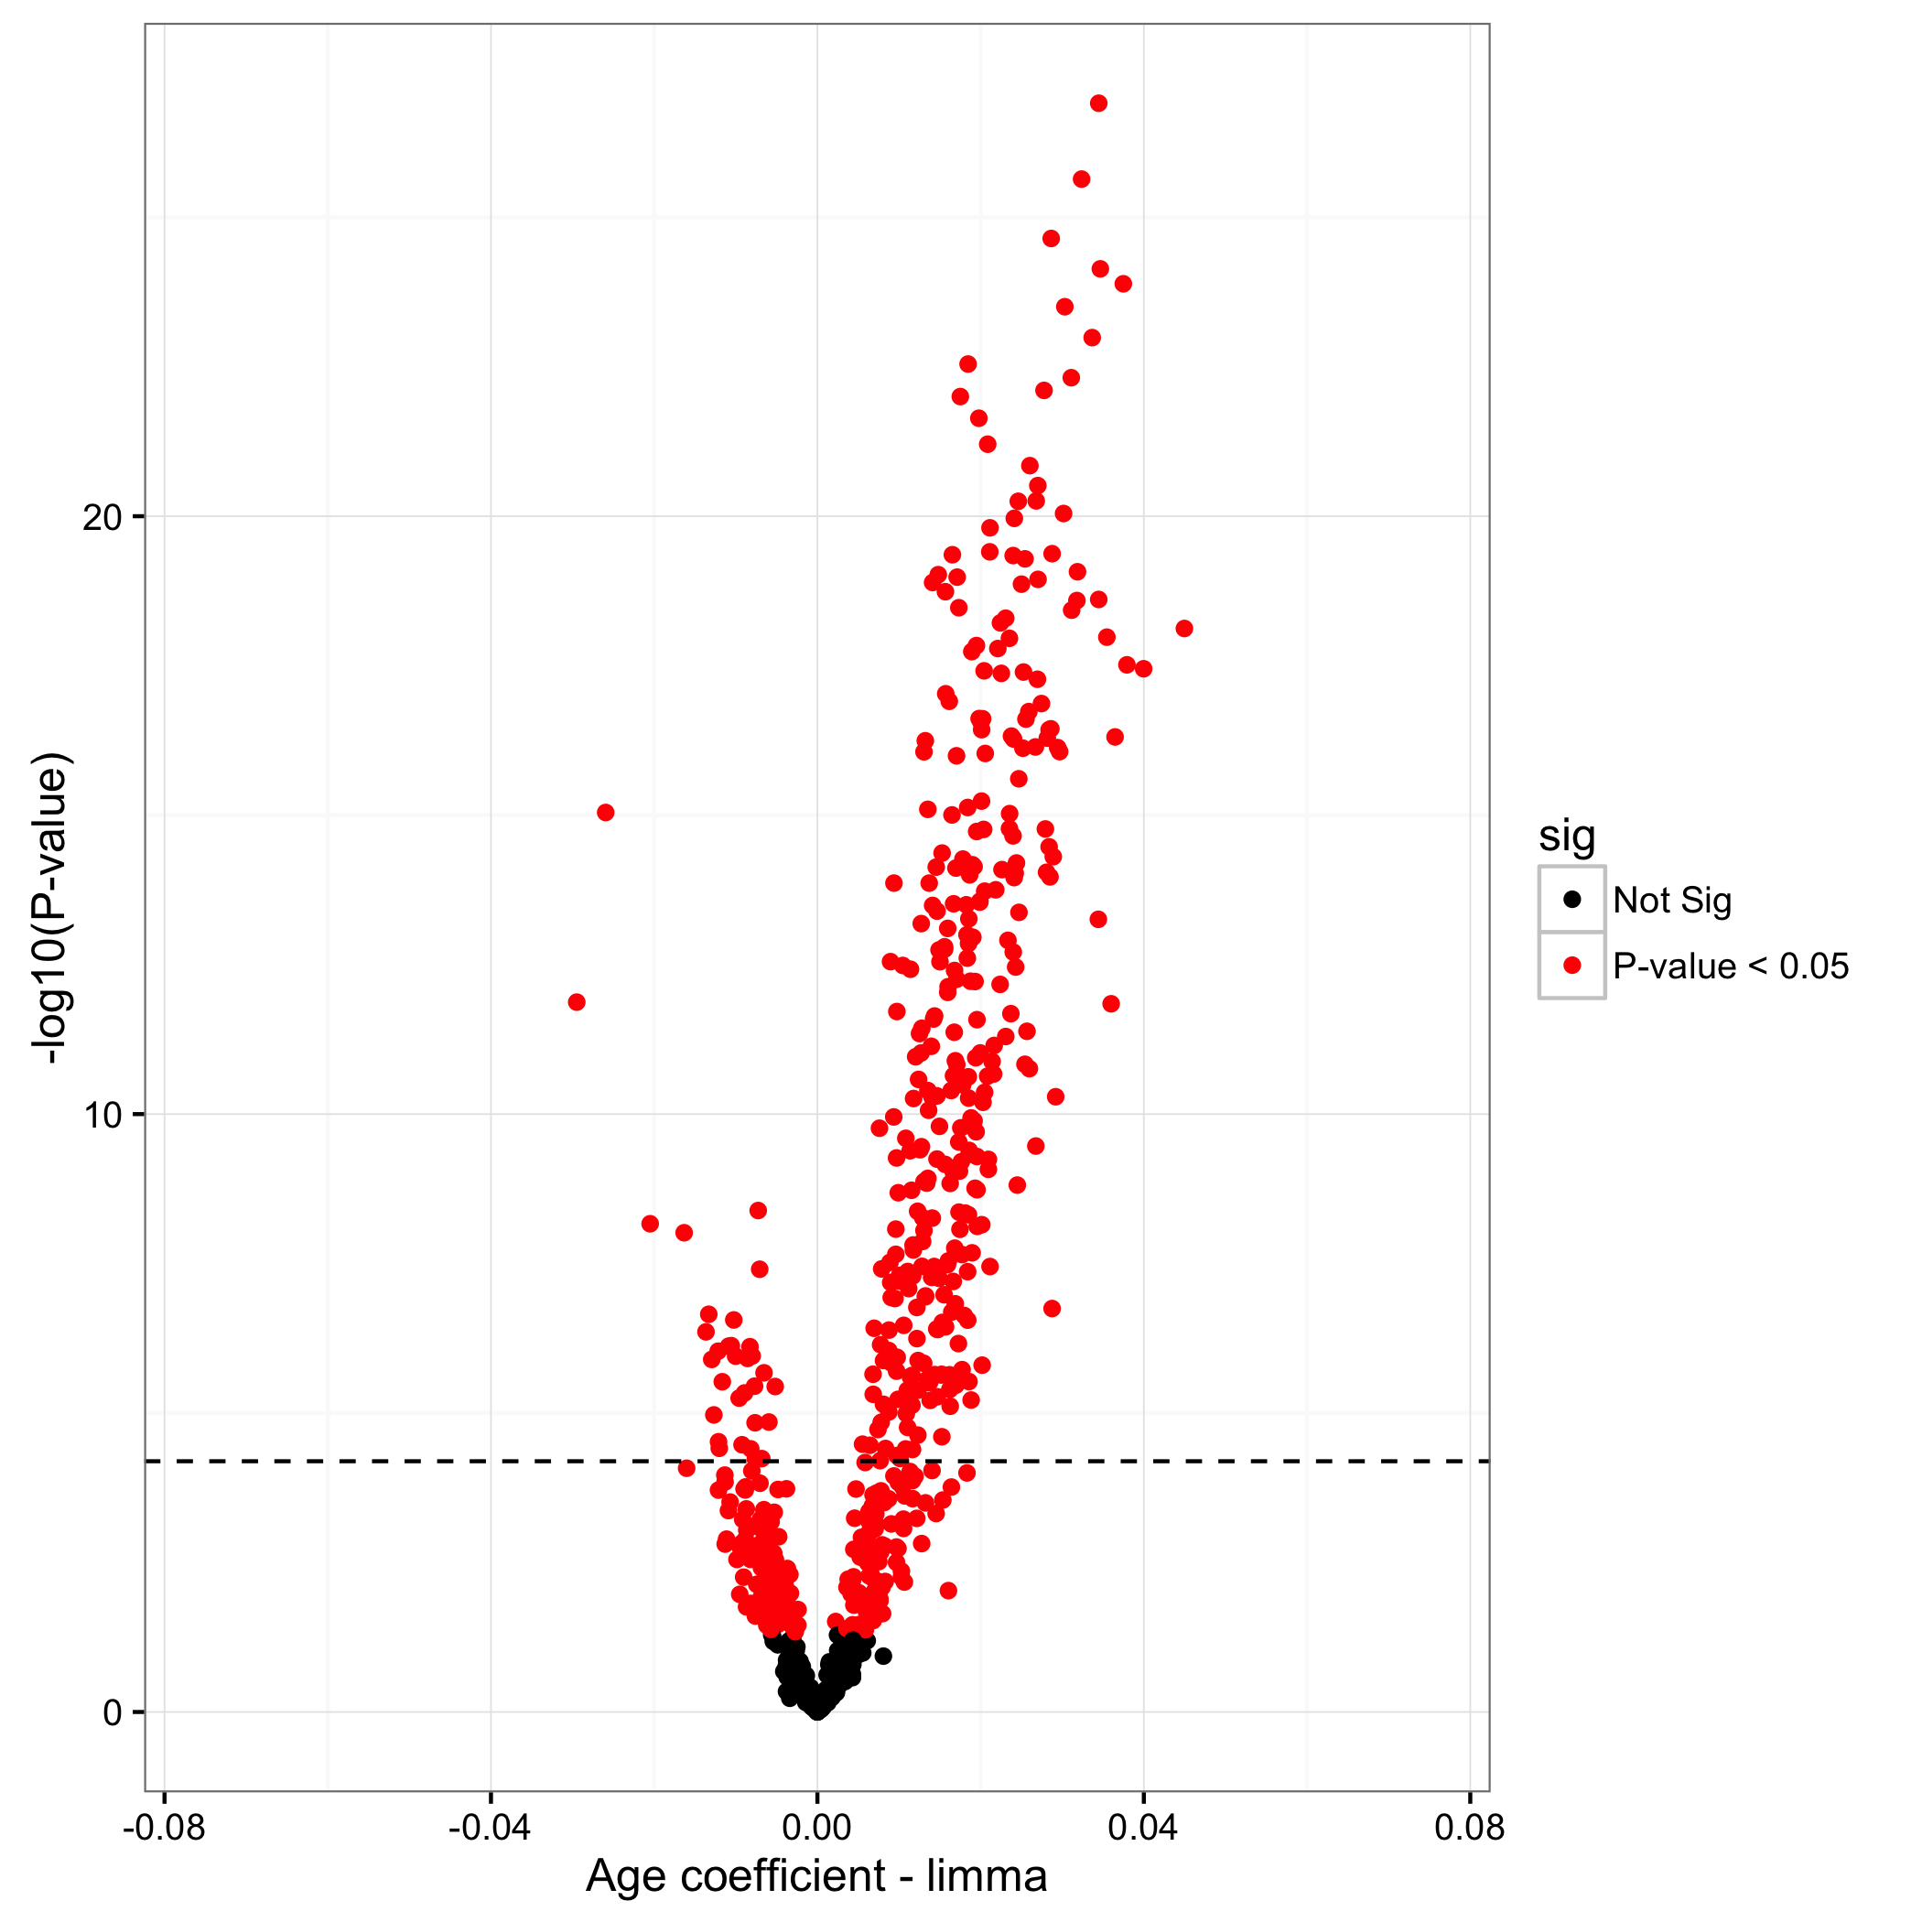
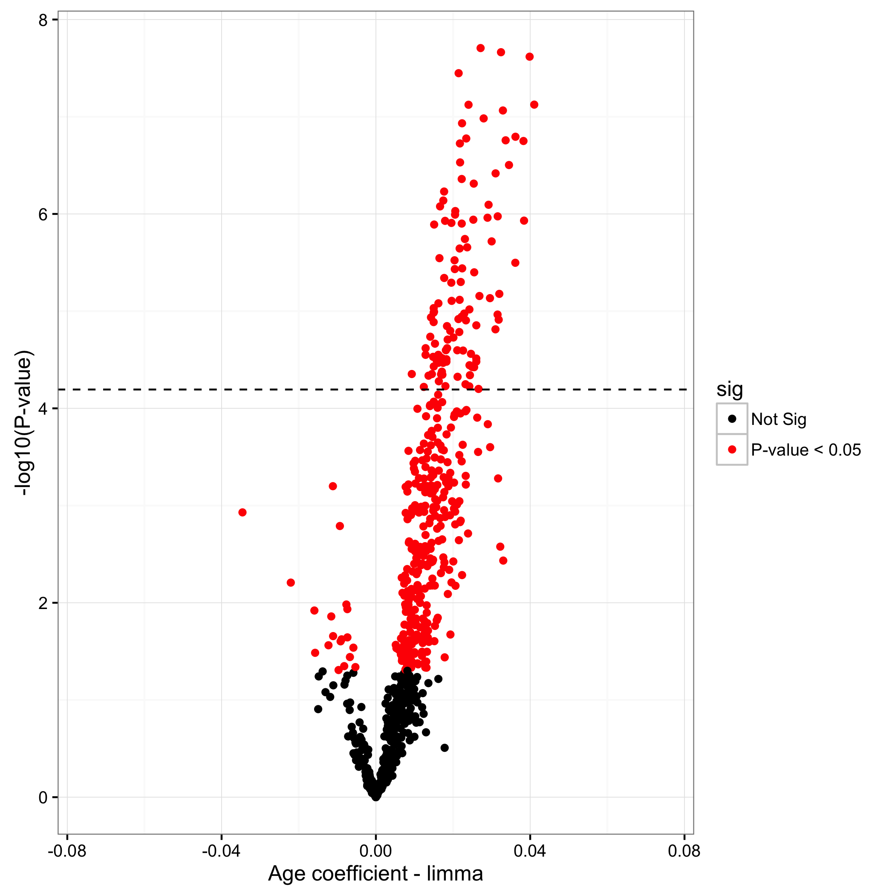
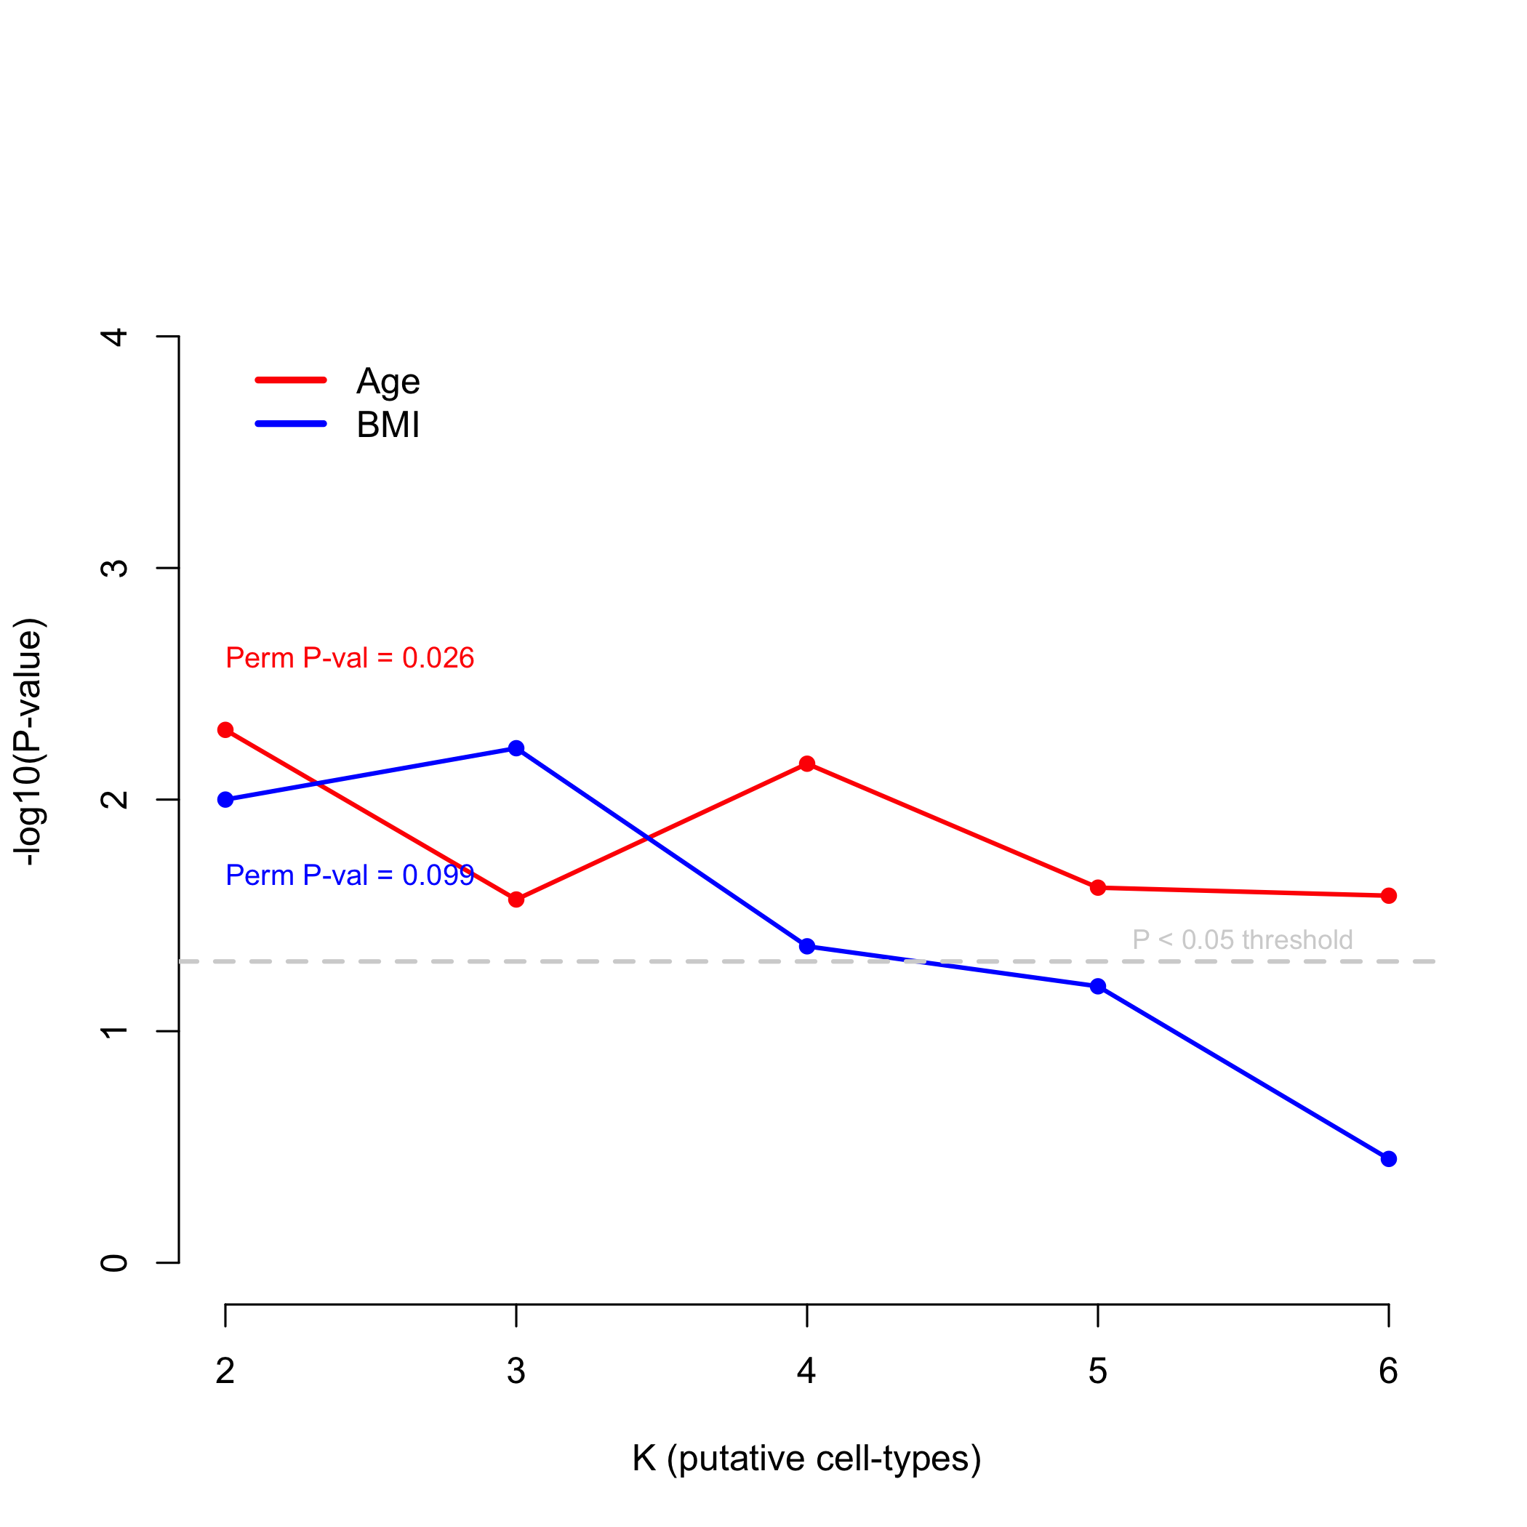
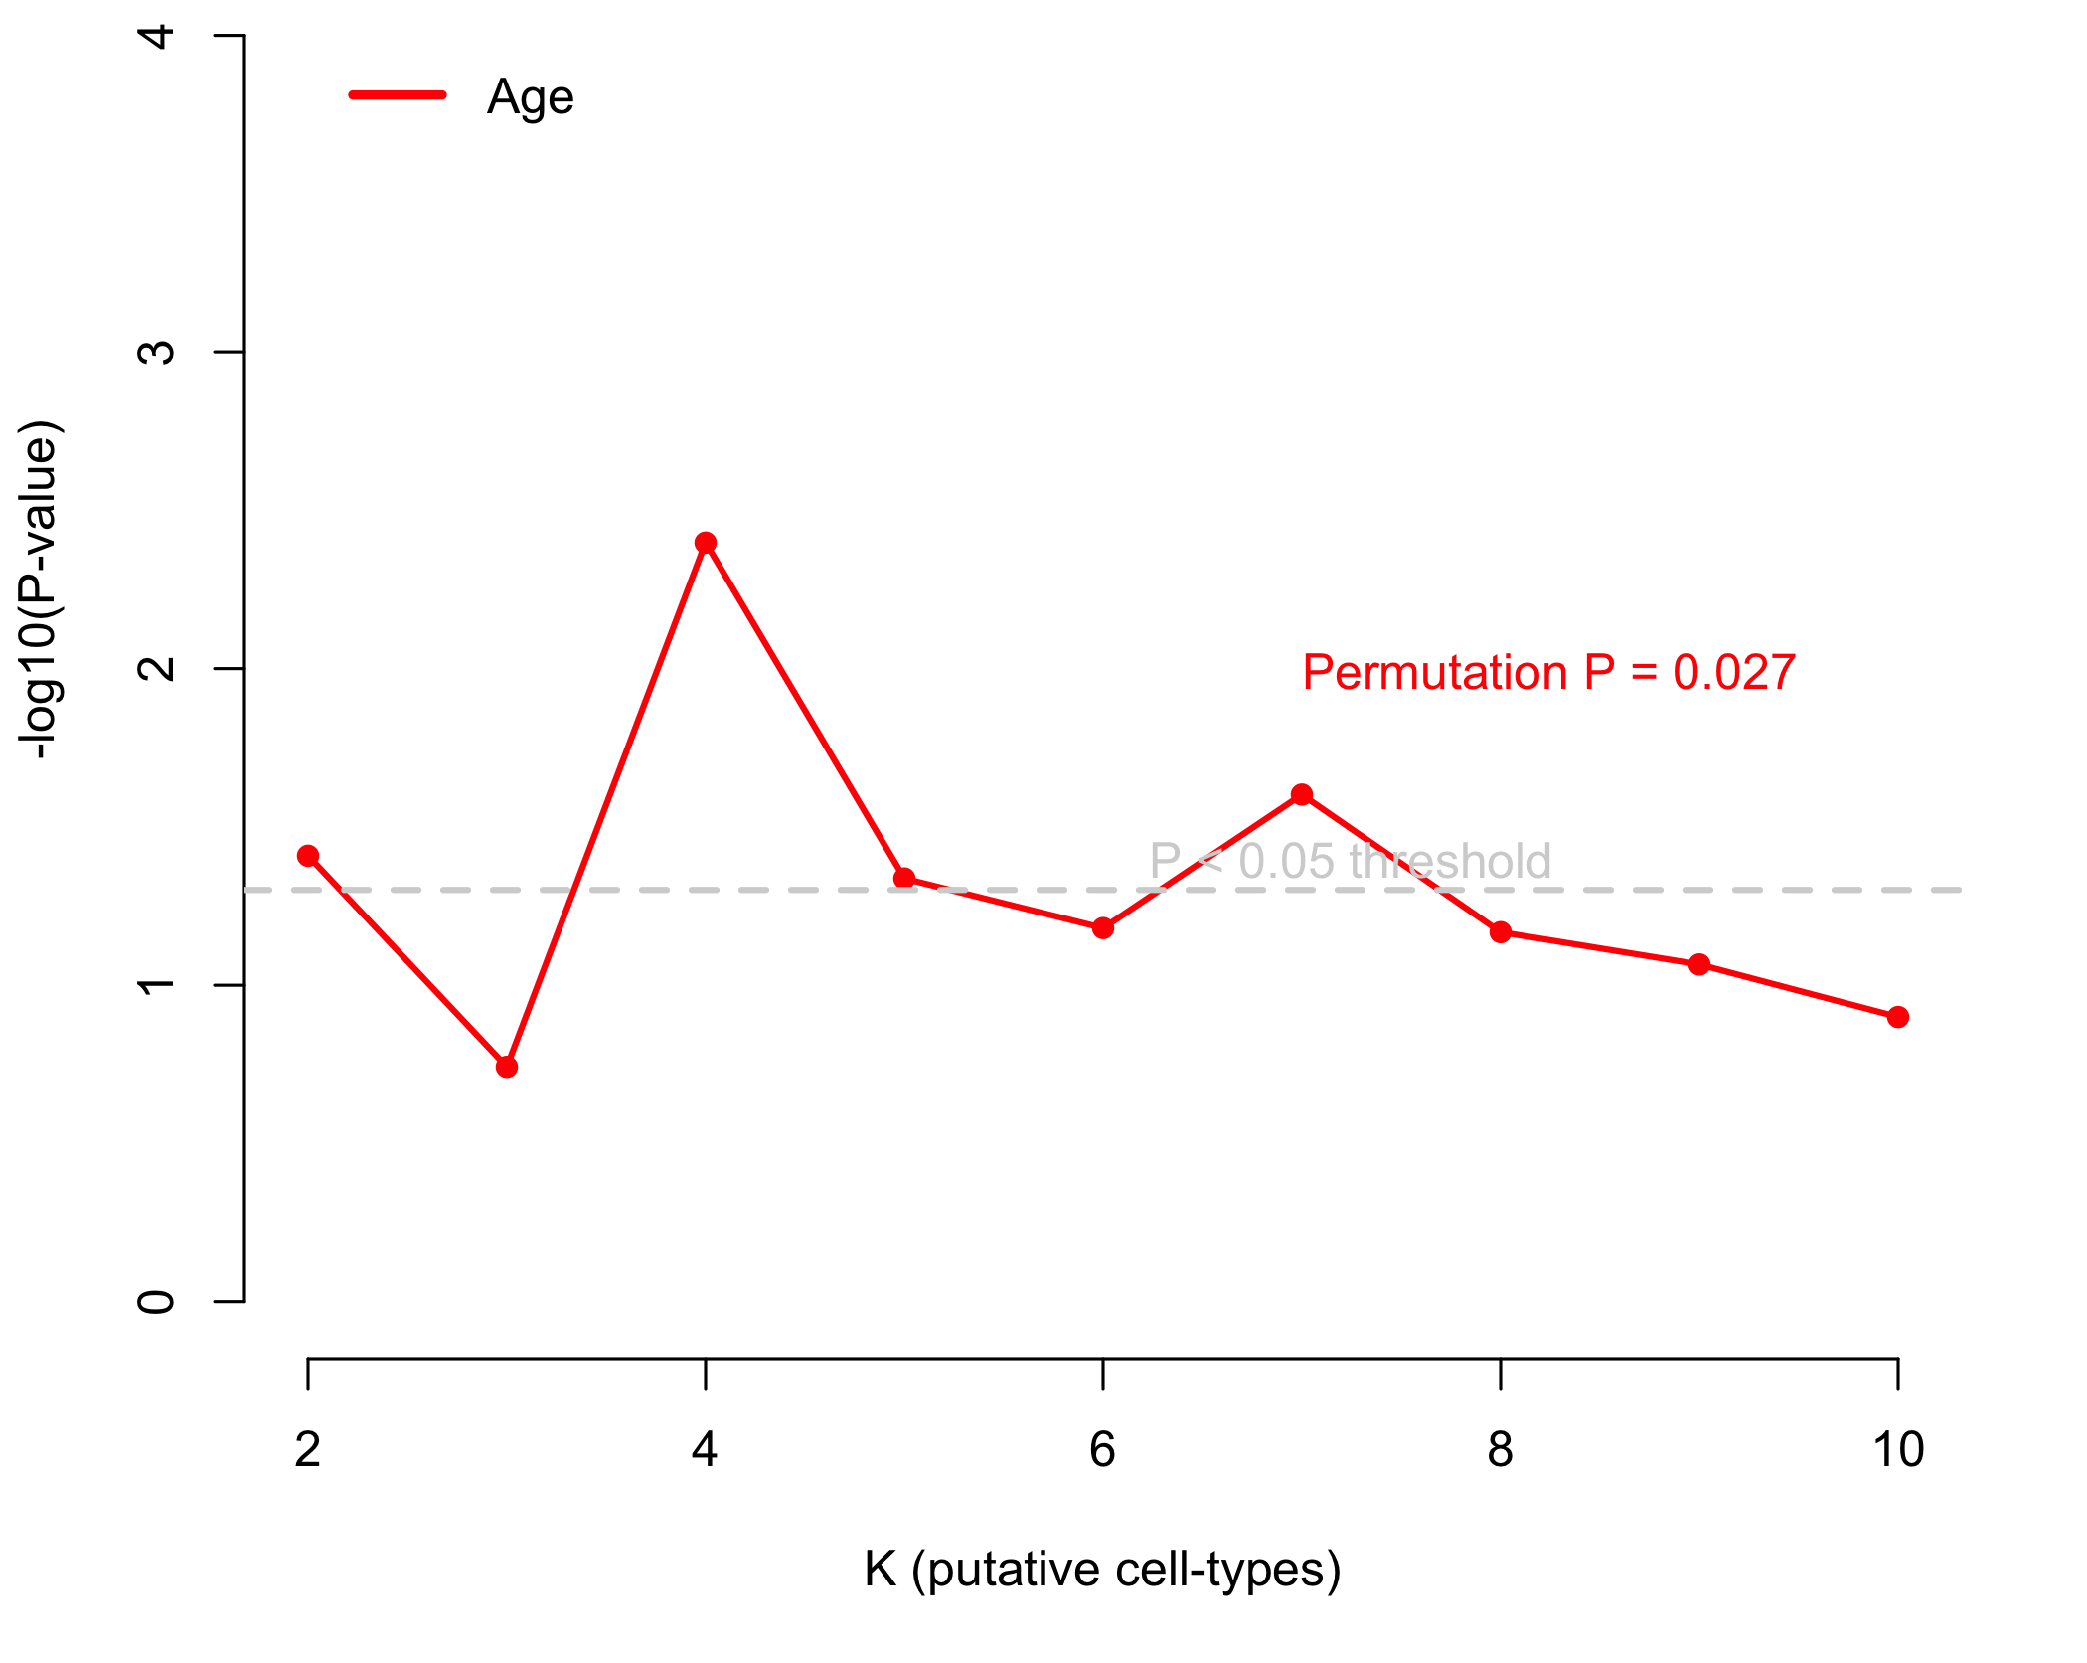
Additional File 5
TCGA – DNA methylation and age
Associations (n = 97)
NDRI – DNA methylation and age
Associations ( n = 18)
A
B
C
TCGA( n = 97)
D
NDRI ( n = 18)

