Slide 1
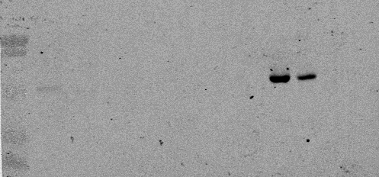
A
MWM 1 2 3 4 5 6 7 8 9
MWM 1 2 3 4 5 6 7 8 9
B
Fig S1: A. SDS-PAGE of tubulin isolated from L. infantum extracts. Lane 1 whole extracts; lane 2 supernatant of centrifugation at 40,000 x g; lane 3 flowtrough of the DEAE-Sepharose (fast flow) column; lanes 5-6 different washes of the column with 0.1 mM PIPES buffer (pH 6.9), containing 1 mM EGTA and 1 mM MgCl₂; lanes 7-9 protein elution with the same buffer containing 0.3 M KCl/0.75 M L-glutamate. B. Western blotting analysis of the purified protein using an polyclonal antibody against α-tubulin (Thermo-Fisher). Signal was revealed with a secondary anti-mouse antibody linked to infrared-emitting protein IRDye®800 (Li-Cor) and analysed in an Odyssey (Li-Cor) infrared imaging system.

Slide 2
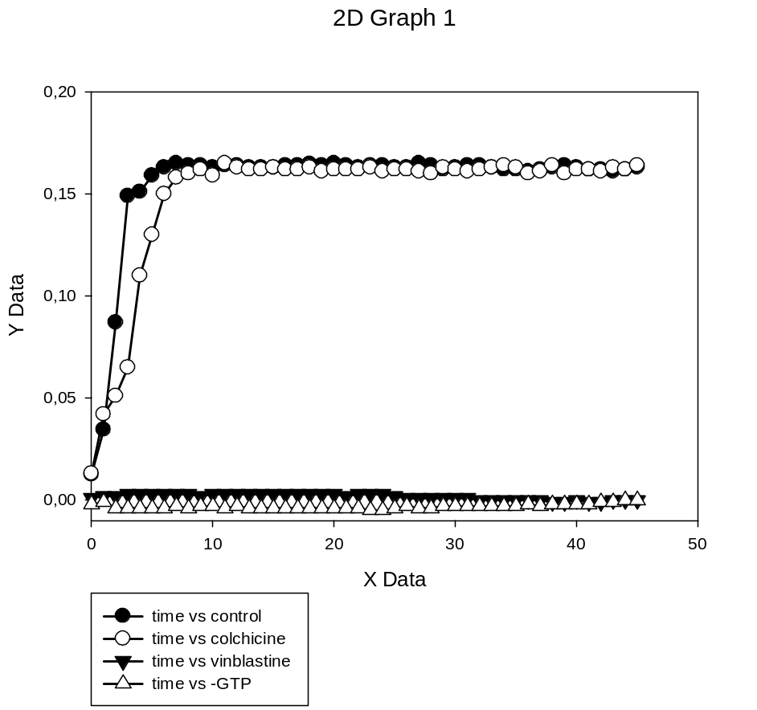
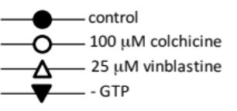
Absorbance 340 nm
Absorbance 340 nm
Time (min)
Figure S2. A Microtubule formation in vitro. Tubulin polymerization was assessed at different concentrations of purified Leishmania tubulin by increase in absorbance at 340 nm with time according to Materials and Methods section. B Polymerization of purified tubulin was assessed in absence and presence of 2 mM GTP. Vinblastine (25 μM) and colchicine (100 μM) were used as positive and negative control for tubulin-targeting agents. DMSO was used as vehicle control. Representative of three independent experiments.

Slide 3
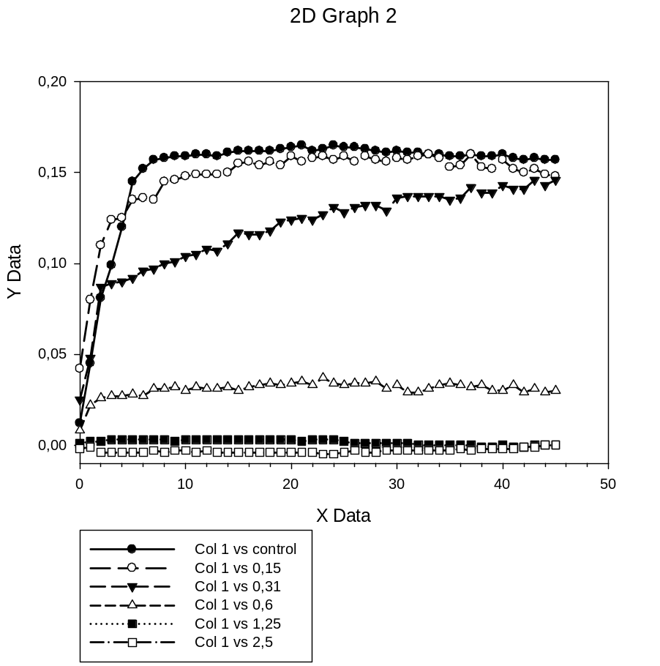
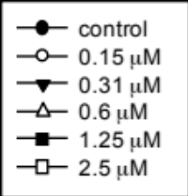
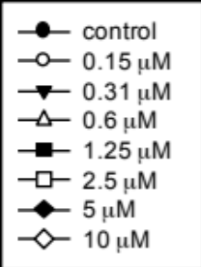
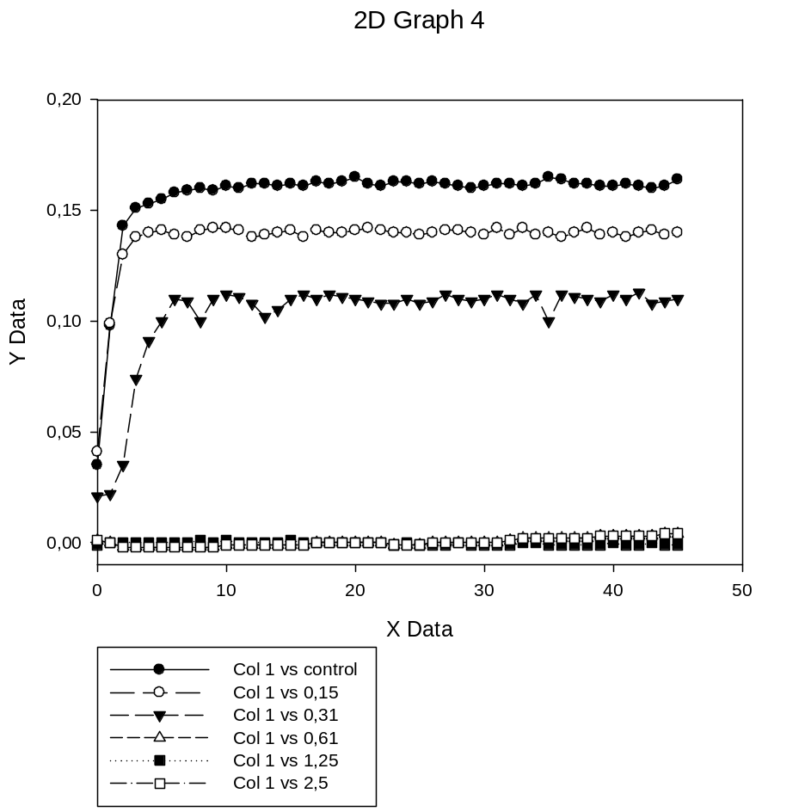
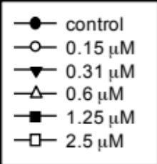
Comp. 2a
A
Absorbance 340 nm
Time (min)
Comp. 14
0.20
B
0.15
Absorbance 340 nm
0.10
0.05
0.00
0
10
20
30
40
50
Time (min)
Comp. 49
C
Absorbance 340 nm
Time (min)

Slide 4
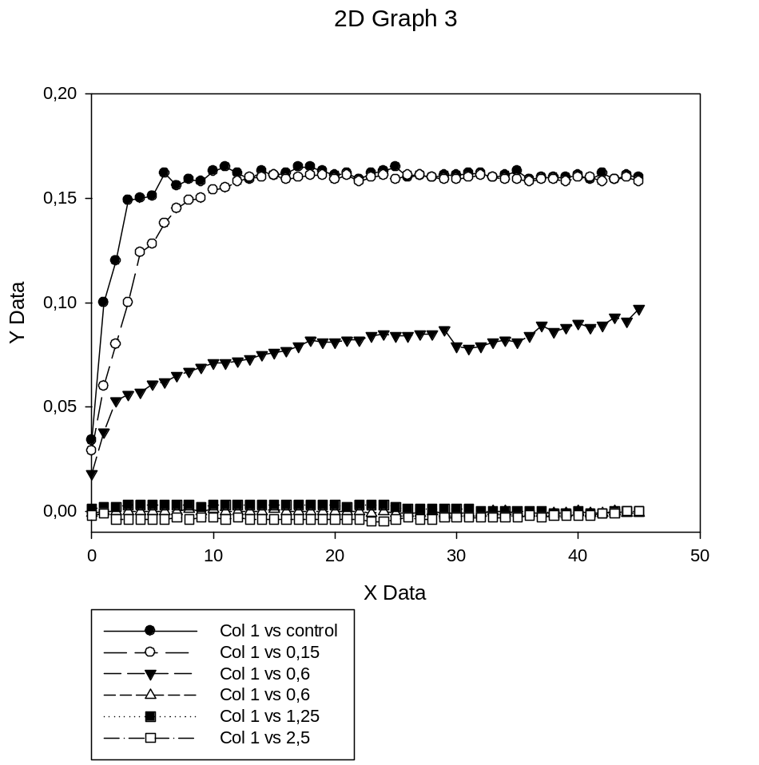
Comp. 46
D
Absorbance 340 nm
Time (min)
E
Figure S3: Graphic representation of the Inhibition of Leishmania tubulin polymerization by representative lignan derivatives. Podophyllotoxin (2a, positive inhibition control); podophyllic aldehyde (14); lignan-benzimidazole hybrid 46 and lignan-imidazopyridine hybrid 49. Dose/response curves were obtained from the time/response kinetics from Figs. A to D by plotting the inhibition of tubulin polymerization vs. drug concentration after 15 min incubation. A, B, C and D are representative of three separate experiments.

Slide 5
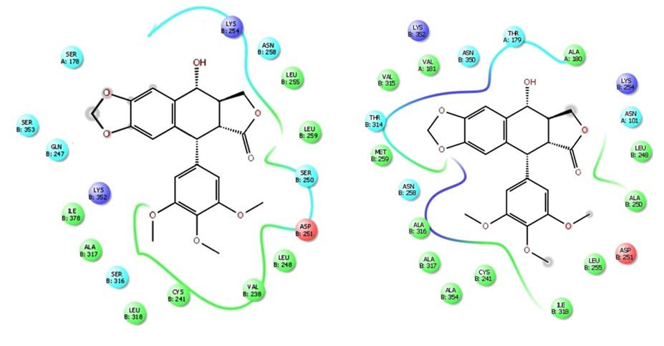
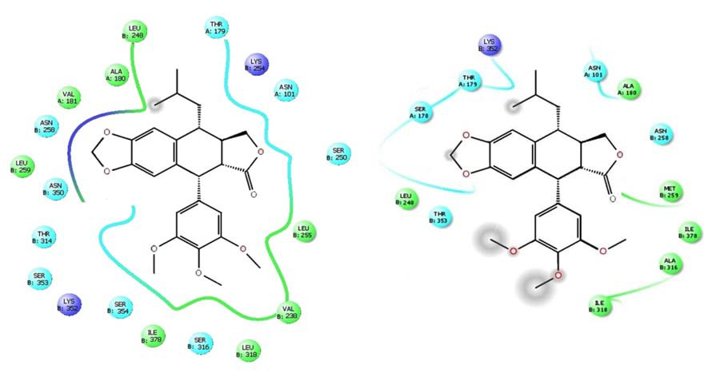
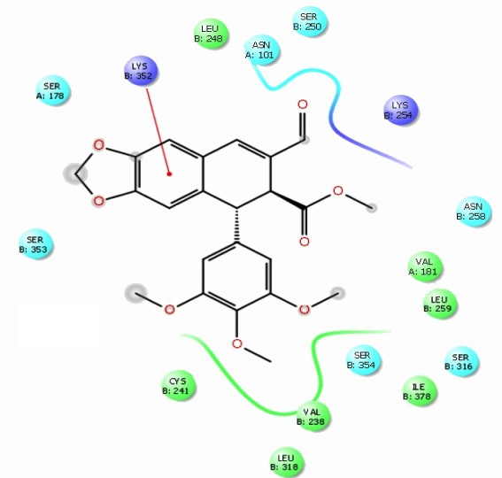
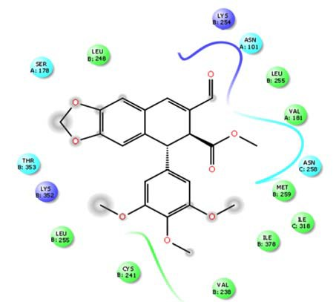
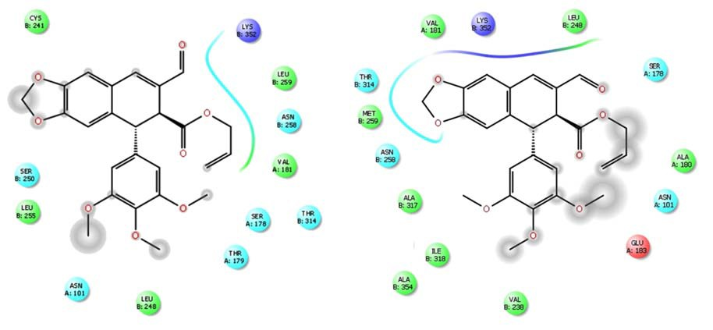
Tubulins:
Leishmania
Bos taurus
2a
5a
14
15

Slide 6
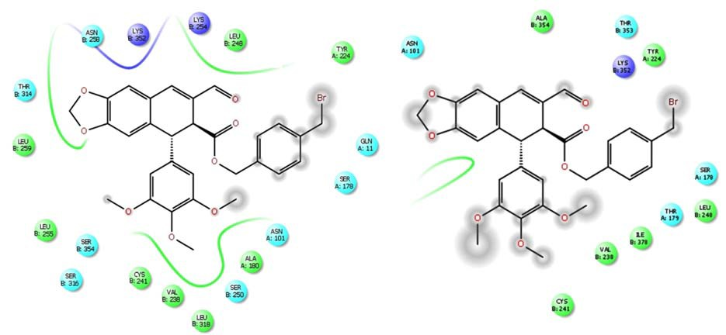
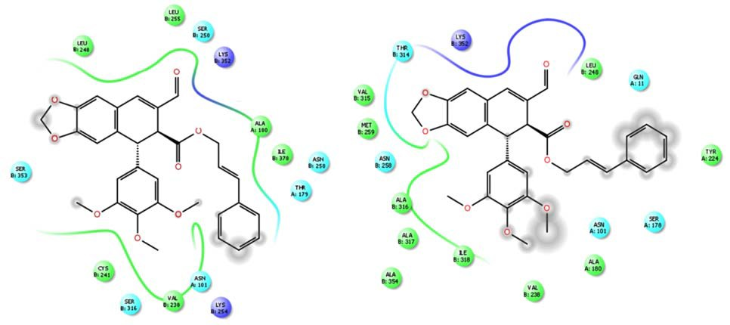
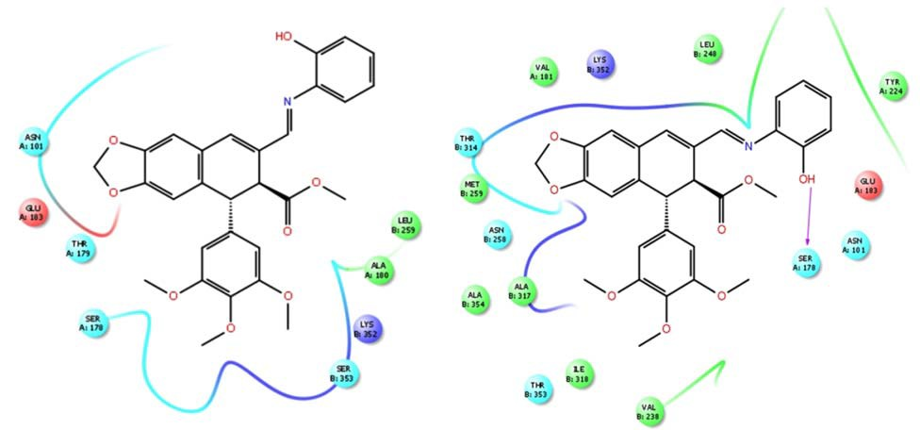
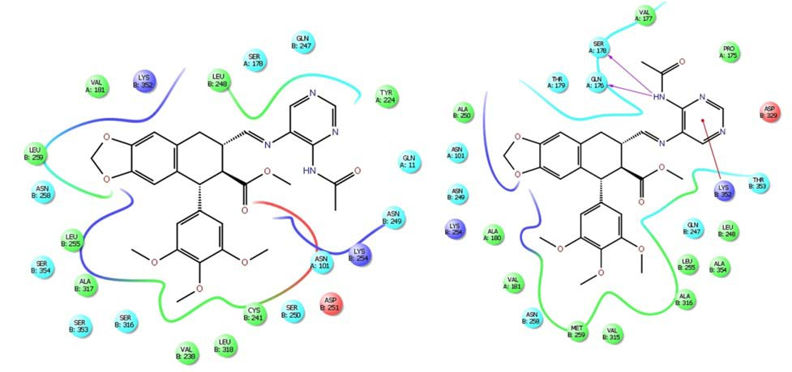
Tubulins:
Leishmania
Bos taurus
21
23
31
34

Slide 7
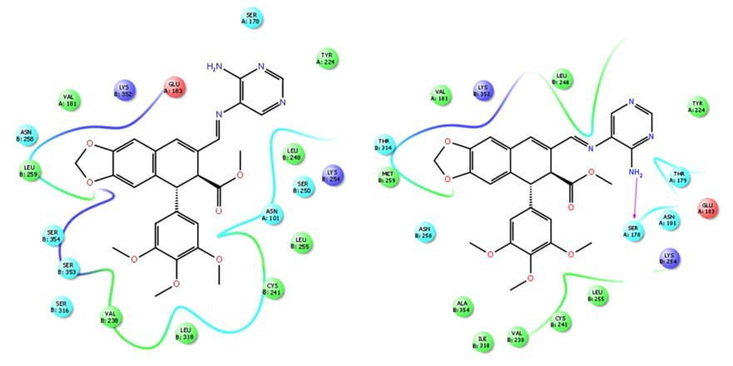
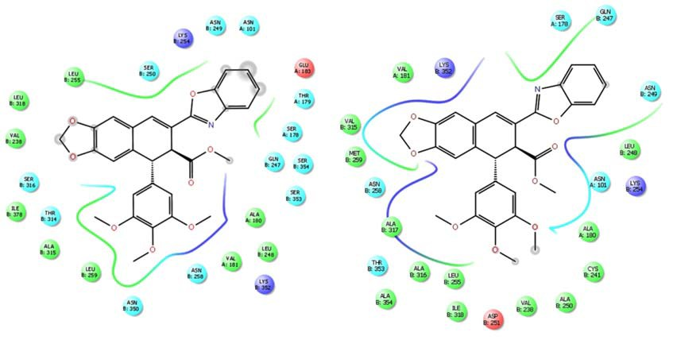
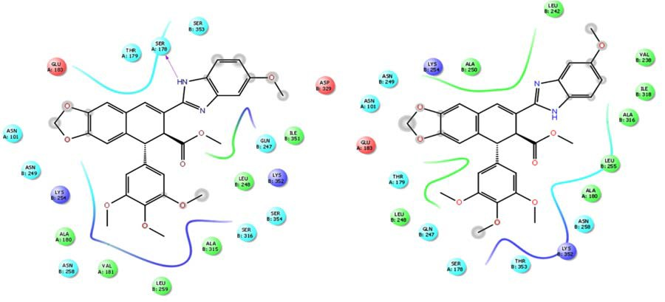
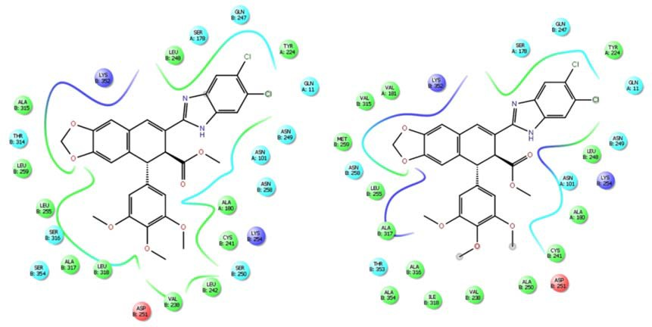
Tubulins:
Leishmania
Bos taurus
35
40
46
48

Slide 8
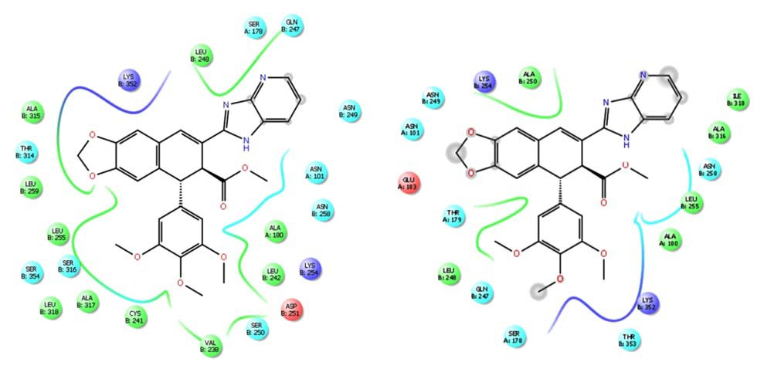
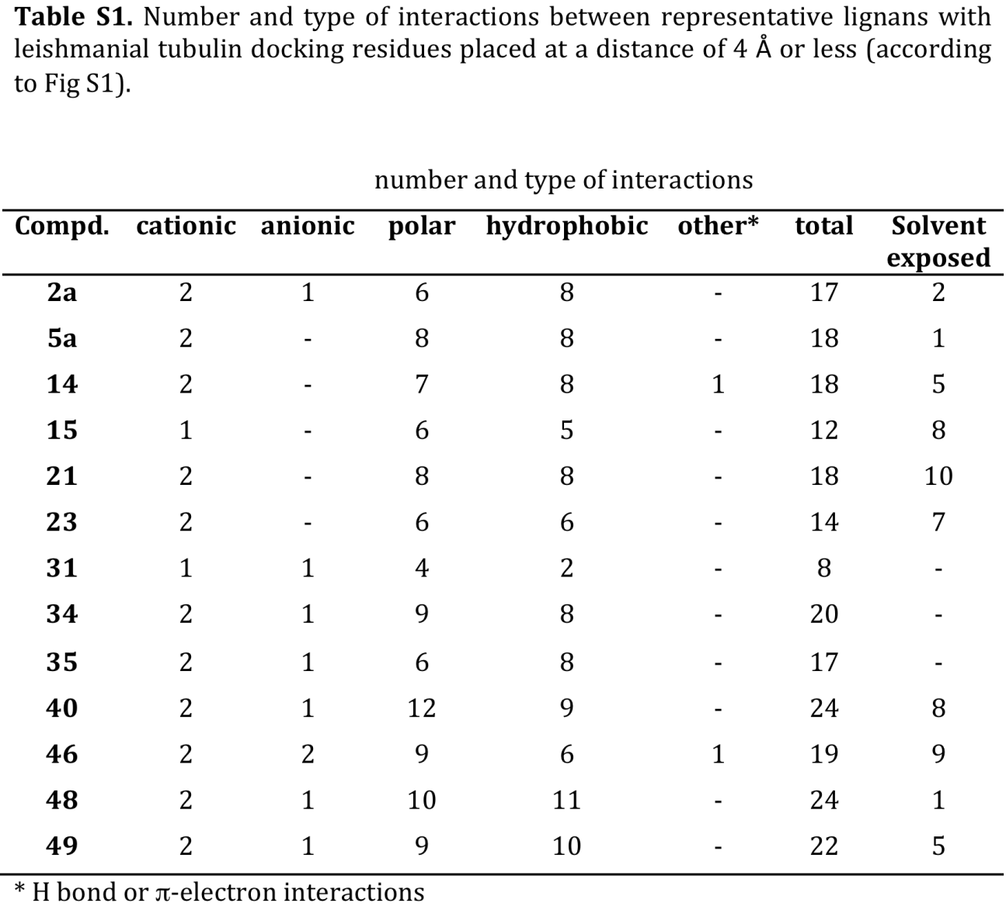
Tubulins:
Leishmania
Bos taurus
49
Figure S4. 2D interaction maps of several podolignans with the colchicine-binding site of Leishmania (left) and mammalian (right) tubulins

