Slide 1
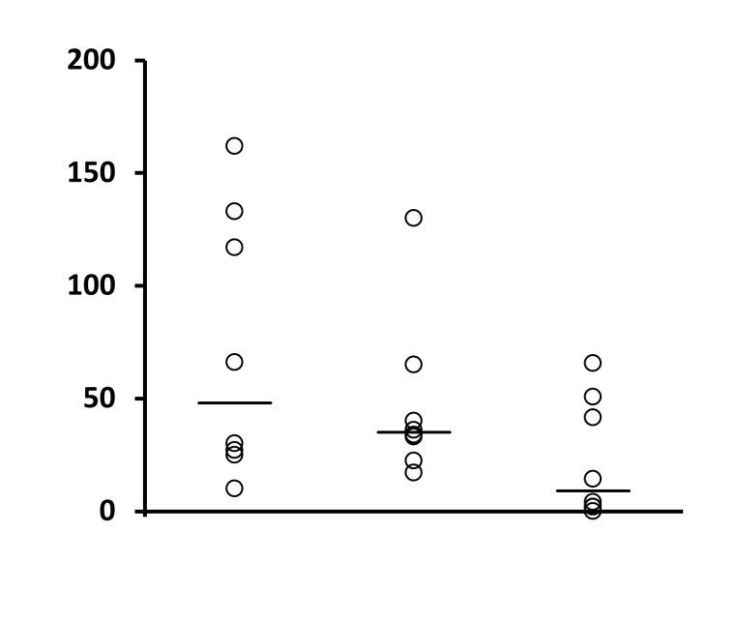
Supplementary figure 2
**
**
*
Nb SFC/5x10⁵ cells
1m
2m
4m
Time (months)

