Slide 1
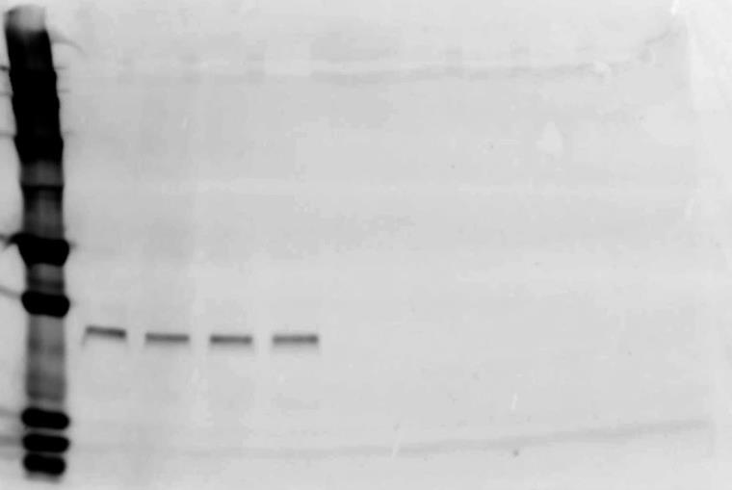
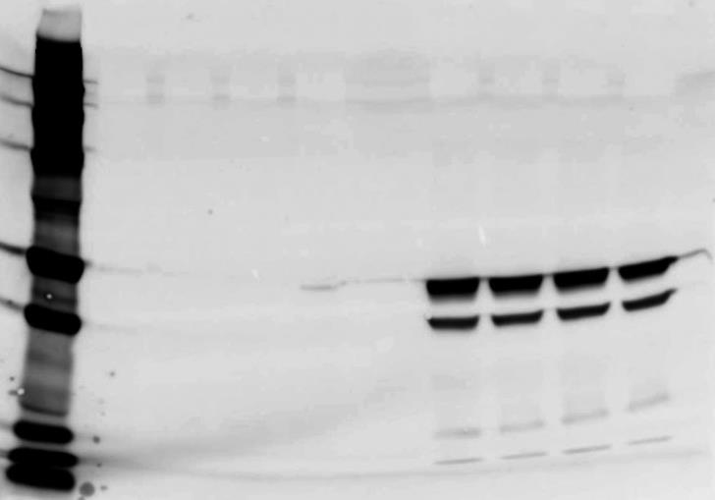
A
kD
250
150
100
75
50
37
GAPDH
25
20
15
10
1 2 3 4 5 6 7 8 9
B
C
M
kD
250
150
100
75
50
RCCV: ATP5A
37
RCCIII: UQCRC2
25
RCCII: SDHB
20
RCCI: NDUFB8
15
10
1 2 3 4 5 6 7 8 9
C
M

