Slide 1
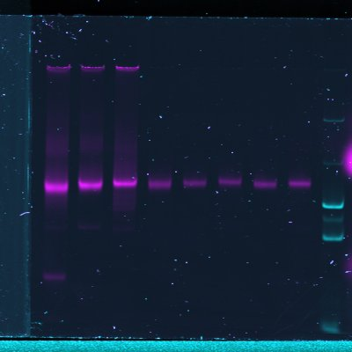
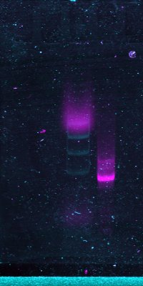
Uncropped gel images for Fig. 1b
M, bp
N13/
91
N35/
112
N57/
135
N13/
91
N35/
112
N57/
135
N35/
112
N57/
135
N13/
91
N35/
112
N57/
135
N13/
91
N35/
112
N57/
135
N35/
112
N57/
135
1000
1000
500
500
280
280
145
145
After reconstitution
After purification
After reconstitution
After purification
Cy5 (nucleosomal templates)
FAM (DNA markers)
Merge
M, bp
Upper panel: Analysis of assembled nucleosomes before and after gel-purification by native PAGE. Fluorescence of Cy5 (DNA-labeled nucleosomes, on the left), FAM (DNA markers, M, in the middle) or combined signals (on the right) were detected using a PhosphorImager. The part of the gel shown in fig. 1b is indicated by the red rectangle.
Lower panel: Analysis of histone-free DNA by native PAGE. Fluorescence of Cy5 (DNA, on the left), FAM (DNA markers, M, in the middle) or combined signals (on the right) were detected using a PhosphorImager. The part of the gel shown in fig. 1b is indicated by the red rectangle.
DNA
DNA
500
500
400
400
300
300
200
200
Cy5 (DNA)
FAM (DNA markers)
Merge

Slide 2
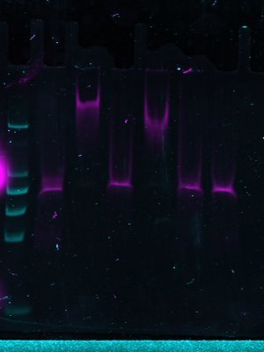
Uncropped gel images for Fig. 2a
- | + | + | - | - | +
- | + | + | + | + | -
- | - | + | - | + | -
- | + | + | - | - | +
- | + | + | + | + | -
- | - | + | - | + | -
Spt16/Pob3
Nhp6
DNA
M, bp
1000
1000
500
500
400
400
300
300
200
200
After purification
FAM (DNA markers)
Cy5 (nucleosomal templates)
Merge
After reconstitution
Binding of FACT and different combinations of its subunits to fluorescently labeled N35/112 nucleosomes analyzed by native PAGE. Fluorescence of FAM (DNA markers, M, on the left), Cy5 (DNA-labeled nucleosomes, in the middle) or combined signals (on the right) were detected using a PhosphorImager. An excess of competitor DNA was added to remove FACT from FACT-nucleosome complexes.

Slide 3
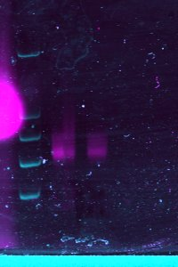
Uncropped gel images for Fig. 5b
H2A-
V101I
WT
H2A-
V101I
WT
M, bp
1000
1000
500
500
400
400
300
300
200
200
FAM (DNA markers)
Cy5 (nucleosomal templates)
Analysis of gel-purified nucleosomes N35/112 (WT) or the nucleosomes containing the suppressor mutation H2A-V101I by native PAGE. Fluorescence of FAM (DNA markers, M , on the left), Cy5 (DNA-labeled nucleosomes, in the middle) or combined signals (on the right) were detected using a PhosphorImager.

