Slide 1
A.
B.
n.s
n.s
#4-5
#9-10
#4-5
#9-10
Supplemental Figure 1. Location of breast tumor xenografts is not a factor in CCL2 antibody uptake or CCL2 levels. MCF10CA1d breast tumors were grafted into the #4-5 and #9-10 inguinal mammary glands. Tumor tissues from anti-CCL2 treated animals were analyzed for levels of A. CCL2 antibodies and B. human CCL2 by ELISA. Statistical analysis was performed using Two Tailed Student T test. Statistical significance was determined by p<0.05. n.s=not significant.

Slide 2
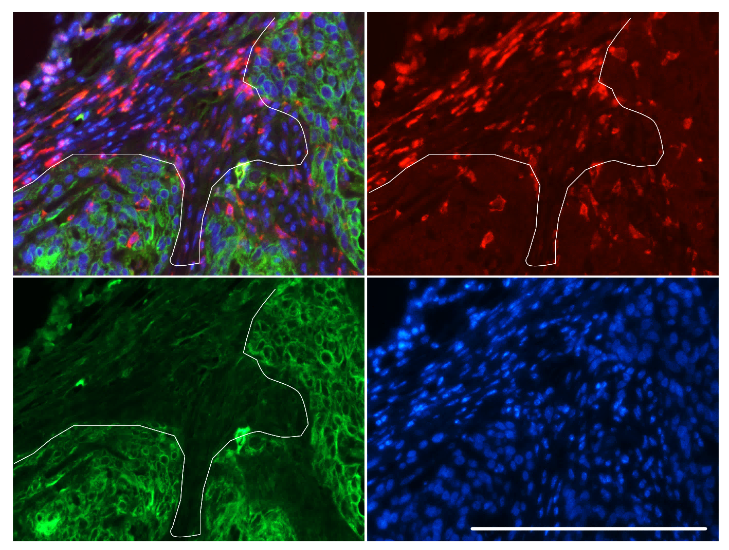
A.
Merge
F4/80
CK5
IE
DAPI
TC
B.
n.s
n.s
Supplemental Figure 2. Quantification of F4/80 macrophage infiltration in MCF10CA1d primary tumor tissues. A. Primary breast tumor xenografts were co-immunofluorescent stained for Cytokeratin 5 (CK5) and F4/80. F4/80+ cells were localized at the invasive edge (IE) and within the tumor core (TC). Representative image is shown. Scale bar=200 microns. B. F4/80 cells were quantified at the invasive edge and tumor core per mm³ using Image J software. Statistical analysis was performed using Two Tailed Student T test. Statistical significance was determined by p<0.05. n.s=not significant. Mean+SEM are shown.

Slide 3
**
Supplemental figure 3. Human recombinant CCL2 bound to neutralizing antibodies can not be detected by ELISA. Recombinant human CCL2 at 1 ng/ml were incubated with 10 ug/ml of control IgG or CCL2 neutralizing antibodies and analyzed for binding to CCL2 capture and detection antibodies by ELISA. Statistical analysis was performed using Two Tailed Student T test . Statistical significance was determined by p<0.05. **p<0.01

