Slide 1
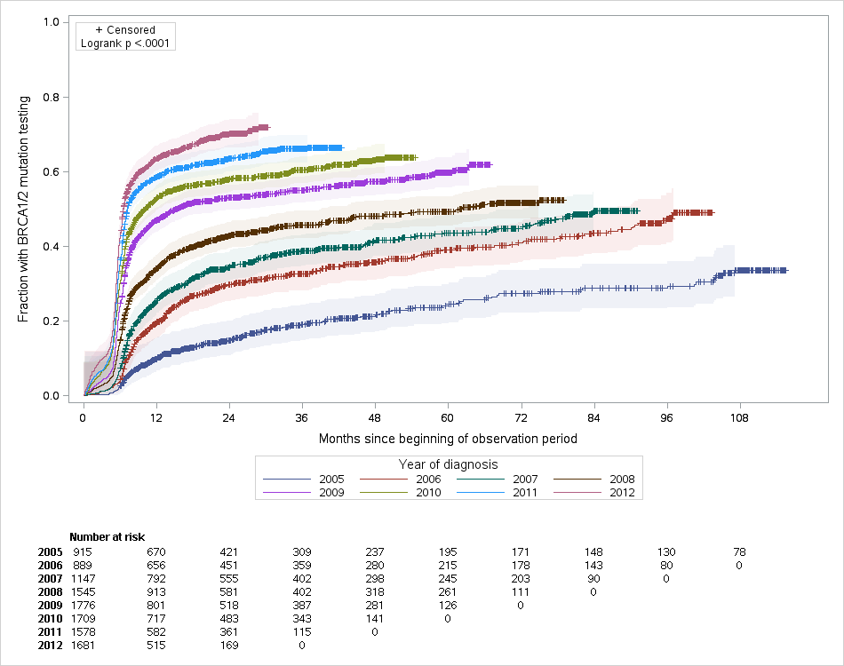
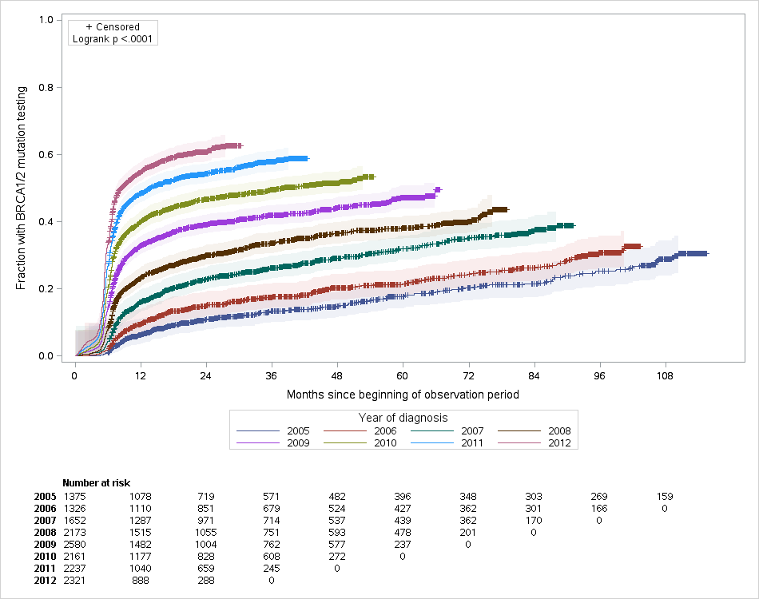
Supplemental Figure 1
Women age ≤ 40
Women age 41-45

