Slide 1
A.
N-terminal
hydrophobic region
C-terminal
hydrophobic region
HA₃
Dfi1-HA
Dfi1_{ΔC}-HA
ΔV271-F337
ΔE2-C47
Dfi1_{ΔN}-HA
ΔE2-C47
Dfi1_{ΔNΔC}-HA
ΔV271-F337
B.
DFI1
DFI1_{ΔC}
DFI1_{ΔN}
DFI1_{ΔNΔC}
C S P C S P C S P C S P
anti-HA
250 kDa
150 kDa
100 kDa
75 kDa
50 kDa
37kDa
anti-tubulin
50 kDa
Herwald et al.,
Figure 1
1 2 3 4 5 6 7 8 9 10 11 12

Slide 2
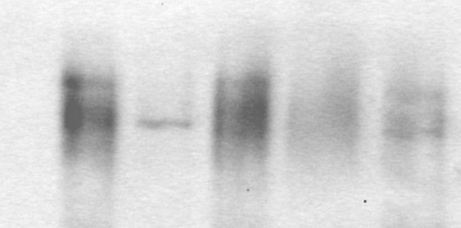
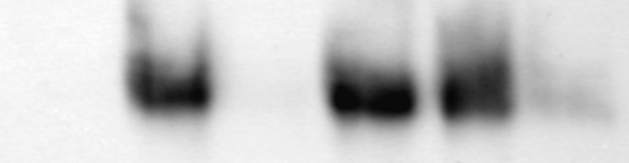
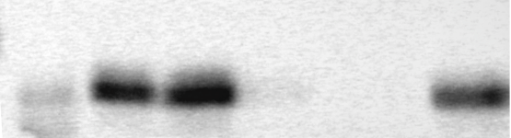
buffer
only
buffer
+urea
buffer
+Triton
buffer
only
buffer
+urea
buffer
+Triton
S P S P S P
S P S P S P
DFI1
DFI1_{ΔN}
1 2 3 4 5 6 7 8 9 10 11 12
DFI1_{ΔC}
DFI1_{ΔNΔC}
13 14 15 16 17 18 19 20 21 22 23 24
Herwald et al.,
Figure 2

Slide 3
DFI1_{N-TM}
DFI1_{N-TM}
DFI1
DFI1_{ΔN}
DFI1_{ΔC}
DFI1_{ΔNΔC}
_{replacement C}
_{replacement Z}
PNGase F
- +
- +
- +
- +
- +
- +
250 kDa
150 kDa
100 kDa
75 kDa
50 kDa
37kDa
1 2 3 4 5 6 7 8 9 10 11 12
Herwald et al.,
Figure 3

Slide 4
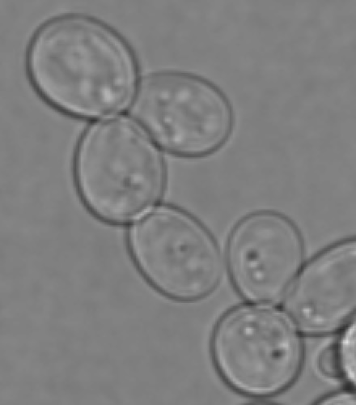
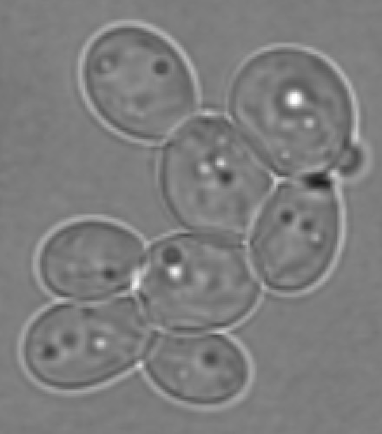
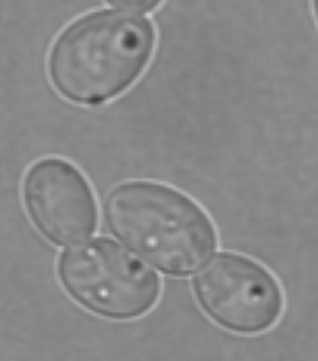
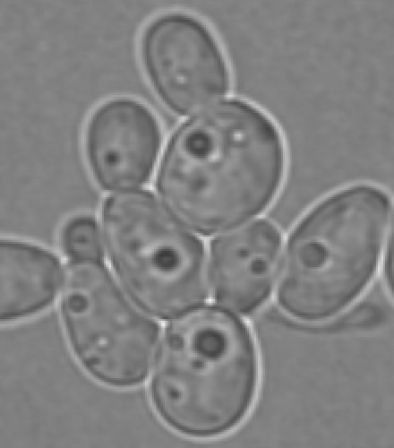
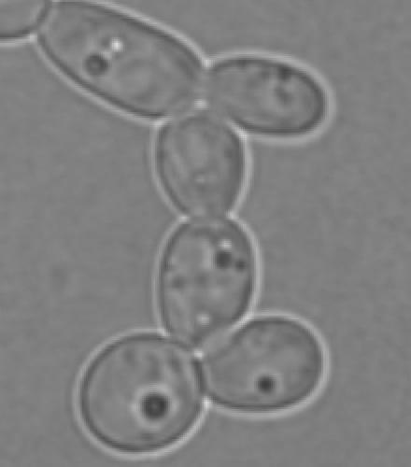

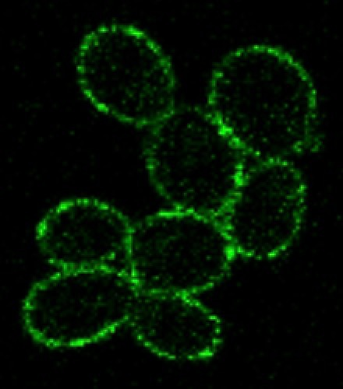
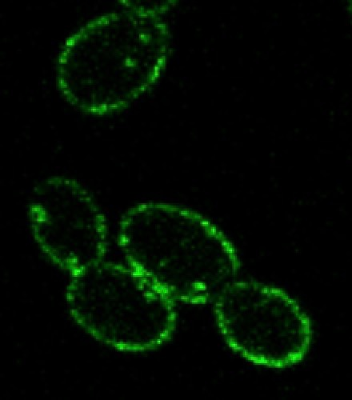
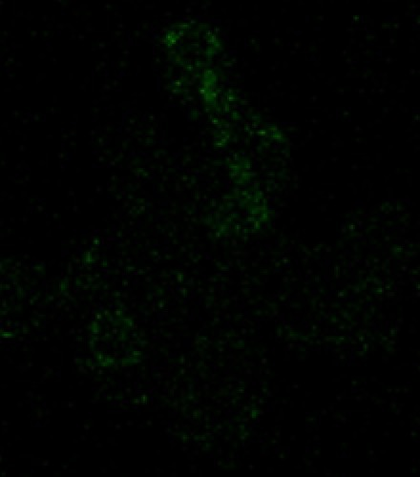
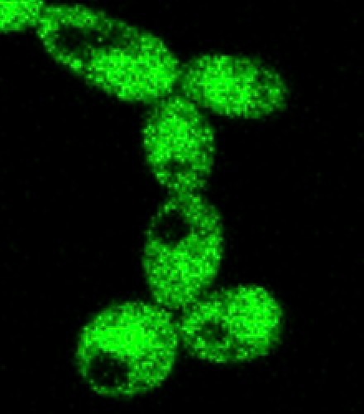
A B C D E
Bright
Field
GFP
Wild-type
DFI1-GFP
DFI1_{ΔN}-GFP
DFI1_{ΔC}-GFP
DFI1_{ΔNΔC}-GFP
Herwald et al.,
Figure 4

Slide 5
buffer
only
buffer
+urea
buffer
+Triton
S P S P S P
DFI1_{ΔN}
50kDa
1 2 3 4 5 6
Herwald et al.,
Figure S1

