Slide 1
Supplementary Figure 1
Legend: Violin plot for the number of NsM (log10) in ICGC + TP data. Red line is the cutoff for 192 NsM.

Slide 2
Supplementary Figure 2
Legend: Correlation between beta values conditional logistic regression controlling for tumor type on TCGA (discovery) and ICGC+TP (replication).

Slide 3
Supplementary Figure 3
Legend: Correlation between gene cDNA size (bp) and TCGA (discovery) and ICGC+TP (replication) meta-analysis beta values from conditional logistic regression controlling for tumor type.

Slide 4
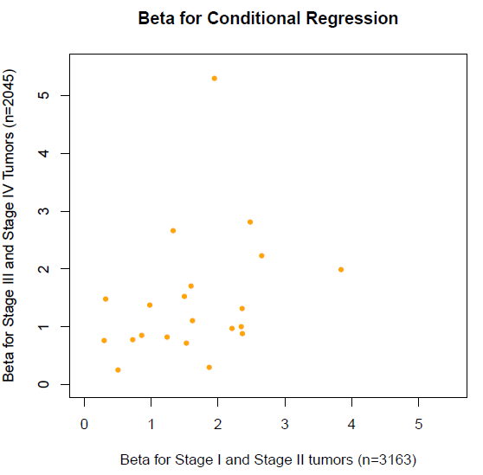
Supplementary Figure 4
Legend: Correlation between conditional logistic regression beta for stage III and stage IV samples and beta for stage I and II samples (Spearman p-value = 0.037, rho=0.45).

Slide 5
Supplementary Figure 5
Legend: Tumor type frequencies (%) on patients that could present benefit for combination therapy, regarding gene mutated.

Slide 6
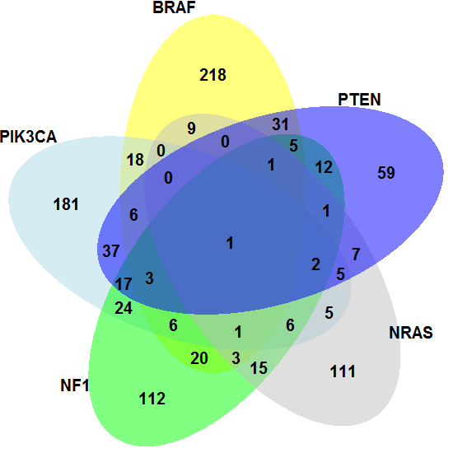
Supplementary Figure 6
Legend: Venn diagram for the top five most common genes mutated on the 1,194 patients that could present benefit for combination therapy.

Slide 7
Supplementary Figure 7
Legend: Violin plot for the number of non-synonymous mutations (log10) across MET, ERBB2, PTEN, and NF2, regarding gene mutation, CNV, both or no alteration. P-value refers to fisher’s test comparing proportion of samples regarding gene alteration and 192 NsM threshold.

