Slide 1
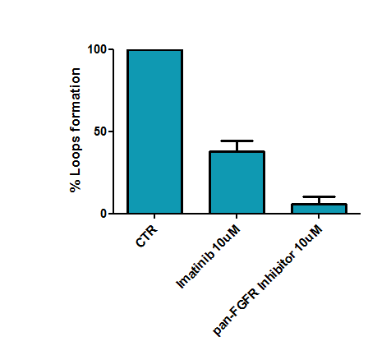
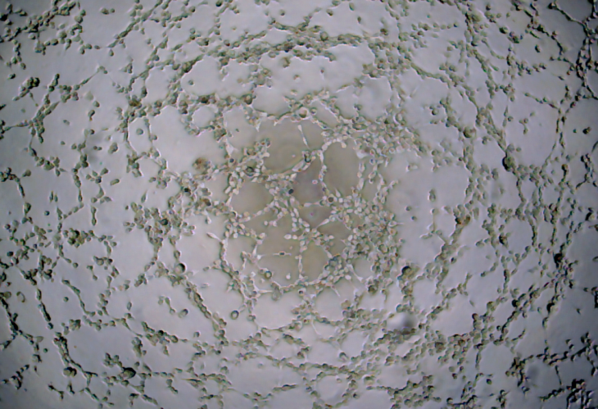
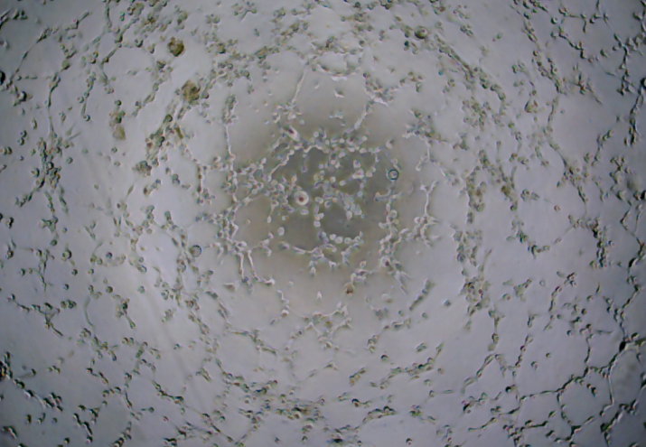
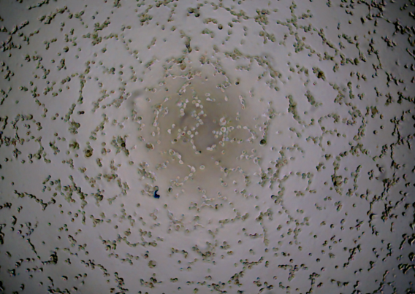
Suppl. Fig. S7
A
CTR
Imatinib10uM
pan-FGFR Inhibitor 10uM
B
FGFR2
PDGFRbeta
Imatinib/DMSO
anti-FGFR/DMSO

