Slide 1
Supplementary Fig. S1 Representative immunoflourescent photos for PAR signal as indication for PARP activity. Cells were treated for 2h with either DMSO or Olaparib before incubation for 20 min with 15mM H2O2. Then cells were fixed and stained for PAR using immunofluorescence (see Materials and methods).

Slide 2
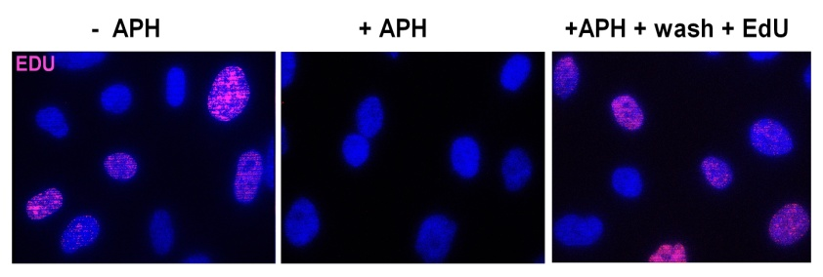
A
B
C
D
Supplementary Fig. S2 Olaparib-mediated radio-sensitization in Responders is replication-independent. (A) Left panel: Representative photos for EdU incorporation in the before APH treatment. Right panel: Quantification of EdU-positive cells before and after APH treatment. (B) Histogram plots of Propidium Iodide (PI) from the indicated cell lines after 18h-treatment with 2.5 µM APH. (C) & (D) Shown are the relative survival fractions for the indicated cells after 2 Gy dose with or without APH in the presence or absence of Olaparib.
Notes:
Effect of Olaparib on sensitization of tumor cells to irradiation

Slide 3
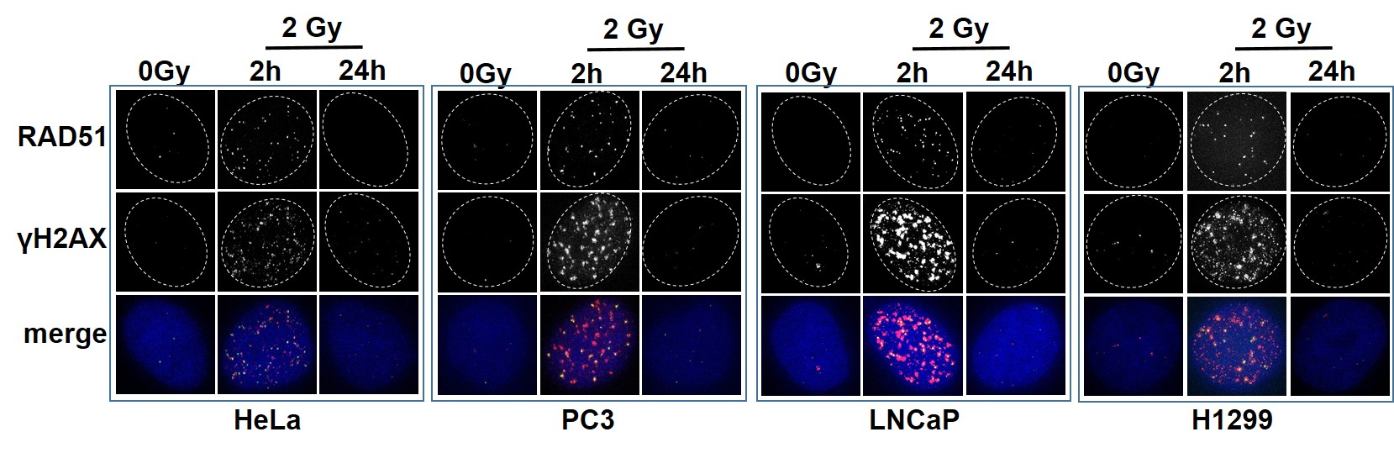
A
B
C
D
Supplementary Fig. S3 Olaparib treatment does not affect HR. (A) Tumor cells were treated with the indicated concentrations of Olaparib and the survival fractions were measured by colonogenic forming assay. (B) the survival fractions measured as in (A) for hamster HR-deficient irs1SF cells (Xrcc3^{-/-}) and their parental wild type AA8 cells. (C) representative photos for RAD51 and γH2AX foci at the indicated time points after 2Gy. (D) HR efficiency measured by HR reporter (pGC) substrate. Cells were transfected by a linearized pGC in the presence or absence of Olaparib and the percent of GFP+ cells were monitored 48h thereafter.

Slide 4
Supplementary Fig. S4 Effect of Olaparib alone on DSB repair. The indicated cells were treated with 1µM Olaparib for 2h and after the indicated time points, the number of γH2AX foci were numerated.

Slide 5
A
B
C
Supplementary Fig. S5 Olaparib treatment does not induce cell cycle arrest or apoptosis. (A)&(B) Indicated cells were firstly incubated with Olaparib for 2h pre-3Gy before fixation at the indicated time points post-irradiation. Cell cycle analysis was performed by flow cytometry after propidium iodide (PI) staining. (C) Detection of apoptosis via caspase activity. Cells X-irradiated with 3 Gy in the presence or absence of Olaparib and analyzed at 24h time point. Values obtained for 0 Gy were subtracted. Jurkat cells irradiated with 3 Gy and incubated with 1 μM staurosporine for 24 h were used as a positive control.

Slide 6
Supplementary Fig. S6 Effect of PARP inhibition on end joining efficiency measured by pEJ substrate. The indicated cells were treated with 1µM Olaparib before transfection with a linearized pEJ substrate to measure end joining efficiency. After 48h, the percent of GFP+ cells were measured by FACs. Indicated are the means ±SEM of at least 4 experiments.

