Slide 1
A
B
Sup Fig 1: Lack of correlation between invasiveness and miR-138 and miR-215 expression levels in a panel of human ADC cell lines.
A. (Left) Relative expression levels of miR-138 in the panel of ADC cell lines. (Right) No correlation was observed between invasiveness and miR-138 expression levels. B. (Left) Relative expression levels of miR-215 in the panel of ADC cell lines. (Right) No correlation was observed between invasiveness and miR-215 expression levels.
Valencia et al.
Sup. Figure 1

Slide 2
Sup Fig. 2: Forced expression of miR-192 decreases MMP activity in cells cultured alone or in coculture with ST-2 cells.
Global MMP activity in a fluorogenic assay using a substrate for MMP-3 and MMP-10 incubated with the conditioned medium derived from cells overexpressing miR-192 cultured alone (Top) or in coculture with stromal ST-2 cells (Bottom). A global MMP inhibitor GM6001 was used as a global inhibitor of metalloprotease activity.
Valencia et al.
Sup. Figure 2

Slide 3
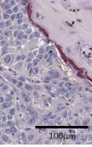
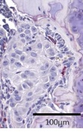
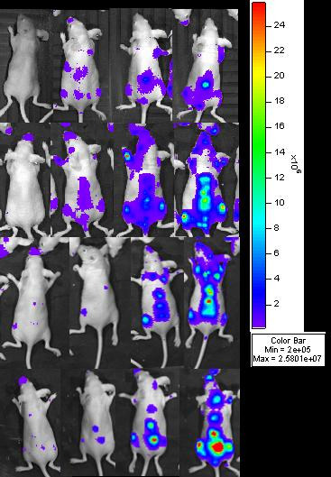
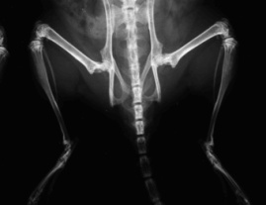
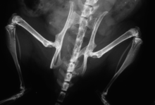
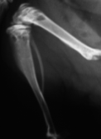
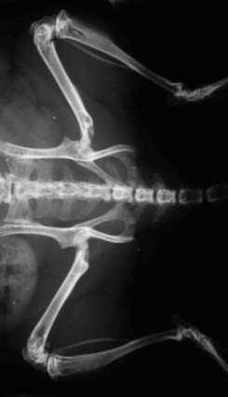

A
mock
miR-192
T
T
B
C
M1
A549
mock
M1
Week
1
2
3
4
miR-138
miR-215
A549
mock
D
miR-138
miR-215
Sup Fig. 3: miR-192 mediates an anti-osteoclastogenic effect in vivo whereas miR-215 and miR-138 do not confer changes in prometastatic activity or cell growth kinetics.
A. Osteoclastogenesis in-vivo was measured by TRAP+ staining at the bone-tumor interphase in 21 day-post injection intracardiac tibias. We found a significantly smaller perimeter of tumor-bone interphase surrounded by TRAP+ cells in miR-192 overexpressing tumors. B. M1 cells overexpressing miR-138 and miR-215 levels, vector-transduced M1 cells (mock), and parental (A549) cells were inoculated into the left cardiac ventricle of athymic nude mice. Top: Quantification of photon flux at day 21 post-inoculation. Bottom: Representative BLI. C. Top: Quantification of osteolytic bone area of X-ray imaging at day 21 post-inoculation. Bottom: Representative images of X-ray showing no differences in osteolytic lesions in miR overexpressors as compared to mock transduced. D. In vitro proliferation assay of miR-138 and miR-215 overexpressing cells, showing no differences in cell growth kinetics.
Valencia et al.
Sup. Figure 3

Slide 4
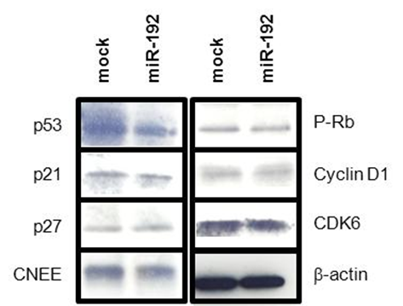
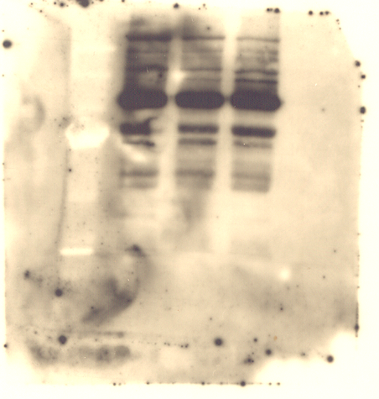
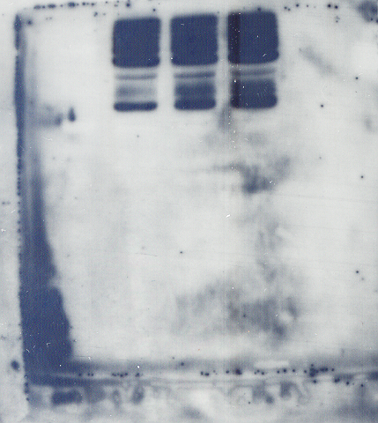

A
B
C
D
E
M1
A549
mock
miR-192
PARP
Cleaved- PARP
Caspase-3
Cleaved- Caspase-3
β-tubulin
Sup Fig. 4: miR-192 does not alter cell growth in vitro or in vivo.
A. In vitro proliferation assay of miR-192 cells by MTT assay. B. In vivo tumor growth after subcutaneous injection of miR-192 and mock cell in the flank of athymic nude mice. C. Western blot analysis of cell cycle proteins in miR-192 and mock cells. D. Cell cycle assessed by flow cytometry. E. Apoptosis studied by cleaved PARP and cleaved caspase-3 in parental A549, mock M1 and miR-192 overexpressing cells, showing no differences among them.
Valencia et al.
Sup. Figure 4

Slide 5
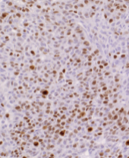
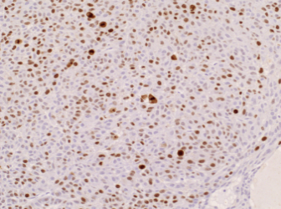
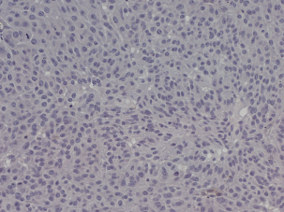
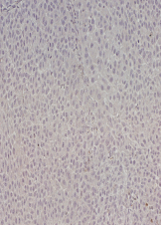
A
mock
miR-192
B
mock
miR-192
Sup Fig 5: miR-192 does not confer changes in proliferation or apoptosis rates in metastatic bone lesions
A. Immunohistochemical analysis of Ki67+ cells in metastatic bone lesions derived from athymic nude mice i.c. inoculated with miR-192 overexpressing cells and mock control cells. No differences were detected. B. Immunohistochemical analysis of activated caspase-3 positive cells in metastatic tumors. No differences were detected.
Valencia et al.
Sup. Figure 5

Slide 6
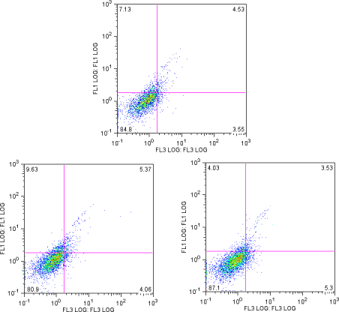
A
HUVEC
A549
HUVEC
mock
HUVEC
miR192
B
C
M1
D
Sup Fig. 6: Conditioned medium (CM) derived from miR-192 overexpressing cells contains high levels of miR-192 but similar ELV and it does not alter apoptosis of HUVEC cells.
A. Apoptosis rate by annexin V was assessed in HUVEC cells previously treated with conditioned media derived from A549 (parental), mock and miR-192-overexpressing cells. No differences in apoptosis rate were detected. B. MiR-192 levels were examined by qPCR in CM of A549 parental cells and M1 cells transduced with vector only (mock), or overexpressing miR-192. Cells were cultured in a special culture medium with ELV-depleted serum. Higher levels of miR-192 were found in A549 and overexpressing cells as compared to M1 mock cells. C. ELV production levels were determined by measuring the amount of protein in the ELVs isolated from supernatant normalized with the total amount of protein in cell lysates. The amount of ELVs from M1 miR-192 and mock cells was similar. D. Quantification of miR-192 levels by qPCR in human bone marrow endothelial cells (HBMEC) co-cultured in a Boyden chambers with A549, mock and miR-192 cells.
Valencia et al.
Sup. Figure 6

Slide 7
A
B
Sup Fig. 7: Genes repressed by miR-192 in HUVEC and their functional categories
A. Top repressed genes in HUVEC cells transfected with miR-192. In yellow, genes previously related to angiogenesis. B. Gene functional enrichment analysis performed by multiple annotation to GO, KEGG, Interpro and SP-Keywords for the set of genes that are repressed by the overexpression of mir-192 in A549 M1 cells. Only categories related with angiogenesis, hemostasis and wound healing are represented.
Valencia et al.
Sup. Figure 7

Slide 8
Sup. Table 1: List of predicted direct or indirect targets repressed by miR-192 in HUVEC
Valencia et al.
Sup. Table 1

Slide 9
A
B
Sup Fig. 8: Pro-angiogenic genes regulated in murine and human cell lines upon miR-192 overexpression by retroviral transduction
A. Left: Overexpression of miR-192 in a mouse endothelial cell line PY4.1 was assessed by qRT-PCR. Right: qRT-PCR analysis confirmed the regulation of ICAM1 and CXCL1, whereas LAMB-1 was unaffected in in miR-192 overexpressing cells as compared to mock transduced cells. B. Left: Overexpression of miR-192 in a human endothelial cell line HBMEC by retroviral transfer. Right: qRT-PCR analysis confirmed the regulation of CXCL1, and IL-8 in miR-192 overexpressing cells, whereas ICAM-1 was unaltered in this cell line.
Valencia et al.
Sup. Figure 8

Slide 10
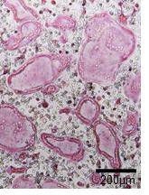
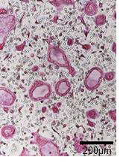
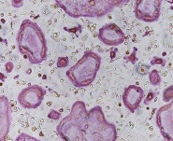
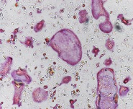
A
B
mock
miR-192
mock
miR-192
Sup. Fig. 9: Osteoclastogenesis in vitro using CM or ELV
A. Osteoclastogenesis assay was performed using CM of tumor cells. CM from tumor cells overexpressing miR-192 induced a significant decrease in the number of multinucleated TRAP+ cells. The experiment was repeated three times with similar results. B. Osteoclastogenesis assay was performed treating mononuclear precursors with 2µg/24h microvesicles derived from A549 cells, M1mock and M1miR192 cells. No differences in the number of multinucleated TRAP+ cells were detected.
Valencia et al.
Sup. Figure 9

Slide 11
Sup Fig 10: Changes in gene expression levels in murine tumor-associated cells of subcutaneous tumors
Three groups (n=6 per group) of nude mice were subcutaneously injected with A549, mock and miR-192 cells. After tumor dissection, analysis of size-matched tumors was performed for murine CXCL1, ICAM1 and LAMB1 by RT-qPCR.
Valencia et al.
Sup. Figure 10

Slide 12
A
B
i.c.
0
Days
7
14
21
28
C
Sup Fig 11: Correlation of serum miR-192 levels and tumor burden in a model of bone metastasis.
A. Experimental regimen inoculating the M1 cells into athymic nude mice. A group of 10 mice was sacrificed at each time point. B. Relative serum levels of miR-192 were validated by qPCR according to previously published protocols . C. Correlation with bioluminescence and X-ray images were performed for miR-192.
Valencia et al.
Sup. Figure 11

