Slide 1
Methods in Supplementary file 2
MCF10A/Tet-on/TRE-ERBB2VE/Eco cells were seeded at a density of 2.0×10⁵ cells in each well of a 24-well plate, followed by infection with a 1:9 (A, B and D) or 1:4 (C) mixture of diluted viruses and growth medium on the next day. After 24 h, the cells were moved to new dishes. Three dimensional culture of the cells was performed following the procedure represented in Materials and methods.
Figure Legends
(A, p.3) (B, p.4-6) Marked phenotypic changes in RARA–infected acinus compared to those infected with other genes included in subgroup #3. MCF10A/Tet-on/TRE-ERBB2VE/Eco cells were transfected with mock or screened genes by retroviruses and were cultured on Matrigel for 14 days.
(C, p.8-10) (D, p.12-14) Almost no effect of 10 genes within subgroup #6 and #10 on acinus formation. MCF10A/Tet-on/TRE-ERBB2VE/Eco cells were infected with indicated genes and cultured on Matrigel for 20 (C) or 19 days (D).
In the lower panels, ERBB2VE was induced by the addition of Dox at day 4. Although some were mistakenly labeled, scale bars all represent 500 µm.

Slide 2
Subgroup #3

Slide 3
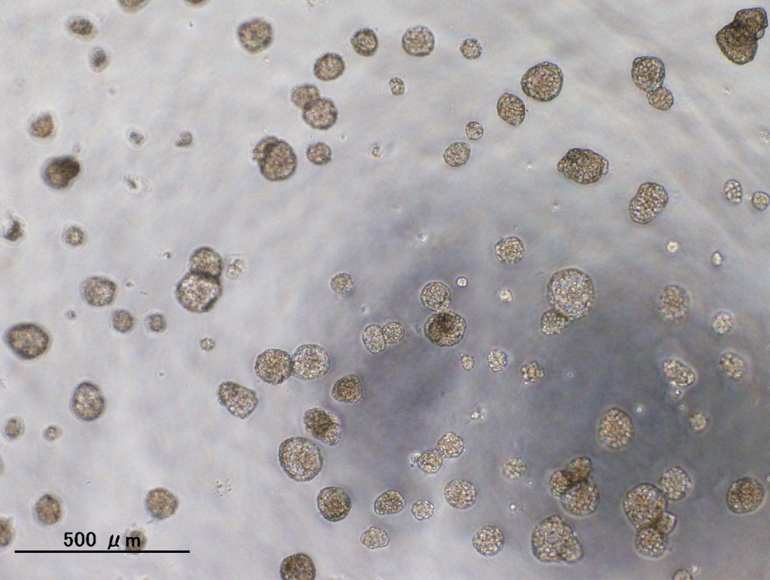
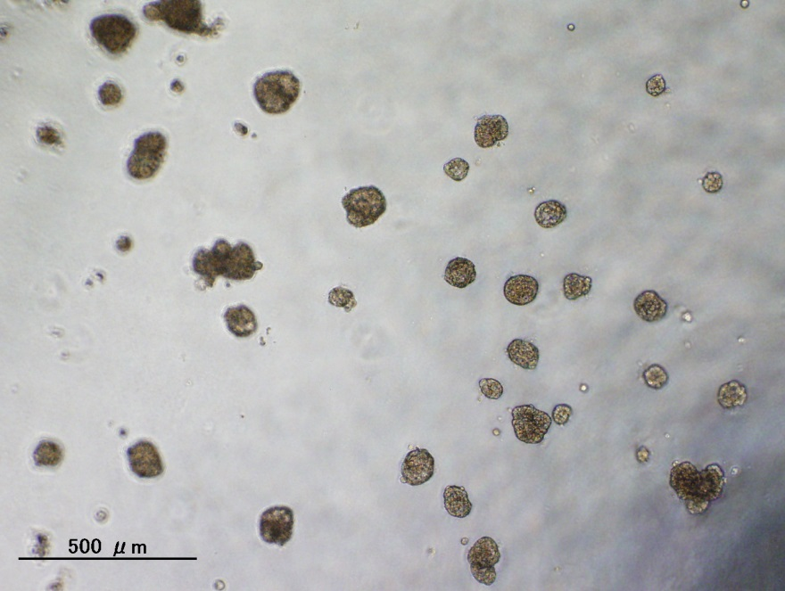
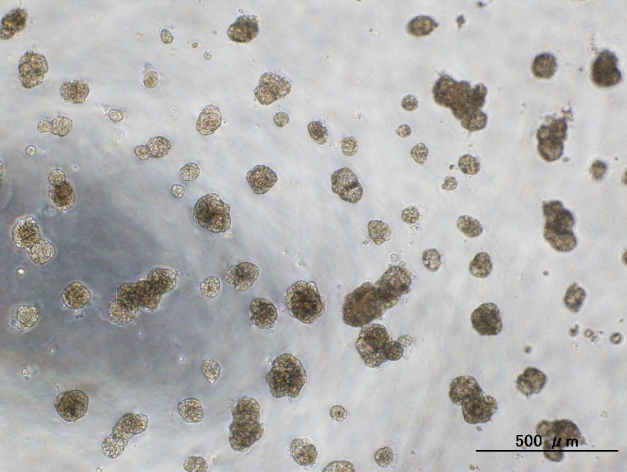
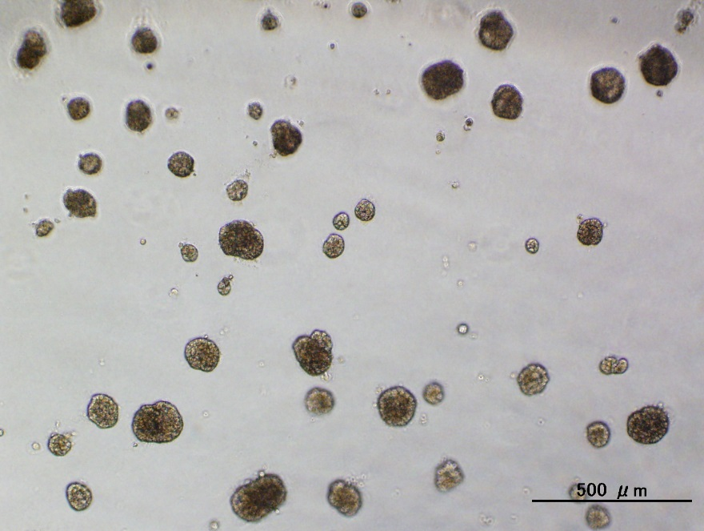
(A)
mock
RPL23
Dox. (-)
Dox. (+)

Slide 4
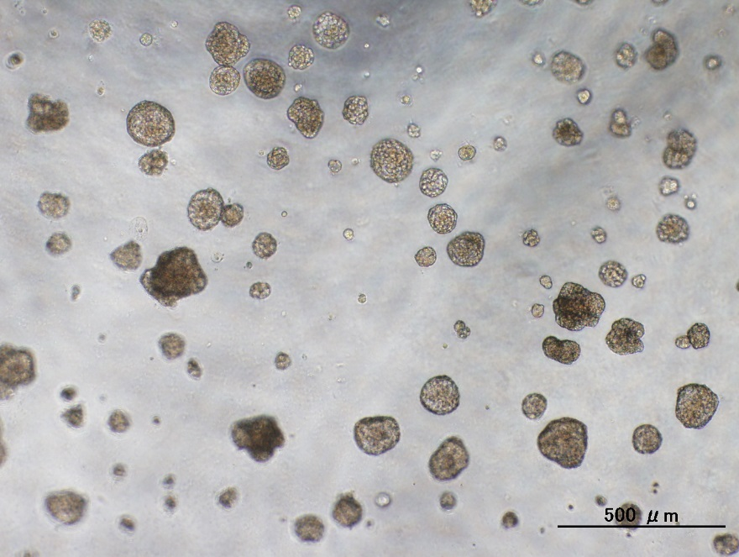
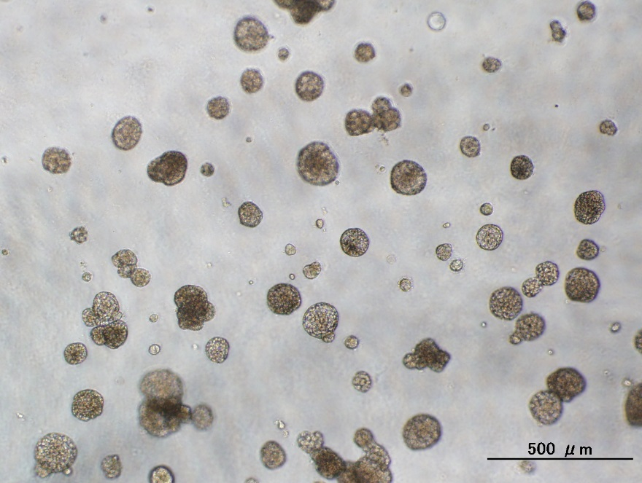
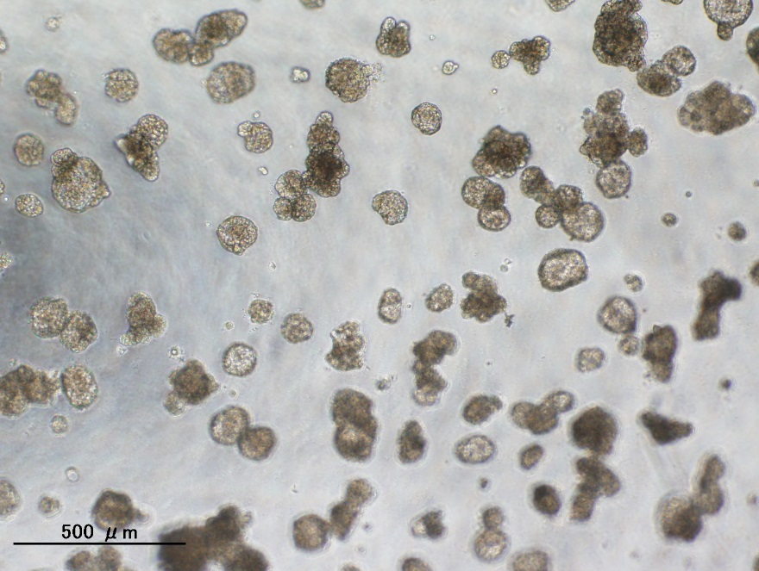
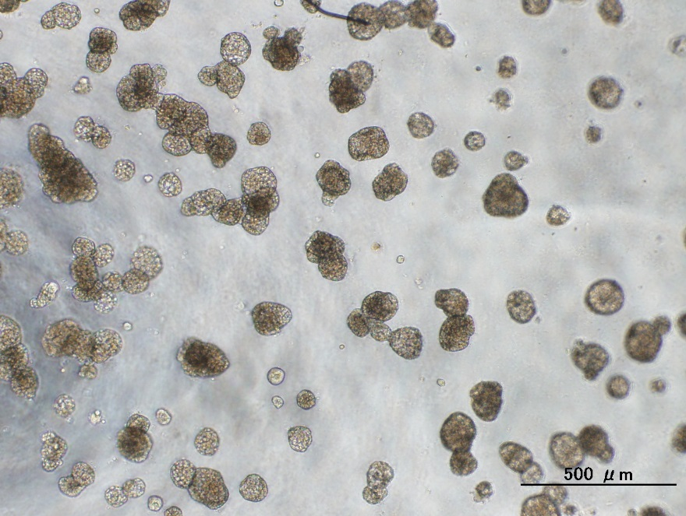
(B)
mock
HNF1B
Dox. (-)
Dox. (+)

Slide 5
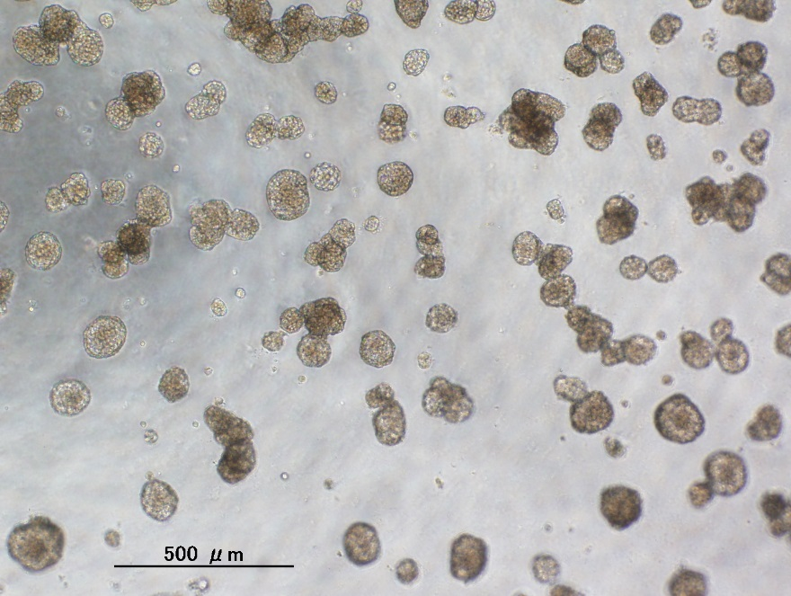
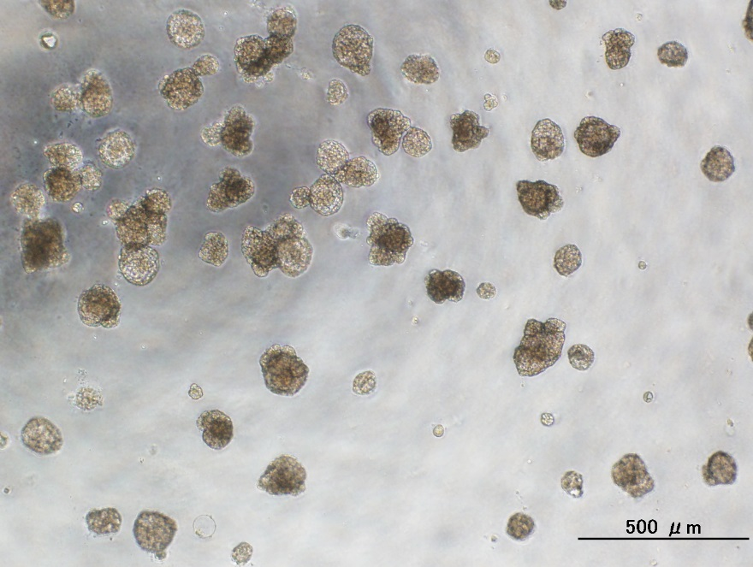
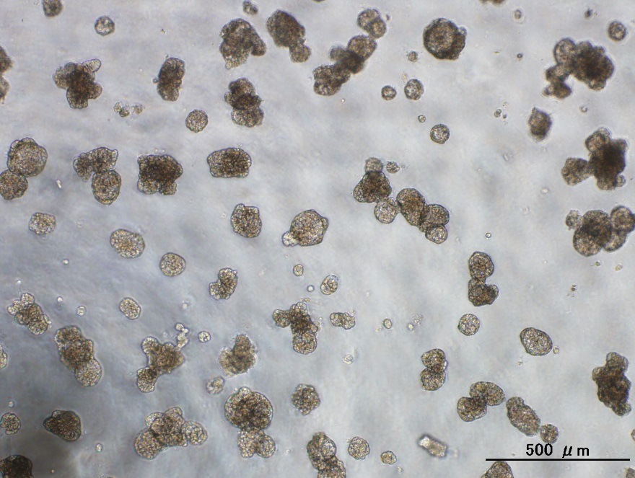
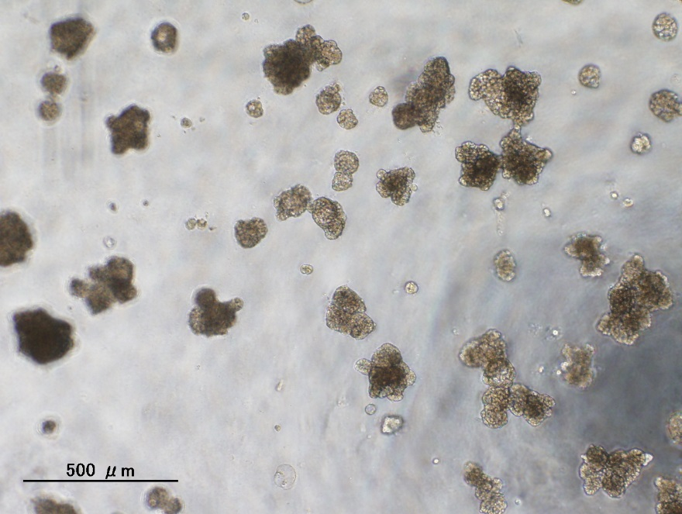
MED1
GSDMB
Dox. (-)
Dox. (+)

Slide 6
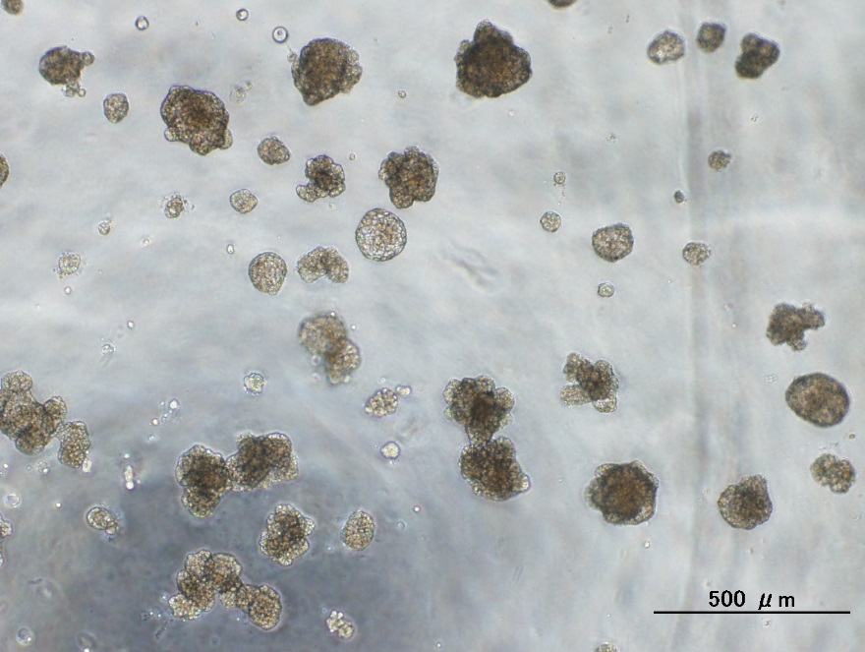
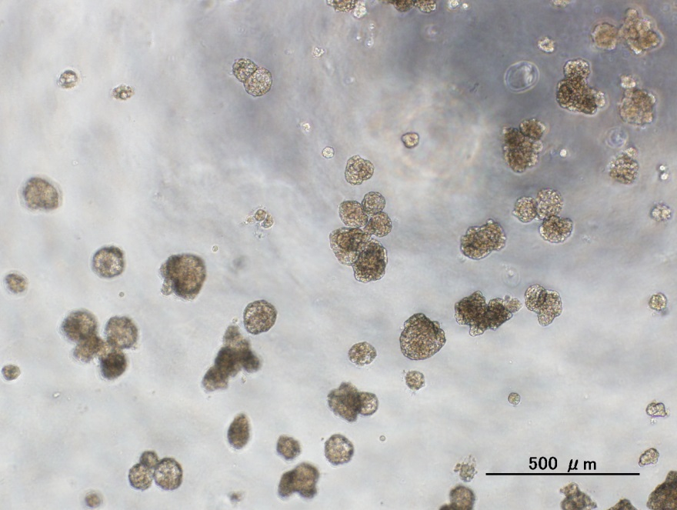
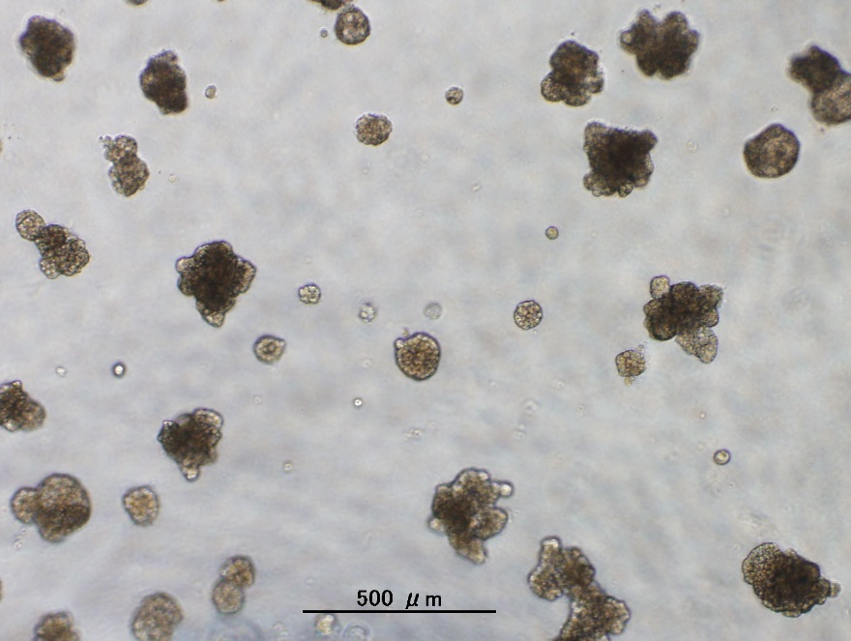
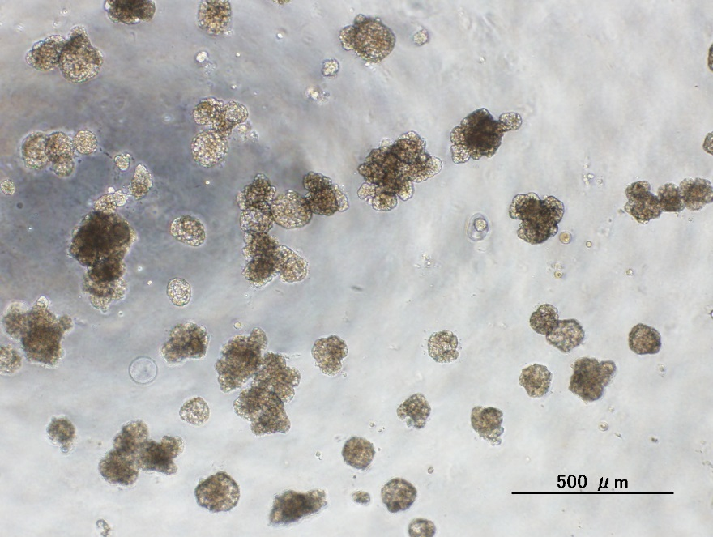
RARA
IGFBP4
Dox. (-)
Dox. (+)

Slide 7
Subgroup #6

Slide 8
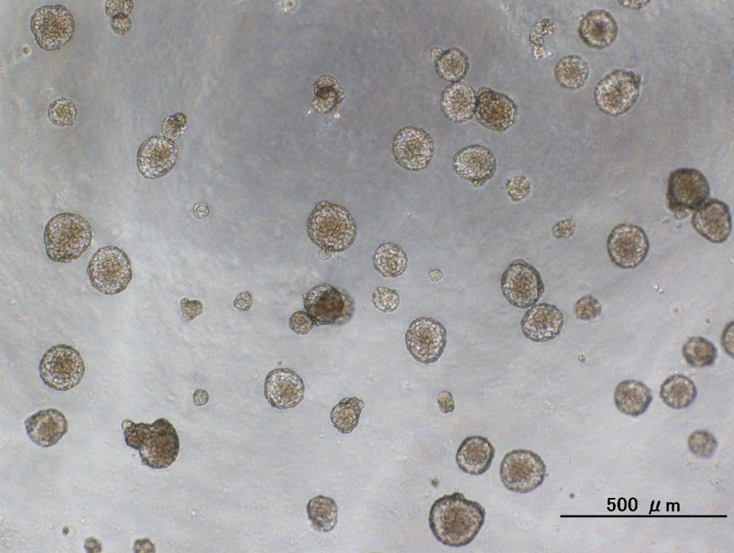
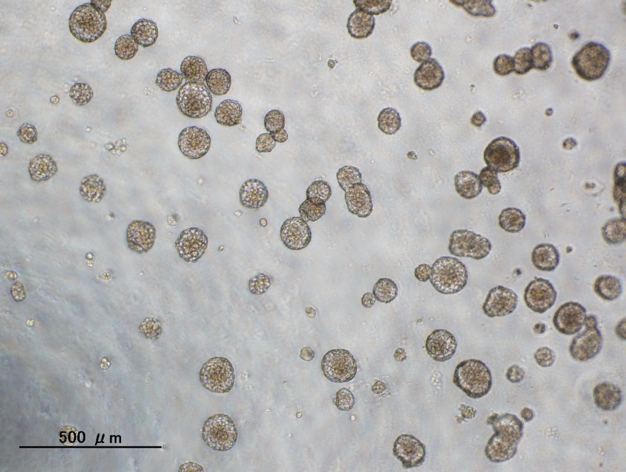
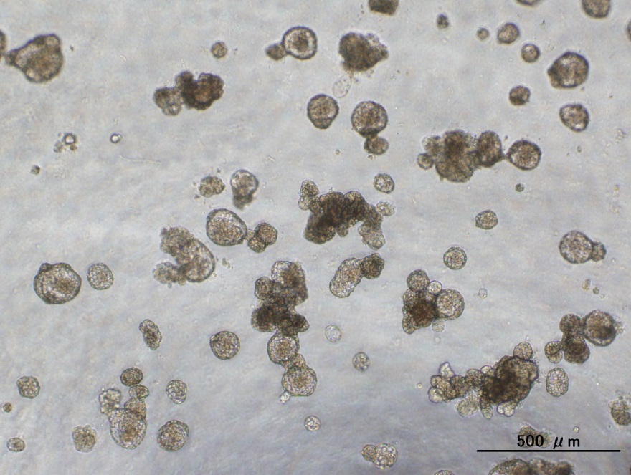
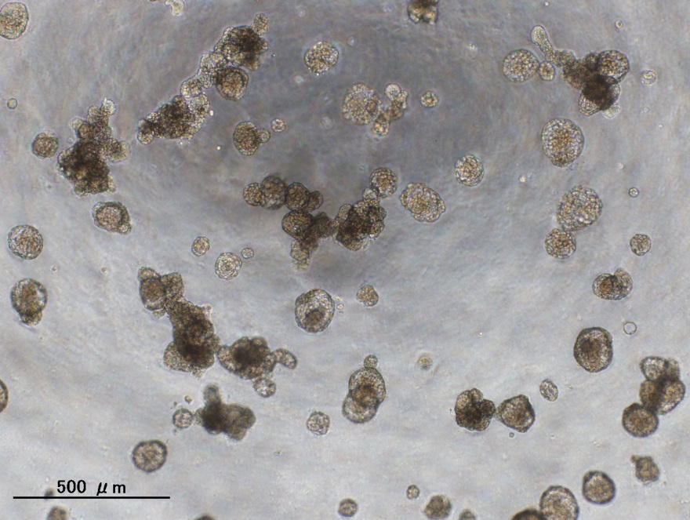
(C)
mock
CWC25
Dox. (-)
Dox. (+)

Slide 9
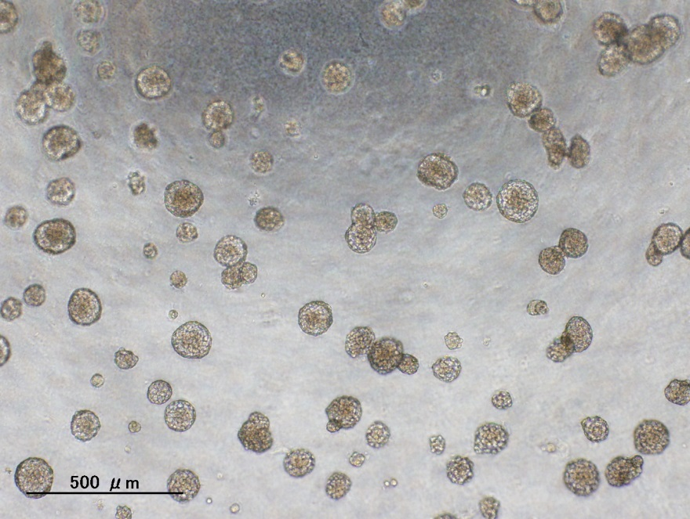
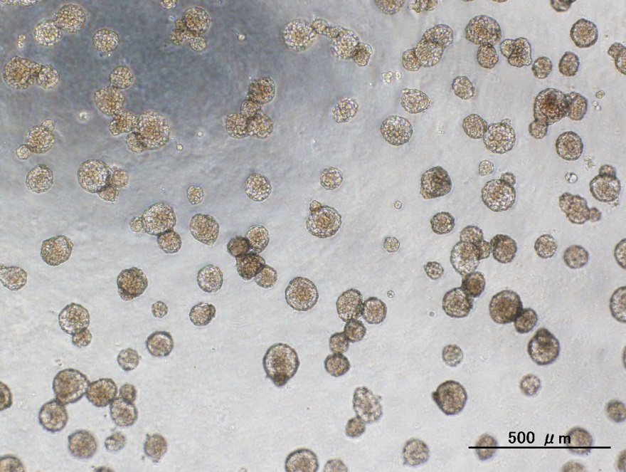
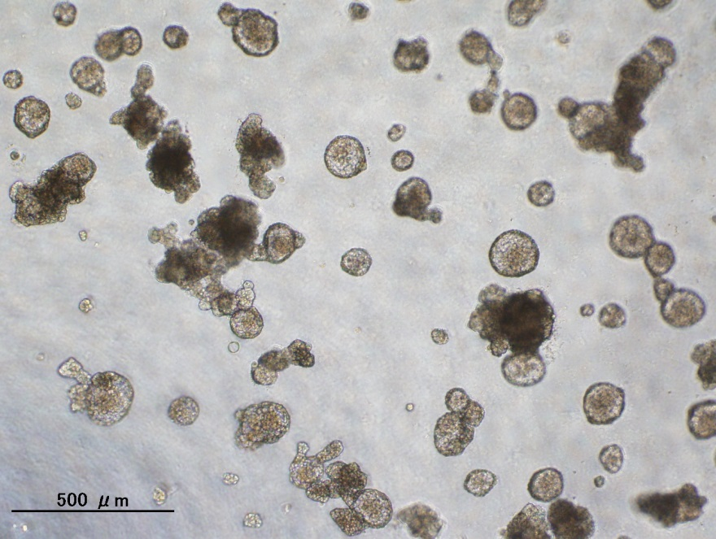
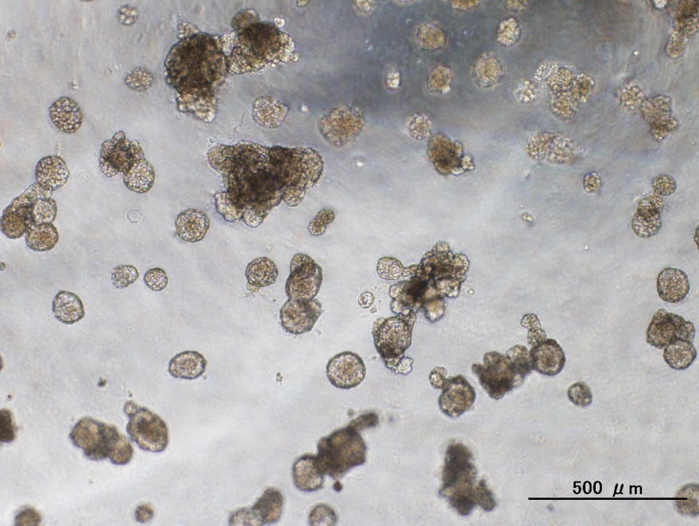
TCAP
PGAP3
Dox. (-)
Dox. (+)

Slide 10
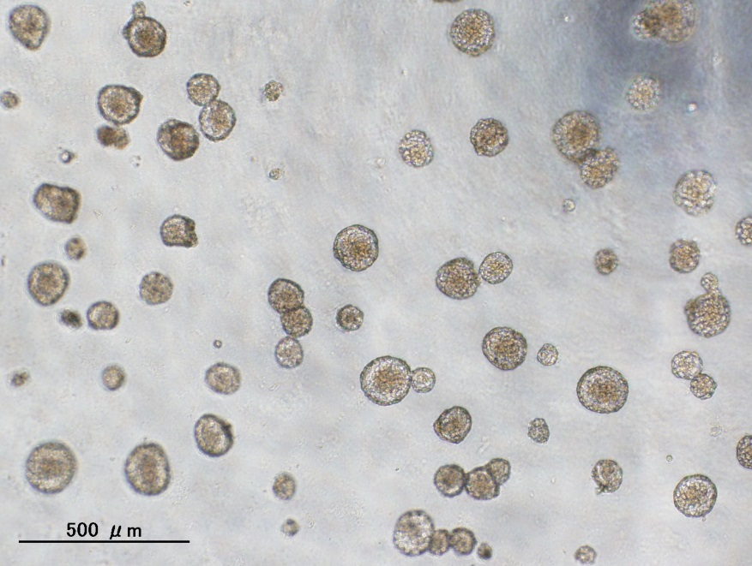
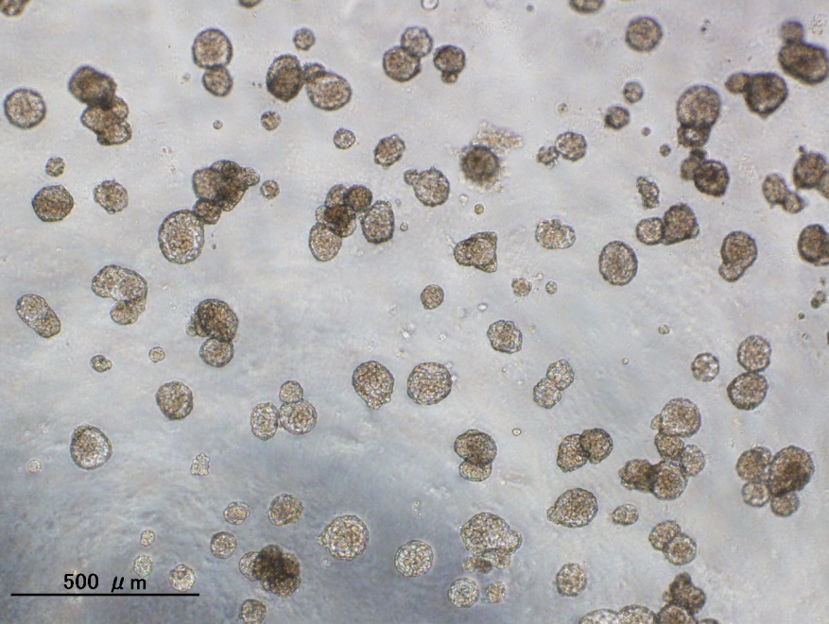
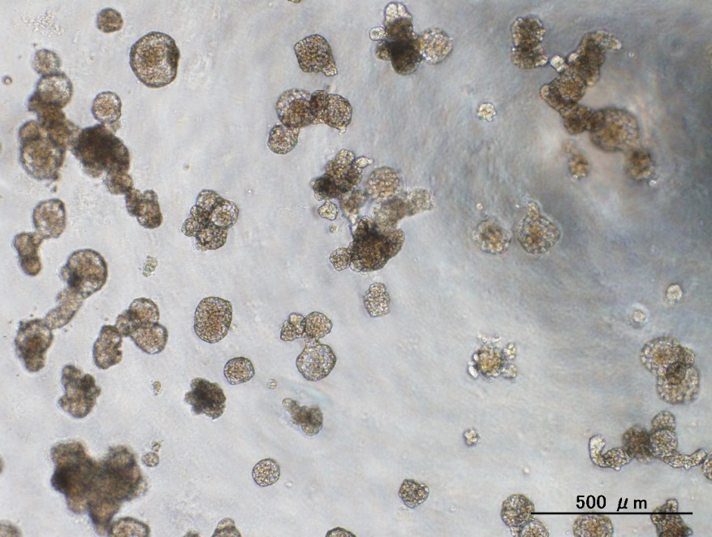
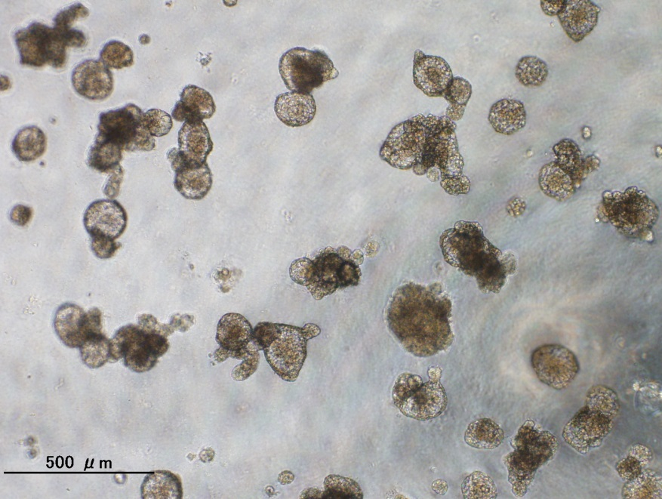
THRA
NR1D1
Dox. (-)
Dox. (+)

Slide 11
Subgroup #10

Slide 12
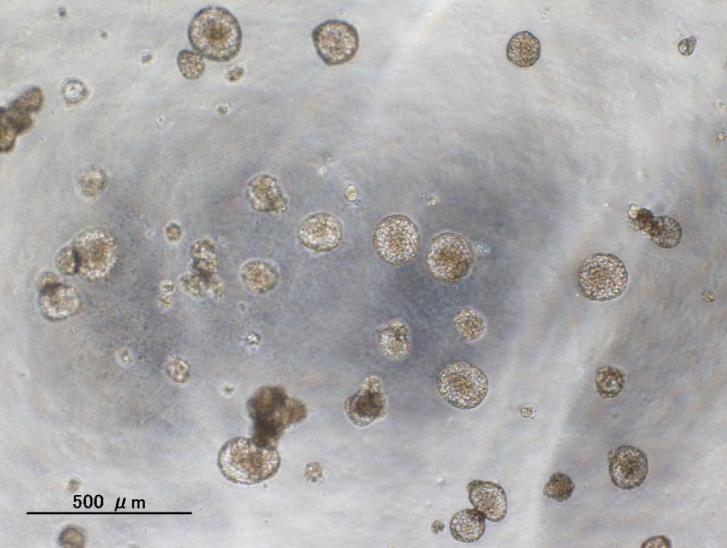
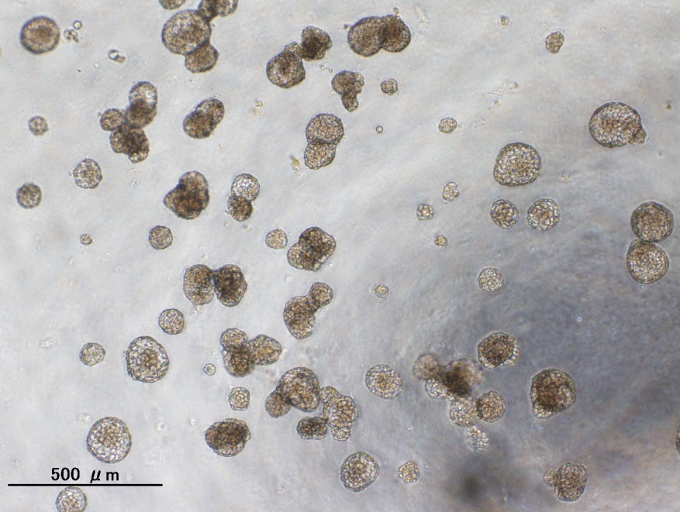
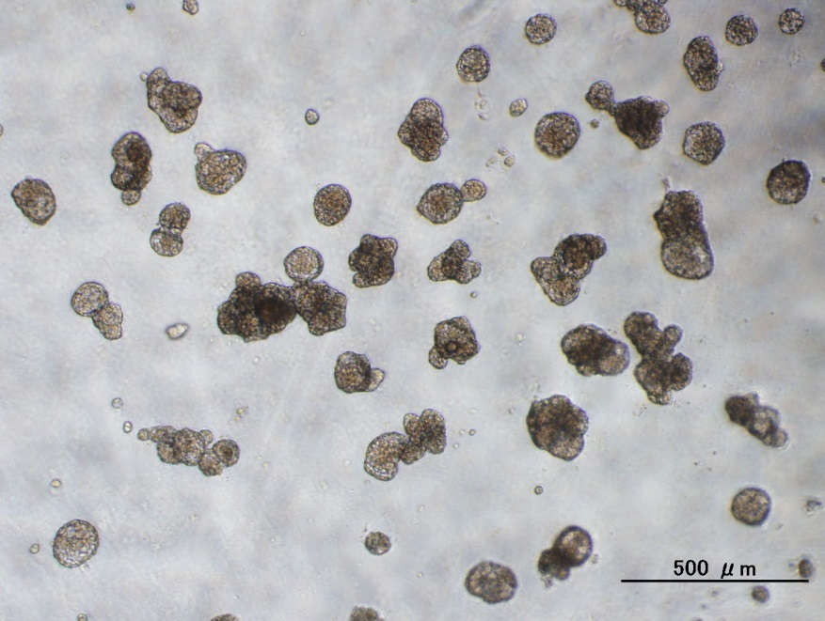
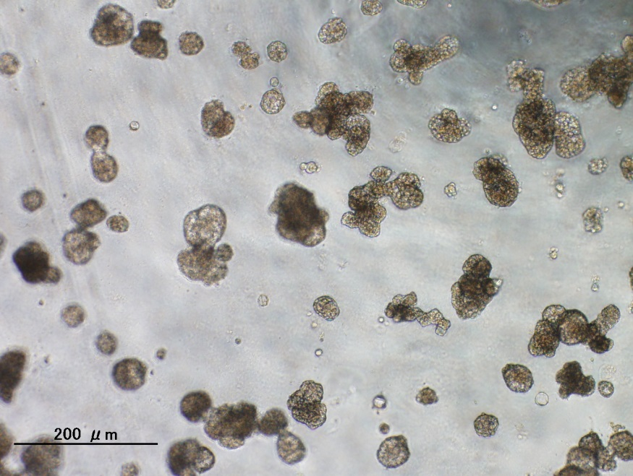
(D)
mock
MLLT6
Dox. (-)
Dox. (+)
500μm

Slide 13
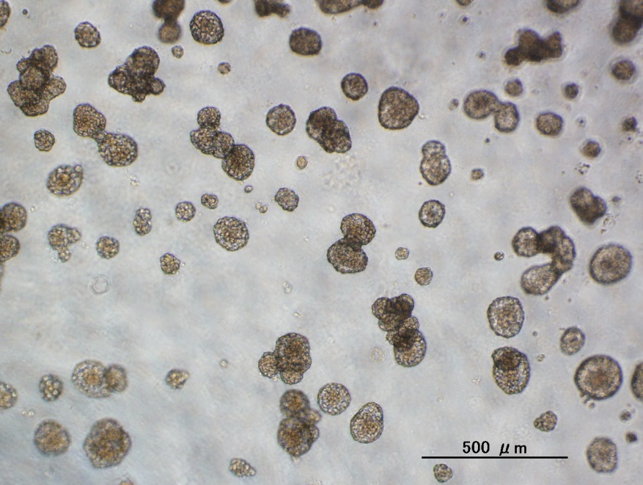
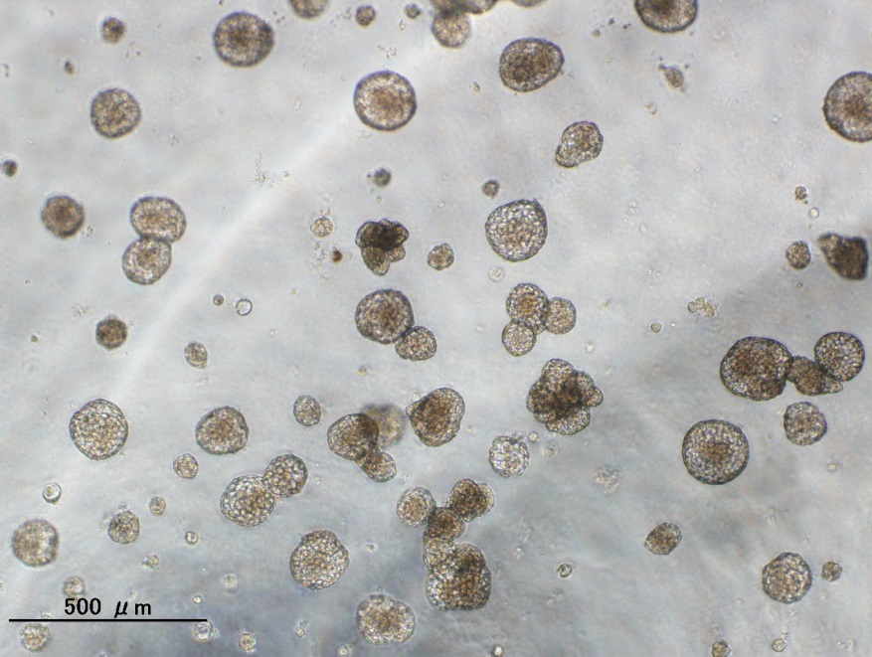
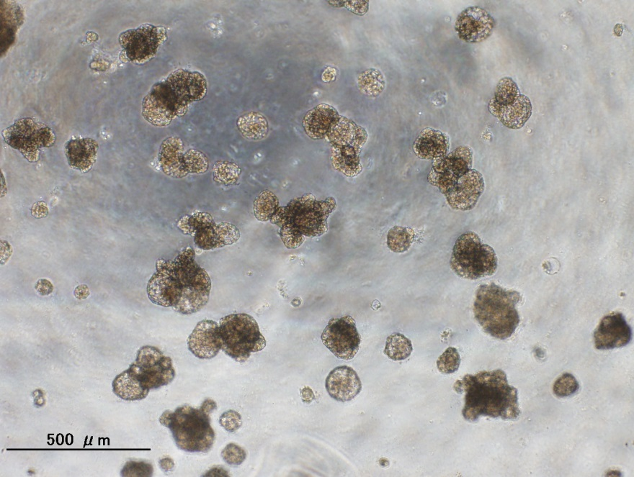
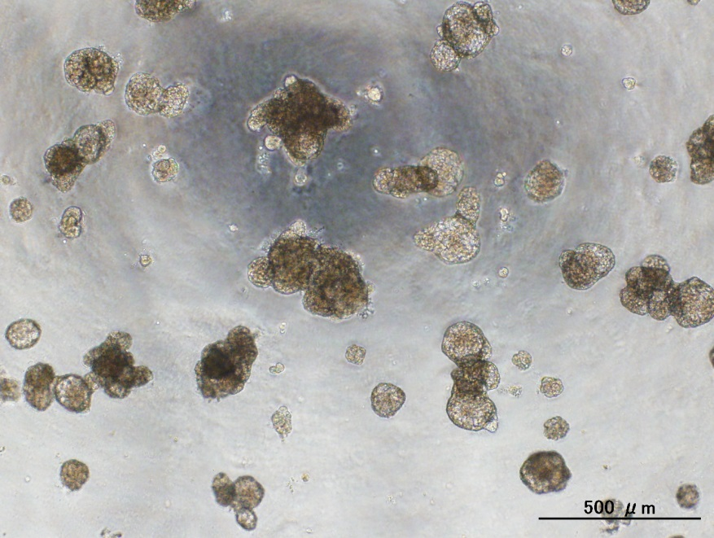
CACNB1
PPP1R1B
Dox. (-)
Dox. (+)

Slide 14
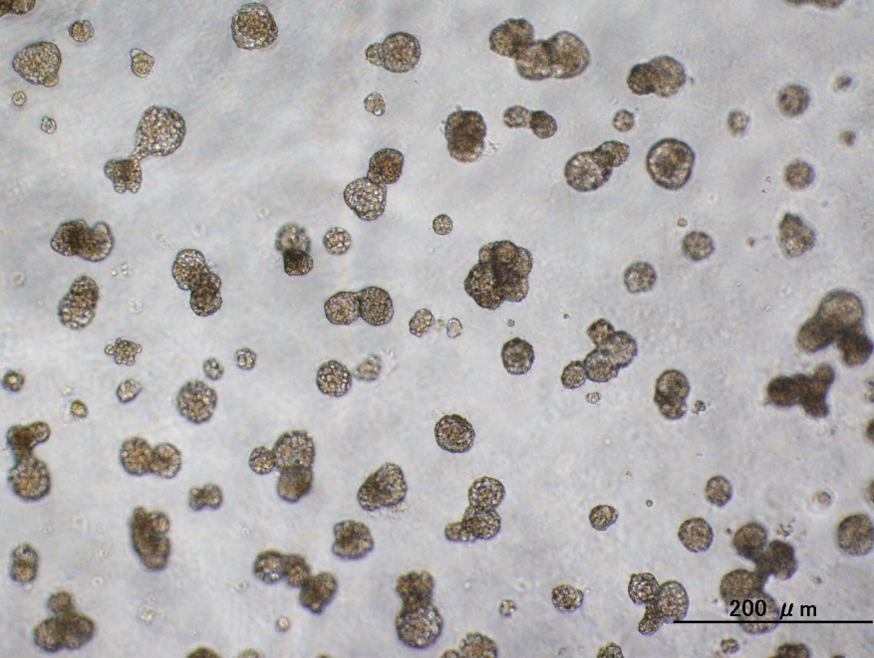
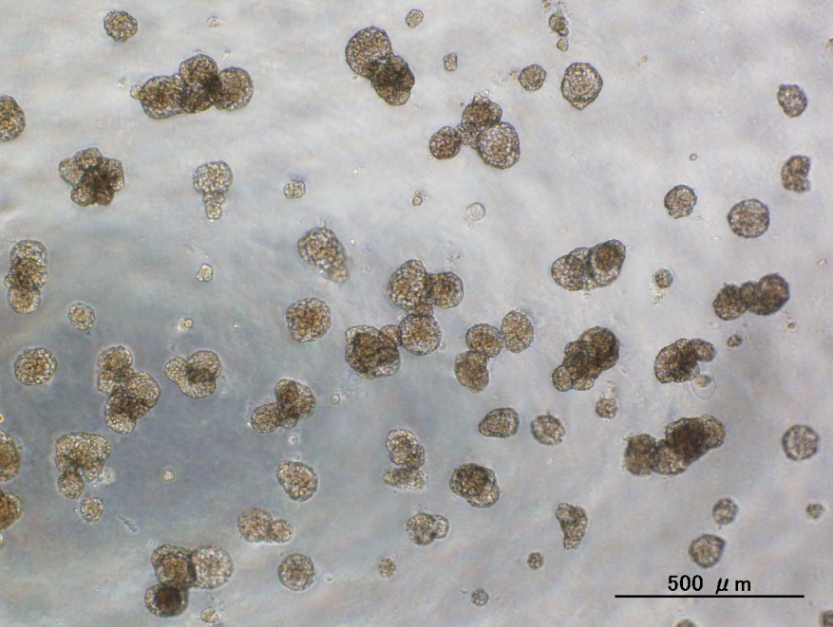
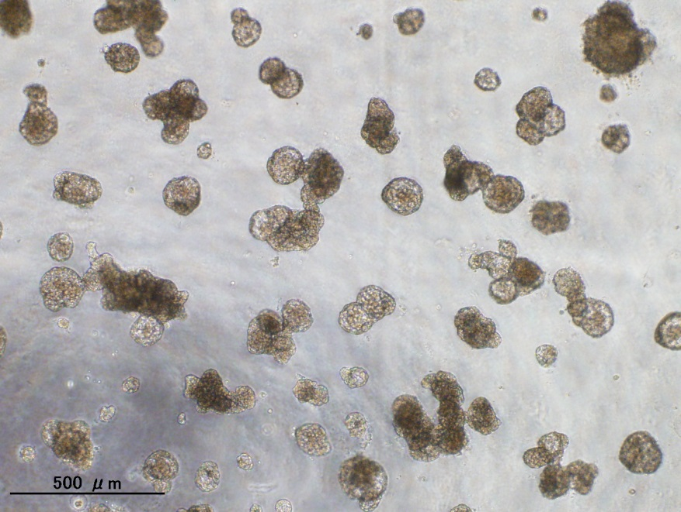
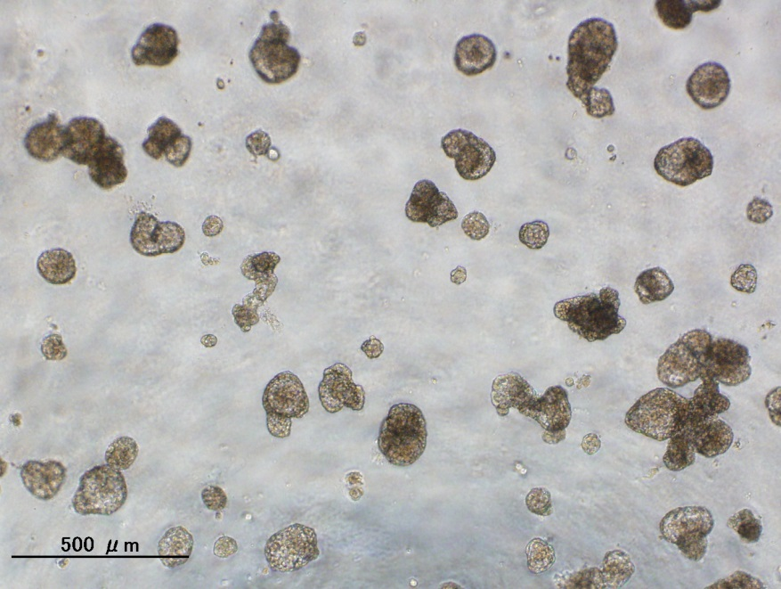
STARD3
KRT24
Dox. (-)
500μm
Dox. (+)

