Slide 1
Supplementary Figures
Ubiquitin Specific Protease 4 Positively Regulates the WNT/β-catenin Signaling in Colorectal Cancer
Sun-Il Yun¹, Hyeon Ho Kim^{2,3}, Jung Hwan Yoon⁴, Won Sang Park⁴,
Hee Cheol Kim⁵, Chin Ha Chung⁶, Kyeong Kyu Kim^{1,3}*

Slide 2
Supplementary Figure 1.
A

Slide 3
Supplementary Figure 1.
B
C

Slide 4
Supplementary Figure 1.
D-1
D-2
D-3

Slide 5
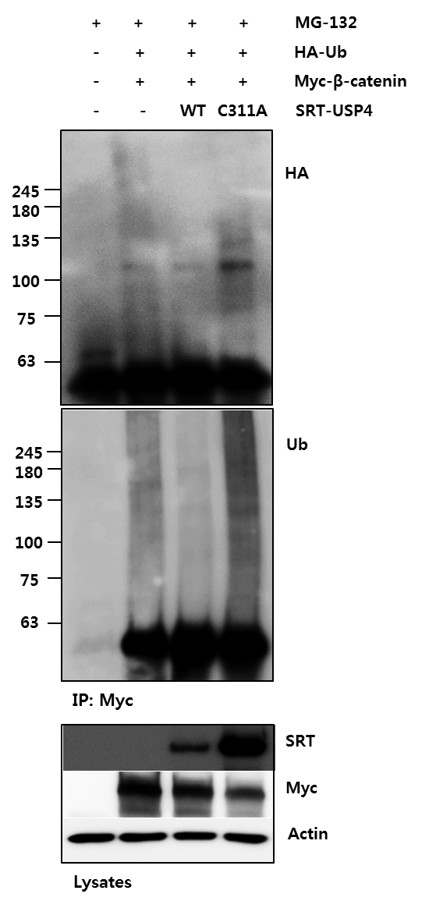
Supplementary Figure 1.
E
F

Slide 6
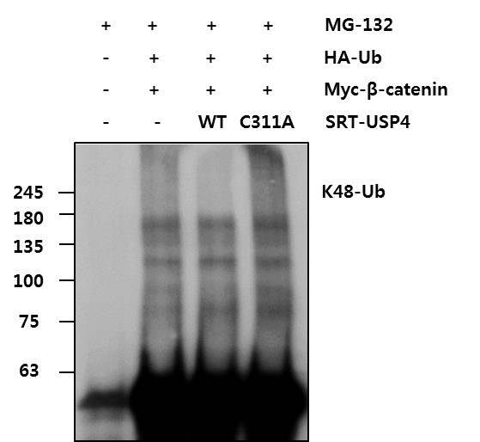
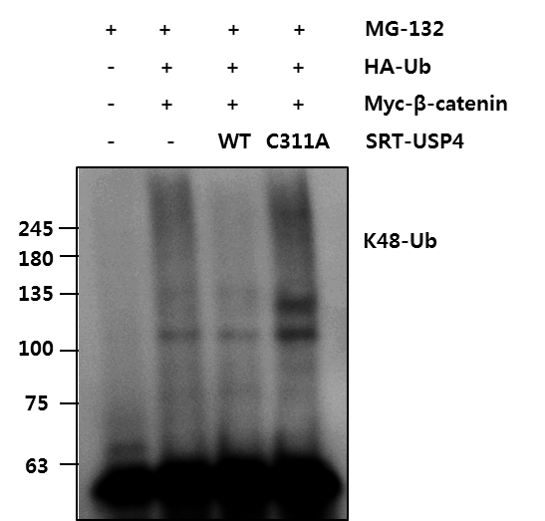
Supplementary Figure 1.
G-1
H
I-1
G-2
I-2

Slide 7
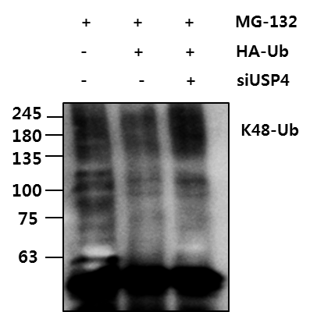
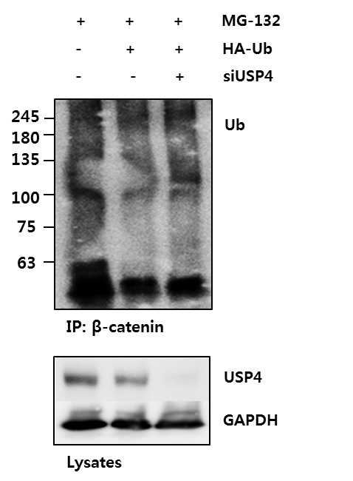
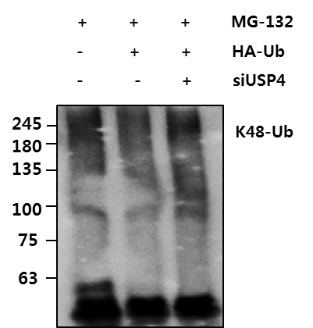
Supplementary Figure 1.
J
K-1
K-2

Slide 8
Supplementary Figure 2.
A
C
B
D

Slide 9
Supplementary Figure 2.
E
F

Slide 10
Supplementary Figure 3.
A

Slide 11
Supplementary Figure 3.
B

Slide 12
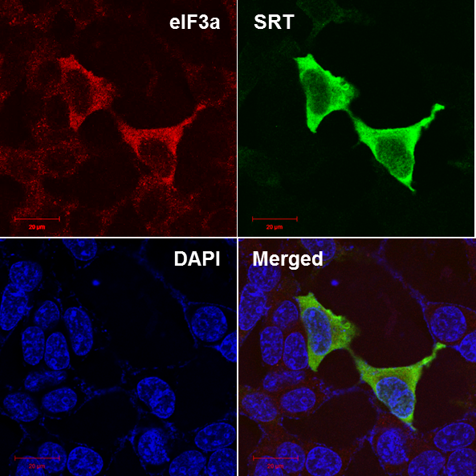
Supplementary Figure 3.
C

Slide 13
Supplementary Figure 4.
A
B
C

Slide 14
Supplementary Figure 5.
A
B
C

