Slide 1
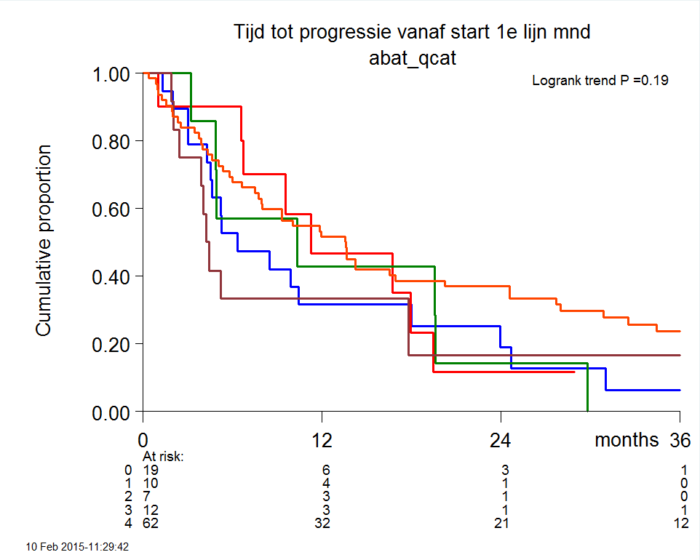
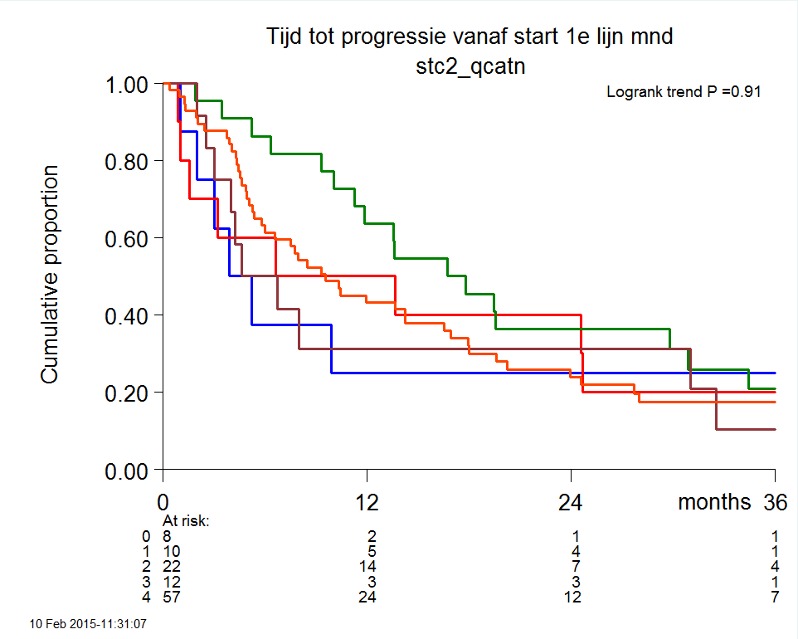
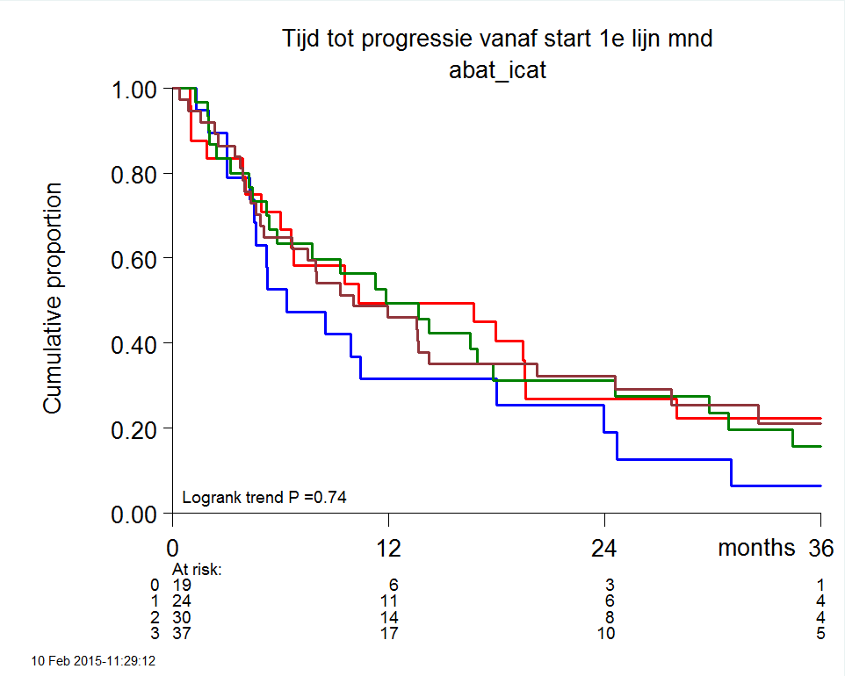
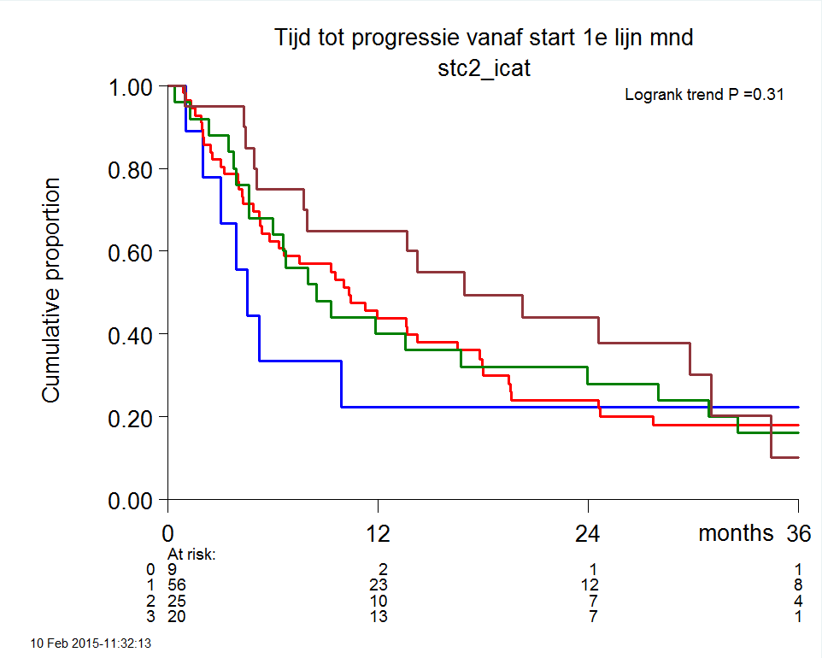
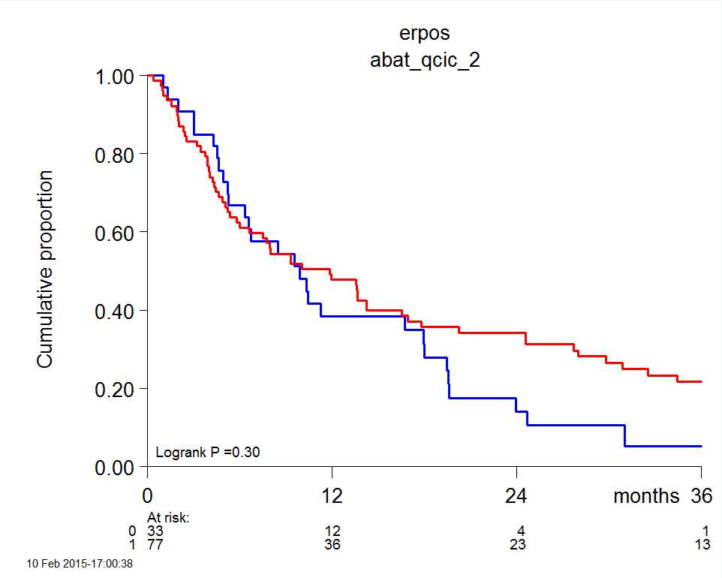
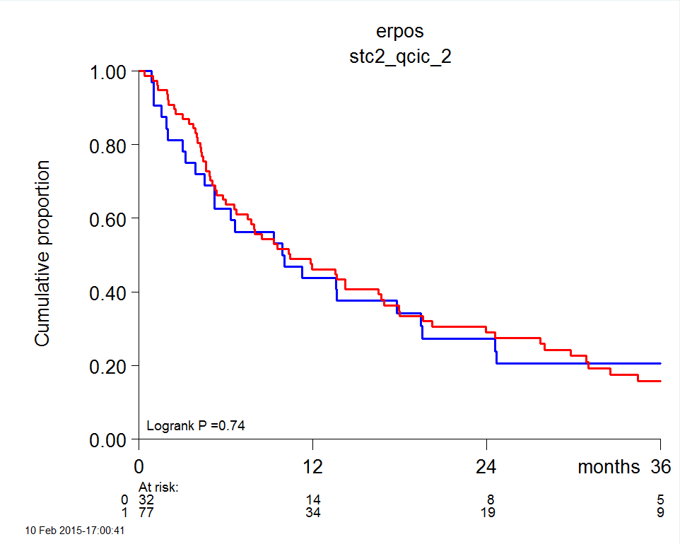
Supplementary Figure 1
ABAT and STC2 protein quantity and intensity staining and IHC-scores:
Their relationship with tamoxifen treatment outcome defined by PFS
ABAT quantity
STC2 quantity
ABAT intensity
STC2 intensity
ABAT IHC-score
STC2 IHC-score
0
1
2
3
4

