Slide 1
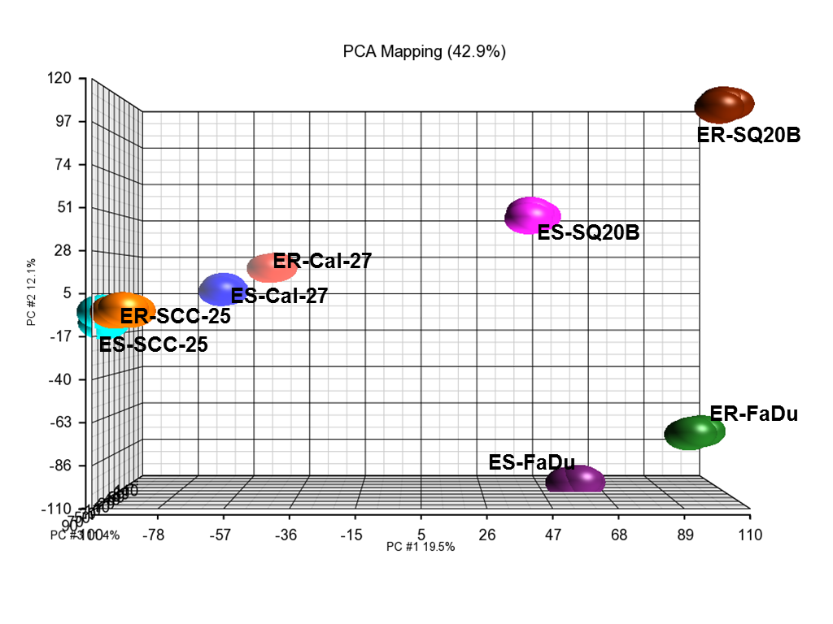
Supplementary Figure 2
Supplementary Figure 2. Principal Component Analysis. Three-dimensional scatter plot displays the results of a principal component analysis of erlotinib-resistant (ER) vs erlotinib-sensitive (ES) FaDu, SQ20B, Cal-27, and SCC-25 HNSCC cells in triplicates.

