Slide 1
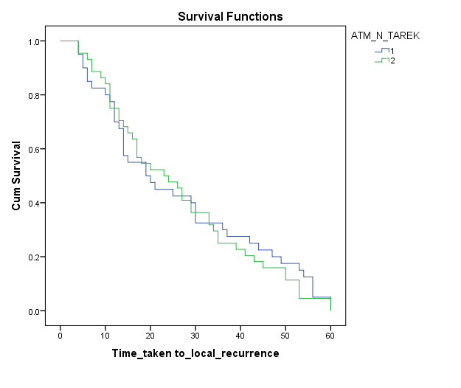
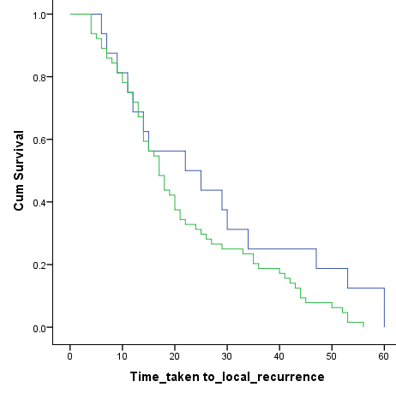
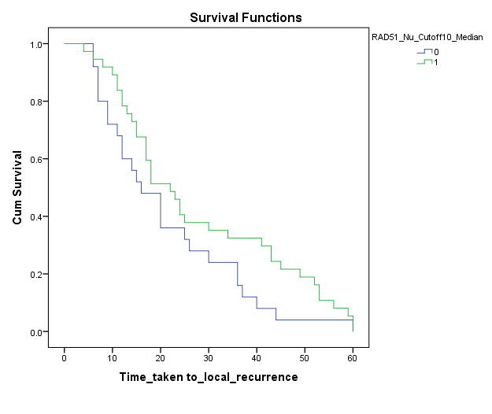
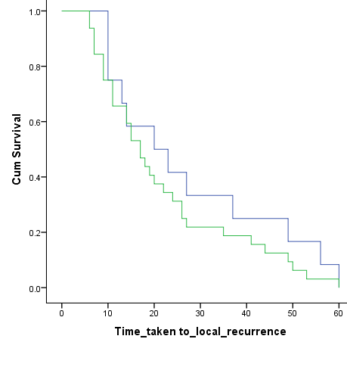
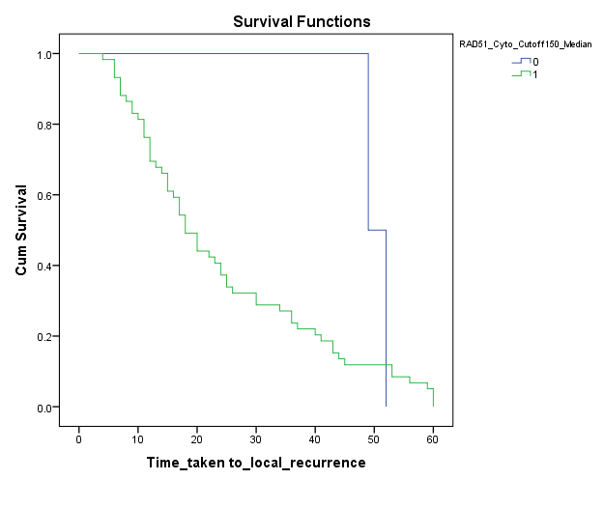
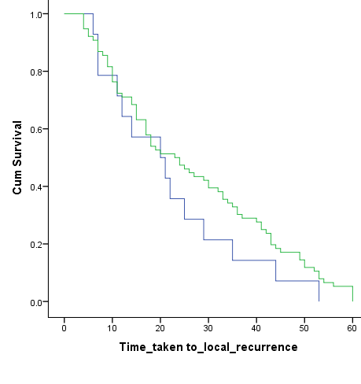
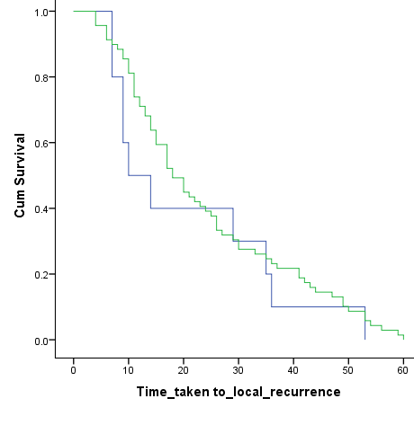
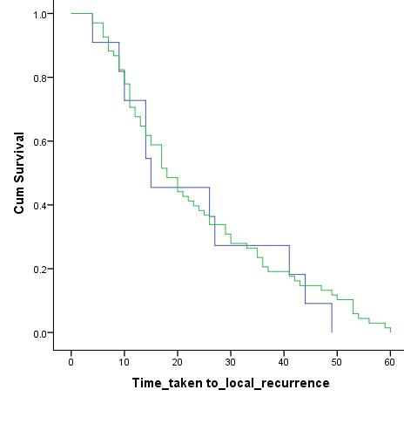
A
B
C
D
ATM and local recurrence
ATR and local recurrence
CHK2 (Nuclear) and local recurrence
RAD51 (Nuclear) and local recurrence
Cum Survival
Cum Survival
Cum Survival
Cum Survival
High (n=37)
Low (n=40)
High (n=32)
Low (n=12)
High (n=64)
Low (n=16)
P = 0.117
P = 0.730
High (n=44)
P = 0.298
P = 0.106
Low (n=25)
Time taken to local recurrence (months)
Time taken to local recurrence (months)
Time taken to local recurrence (months)
Time taken to local recurrence (months)
E
F
G
H
yH2AX (Cytoplasmic) and local recurrence
RAD51 (Cytoplasmic) and local recurrence
BRCA1 and local recurrence
yH2AX (Nuclear) and local recurrence
Low (n=2)
High (n=69)
Cum Survival
Cum Survival
Cum Survival
High (n=76)
Cum Survival
Low (n=11)
High (n=59)
Low (n=14)
Low (n=10)
P = 0.280
P = 0.264
P = 0.468
High (n=68)
P = 0.689
Time taken to local recurrence (months)
Time taken to local recurrence (months)
Time taken to local recurrence (months)
Time taken to local recurrence (months)
Supplementary Figure S1

Slide 2
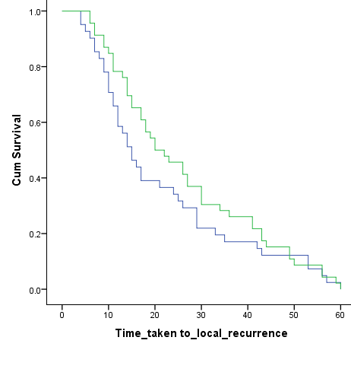
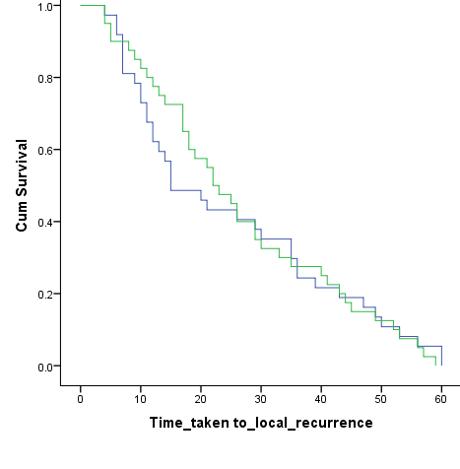
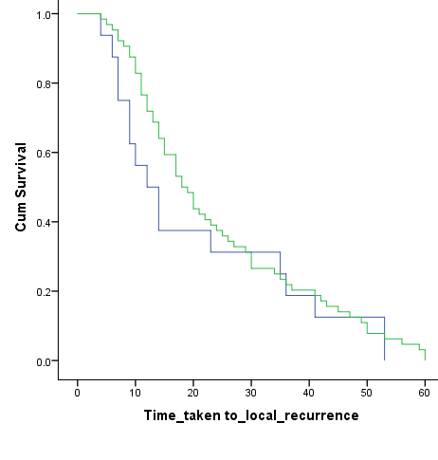
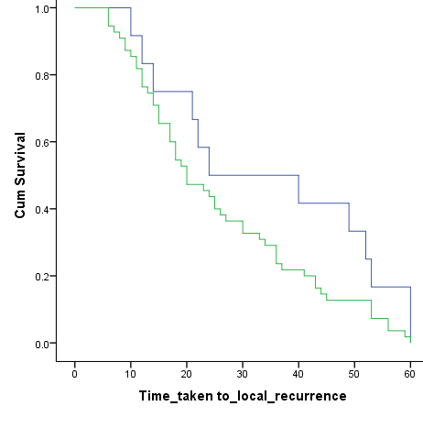
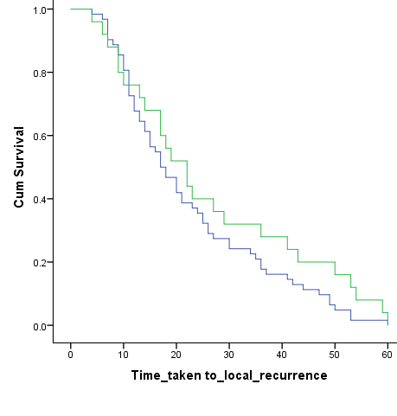
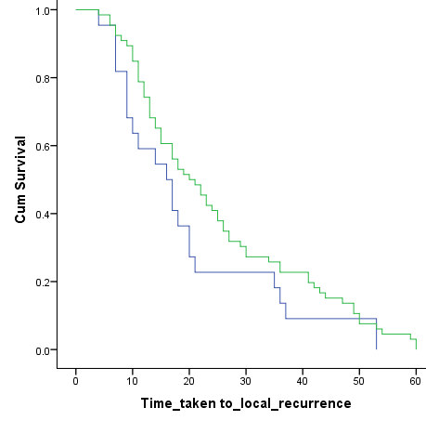
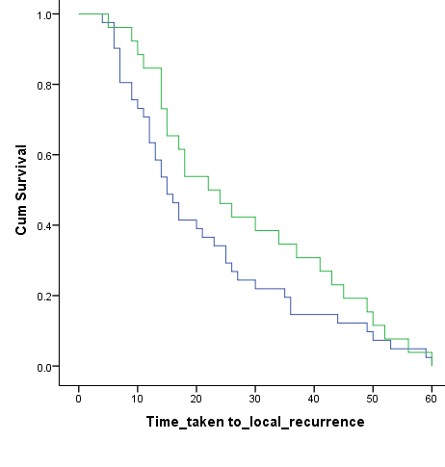
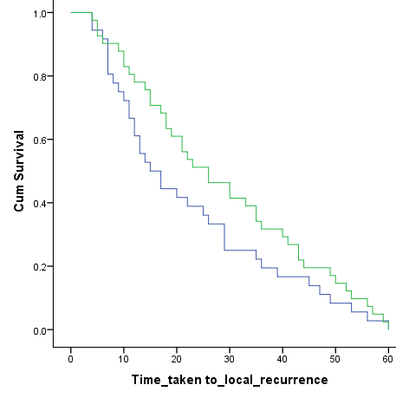
J
K
RECQL5 (Nuclear) and local recurrence
L
I
DNA-PKcs and local recurrence
KU70/80 and local recurrence
WRN (Cytoplasmic) and local recurrence
High (n=40)
Low (n=12)
High (n=46)
Cum Survival
High (n=64)
Cum Survival
Cum Survival
Cum Survival
Low (n=37)
High (n=55)
Low (n=16)
P = 0.088
P = 0.266
P = 0.993
P = 0.415
Low (n=41)
Time taken to local recurrence (months)
Time taken to local recurrence (months)
Time taken to local recurrence (months)
Time taken to local recurrence (months)
M
N
O
P
WRN (Nuclear) and local recurrence
BLM (Cytoplasmic) and local recurrence
PTEN (Nuclear) and local recurrence
BLM (Nuclear) and local recurrence
High (n=26)
Cum Survival
High (n=41)
Cum Survival
Cum Survival
High (n=25)
Cum Survival
High (n=66)
Low (n=36)
P = 0.169
P = 0.192
P = 0.152
P = 0.179
Low (n=62)
Low (n=22)
Low (n=41)
Time taken to local recurrence (months)
Time taken to local recurrence (months)
Time taken to local recurrence (months)
Time taken to local recurrence (months)
Supplementary Figure S1

Slide 3
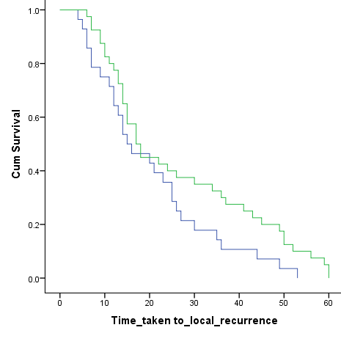
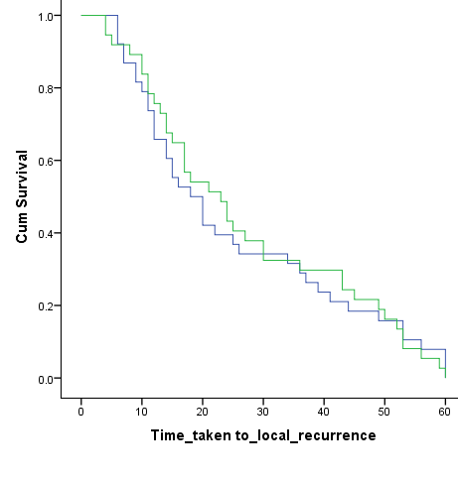
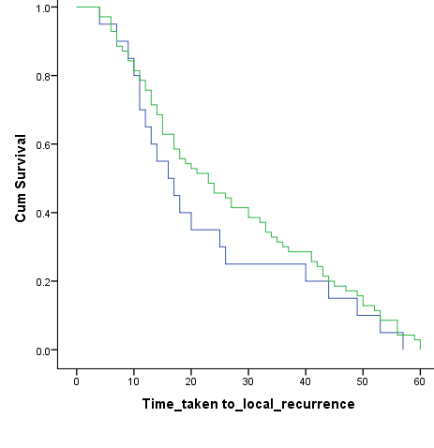
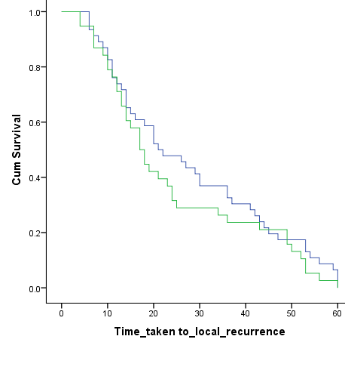
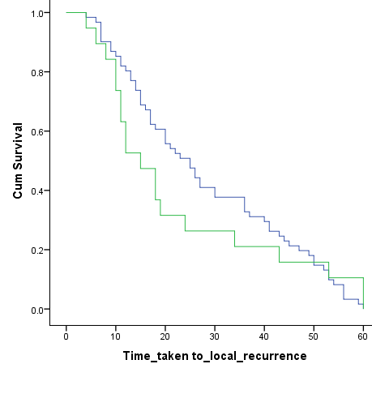
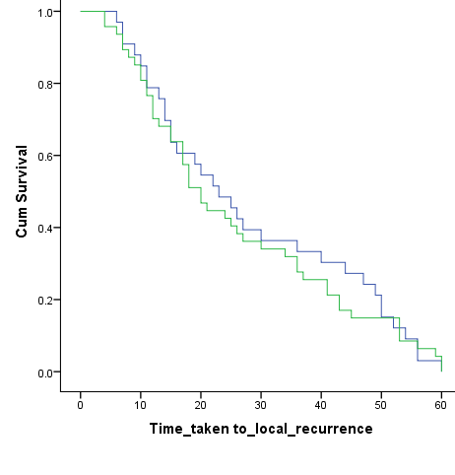
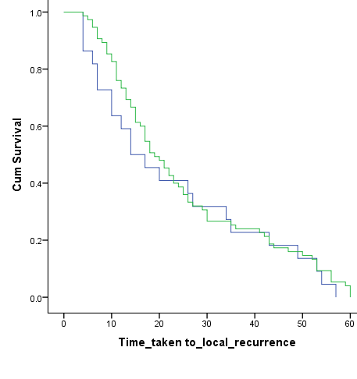
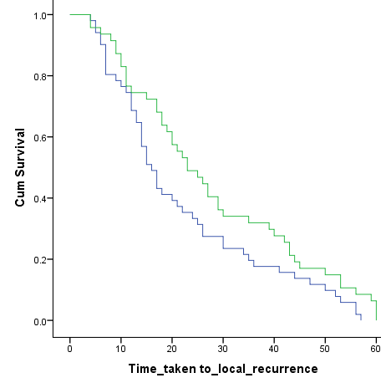
Q
R
S
XRCC1 and local recurrence
T
PTEN (Cytoplasmic) and local recurrence
SMUG1 and local recurrence
PARP1 and local recurrence
Cum Survival
High (n=40)
Cum Survival
Cum Survival
High (n=70)
Cum Survival
Low (n=46)
High (n=37)
Low (n=38)
Low (n=28)
P = 0.334
High (n=38)
P = 0.070
P = 0.952
Low (n=20)
P = 0.307
Time taken to local recurrence (months)
Time taken to local recurrence (months)
Time taken to local recurrence (months)
Time taken to local recurrence (months)
U
FEN1 (Nuclear) and local recurrence
V
W
X
FEN1 (Cytoplasmic) and local recurrence
POLß and local recurrence
Total Chk1(Nuclear) and local recurrence
High (n=22)
High (n=47)
Cum Survival
Low (n=33)
Low (n=61)
Cum Survival
Cum Survival
Cum Survival
Low (n=75)
High (n=47)
Low (n=51)
P = 0.622
P = 0.490
High (n=19)
P = 0.711
P = 0.054
Time taken to local recurrence (months)
Time taken to local recurrence (months)
Time taken to local recurrence (months)
Time taken to local recurrence (months)
Supplementary Figure S1

Slide 4
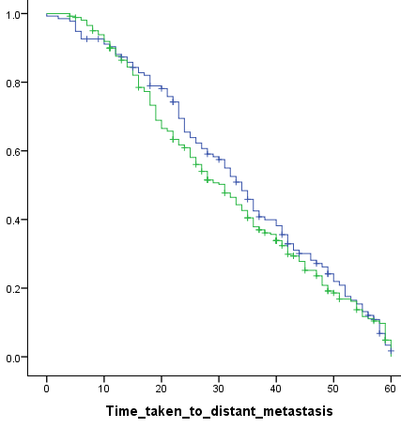
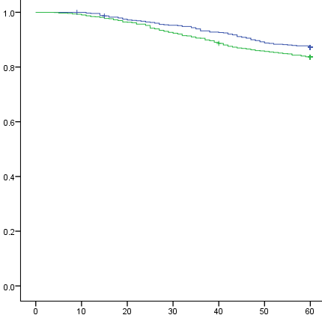
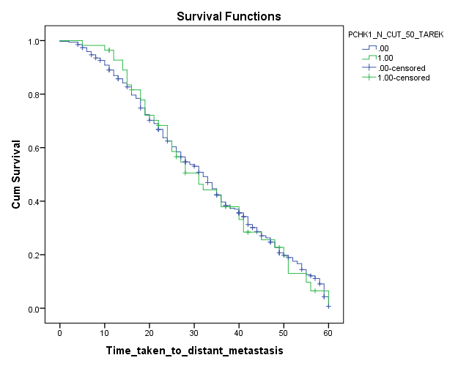
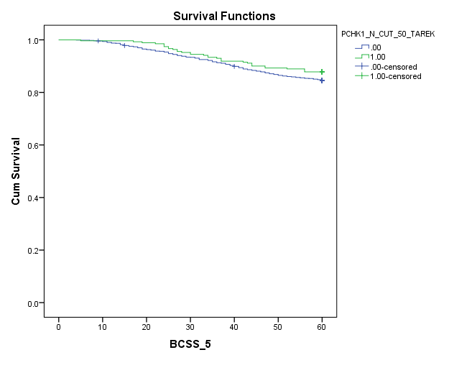
A
pCHK1 (cytoplasmic) and distant metastasis
B
pCHK1 (cytoplasmic) and survival
Low (n=679)
High (n=1021)
Low (n=135)
Cum Survival
Cum Survival
High (n=261)
P= 0.417
P= 0.040
C
Time taken to distant metastasis (months)
Breast cancer specific survival (months)
D
pCHK1 (nuclear) and distant metastasis
pCHK1 (nuclear) and survival
High (n=56)
High (n=271)
Low (n=340)
Low (n=1428)
Cum Survival
Cum Survival
P= 0.838
P= 0.159
Time taken to distant metastasis (months)
Breast cancer specific survival (months)
Supplementary Figure S2

Slide 5
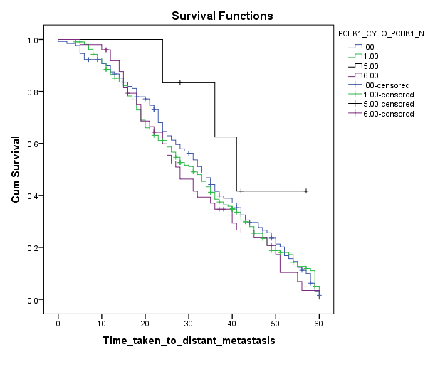
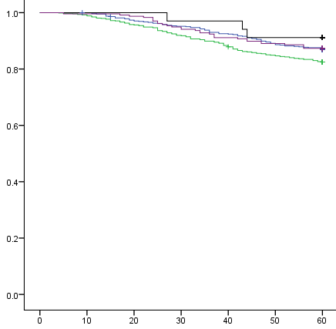
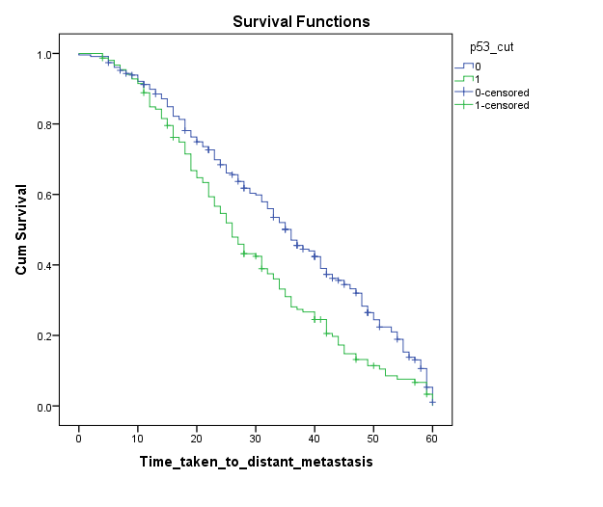
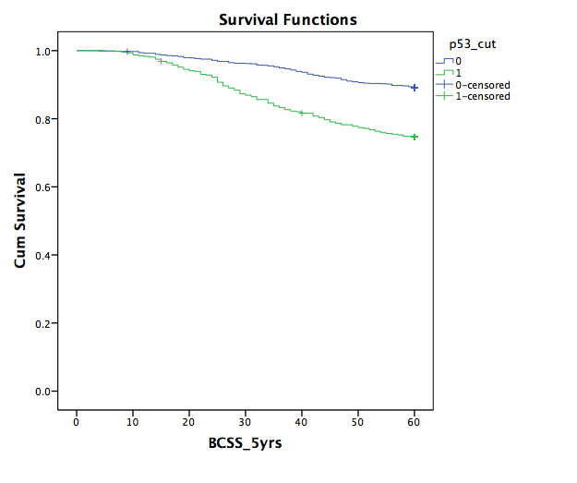
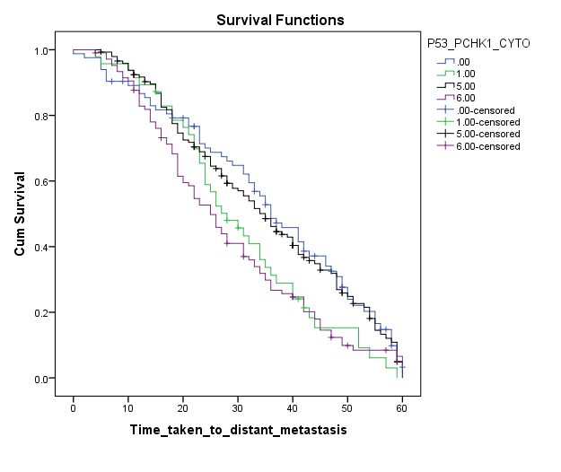
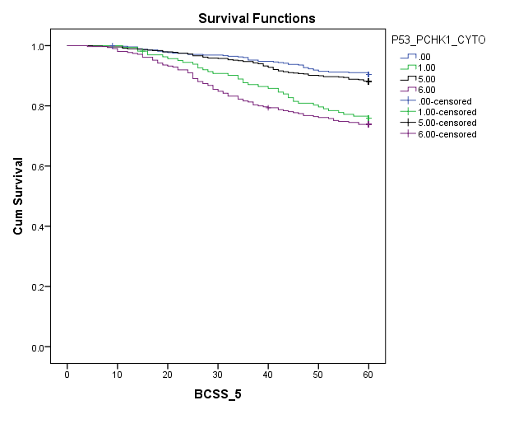
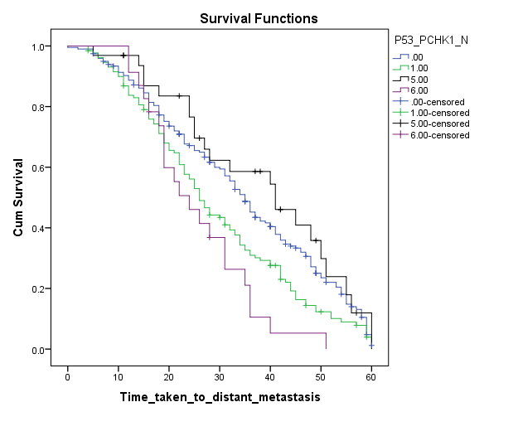
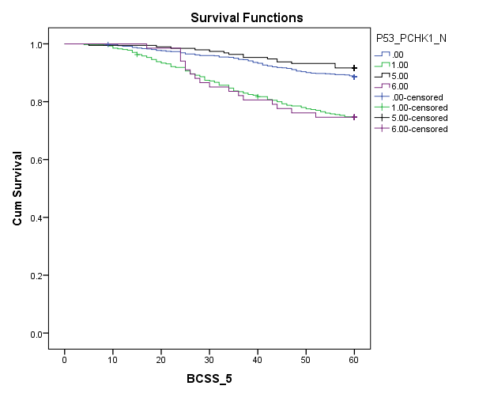
F
G
pCHK1 (cytoplasmic and nuclear)
co-expression and distant metastasis
pCHK1 (cytoplasmic and nuclear)
co-expression and survival
H
E
P53 and distant metastasis
P53 and survival
C +/ N + (n=237)
C -/ N + (n=6)
C -/ N - (n=645)
Low (n=1162)
C -/ N + (n=34)
C +/ N - (n=783)
High (n=474)
Cum Survival
Cum Survival
Low (n=229)
Cum Survival
Cum Survival
C -/ N - (n=129)
C +/ N - (n=211)
High (n=153)
P= 0.452
P= 0.042
P < 0.001
P < 0.001
C +/ N + (n=50)
Breast cancer specific survival (months)
Time taken to distant metastasis (months)
Breast cancer specific survival (months)
Time taken to distant metastasis (months)
I
J
K
L
P53 and pCHK1 (cytoplasmic) co-expression and distant metastasis
P53 and pCHK1 (cytoplasmic) co-expression and survival
P53 and pCHK1 (nuclear) co-expression and distant metastasis
P53 and pCHK1 (nuclear) co-expression and survival
P53 -/ CHK1 + (n=146)
P53 -/ CHK1 - (n=481)
P53 -/ CHK1 - (n=197)
P53 -/ CHK1 + (n=680)
P53 -/ CHK1 + (n=680)
P53 -/ CHK1 + (n=32)
P53 +/ CHK1 - (n=192)
P53 -/ CHK1 - (n=968)
P53 +/ CHK1 - (n=163)
P53 -/ CHK1 - (n=83)
P53 +/ CHK1 + (n=310)
P53 +/ CHK1 + (n=67)
Cum Survival
Cum Survival
Cum Survival
Cum Survival
P53 +/ CHK1 + (n=106)
P53 +/ CHK1 + (n=23)
P= 0.003
P< 0.001
P= 0.001
P53 +/ CHK1 - (n=130)
P< 0.001
P53 +/ CHK1 - (n=47)
Time taken to distant metastasis (months)
Breast cancer specific survival (months)
Time taken to distant metastasis (months)
Breast cancer specific survival (months)
Supplementary Figure S2

Slide 6
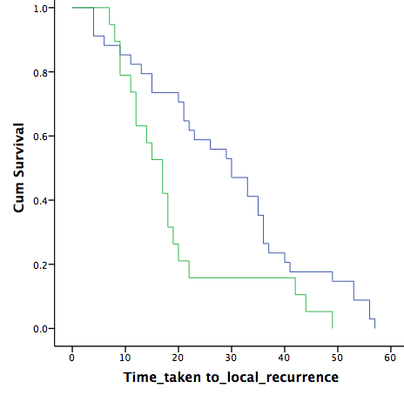
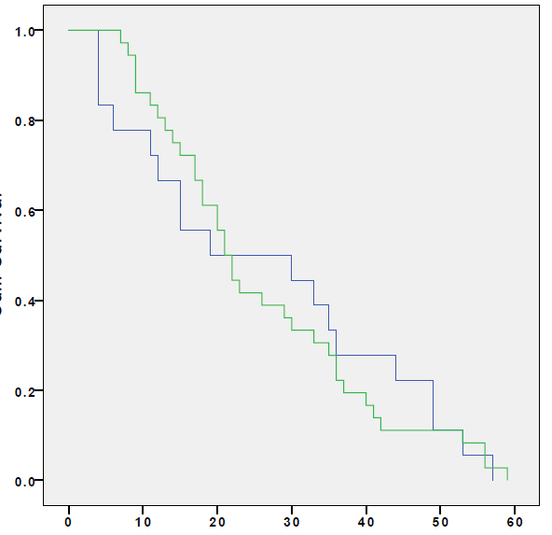
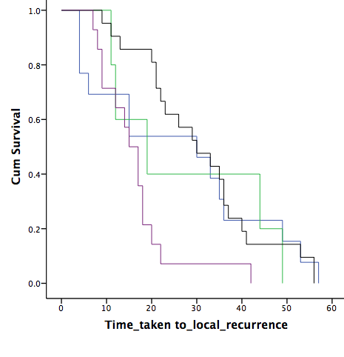
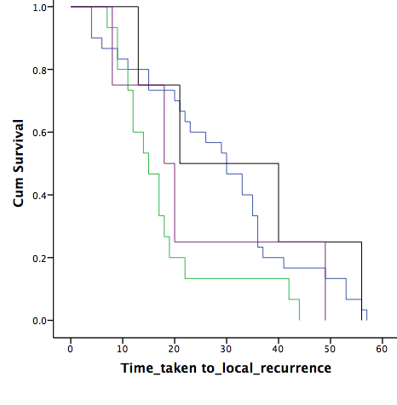
A
P53 and local recurrence
B
C
pCHK1 (cytoplasmic) and local recurrence
pCHK1 (nuclear) and local recurrence
Cum Survival
Cum Survival
Cum Survival
Low (n=18)
Low (n=34)
Low (n=46)
High (n=136)
High (n=8)
P = 0.014
High (n=19)
P= 0.898
P= 0.786
Time taken to local recurrence (months)
Time taken to local recurrence (months)
Time taken to local recurrence (months)
D
P53 and pCHK1 (cytoplasmic) co-expression and local recurrence
E
P53 and pCHK1 (nuclear) co-expression and local recurrence
P53 -/ pCHK1 + (n=4)
P53 -/ pCHK1 + (n=21)
Cum Survival
P53 -/ pCHK1 - (n=30)
P53 +/ pCHK1 - (n=5)
P53 +/ pCHK1 + (n=4)
P53 +/ pCHK1 - (n=15)
P53 -/ pCHK1 - (n=13)
P53 +/ pCHK1 + (n=14)
P= 0.064
P= 0.017
Supplementary Figure S3
Time taken to local recurrence (months)
Time taken to local recurrence (months)

Slide 7
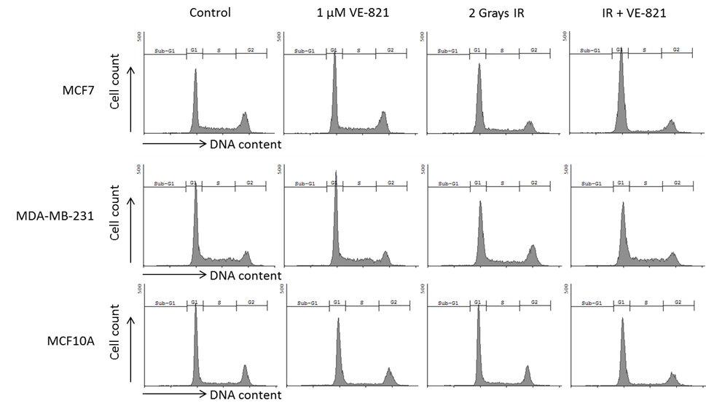
Control
1 μ M VE-821
2 Grays IR
IR+VE-821
MCF-7
MDA-MB-231
Supplementary Figure S4

