Slide 1
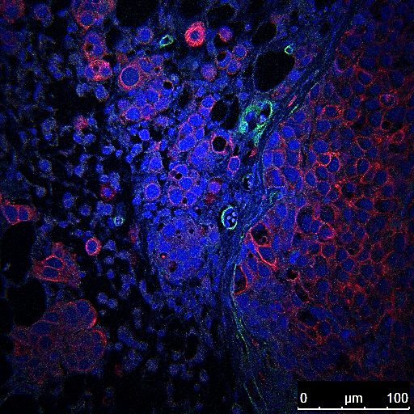
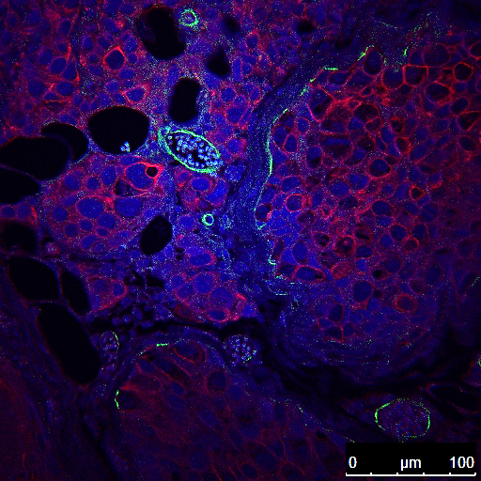
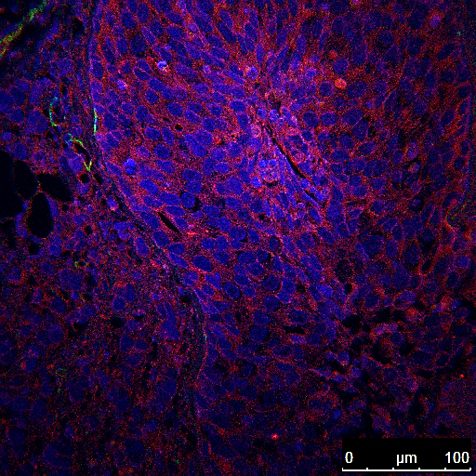
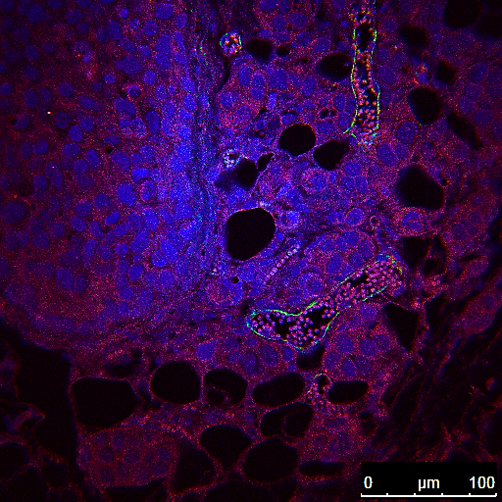
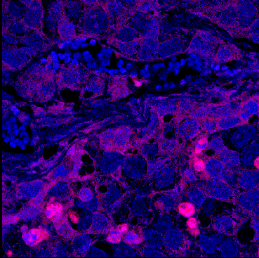
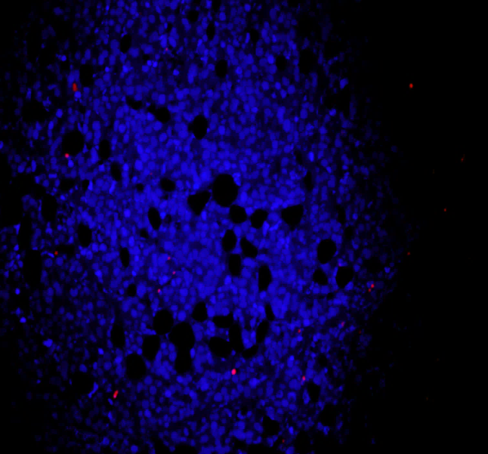
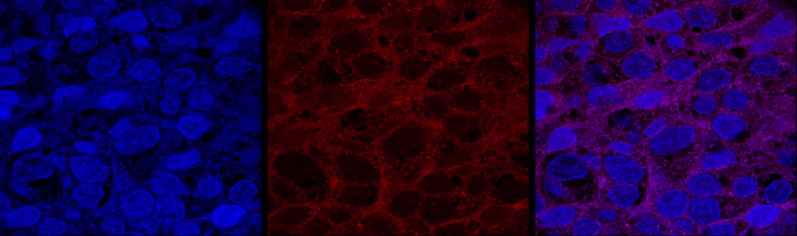
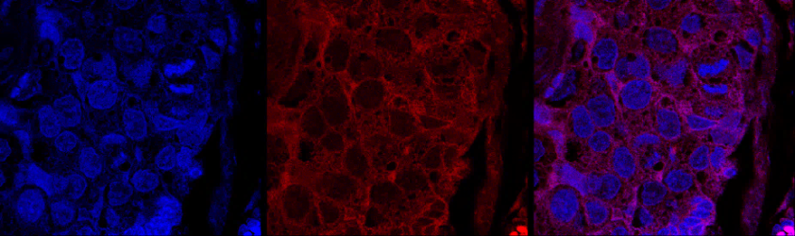
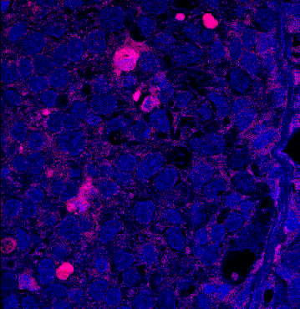
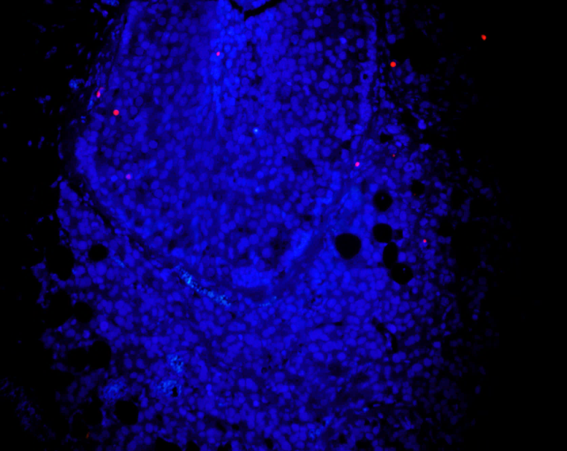
Supplementary Figure 6
A
-Dox
+Dox
B
-Dox
+Dox
K19
IFITM1
100 µM
100 µM
100 µM
100 µM
C
Ki67
TUNEL
D
DAPI
p21
Merge
-Dox
-Dox
50 µM
100 µM
+Dox
+Dox
50 µM
100 µM
TUNEL Intensity
% Ki67 Positive
p21 Intensity
-Dox
+Dox
-Dox
+Dox
-Dox
+Dox
Supplementary Figure 6. MIND injection of MCF-7:5C/IFsh and MCF-7:5C/C9Con cells. 5,000 (a-d) MCF-7:5C/C9Con cells were injected into the duct of the 4th mammary gland of female ovarectomized NSG mice by the MIND injection protocol. After 10 days, mice were randomized to treatment groups and half were provided doxycycline (Dox)-treated drinking water. After 3 weeks, mammary glands were removed and processed. Immunofluorescent staining of the breast cancer cells for (b) human keratin 19 (HuK19-red), or (c) IFITM1 and the mammary duct for smooth muscle actin (SMA-green) was conducted. As well as (d) Ki67, TUNEL (quantified on the right) and (e) p21 staining (quantified in lower panel)

