Slide 1
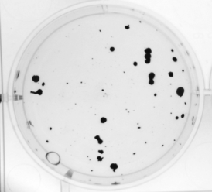
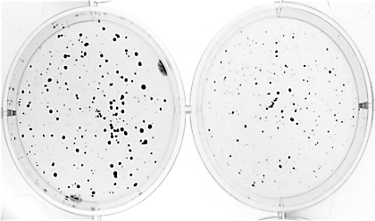
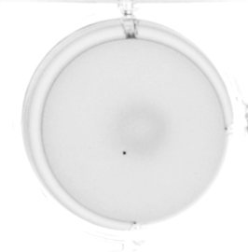
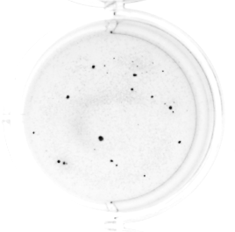
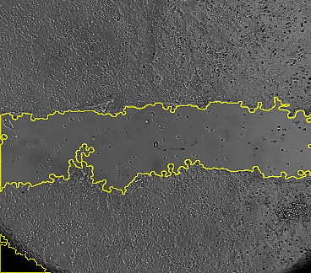
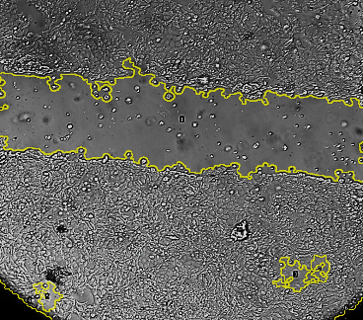
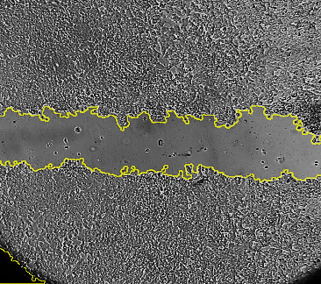
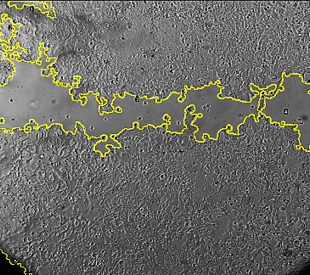
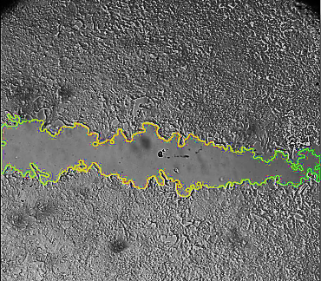
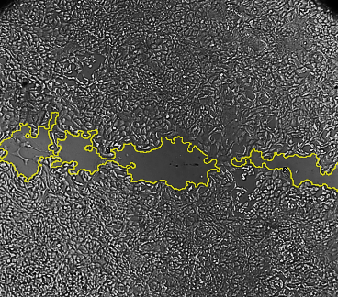
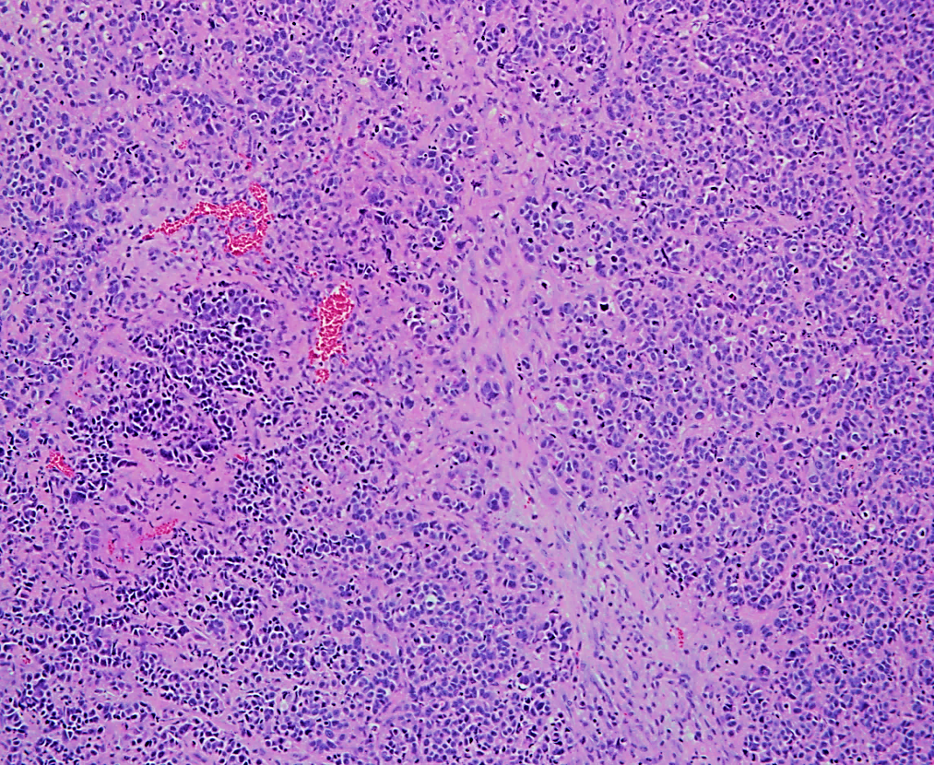
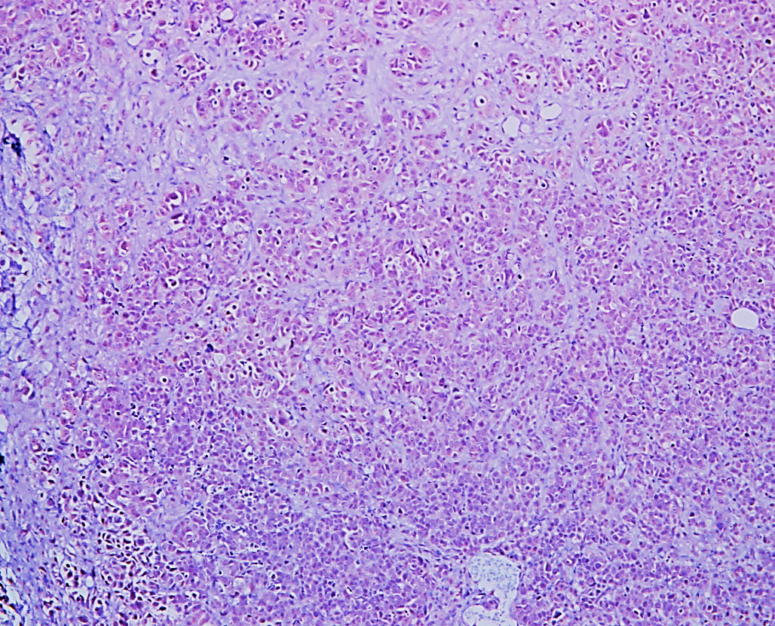
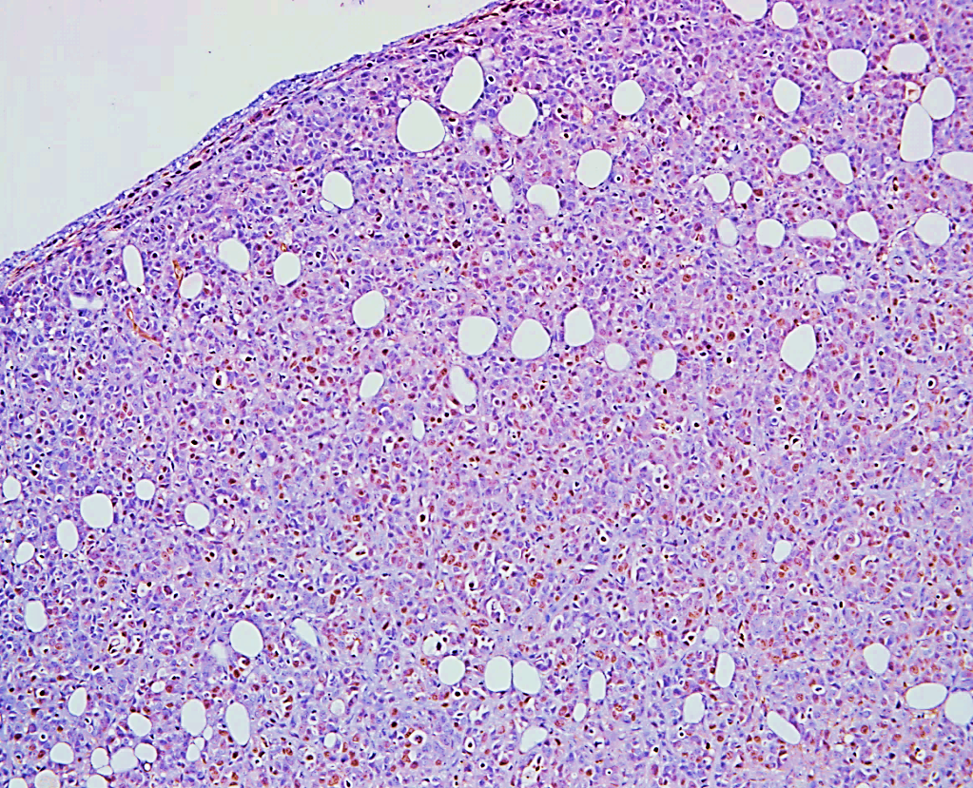
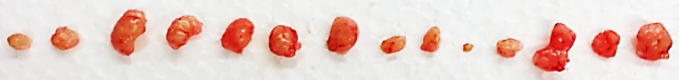
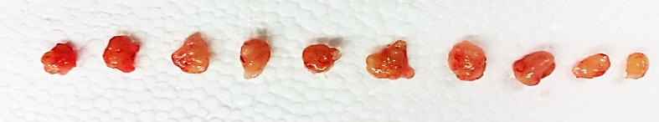
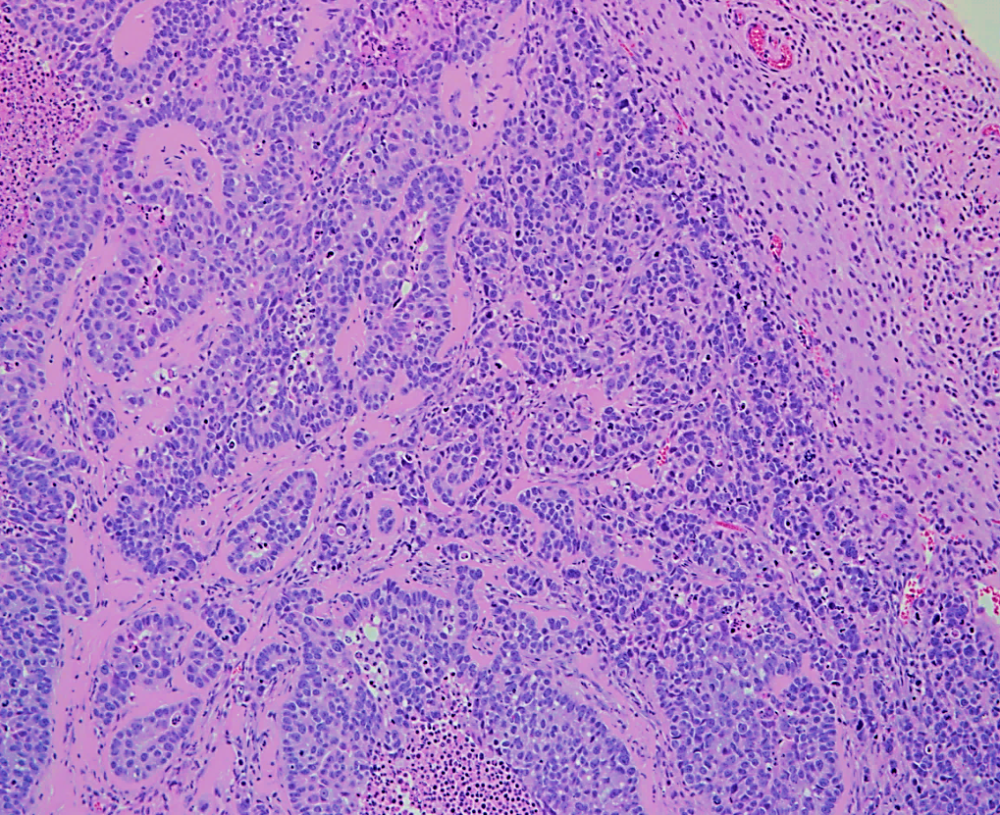
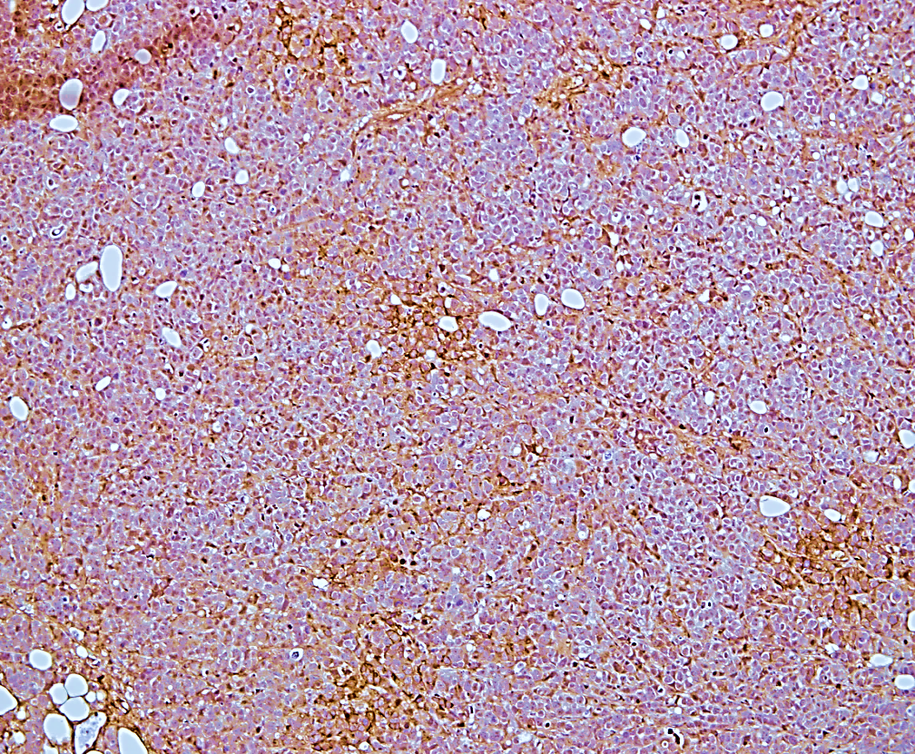
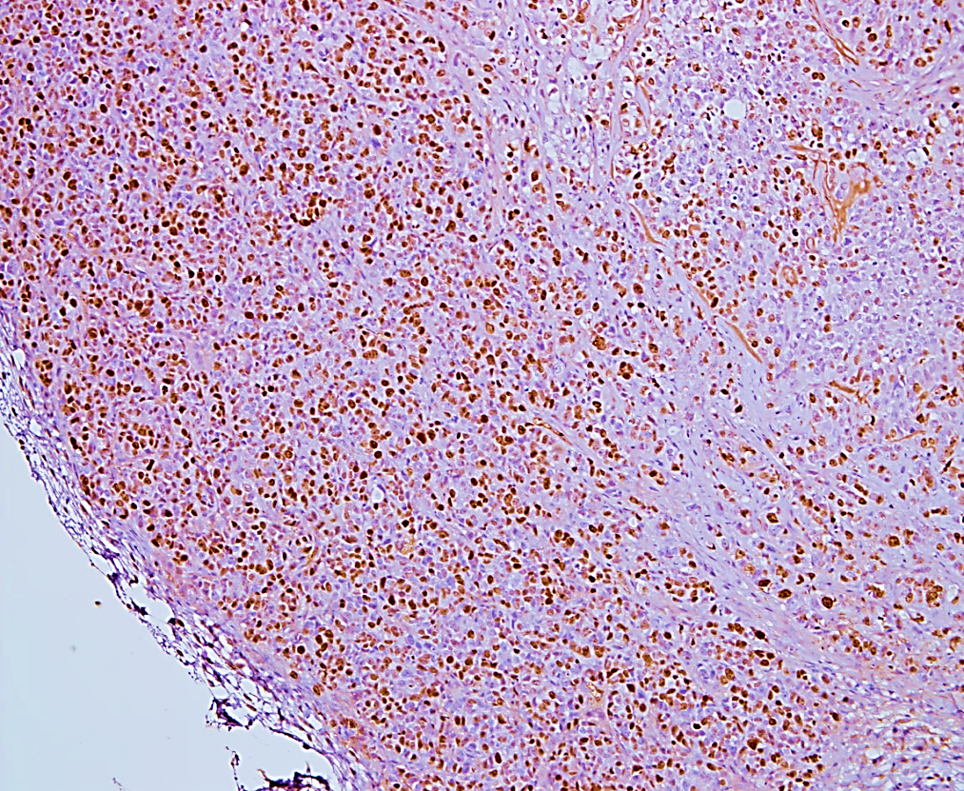
Supplementary Figure 7
A
B
MCF-7/C9Con
MCF-7/IF-1
*
Estrogen
**
Percent of Control
Colony Count
**
No Estrogen
D
C
MCF-7/C9Con
MCF-7/IF-1
0
*
Wound Area
(Pixels x 100,000)
*
*
24
*
**
48
F
Hours
H + E
IFITM1
Ki67
E
MCF-7/C9Con
MCF-7/IF-1
MCF-7/C9Con
100 µM
100 µM
100 µM
*
**
Tumor Volume (mm³)
% Ki67 Positive
MCF-7/IF-1
100 µM
100 µM
100 µM
MCF-7/C9Con
MCF-7/IF-1
Supplementary Figure 7. Overexpression of IFITM1 promoted breast cancer cell proliferation and invasion. (a) The proliferation of parental MCF-7, MCF-7/C9Con and MCF-7/IF-1 was measured over 96 hours by Cell Viability assay. (b) MCF-7/C9Con and MCF-7/IF-1 cells were subjected to soft agar anchorage independent growth assay. After 21 days the number of colonies was quantified using Image J (right panel). Values represent two independent experiments conducted in duplicate. (c) Scratch assay was conducted on 70 % confluent plates of MCF-7/C9Con and MCF-7/IF-1 cells. Plates were imaged at 0, 24 and 48 hours and the size of the wound was quantified by image J (right panel). Values represent two independent experiments conducted in triplicate. (d) Intact female NSG mice were orthotopically injected with MCF-7/C9Con and MCF-7/IF-1 cells. Tumor volume (mm³) was calculated and charted over time. (e) Tumors were imaged and final tumor volume (mm³) determined. (f) IFITM1 and Ki67 expression was determined by immunohistochemical staining. The percent of Ki67 positive cells was determined by counting four separate 40X fields (left panel).

