Slide 1
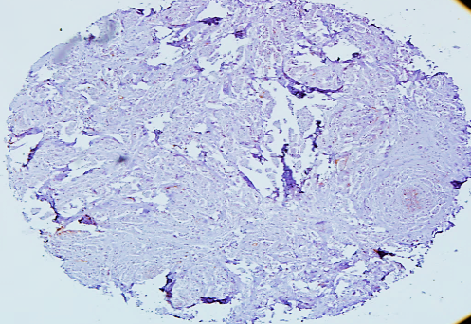
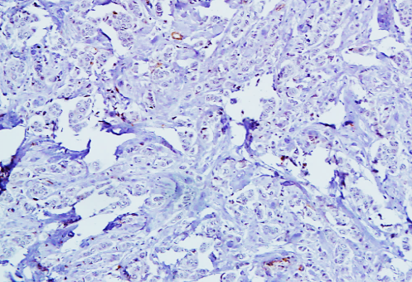
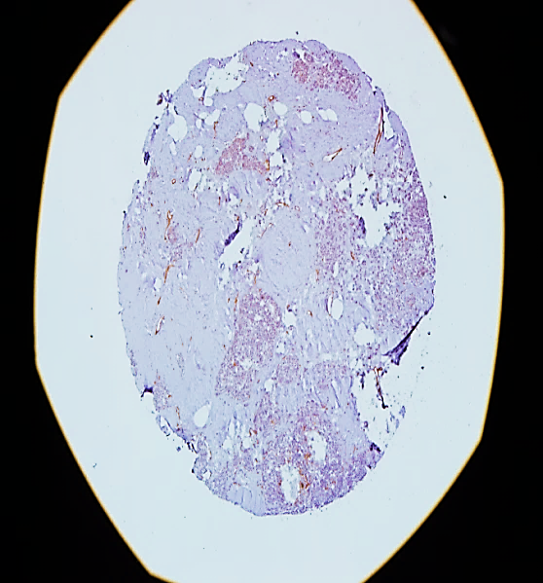
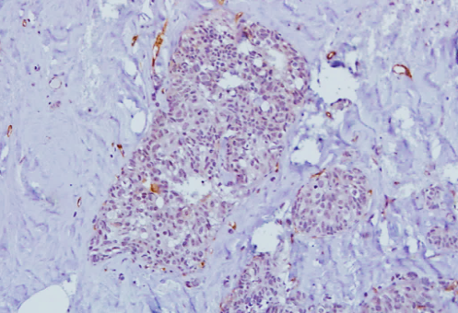
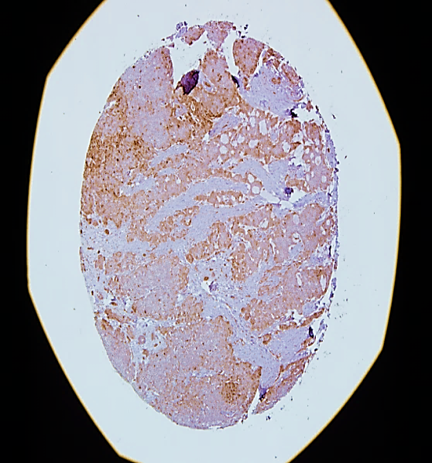
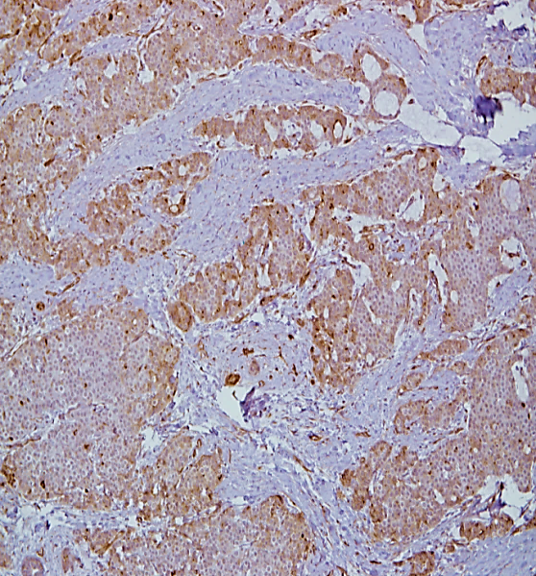
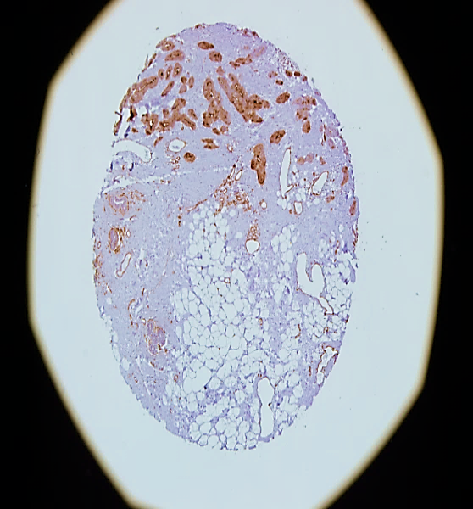
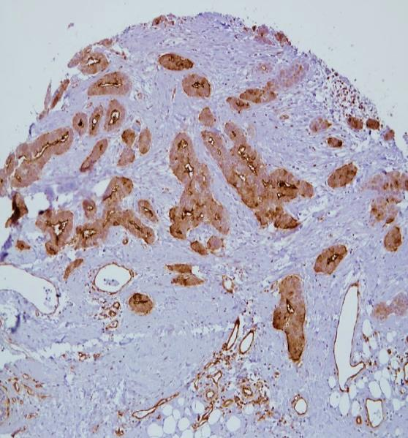
Supplementary Figure 1
4x
10x
0+ Intensity
4x
10x
1+ Intensity
4x
10x
2+ Intensity
4x
10x
3+ Intensity
Supplementary Figure 1: IFITM1 staining intensities for ER+ breast cancer patients. Immunohistochemical staining for IFITM1 expression was conducted in 94 ER+ breast cancer patient samples and 6 normal breast tissue samples. Staining intensity was graded on a scale of 0-3 with representative images of each staining intensity shown.

