Slide 1
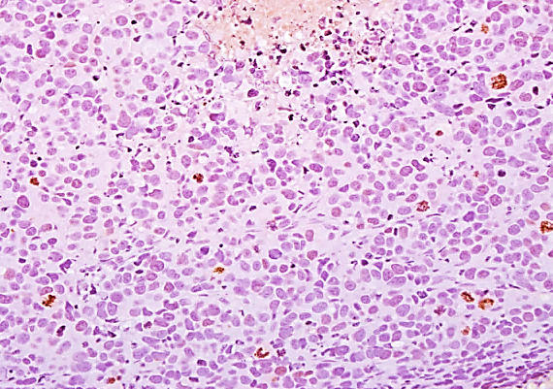
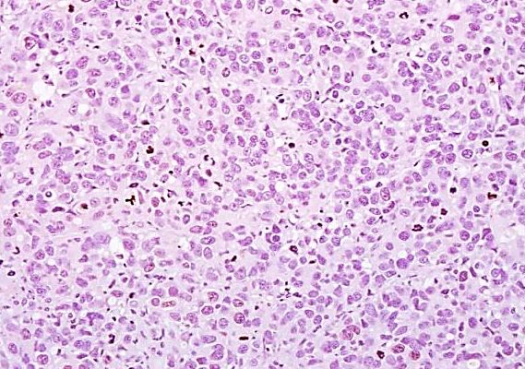
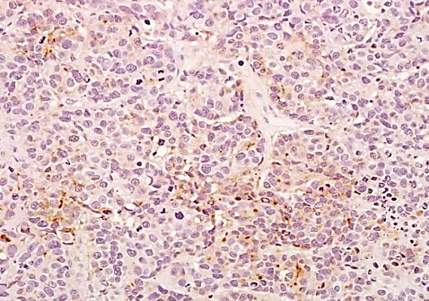
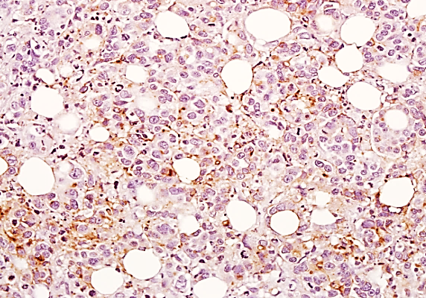
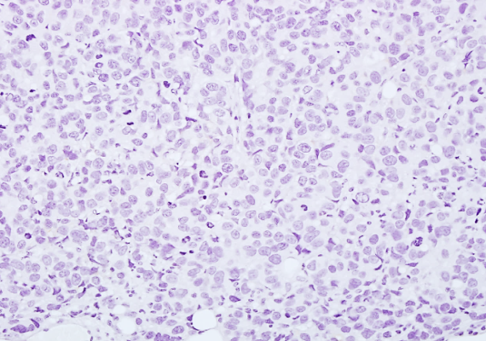
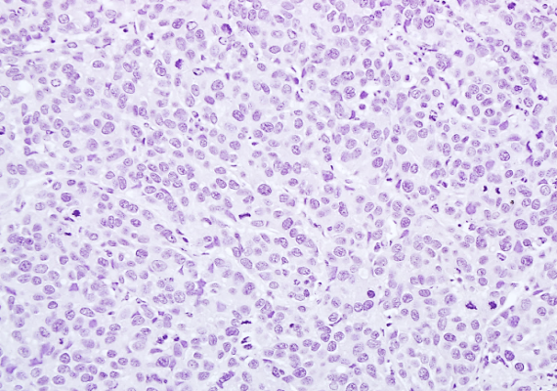
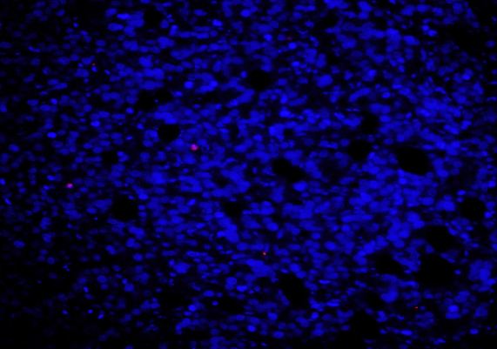
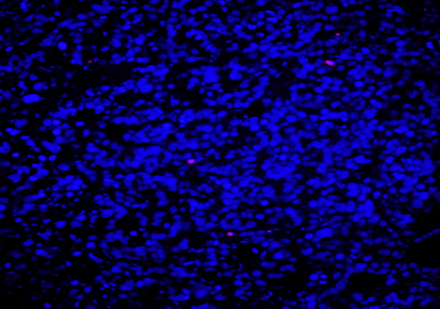
Supplementary Figure 4
Control
Doxycycline
IgG
100 µM
100 µM
IFITM1
100 µM
100 µM
Ki67
% Ki67 Positive
100 µM
100 µM
-Dox
+Dox
TUNEL
TUNEL Intensity
100 µM
100 µM
-Dox
+Dox
Supplementary Figure 4: Doxycycline induced IFITM1 shRNA expression is specific to MCF-7:5C/IFsh cells.
3 million MCF-7:5C/C9Con cells were injected into the 4th mammary fat pad of ovarectomized female NSG mice. 9 days after orthotopic injection, mice were randomized to treatment groups and half were provided doxycycline (Dox)-treated drinking water. Excised tumors were fixed, embedded in paraffin and sectioned onto glass slides. IFITM1 and Ki67 expression was determined by immunohistochemical staining. The percent of Ki67 positive cells was determined by counting four separate 40X fields. Cell death was analyzed by TUNEL staining and quantified by Image J software analysis of six separate 20X images. Representative images are shown.

