Slide 1
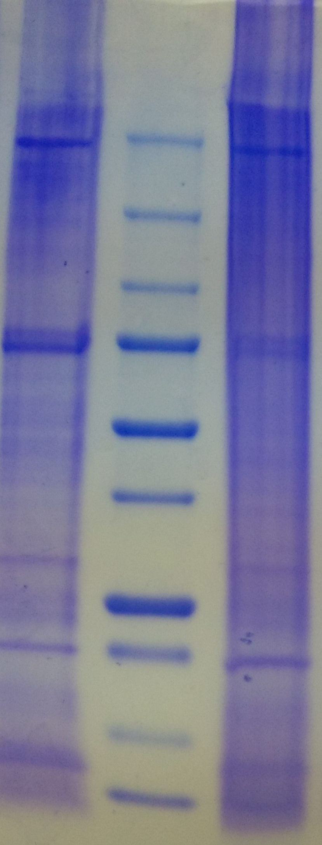
Fig. 1
A
CP
M
IP
# M_{r} range
kDa
1: >350
250
2: 250−350
3: 230−250
in-gel trypsin digestion
150
4: 140−230
100
5: 80−140
LC-MS/MS
Fig. 2
75
6: 70−80
Database search
50
7: 45−70
37
8: 30−45
Protein identification
A
25
9: 22−30
Quantification
Others
(363)
immunity
(233)
20
10: 20−22
15
11: 15−20
ribosomal protein (78)
10
12: <15
B
sensory/ cuticle (52)
metabolism
(524)
ATP/NAD(P)H binding (181)
Cytoskeleton/motor (73)
Ion binding (147)
DNA/RNA
synthesis (105)
B
PRR (53)
others (42)
Fig. 3
A
TEP (8)
SP (59)
proPO (7)
Protein numbers
AMP (9)
SPH (38)
serpin (17)
B
0
10⁰⁻⁶
10⁶⁻⁷
10⁷⁻⁸
10⁸⁻⁹
10⁹⁻¹⁰
>10¹⁰
LFQ percentages (%)
0
10⁰⁻⁶
10⁶⁻⁷
10⁷⁻⁸
10⁸⁻⁹
10⁹⁻¹⁰
>10¹⁰
LFQ range

Slide 2
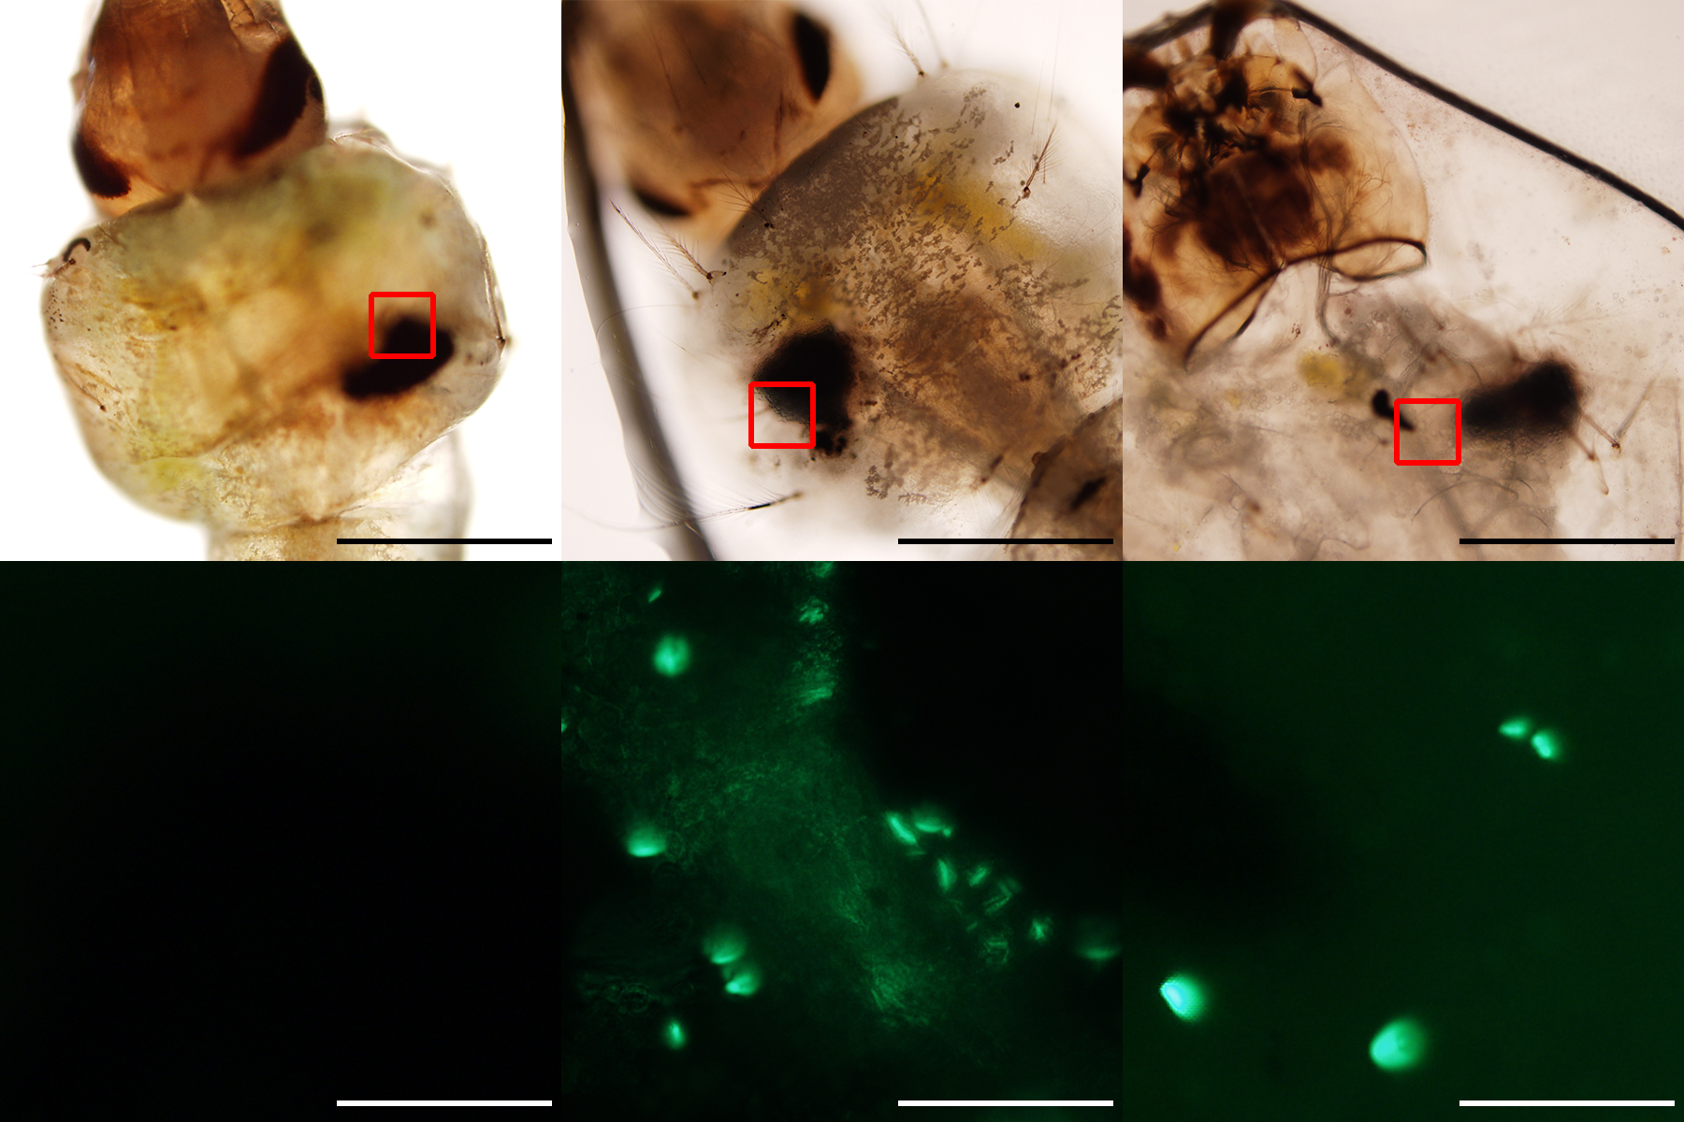
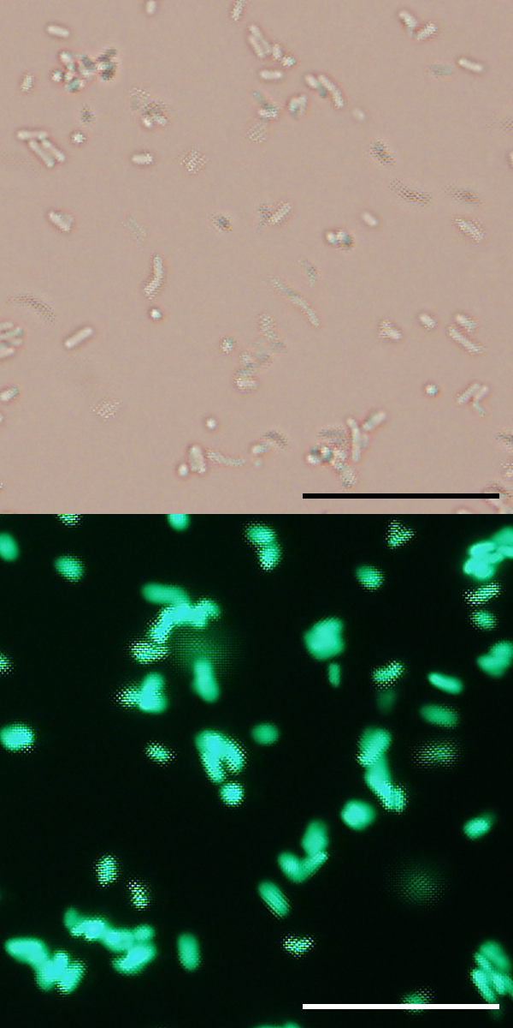
Fig. 4
Fig. 5
A
treatment | E. coli |  | PBS |  | no
 | pricked | injected | pricked | injected
total # | 146 | 134 | 151 | 173 | 180
survival | 63% | 66% | 80% | 83% | 100%
A
117
99
321
151
134
133
133
55
84
68
93
B
log₂LFQ
213
PBS, live
E. coli, live
E. coli, dead
E. coli culture
CP
BF
1 mm
B
97
98
64
78
355
C
GFP
0.1 mm
log₂LFQ
284
141
112
143
173
65
73
gambicin-1
IP
# of gel slices detected
cecropin A
0 2 6 24 2 6 24 2 6 24 2 6 24 (h)
- ctrl
PBS E. coli
pricking injection pricking injection

