Slide 1
Supporting Information
Materials and Methods
We used a Shimadzu LC-HPLC equipped with LC-20ADXR pumps (Shimadzu Corp., Columbia, MD) for solvent and sample delivery and a 2.1 mm X 100 mm, 130 Å pore size, 3.5 μm particle size C18 column (Waters Corp.) for the peptide separations using the following linear gradient: 0min 5%B; 10 min 36%B; 12 min 90%B; 13.5 min 90%B; 14 min 5%B at a flow rate of 0.2ml/min. The total run time was 18 min per sample. Triplicate injections of 10 μl of sample were carried out via the SIL-20AXR autosampler (Shimadzu Corp.). To eliminate possible carryover, the column was re-equilibrated at 50%B for 10 min and a blank run was performed prior to initiating the next sample injection. QTRAP 5500 mass spectrometer with electrospray ionization (ESI) source controlled by Analyst 1.5 software (AB Sciex, Framingham, MA) was used for all LC-SRM-MS detection and analysis. Mass spectrometric analyses were performed in positive ion mode. ESI interface parameters were set as follows: capillary temperature 650°C and a curtain gas setting of 30 psi. A total of 27 SRM transitions from 9 peptides were monitored during an individual sample analysis with Q1 and Q3 set to dwell time 15 msec, declustering potential (DE) 10 V and peptide-specific tuned collision energy (CE), entrance potential (EP) and collision cell exit (CXP) voltages for each transition.

Slide 2
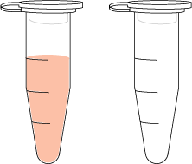
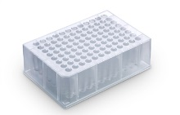
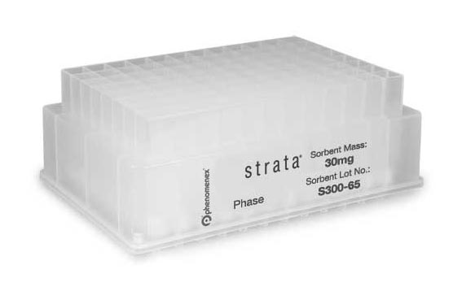
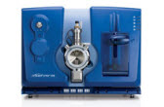
5 µl
QC plasma
Digestion
Sample
preparation workflow
Clean up
Pooled
LC-MS/MS assay
Technical component I
(Entire variability)
Technical component II
(LC-MS/MS variability)
Figure S1. Sources of technical variation in a typical SRM workflow

Slide 3
A
%CV of transition ion peak area
B
Spiked SISs concentration (fmol/µl)
100 fmol/µl
20 fmol/µl
10% CV
Figure S2. Optimal heavy-SIS spiking concentration and technical reproducibility
Experiments with 8 biological replicates and 3 technical repeats were performed to determine SRM variation from a given SIS spiking concentration. A. a comparison of technical variability with different SIS spiking concentrations at the transition level . The SIS spiking concentration was determined based on three criteria: 1) technical variability of each SIS ion (CV must be ≤10%); 2) the signal generated by spiked SIS peptide must be greater than its corresponding endogenous peptide signal in the sample with the exception of the HSA peptide, and 3) consumption of SIS peptides (optimal results has to be at minimized cost). B. a comparison of entire variability between 20 and 100 fmol/µl SIS spiking concentrations at peptide level. Obviously, 100 fmol/µl as final spiking concentration meets these three criteria.

Slide 4
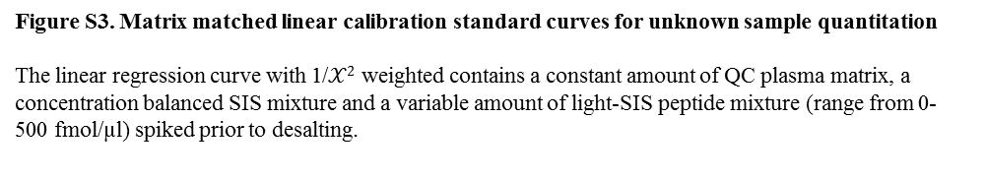
7
2.5
6
2.25
5
2
y4
1.75
4
y5
1.5
y10+2
Relative signal (standard/SIS ratio)
Relative signal (standard/SIS ratio)
1.25
y11+2
3
y8
1
y3
2
.75
1
.5
0
.25
0
-1
-100
0
100
200
300
400
500
600
-.25
-100
0
100
200
300
400
500
600
Concentration (fmol/µl)
Concentration (fmol/µl)
7CFH 62V_SLGNVIMV(Cam)R_y5 = -.006 + .013 * Concentration (fmol/µl); R^2 = .998
35CFH3_WSSPPQ(Cam)EGLP(Cam)K_y11+2 = -.031 + .005 * Concentration (fmol/µl); R^2 = .997
7CFH 62V_SLGNVIMV(Cam)R_y8 = -.013 + .012 * Concentration (fmol/µl); R^2 = .998
35CFH3_WSSPPQ(Cam)EGLP(Cam)K_y3 = -.042 + .005 * Concentration (fmol/µl); R^2 = .998
7CFH 62V_SLGNVIMV(Cam)R_y4 = -.024 + .013 * Concentration (fmol/µl); R^2 = .995
35CFH3_WSSPPQ(Cam)EGLP(Cam)K_y10+2 = -.023 + .004 * Concentration (fmol/µl); R^2 = .999
3
2.5
2.5
2.25
2
2
1.75
1.5
y4
1.5
3b2
Relative signal (standard/SIS ratio)
1.25
y5
Relative signal (standard/SIS ratio)
3y13+2
1
y8
1
3y14+2
.5
.75
.5
0
.25
-.5
0
-100
0
100
200
300
400
500
600
-.25
-100
0
100
200
300
400
500
600
Concentration (fmol/µl)
Concentration (fmol/µl)
11CFH I62V_SLGNIIMVCamR_y5 = -.003 + .005 * Concentration (fmol/µl); R^2 = 1
37CFH H402_(Cam)YFPYLENGYNQNHGR_3y13+2 = -.004 + .005 * Concentration (fmol/µl); R^2 = 1
11CFH I62V_SLGNIIMVCamR_y8 = -.008 + .006 * Concentration (fmol/µl); R^2 = .999
37CFH H402_(Cam)YFPYLENGYNQNHGR_3y14+2 = .003 + .004 * Concentration ((fmol/µl); R^2 = .999
11CFH I62V_SLGNIIMVCamR_y4 = -.002 + .005 * Concentration (fmol/µl); R^2 = 1
37CFH H402_(Cam)YFPYLENGYNQNHGR_3b2 = .002 + .005 * Concentration ((fmol/µl); R^2 = 1
6
1.4
5
1.2
4
1
3
y6
.8
3y6
Relative signal (standard/SIS ratio)
y7
Relative signal (standard/SIS ratio)
3y7
2
y8
.6
3y8
1
.4
0
.2
-1
0
-100
0
100
200
300
400
500
600
-.2
-100
0
100
200
300
400
500
600
Concentration (fmol/µl)
Concentration (fmol/µl)
31CFH1_LSYT(Cam)EGGFR_y7 = -.025 + .009 * Concentration (fmol/µl); R^2 = .999
39CFH Y402_(Cam)YFPYLENGYNQNYGR_+3y7 = -.019 + .002 * Concentration (fmol/µl); R^2 = .997
31CFH1_LSYT(Cam)EGGFR_y8 = -.023 + .011 * Concentration (fmol/µl); R^2 = 1
39CFH Y402_(Cam)YFPYLENGYNQNYGR_+3y8 = -.066 + .003 * Concentration (fmol/µl); R^2 = .991
31CFH1_LSYT(Cam)EGGFR_y6 = -.025 + .011 * Concentration (fmol/µl); R^2 = 1
39CFH Y402_(Cam)YFPYLENGYNQNYGR_+3y6 = .025 + .002 * Concentration (fmol/µl); R^2 = .994
3
2.5
2
b2
1.5
Relative signal (standard/SIS ratio)
y11
1
y9
.5
0
-.5
-100
0
100
200
300
400
500
600
Concentration (fmol/µl)
33CFH2_(Cam)FEGFGIDGPAIAK_y11 = -.026 + .006 * Concentration (fmol/µl); R^2 = 1
33CFH2_(Cam)FEGFGIDGPAIAK_y9 = -.028 + .006 * Concentration (fmol/µl); R^2 = .999
33CFH2_(Cam)FEGFGIDGPAIAK_b2 = -.02 + .005 * Concentration (fmol/µl); R^2 = .999
Figure S3. Matrix matched linear calibration standard curves for unknown sample quantitation
The linear regression curve with 1/$𝒳2$ weighted contains a constant amount of QC plasma matrix, a concentration balanced SIS mixture and a variable amount of light-SIS peptide mixture (range from 0-500 fmol/µl) spiked prior to desalting.

Slide 5
A.
3.0
Automated
2.5
Manual
2.0
Plasma concentration (µM)
1.5
1.0
0.5
0.0
7CFH 62V_SLGNVIMV(Cam)R
31CFH1_LSYT(Cam)EGGFR
11CFH I62V_SLGNIIMV(Cam)R
33CFH2_(Cam)FEGFGIDGPAIAK
35CFH3_WSSPPQ(Cam)EGLP(Cam)K
37CFH H402_(Cam)YFPYLENGYNQNHGR
39CFH Y402_(Cam)YFPYLENGYNQNYGR
B.
2.0
Automated
2.0
1.5
Manual
1.5
CFH variant concentration
in plasma (µM)
CFH concentration
in plasma (µM)
1.0
1.0
0.5
0.5
0.0
0.0
Plate1
Plate2
Plate3
Plate4
Plate1
Plate2
Plate3
Plate4
Figure S4. A comparison of plasma CFH protein and its variant data between automated and manual sample preparation
The CFH and its variant concentrations in QC digests prepared by manual method (n=16) and automated method (n=30, across 4 different plates ) were calculated with calibration standard curves. A. The peptide concentration in plasma was calculated by averaging 3 different transitions. B. plasma CFH protein and CFH variant concentration were calculated by averaging 3 different CFH peptides (peptides: 31, 33, 35) in right panel and 4 different variant peptides (peptides: 7, 11, 37 and 39) in left panel, respectively.

