Slide 1
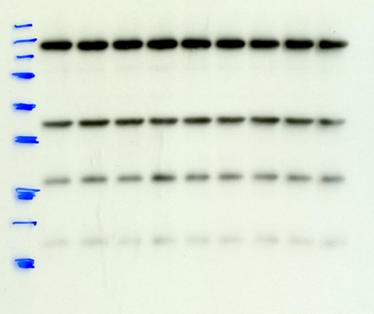
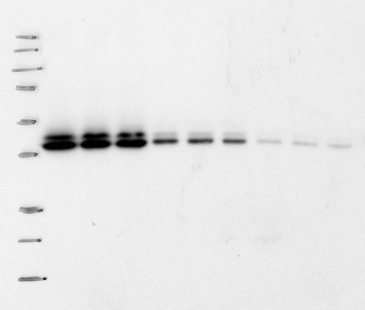
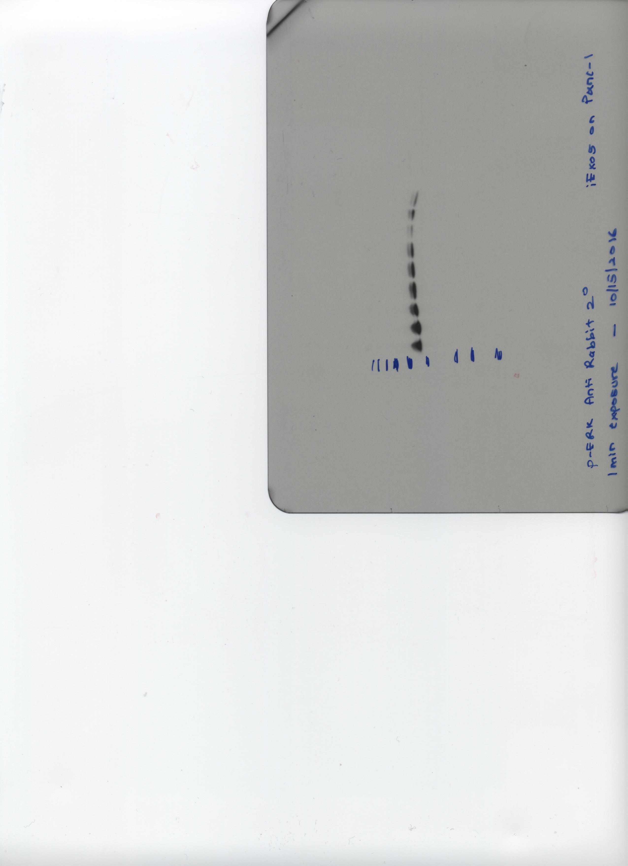
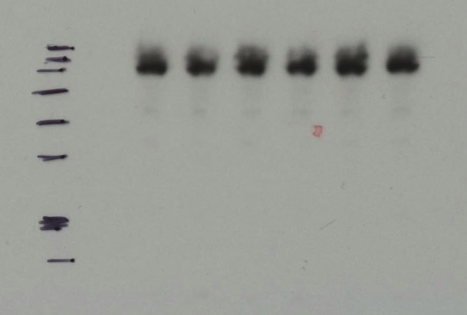
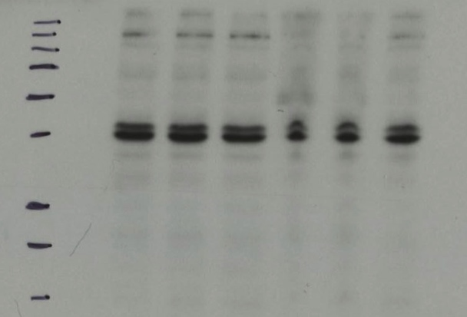
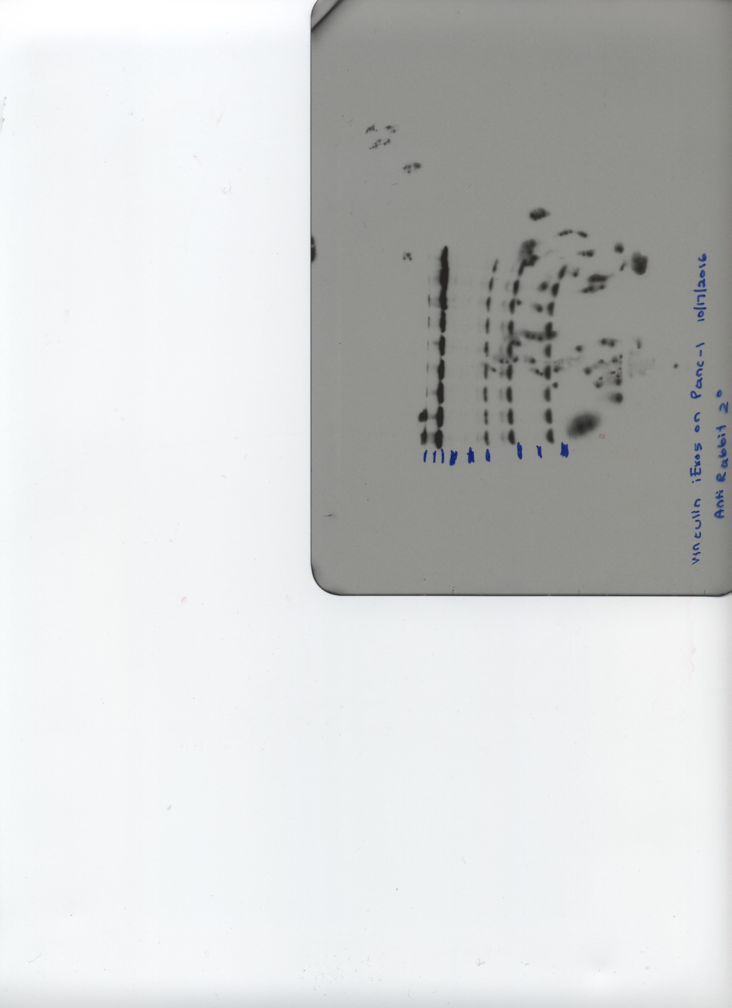
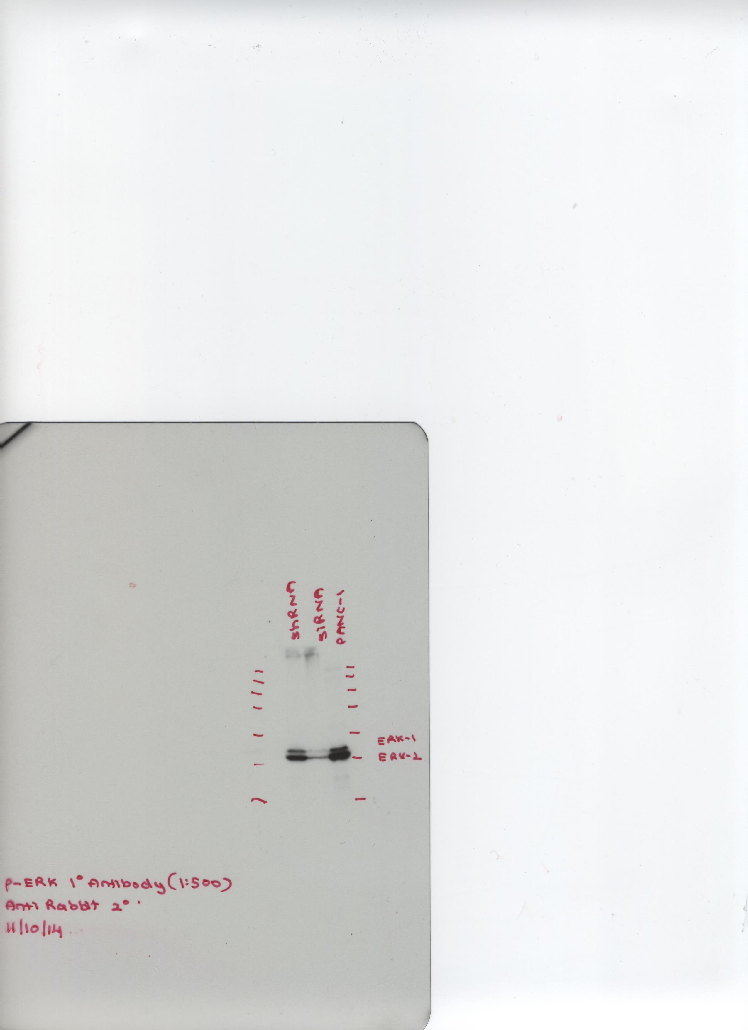
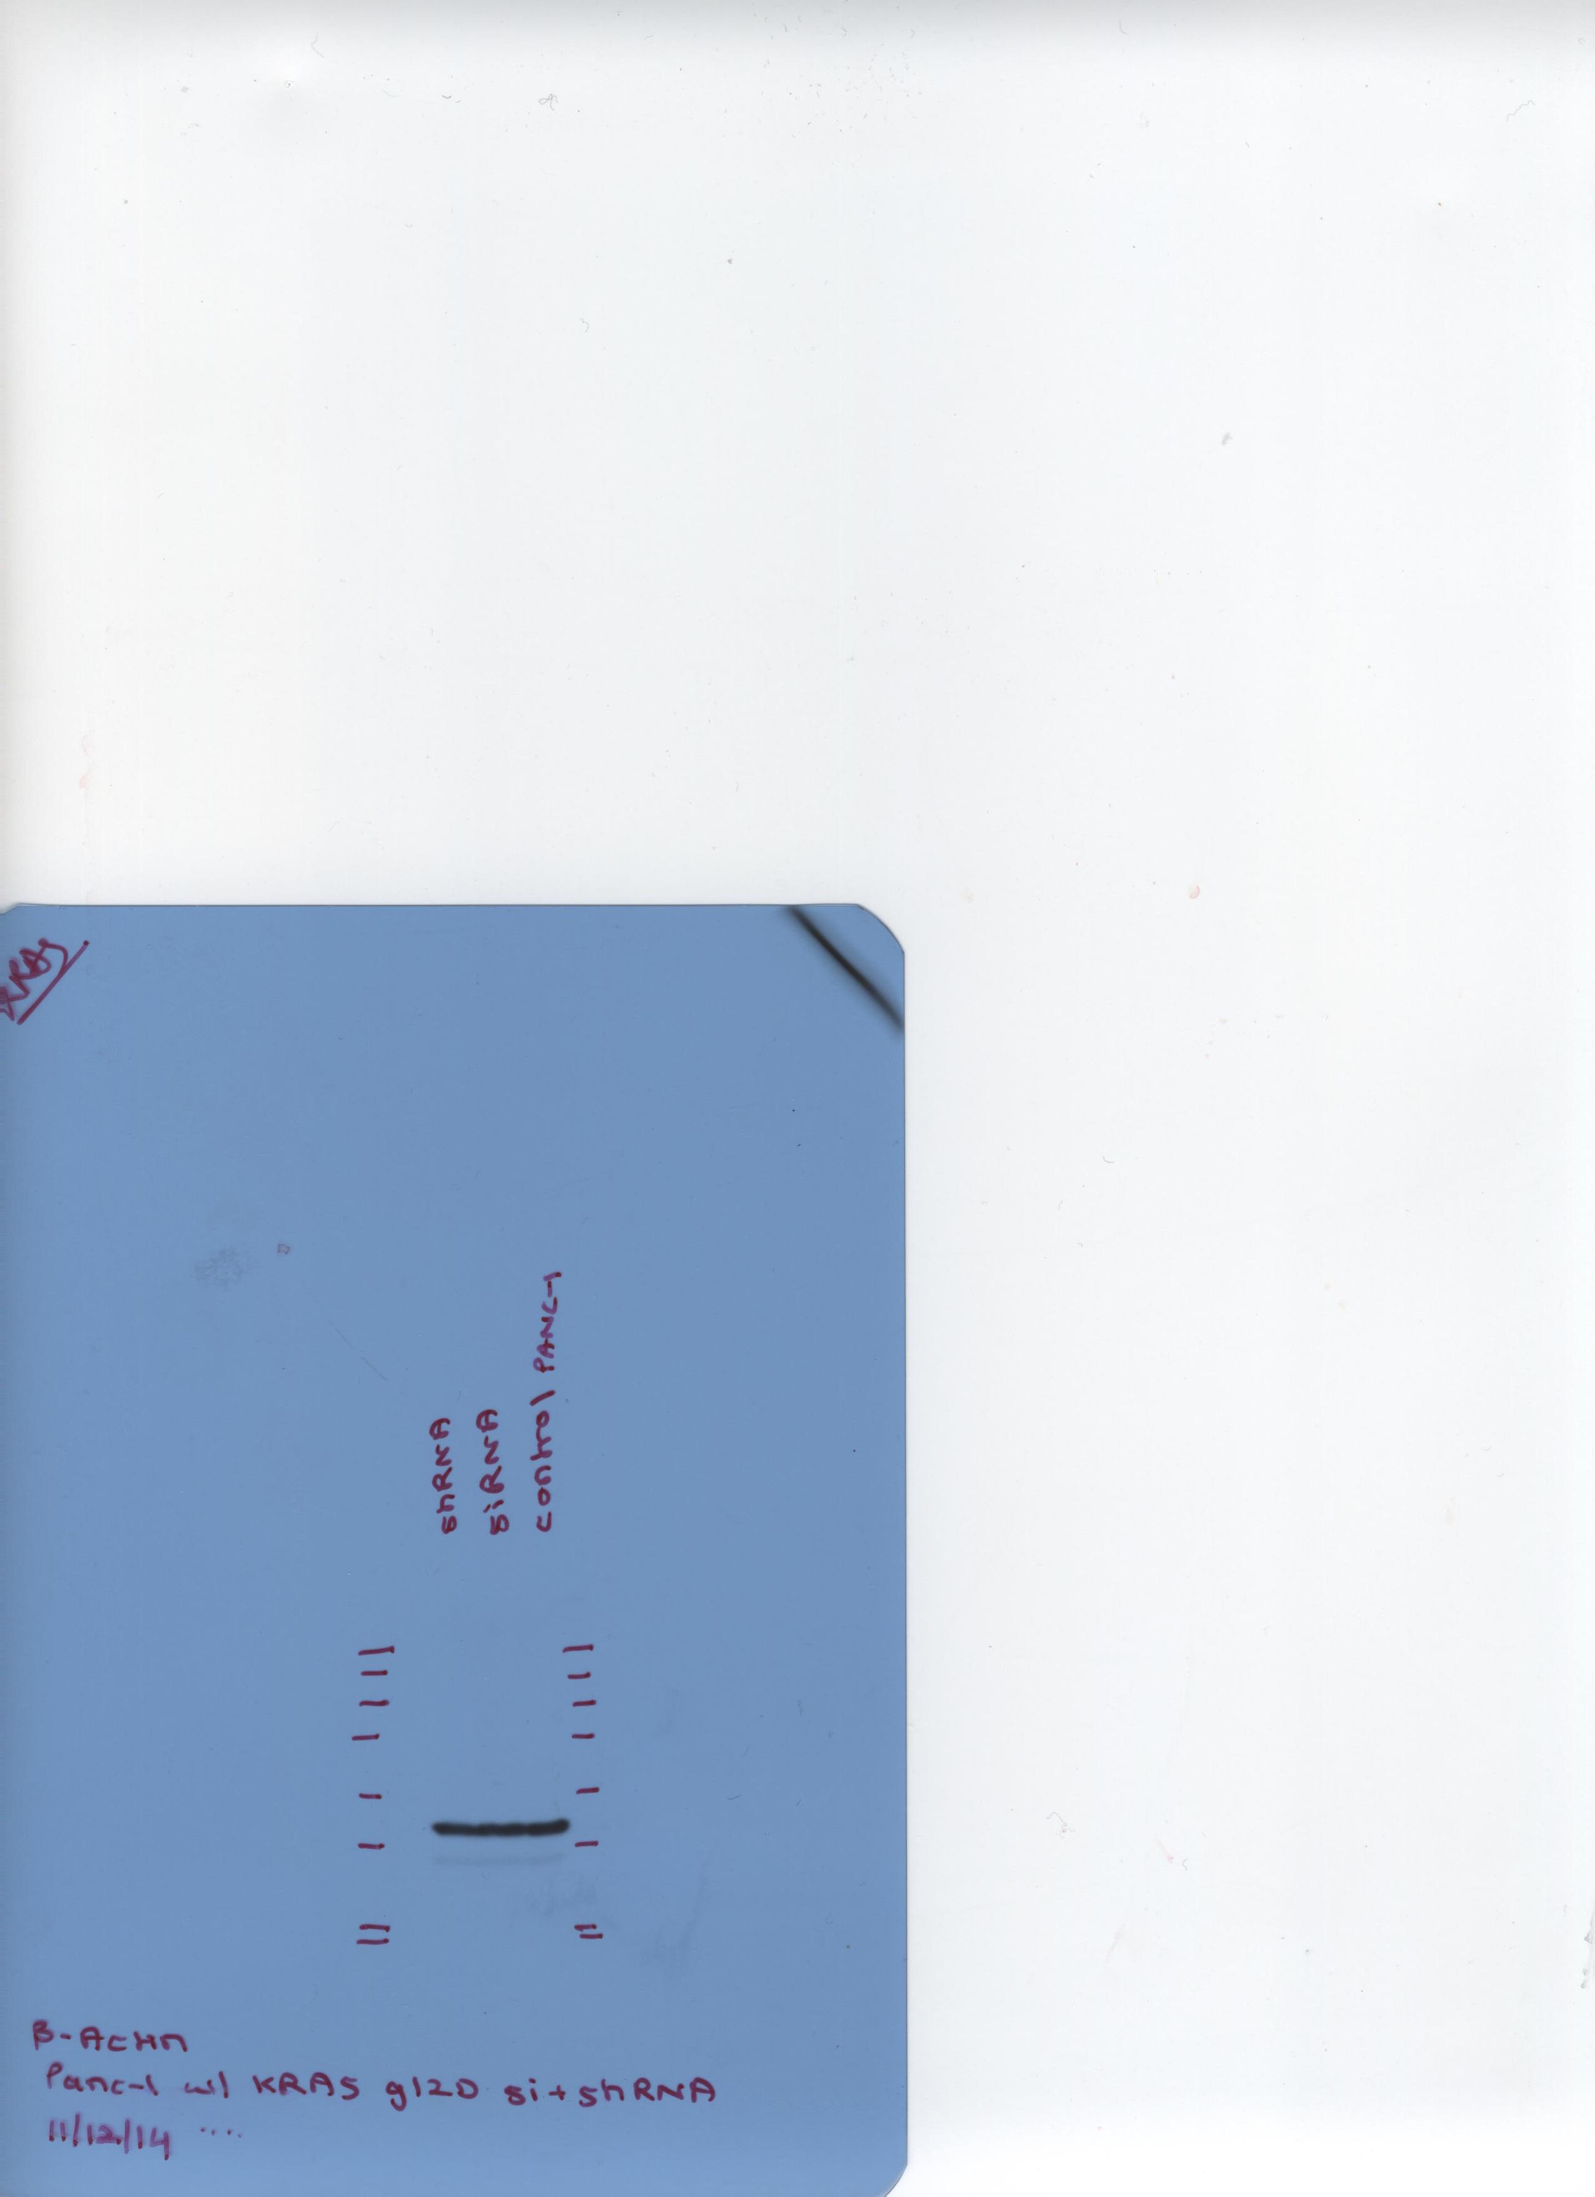
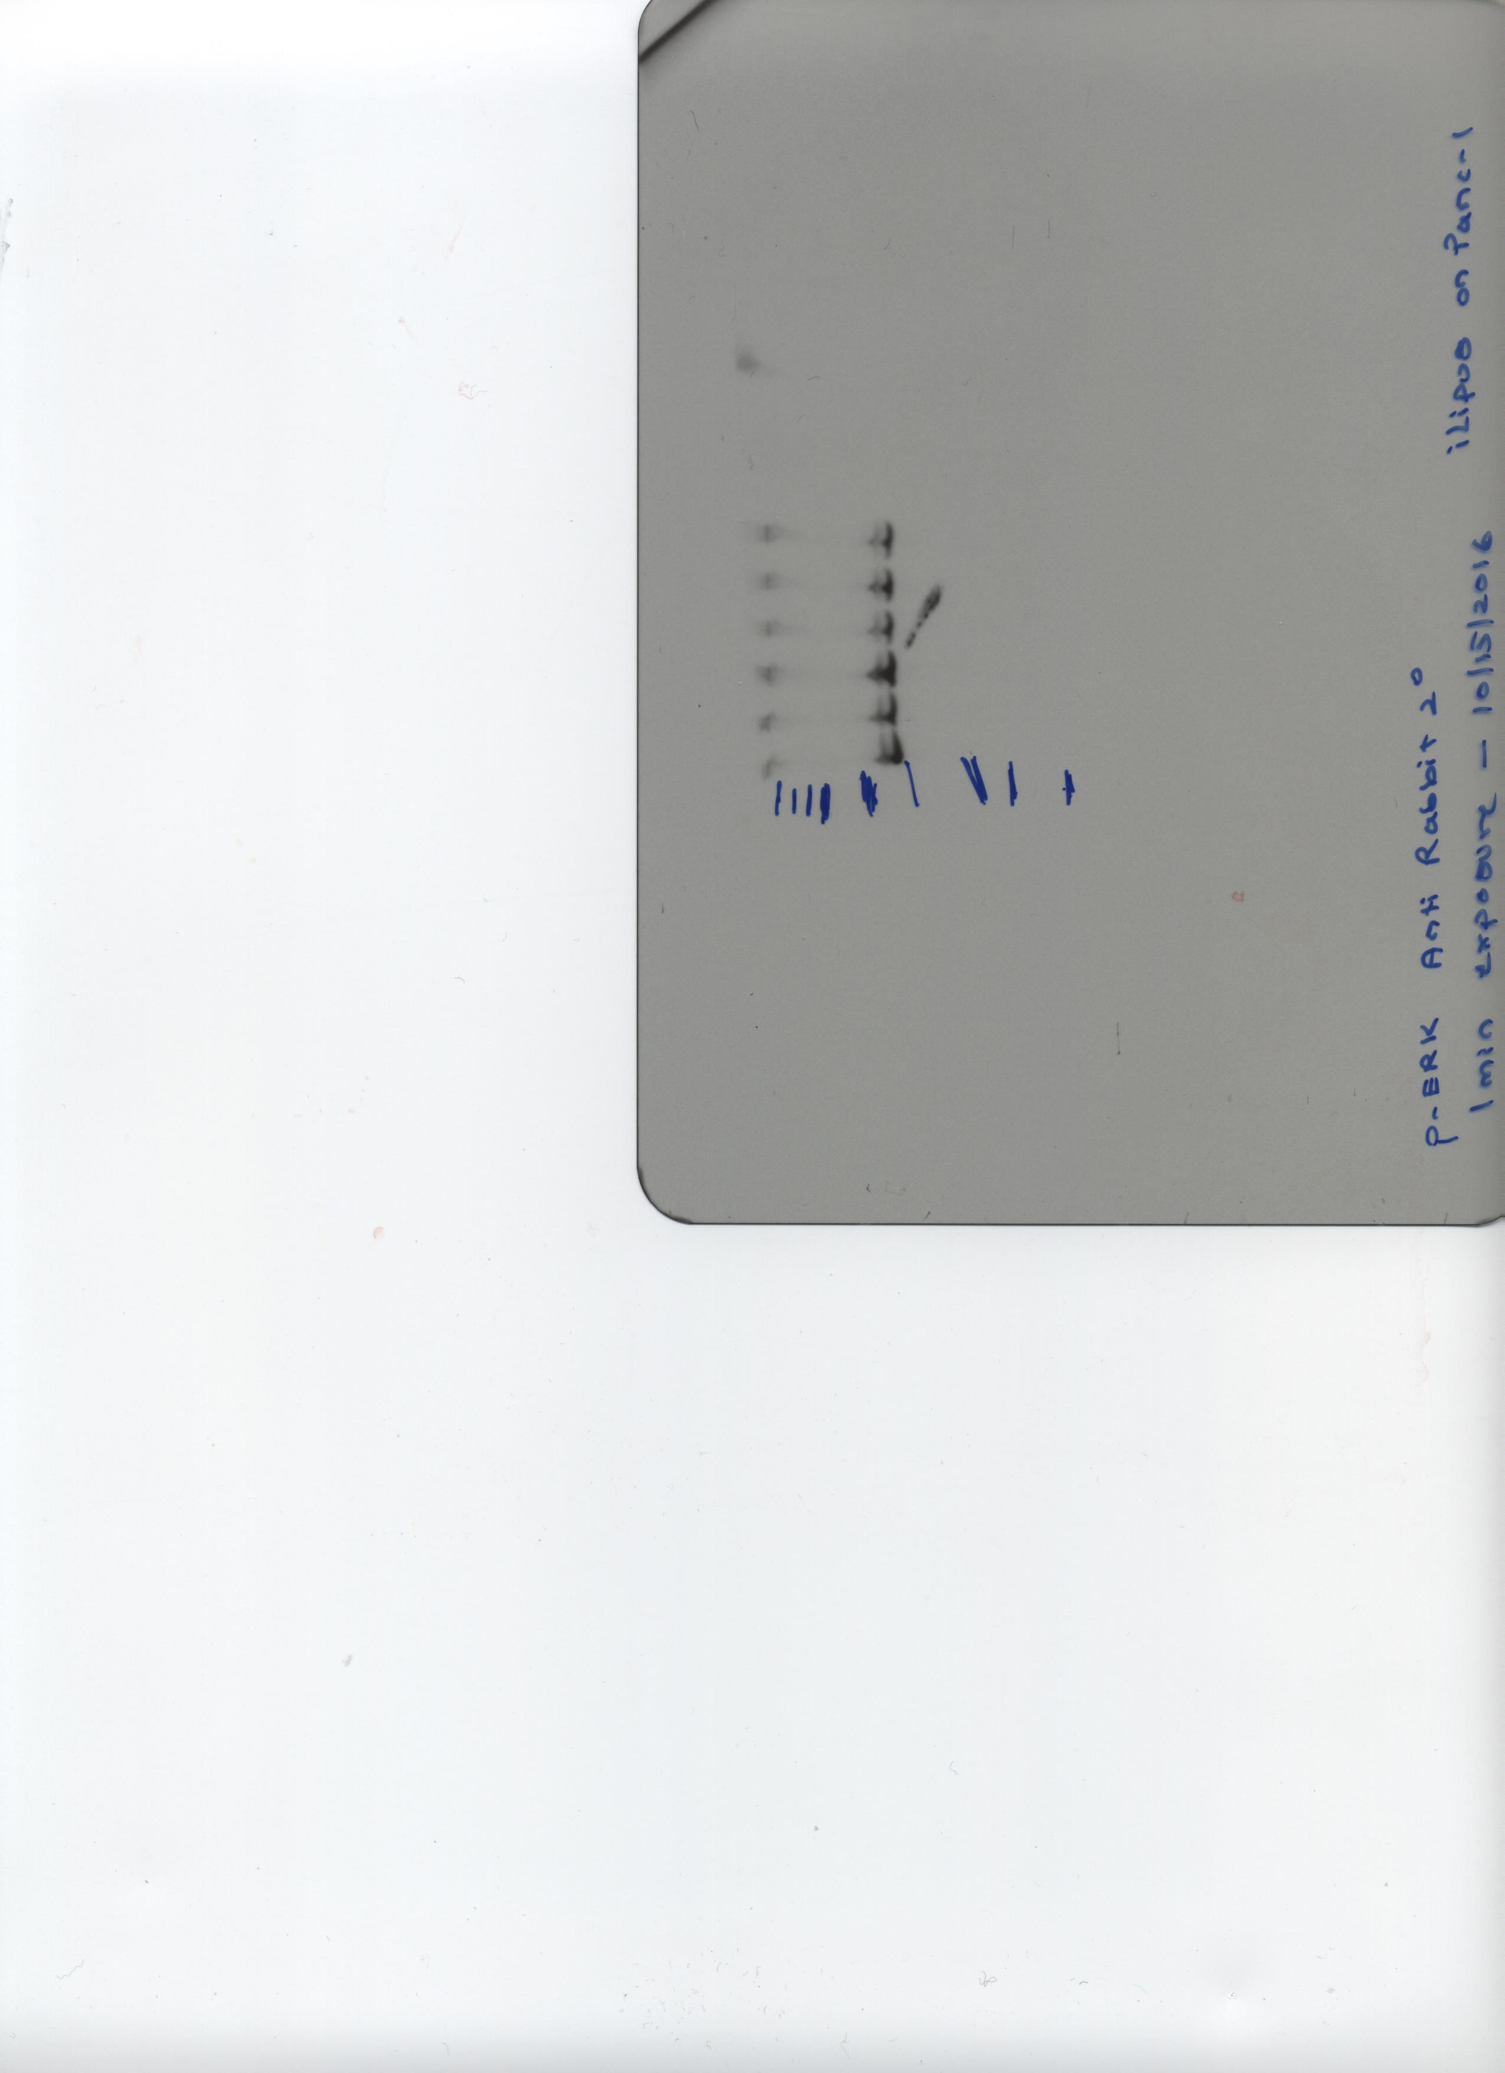
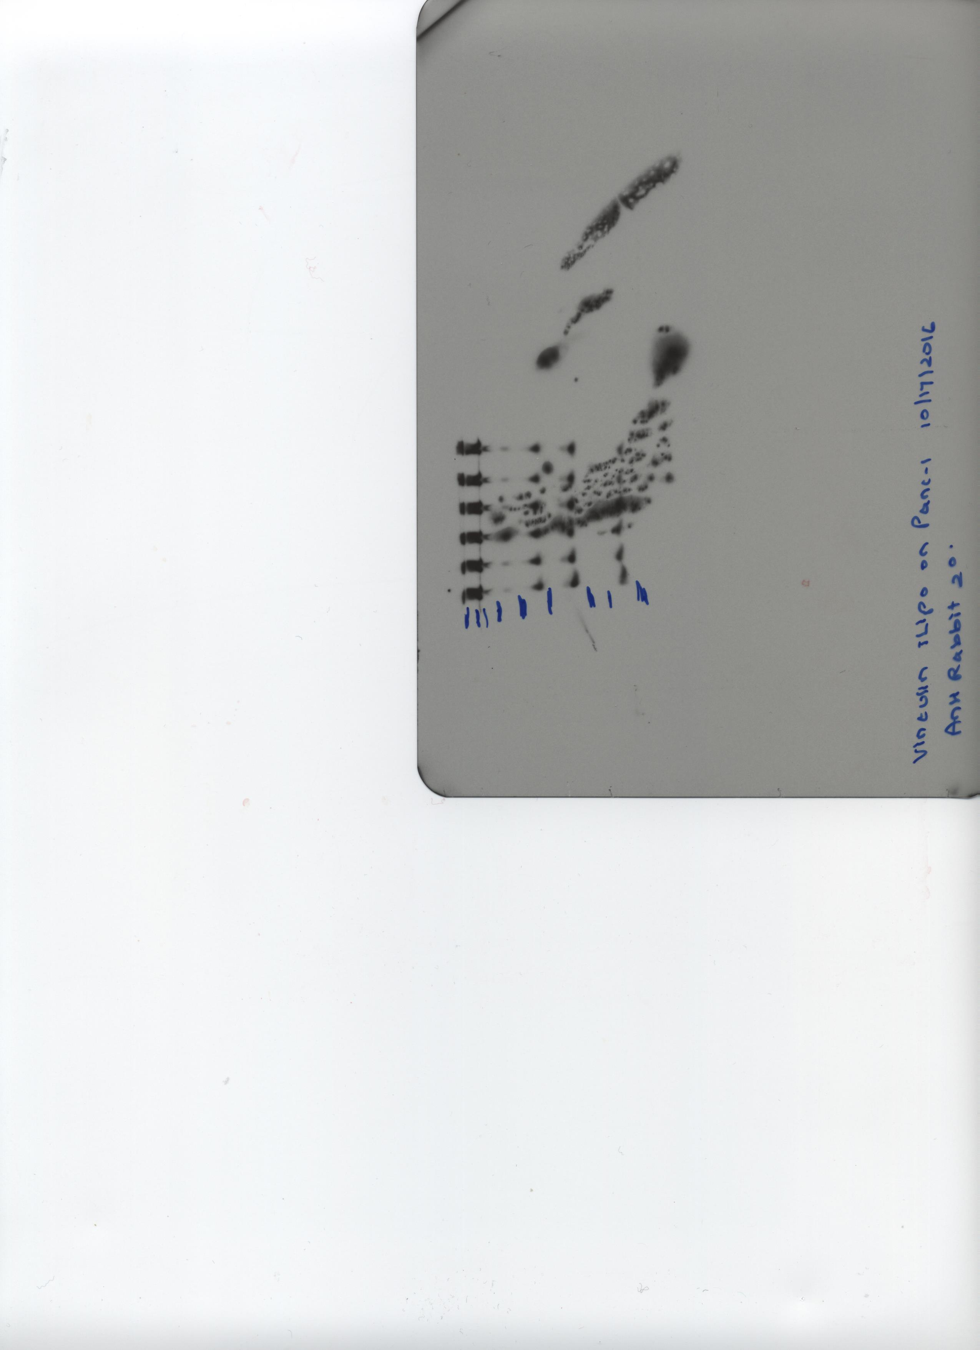
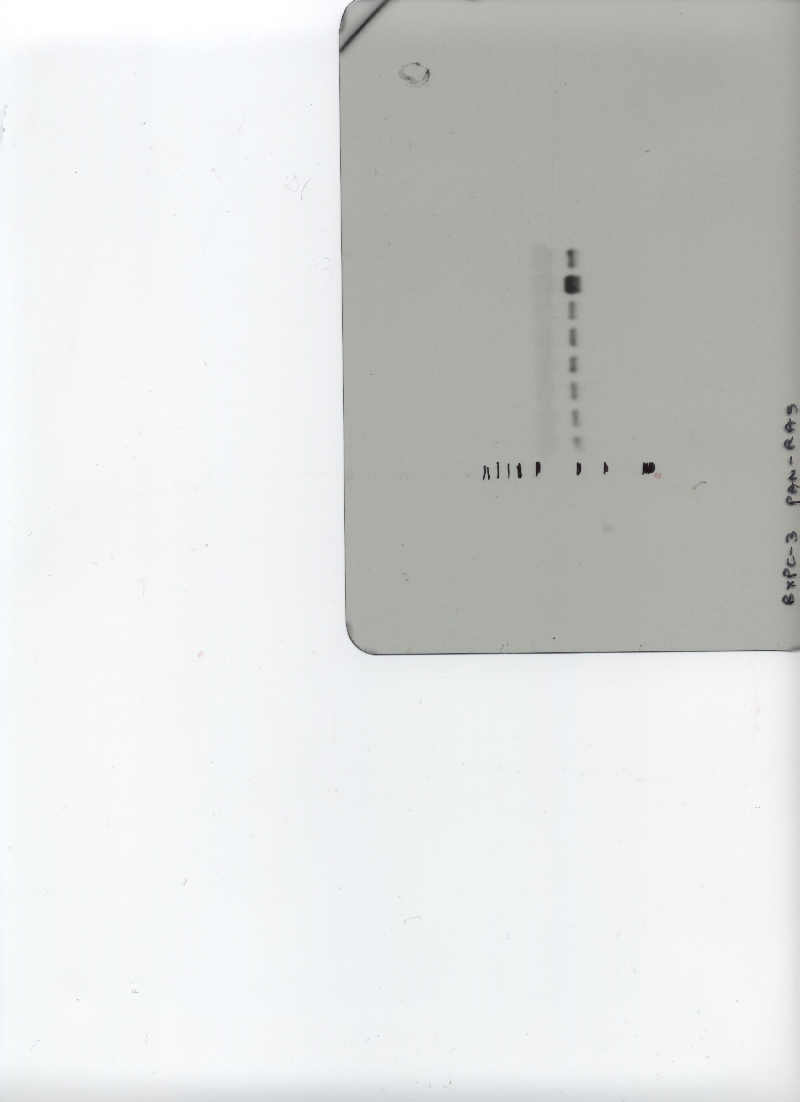
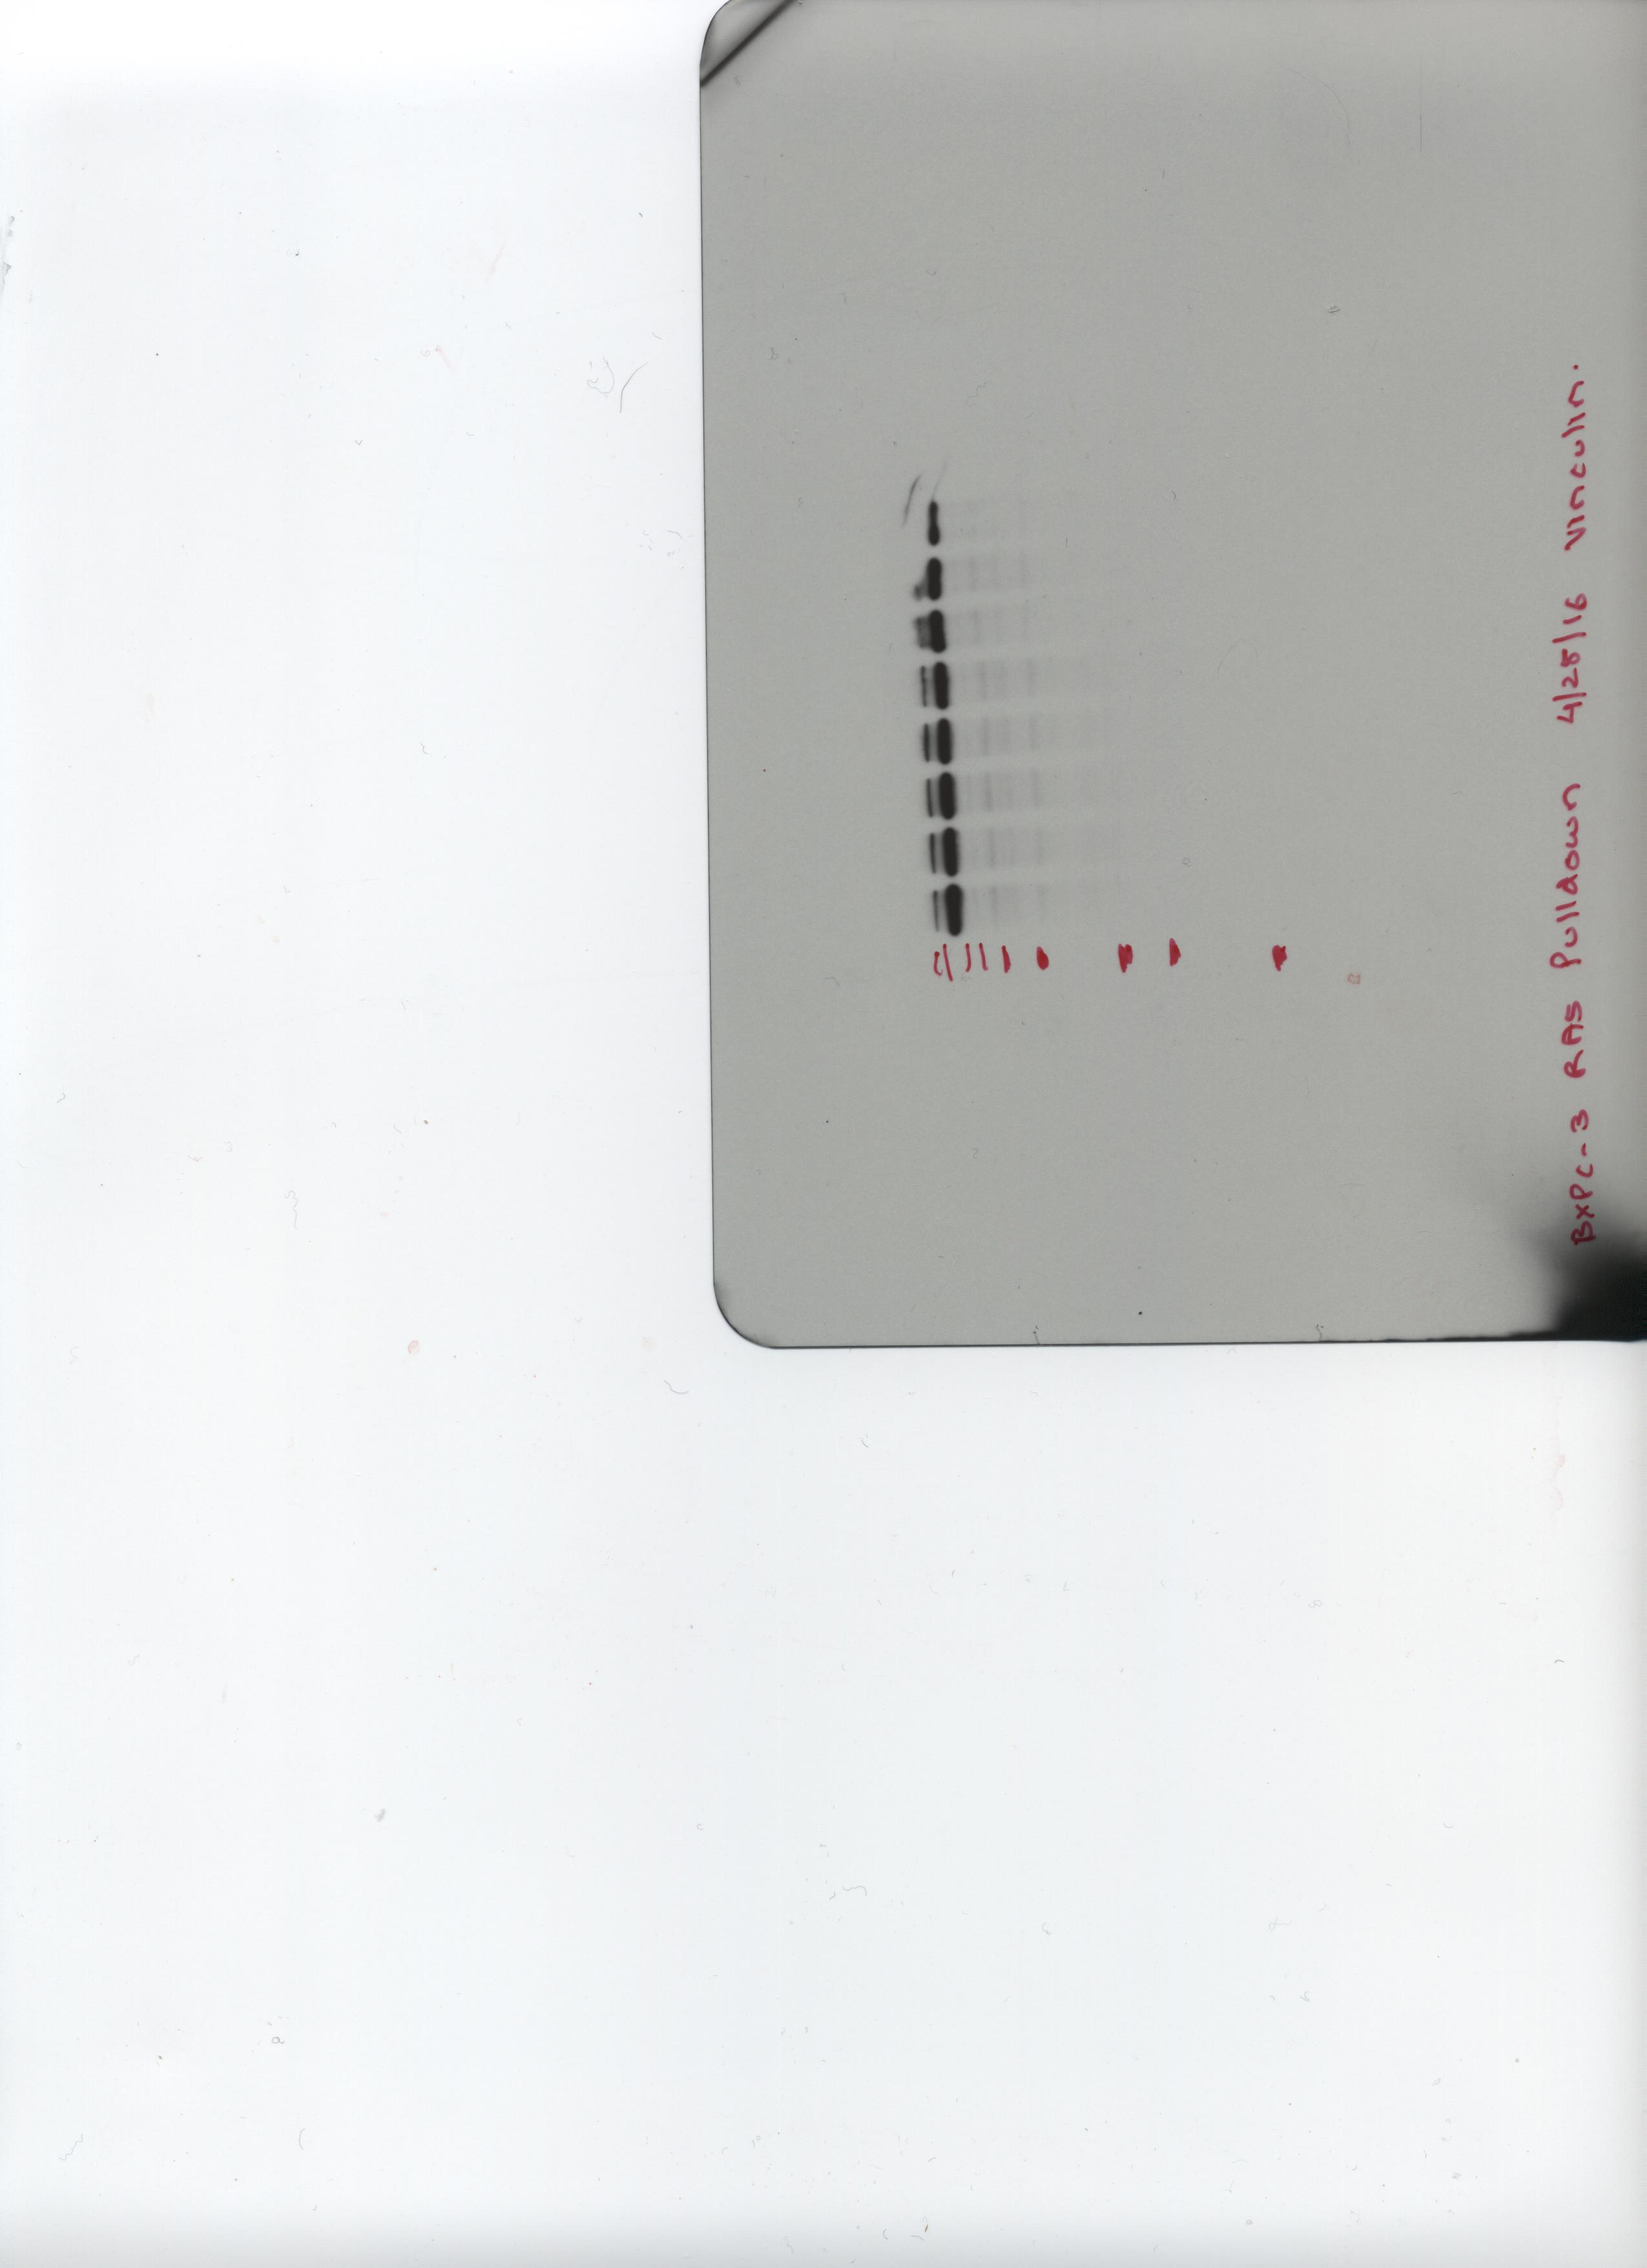
a
Vinculin, iExo (ED Fig. 4h)
p-ERK, iExo (ED Fig. 4h)
Supplementary Figure 1
250
150
100
75
50
37
25
20
15
Vinculin
250
150
100
75
50
37
25
20
15
b
Repeated experiment for quantification shown in ED Fig 4h (iExosomes)
p-ERK
250
150
100
75
50
37
25
20
15
p-ERK
Vinculin, iLipo (ED Fig. 4h)
250
150
100
75
50
37
25
20
15
p-ERK, iLipo (ED Fig. 4h)
250
150
100
75
50
37
25
20
Vinculin
p-ERK
250
150
100
75
50
37
25
20
15
Vinculin
c
Independently performed experiment of iExosomes
treatment to suppress p-ERK levels: (Not included in quantifications)
Repeated experiment for quantification shown in ED Fig 4h (iLiposomes)
250
150
100
75
50
37
25
250
150
100
75
50
37
25
250
150
100
75
50
37
25
20
15
p-ERK
Actin
p-ERK
d
Vinculin, Panc-1 (ED Fig. 4i)
Pan-Ras, Panc-1 (ED Fig. 4i)
250
150
100
75
50
37
25
20
15
250
150
100
75
50
37
25
20
15
Vinculin
Vinculin
250
150
100
75
50
37
25
20
15
Pan-Ras
Pan-Ras, BxPC-3 (ED Fig. 4i)
Vinculin, BxPC-3 (ED Fig. 4i)
250
150
100
75
50
37
25
20
15
250
150
100
75
50
37
25
20
15
Vinculin
Pan-Ras
Supplementary Figure 1: Uncropped western blots
(A) Uncropped images for western blot (p-ERK and Vinculin) in Extended Fig. 4h. (B-C) Additional experiments used for quantification are shown (B) as well as another independent repeated experiment (not used for quantification) (C) . (D) uncropped images for RAS pulldown assay for Pan RAS and Vinculin in both Panc-1 and BxPC-3 cells in Extended Fig. 4i. The numbers listed show the molecular weights of the protein ladder (kDa).

