Slide 1
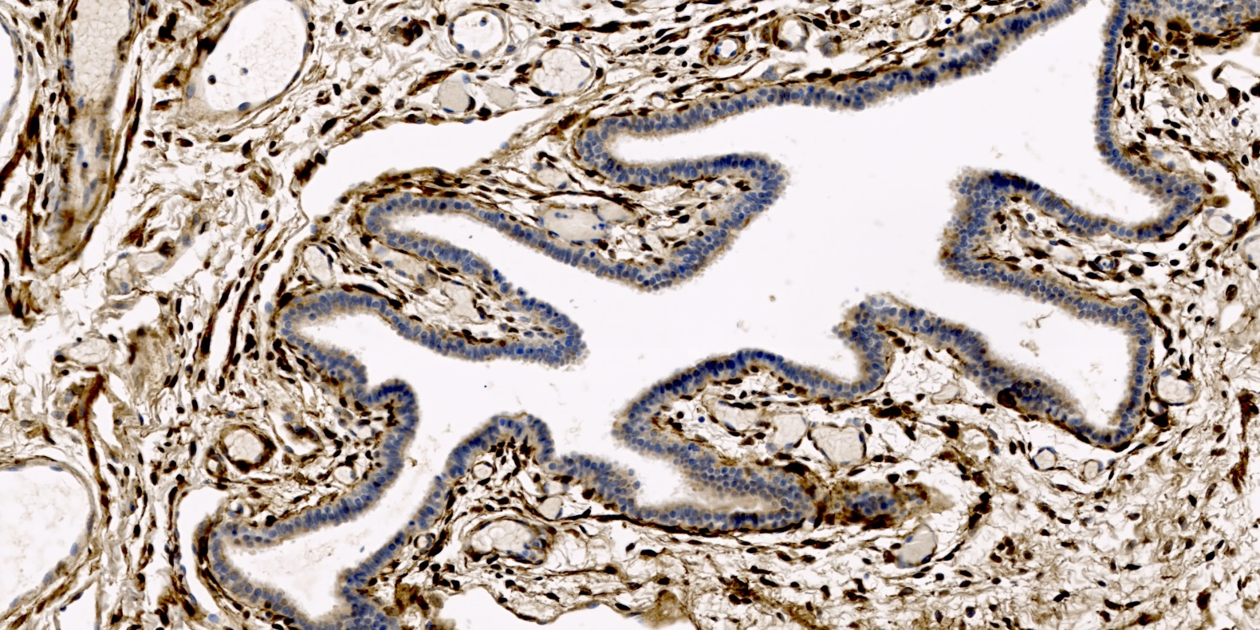
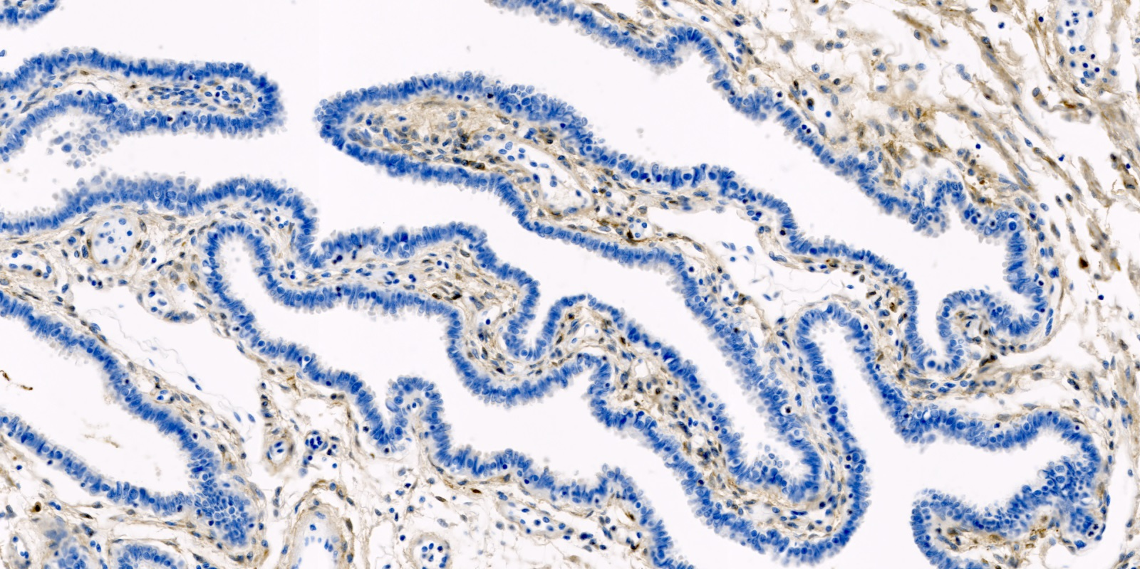
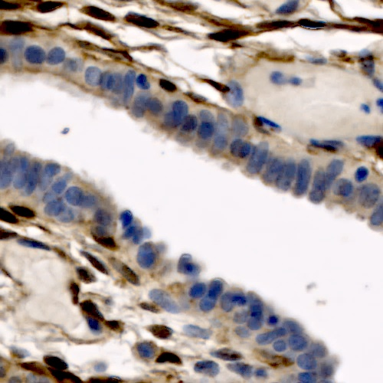
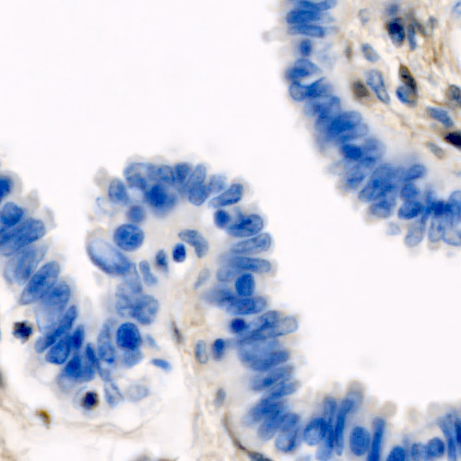
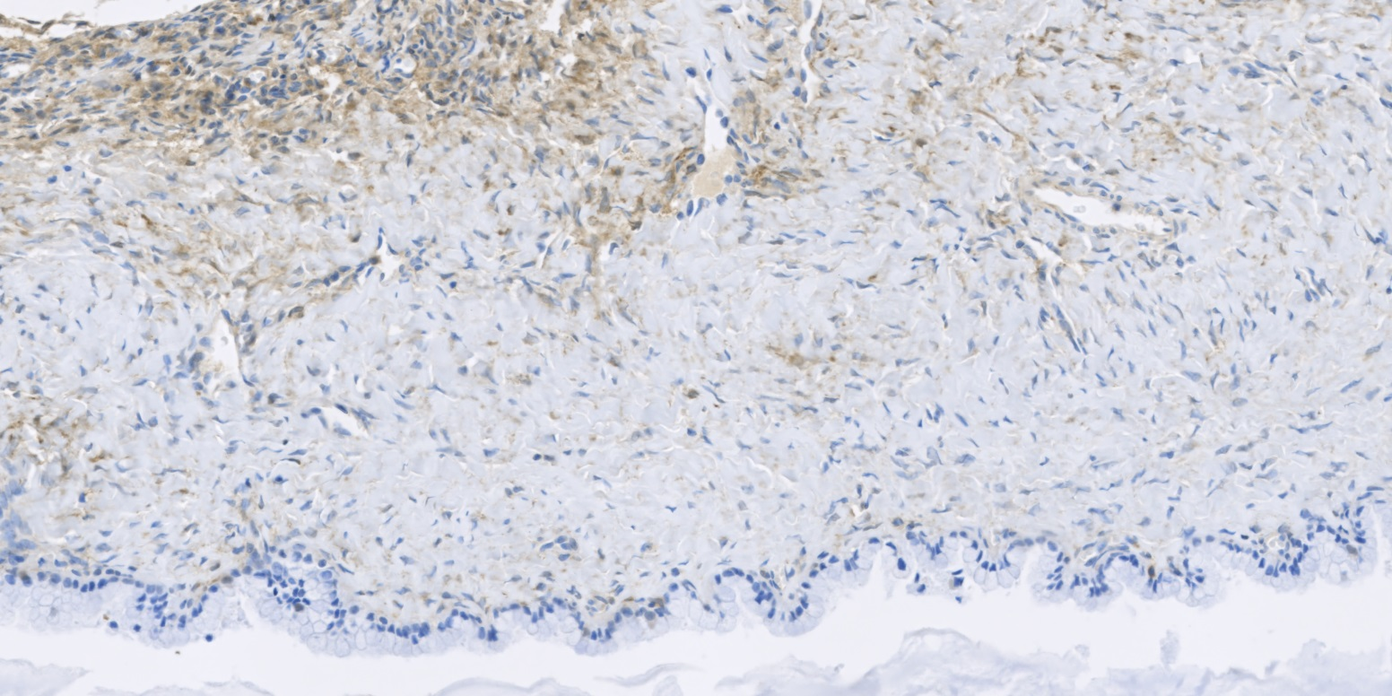
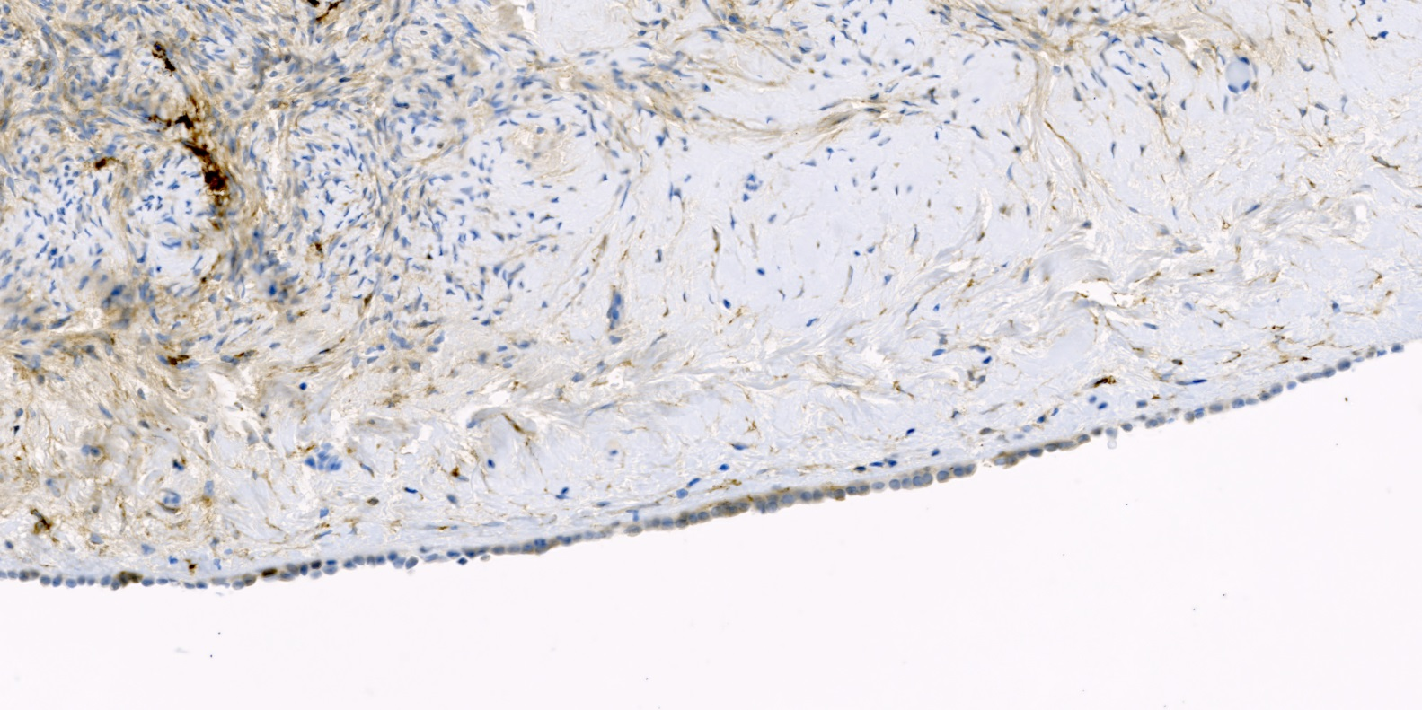
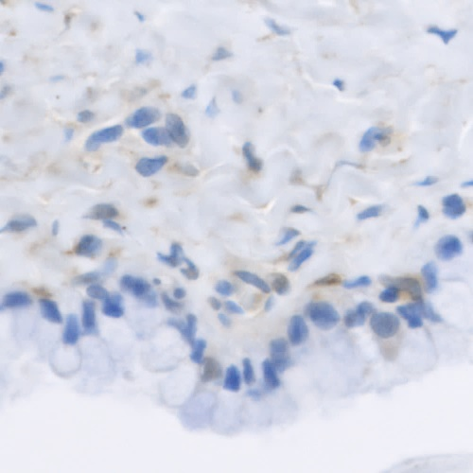
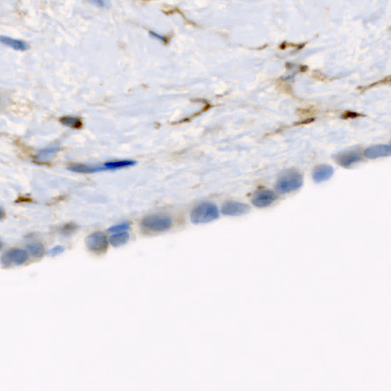
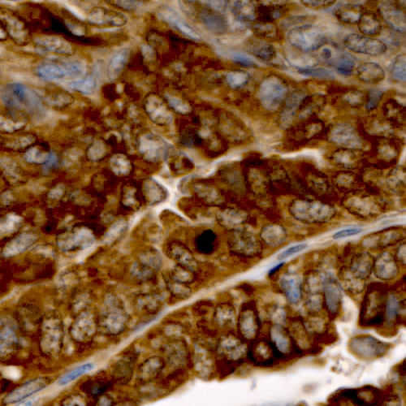
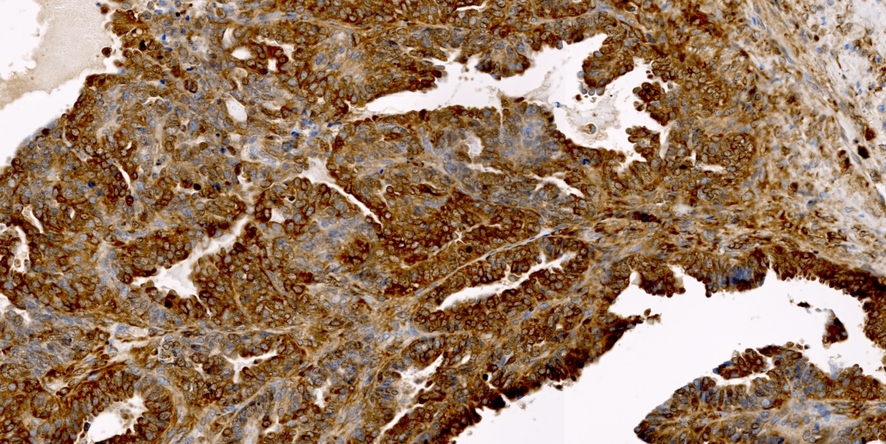
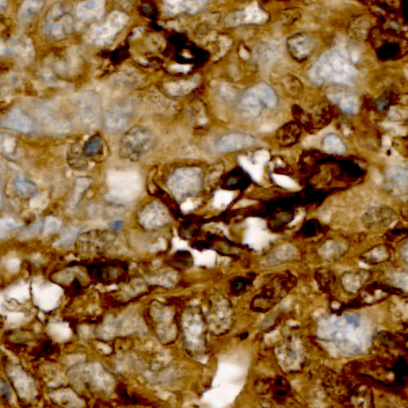
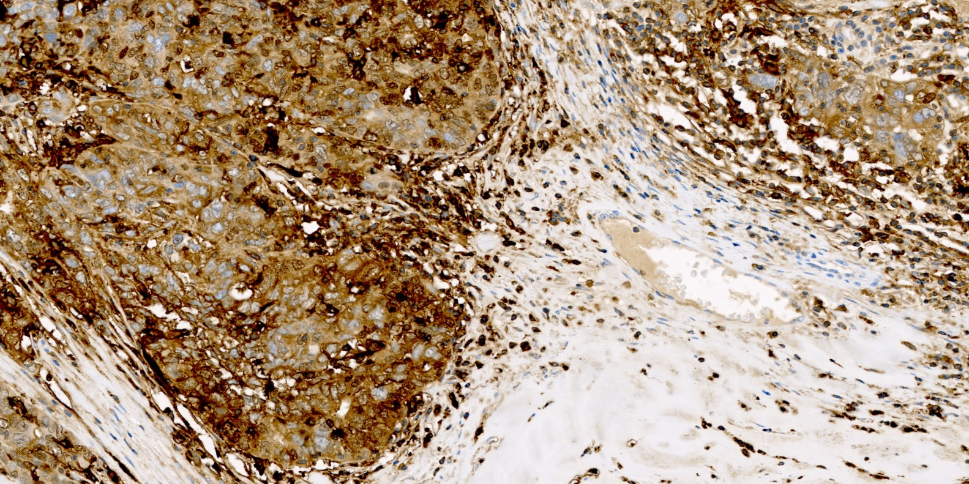
Supplemental Figure 1
Normal Fimbria
FTH
Normal Fimbria
FTL
Normal Ovary
Normal Ovary
HGSOC
HGSOC
**
***
200
**
*
150
150
100
Reciprocal Intensity (au)
Reciprocal Intensity (au)
100
50
0
50
HGSOC
0
HGSOC
Normal Fimbria
Normal Ovary
Normal Fimbria
Normal Ovary

Slide 2
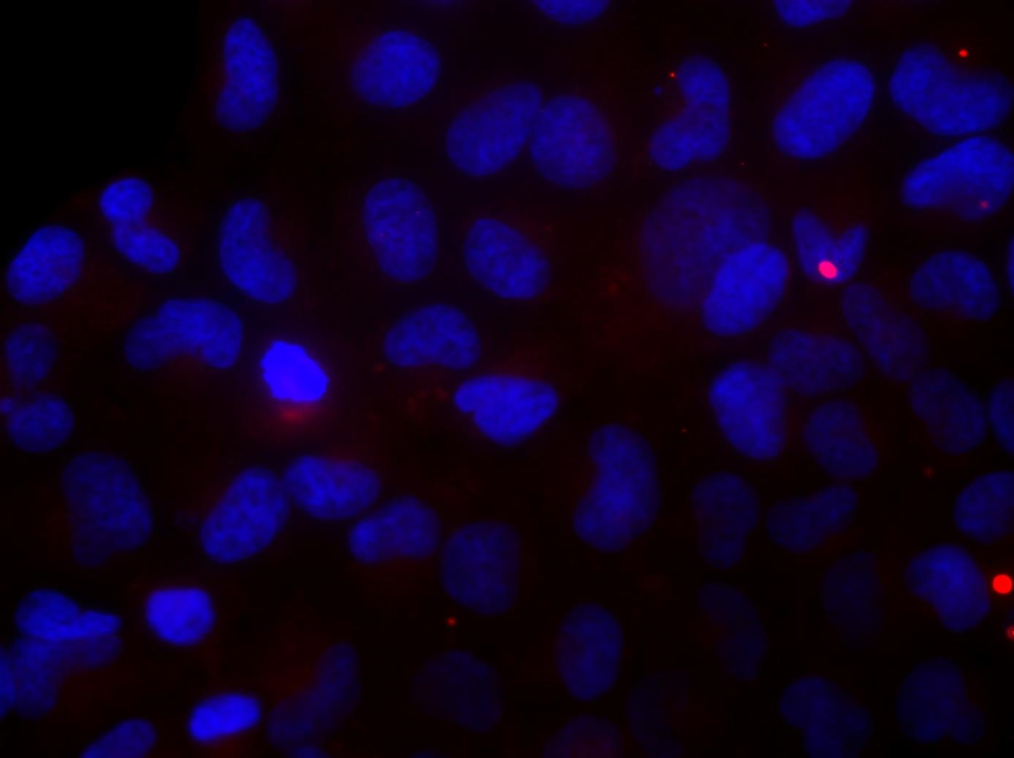
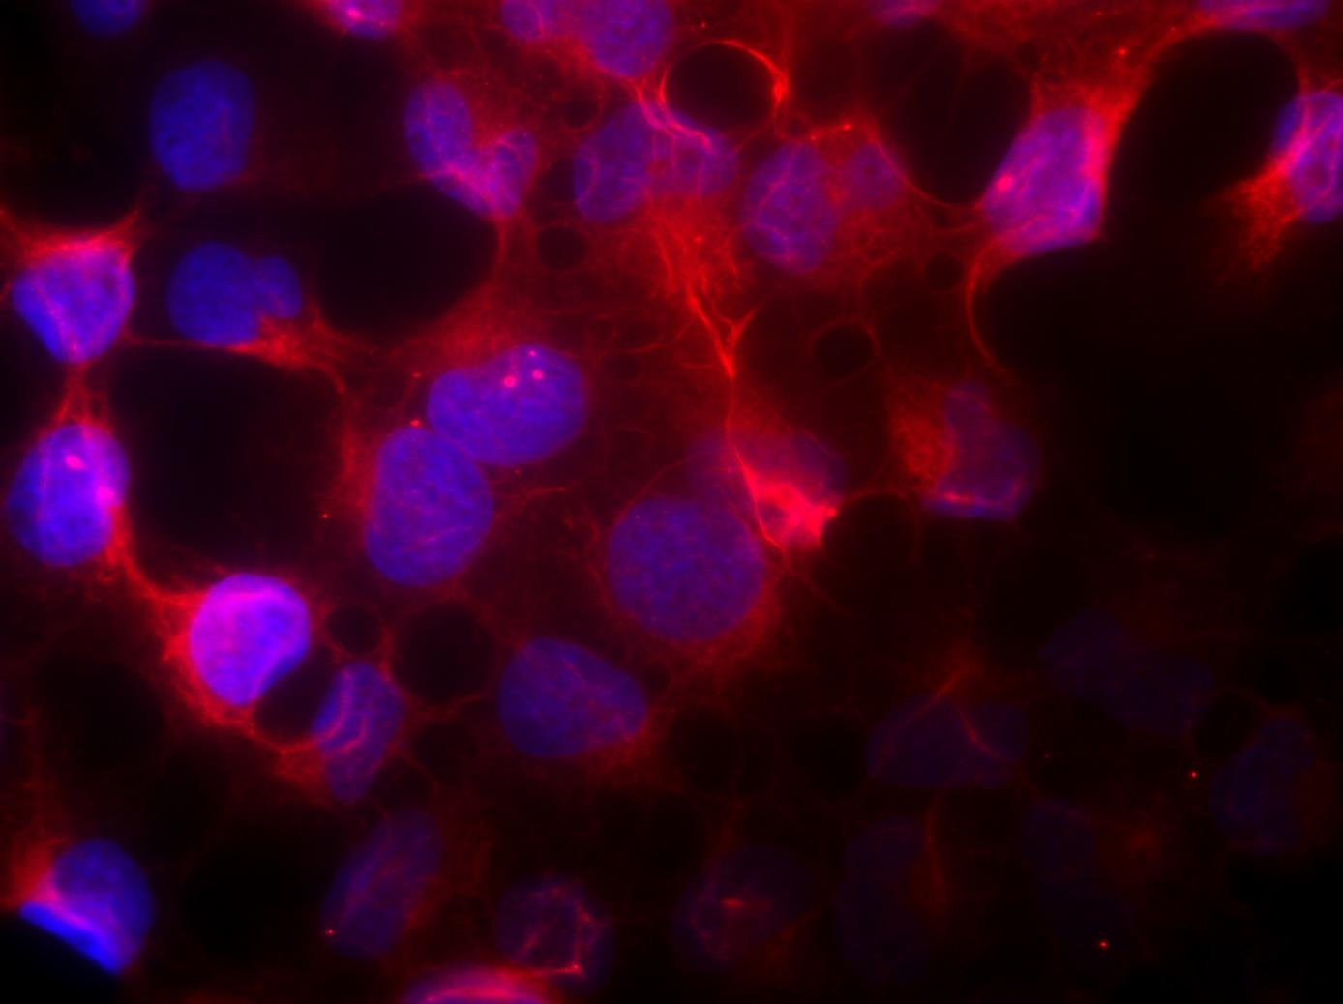
Supplemental Figure 2
a
b
Empty vector
+dox
p<1x10⁻⁵
1
*
0.9
0.8
0.7
0.6
Relative FPN / βactin mRNA
0.5
FPN tet-on
+dox
0.4
0.3
0.2
0.1
0
empty vector + dox
FPN tet-on + dox
c
16
14
12
10
p=0.02
Labile iron pool
(fluorescence per 1000 cells)
*
8
6
4
2
0
Empty vector + dox
Fpn tet on + dox
Notes:
***

Slide 3

Supplemental Figure 3
a
b
120
FPN mRNA
100
80
0.25ug/ml Dox
0 Dox
60
40
FPN-
20
β-actin-
0
Cov362 Tet-
Cov362 Tet-
Tet-FPN
Vec 0.5 ug/mL
FPN 0.5 ug/mL
Dox
Dox

Slide 4


Supplemental Figure 4
a
b
*p<0.0004
450
400
350
Tet-Vec
Tet-Fpn
Tet-Fpn (mut)
300
Dox+
Dox
-
+
-
+
-
+
250
# of colonies
*
Dox-
200
Fpn-
150
100
GAPDH-
50
0
Cov362 Vec
Cov362 Tet-FPN
Cov362 Tet-FPN
Mutant

Slide 5
Supplemental Figure 5
p=0.000002
*
)
150
u
.
a
(
y
t
100
i
s
n
e
t
n
50
i
l
a
c
o
r
0
p
i
c
e
R
-50
Empty vector + dox
Fpn-tet-on + dox

Slide 6
Supplemental Figure 6
1.2
MMP2
2
MMP9
1.4
MMP14
1
1.8
1.2
1.6
0.8
1.4
1
p = 0.001
p = 3x10⁻⁵
1.2
0.8
*
0.6
*
1
0.8
p = 0.02
0.6
0.4
0.6
*
0.4
0.2
0.4
0.2
0.2
0
0
0
EV + DOX
FPN-TET-ON + DOX
EV + DOX
FPN-TET-ON + DOX
EV + DOX
FPN-TET-ON + DOX
1.2
uPA
1
0.8
0.6
p = 1.5x10⁻⁵
0.4
*
0.2
0
EV + DOX
FPN-TET-ON + DOX

Slide 7
Supplemental Figure 7
1.4
*p<0.025
1.2
1.0
IL6 mRNA
0.8
*
0.6
0.4
0.2
0.0
CTL
DFO

