Slide 1
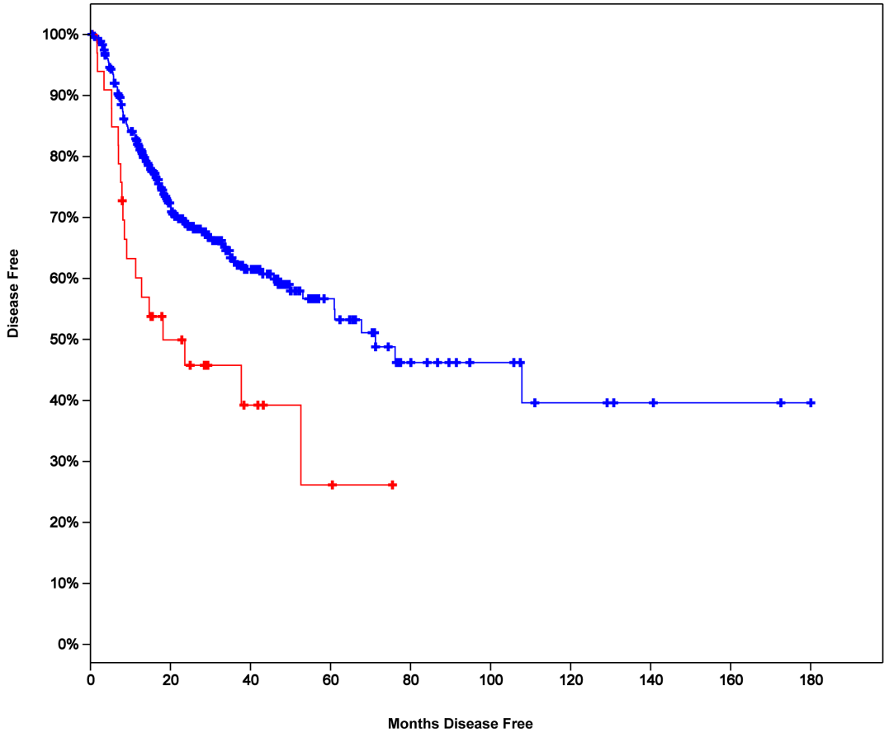
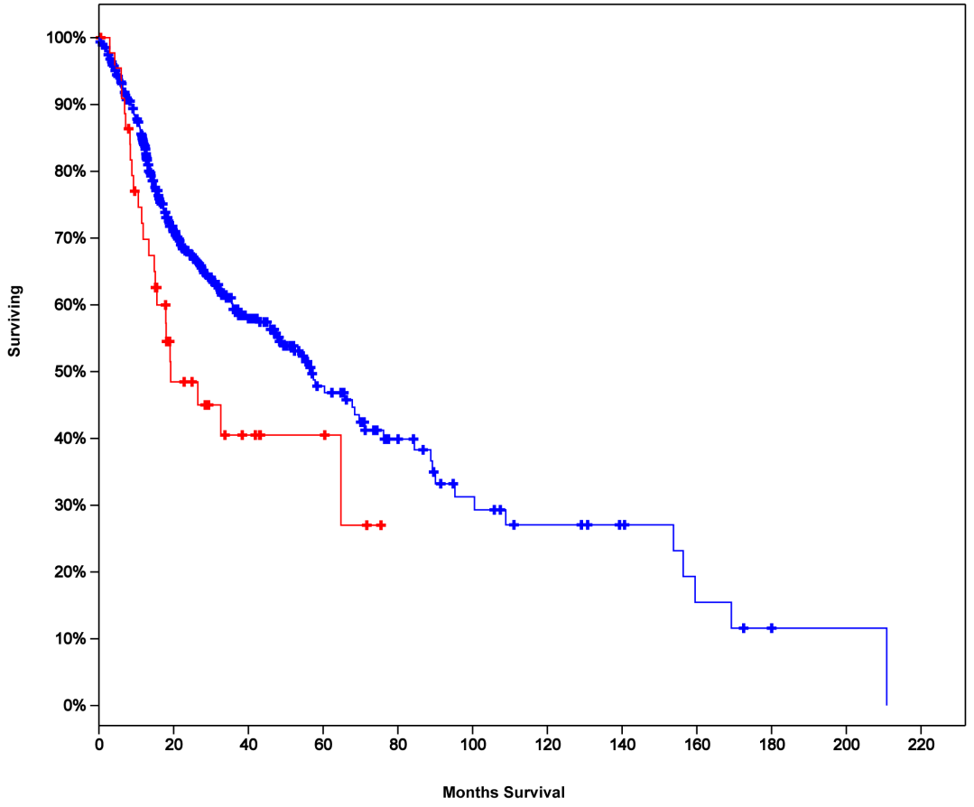
Suppl. Fig. S7, Lupu-Plesu M. et al.
100%
90%
80%
70%
60%
50%
40%
30%
20%
10%
0%
A
100%
90%
80%
70%
60%
50%
40%
30%
20%
10%
0%
B
Cases with Alteration(s) in VEGF-C Gene
Cases without Alterations in VEGF-C gene
Logrank Test P-Value: 0.0022
% Overall Survival
Cases with Alteration(s) in VEGF-C Gene
Cases without Alterations in VEGF-C gene
Logrank Test P-Value: 0.015
% Disease Free
0 20 40 60 80 100 120 140 160 180
0 20 40 60 80 100 120 140 160 180 200 220
0 20 40 60 80 100 120 140 160 180 200 220
Months Disease Free
Months Overall Survival

