Slide 1
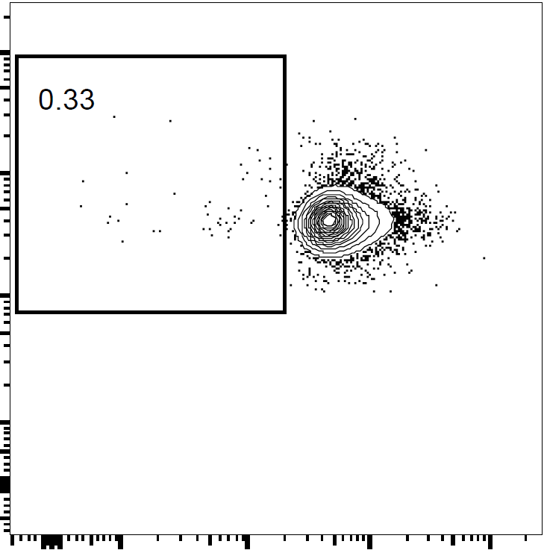
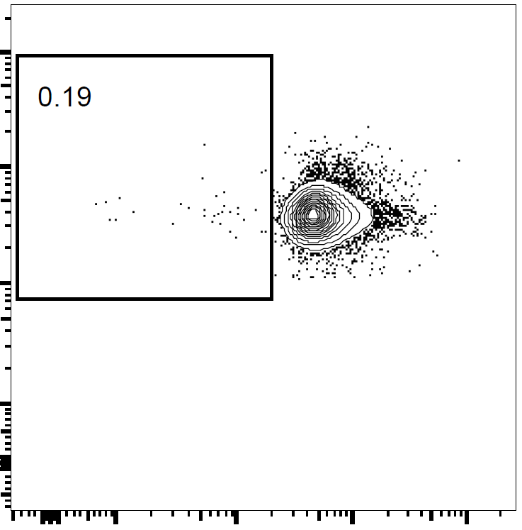
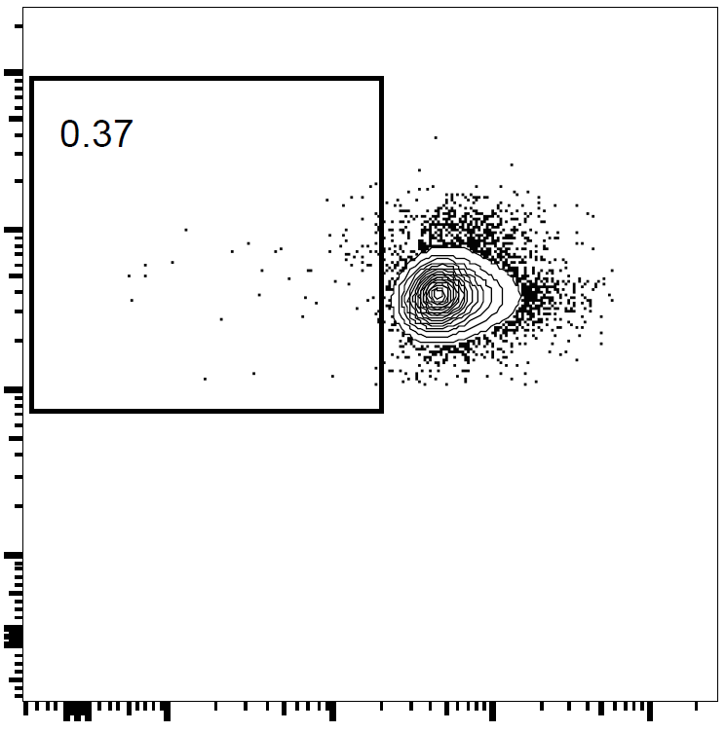
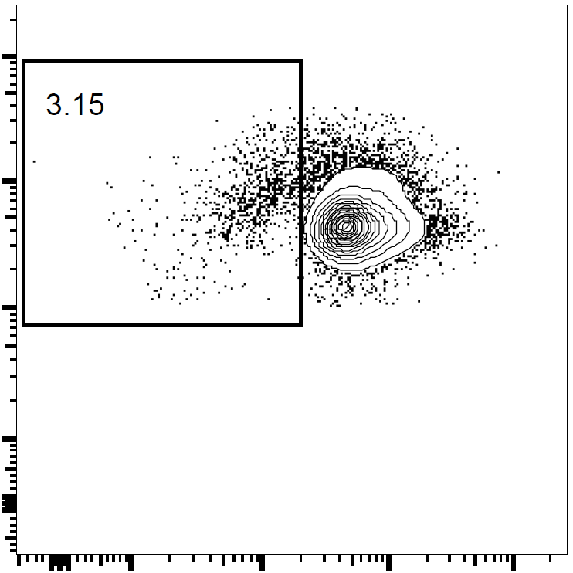
(a)
CD11b⁺
CD103⁺
PD-L1^{High}
CD11b⁻
CD103⁺
PD-L1^{High}
CD11b⁻
CD103⁺
PD-L1^{Low}
CD11b⁺
CD103⁻
PD-L1^{Int.}
(b)
CD4
a
a
b
CFSE
a
CD11b
CD103
PD-L1
Supplementary figure 1. Potential of MLN DC subsets to induce T cell proliferation without Ags.
Four MLN CD11c⁺ cell subsets from DW-fed mice were cultured with CFSE-labeled CD4⁺ cells from DO11.10 mice (3 wells/sample) without exogenous Ags. After 3 days, the cells in the each well were collected, and CD4 and CFSE expression on CD4⁺CD11c⁻ cells were analyzed by flow cytometry. Two independent experiments were performed. (a) Data are from a representative well of each sample. (b) Proportion of proliferated (CFSELow) cells in CD4⁺CD11c⁻ cells (gates shown in (a)) were analyzed. The plot shows representative data from one experiment (n = 3). Circles and horizontal bars indicate data from one well and mean of results from three wells, respectively. Statistical analysis was performed by Tukey’s HSD test. Values not sharing a common letter are significantly different (p < 0.05).

Slide 2
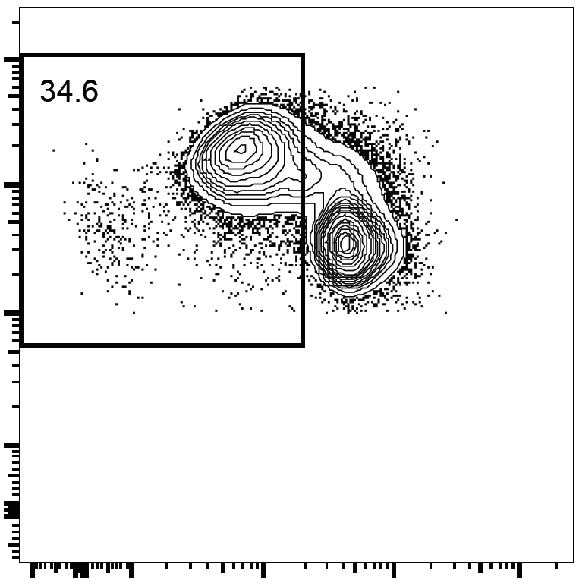
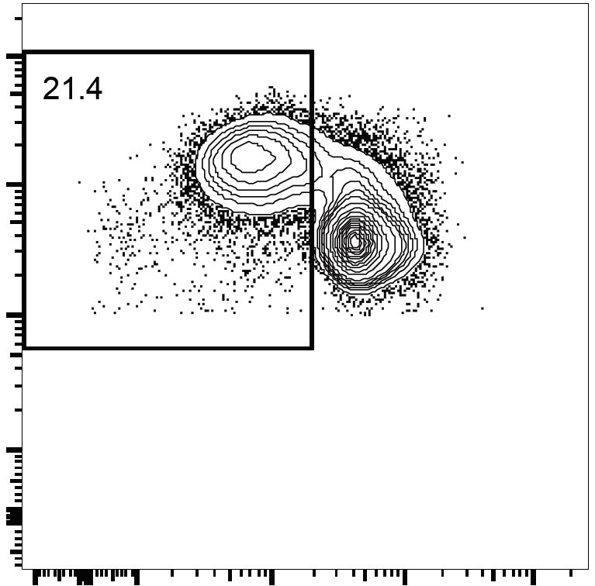
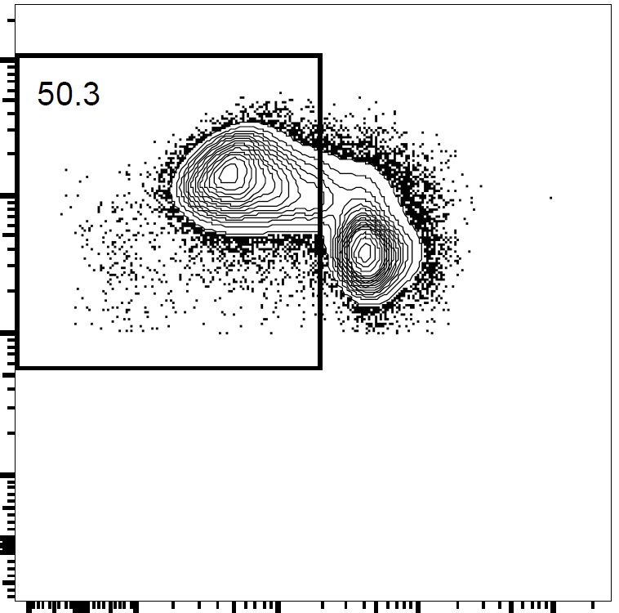
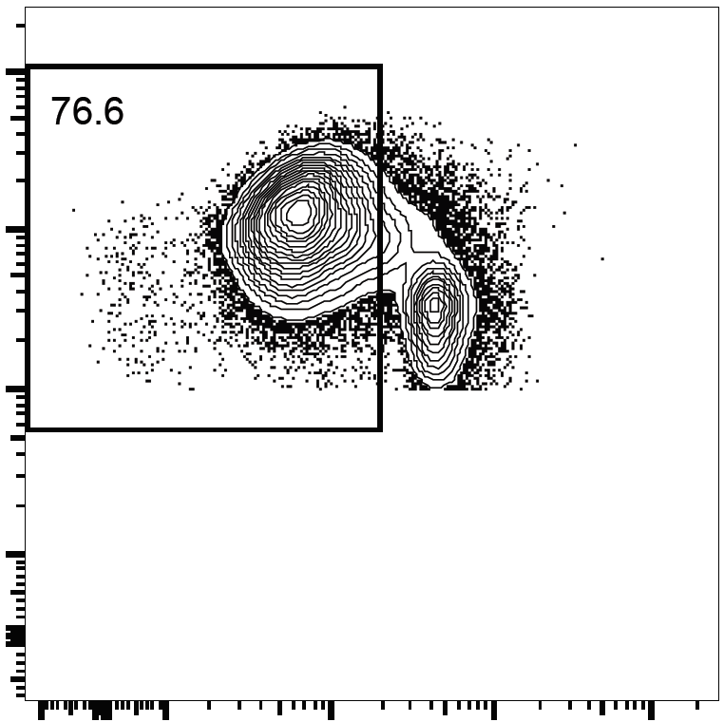
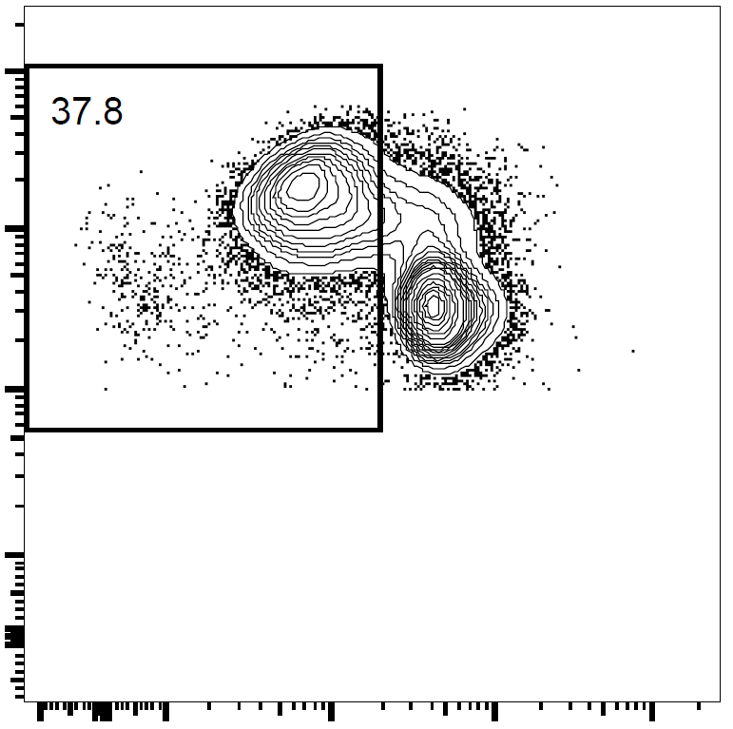
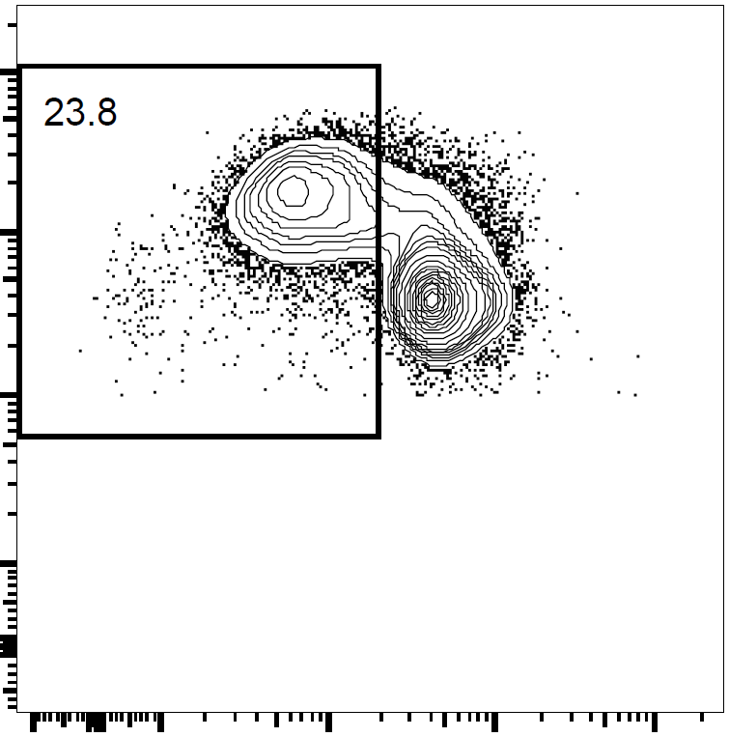
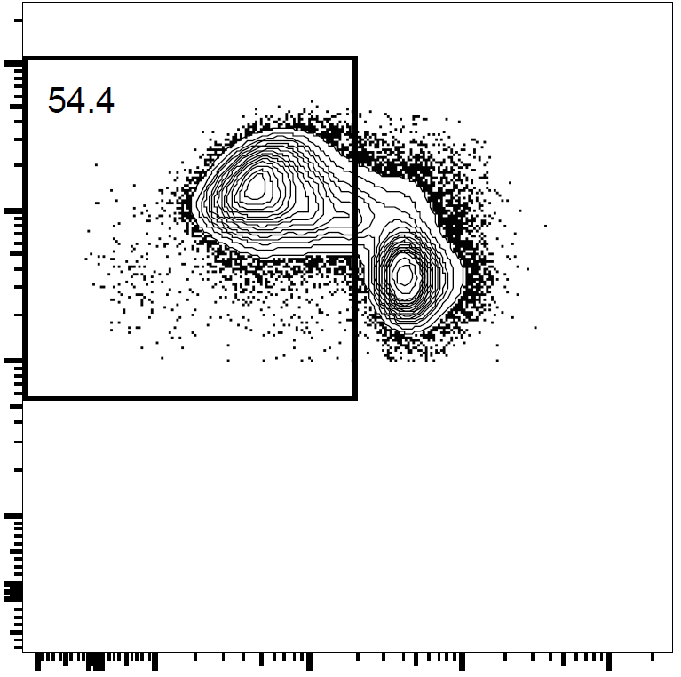
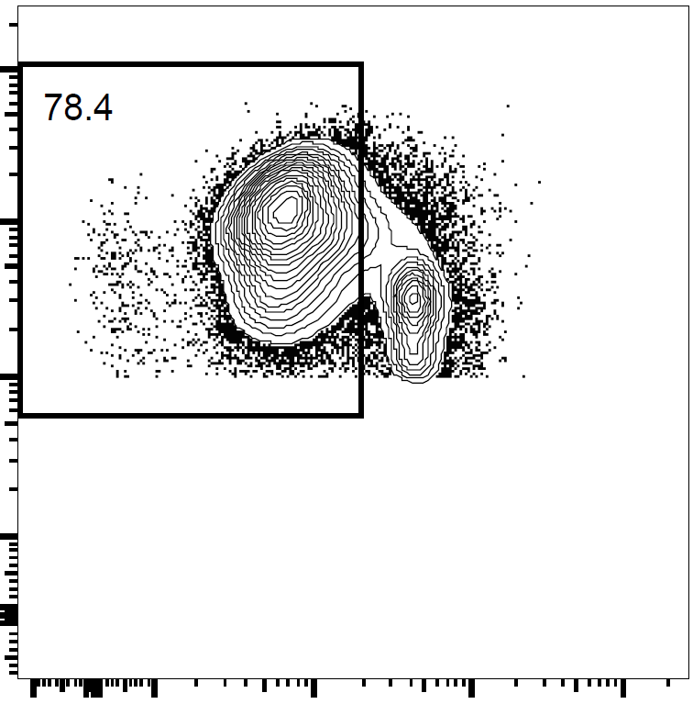
(a)
CD11b⁺
CD103⁺
PD-L1^{High}
CD11b⁻
CD103⁺
PD-L1^{High}
CD11b⁻
CD103⁺
PD-L1^{Low}
CD11b⁺
CD103⁻
PD-L1^{Int.}
(b)
Isotype
Anti-PD-L1
CD4
CD11b
CD103
CFSE
CD8α
PD-L1
Two-way ANOVA
Subset | p < 0.001
Antibody | p < 0.001
Subset×Antibody | n.s.
 | Subset 2 | Subset 3 | Subset 4
Subset 1 | p < 0.001 | p < 0.001 | p < 0.001
Subset 2 | - | p < 0.001 | p < 0.001
Subset 3 | - | - | p < 0.001
Supplementary figure 2. PD-L1 is not involved directly in Ag uptake of MLN DC subsets.
Four MLN CD11c⁺ cell subsets from DW-fed mice were cultured with CFSE-labeled CD4⁺ cells from DO11.10 mice (3 wells/sample) in the presence of OVA protein (100 ng/mL) with anti-PD-L1 or isotype control antibodies (9 μg/mL). After 3 days, the cells in the each well were collected, and CD4 and CFSE expression on CD4⁺CD11c⁻ cells were analyzed by flow cytometry. Two independent experiments were performed. (a) Data are from a representative well of each sample. (b) Proportion of proliferated (CFSELow) cells in CD4⁺CD11c⁻ cells (gates shown in (a)) were analyzed. The plot shows representative data from one experiment (n = 3). Circles or crosses and horizontal bars indicate data from one well and mean of results from three wells, respectively. Statistical analysis was performed by two-way ANOVA and subsequent Tukey’s HSD test. n.s. (not significant): p ≥ 0.1.

