Slide 1
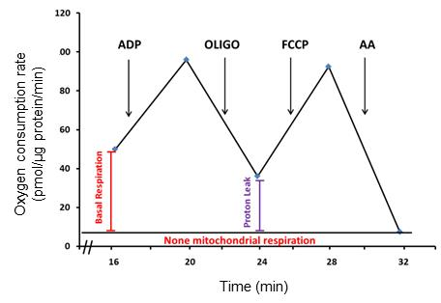
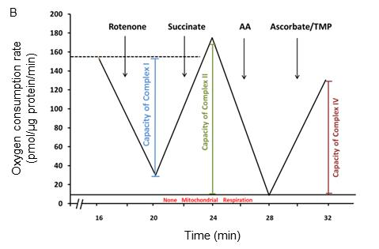
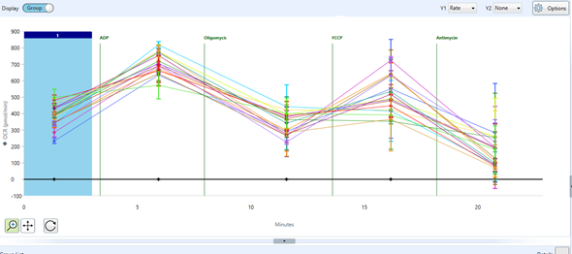
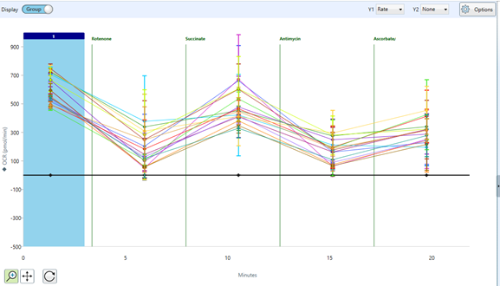
Supporting information for online publication
A
C
D
E
WT WT KO KO
LAMP-1 (H4A3)
Catalase (H9)
ATP5A1
Supporting information Figure S1 Functional assay on isolated hepatic mitochondria A, The calculation of basal respiration rate and proton leak in the mitochondrial coupling assay. B, The calculation of capacities of complex I, II and IV in the mitochondrial electron flow assay. C, The original Seahorse OCR graph of coupling experiments. D, The original Seahorse OCR graph of electron flow experiments. E, Immunoblotting of marker proteins of lysosomes (LAMP-1), peroxisomes (catalase), and mitochondria (ATP5A1) in the crude mitochondrial fractions used for the mitochondrial activity analysis. LAMP-1, lysosome-associated membrane protein 1; ATP5A1, ATP synthase α subunit 1; AA, antimycin A; FCCP, carbonilcyanide p-triflouromethoxyphenylhydrazone; OLIGO, oligomycin; TMP, 5,10,15,20-tetrakis (2,4,6-trimethylphenyl) porphyrin

Slide 2



Supporting information for online publication
A
WT WT KO KO
HADH
β-actin
VDAC1
β-actin
Band intensity
(HADH/β-actin)
*
WT KO
B
WT WT KO KO
*
Band intensity
(VDAC1/β-actin)
WT KO
Supporting Information Figure S2 Altered hepatic mitochondrial protein expression in BCO2 KO mice. Decreased expression of HADH (A) and VDAC1 (B) in the BCO2 KO compared to WT mice (n=6, p<0.05). HADH: hydroxyacyl-coenzyme A dehydrogenase; VDAC1: voltage-dependent anion-selective channel protein 1

Slide 3
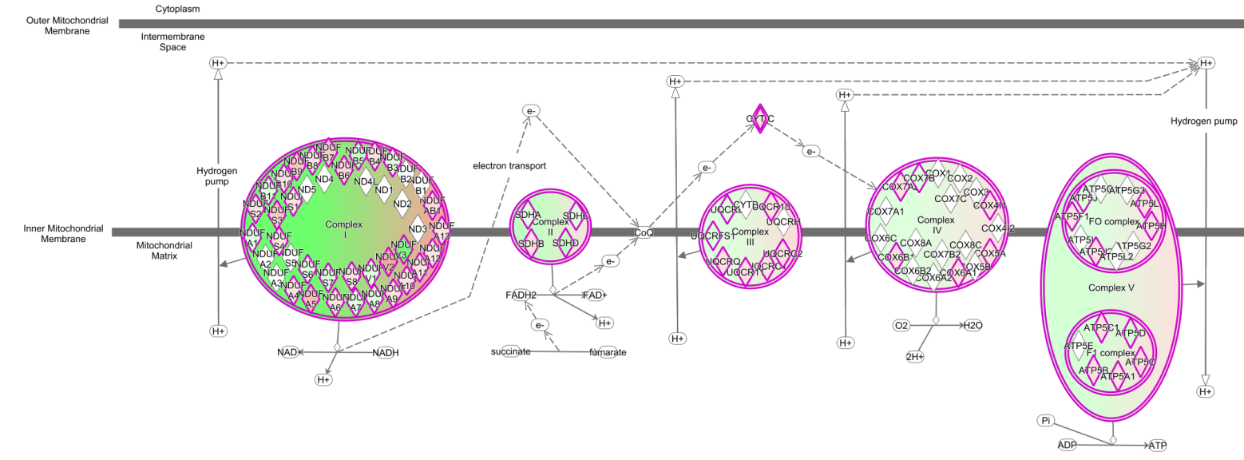
Supporting information for online publication
A
B
Supporting Information Figure S3 Lack of BCO2 remodels the ETC/OXPHOS proteome and leads to oxidative stress in 6-week-old male mice Hepatic mitochondrial LC-MS/MS raw data were uploaded to the Ingenuity Pathway Analysis (IPA). A. Altered ETC/OXPHOS proteomes were then analyzed. The ETC/OXPHOS proteins up-regulated and down-regulated in BCO2 KO compared to the WT control were shown in pink diamonds and green diamonds, respectively. The overall protein levels of complex I, II, IV and V were predicted to be downregulated, while complex III was predicted to be upregulated in BCO2 KO compared to WT mice. B. Proteomic analysis and IPA bioinformatics showed decreased levels of GSR, SOD2 and aconitase and elevated level of PRX3 and PRX5 indicative of oxidative stress in BCO2 KO liver compared to the WT. n=3/group, with 4 technical replicates. GSR, Glutathione reductase; PRX3, peroxiredoxin 3; PRX5, peroxiredoxin 5; SOD2, mitochondrial manganese superoxide dismutase

